Slide 1
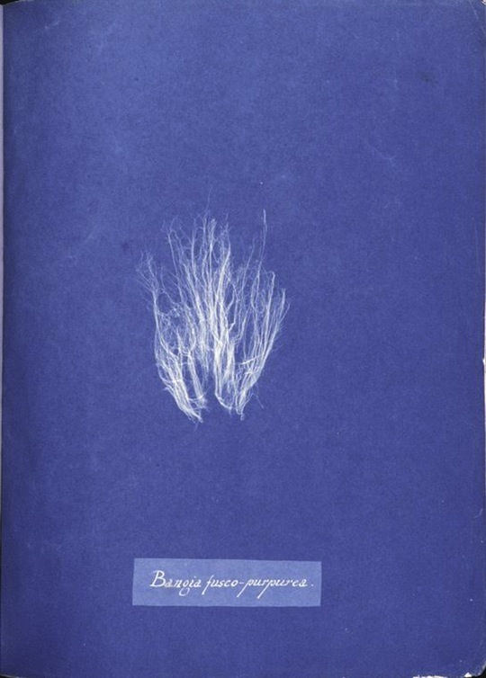
Notes:
Anna Atkins (1799-1871), Cyanotype 1843
Book: Photographs of British Algae: Cyanotype Impressions
First photography book
https://hyperallergic.com/473240/blue-prints-the-pioneering-photographs-of-anna-atkins/

Slide 2
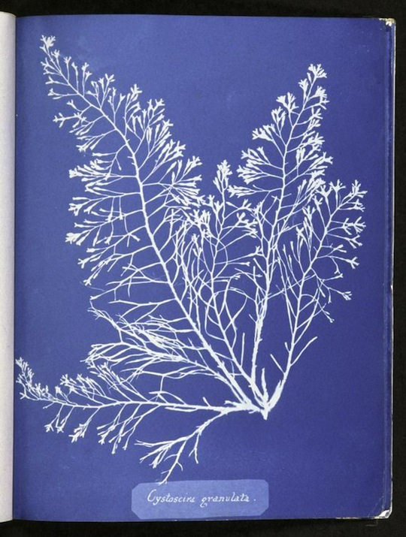
Notes:
Anna Atkins (1799-1871), Cyanotype 1843

Slide 3
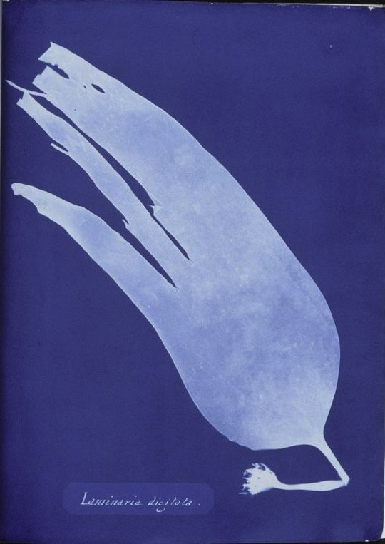
Notes:
Anna Atkins (1799-1871), Cyanotype 1843

Slide 4
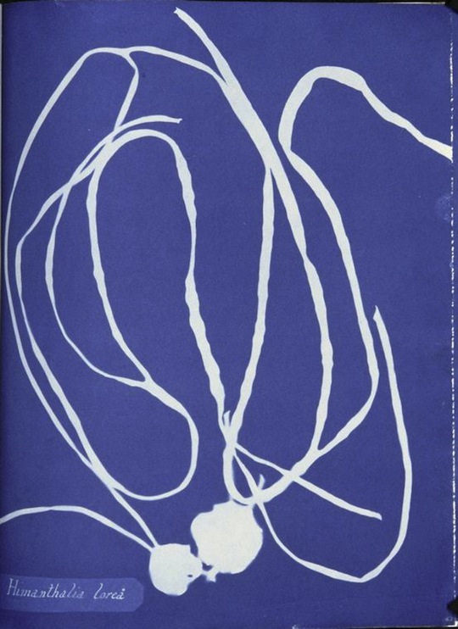
Notes:
Anna Atkins (1799-1871), Cyanotype 1843

Slide 5
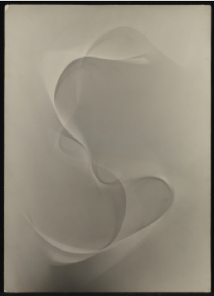
Notes:
Lotte Jacobi, Untitled (Photogenic), 1950–51
19 1/2 x 14 in. Princeton Art Museum

Slide 6
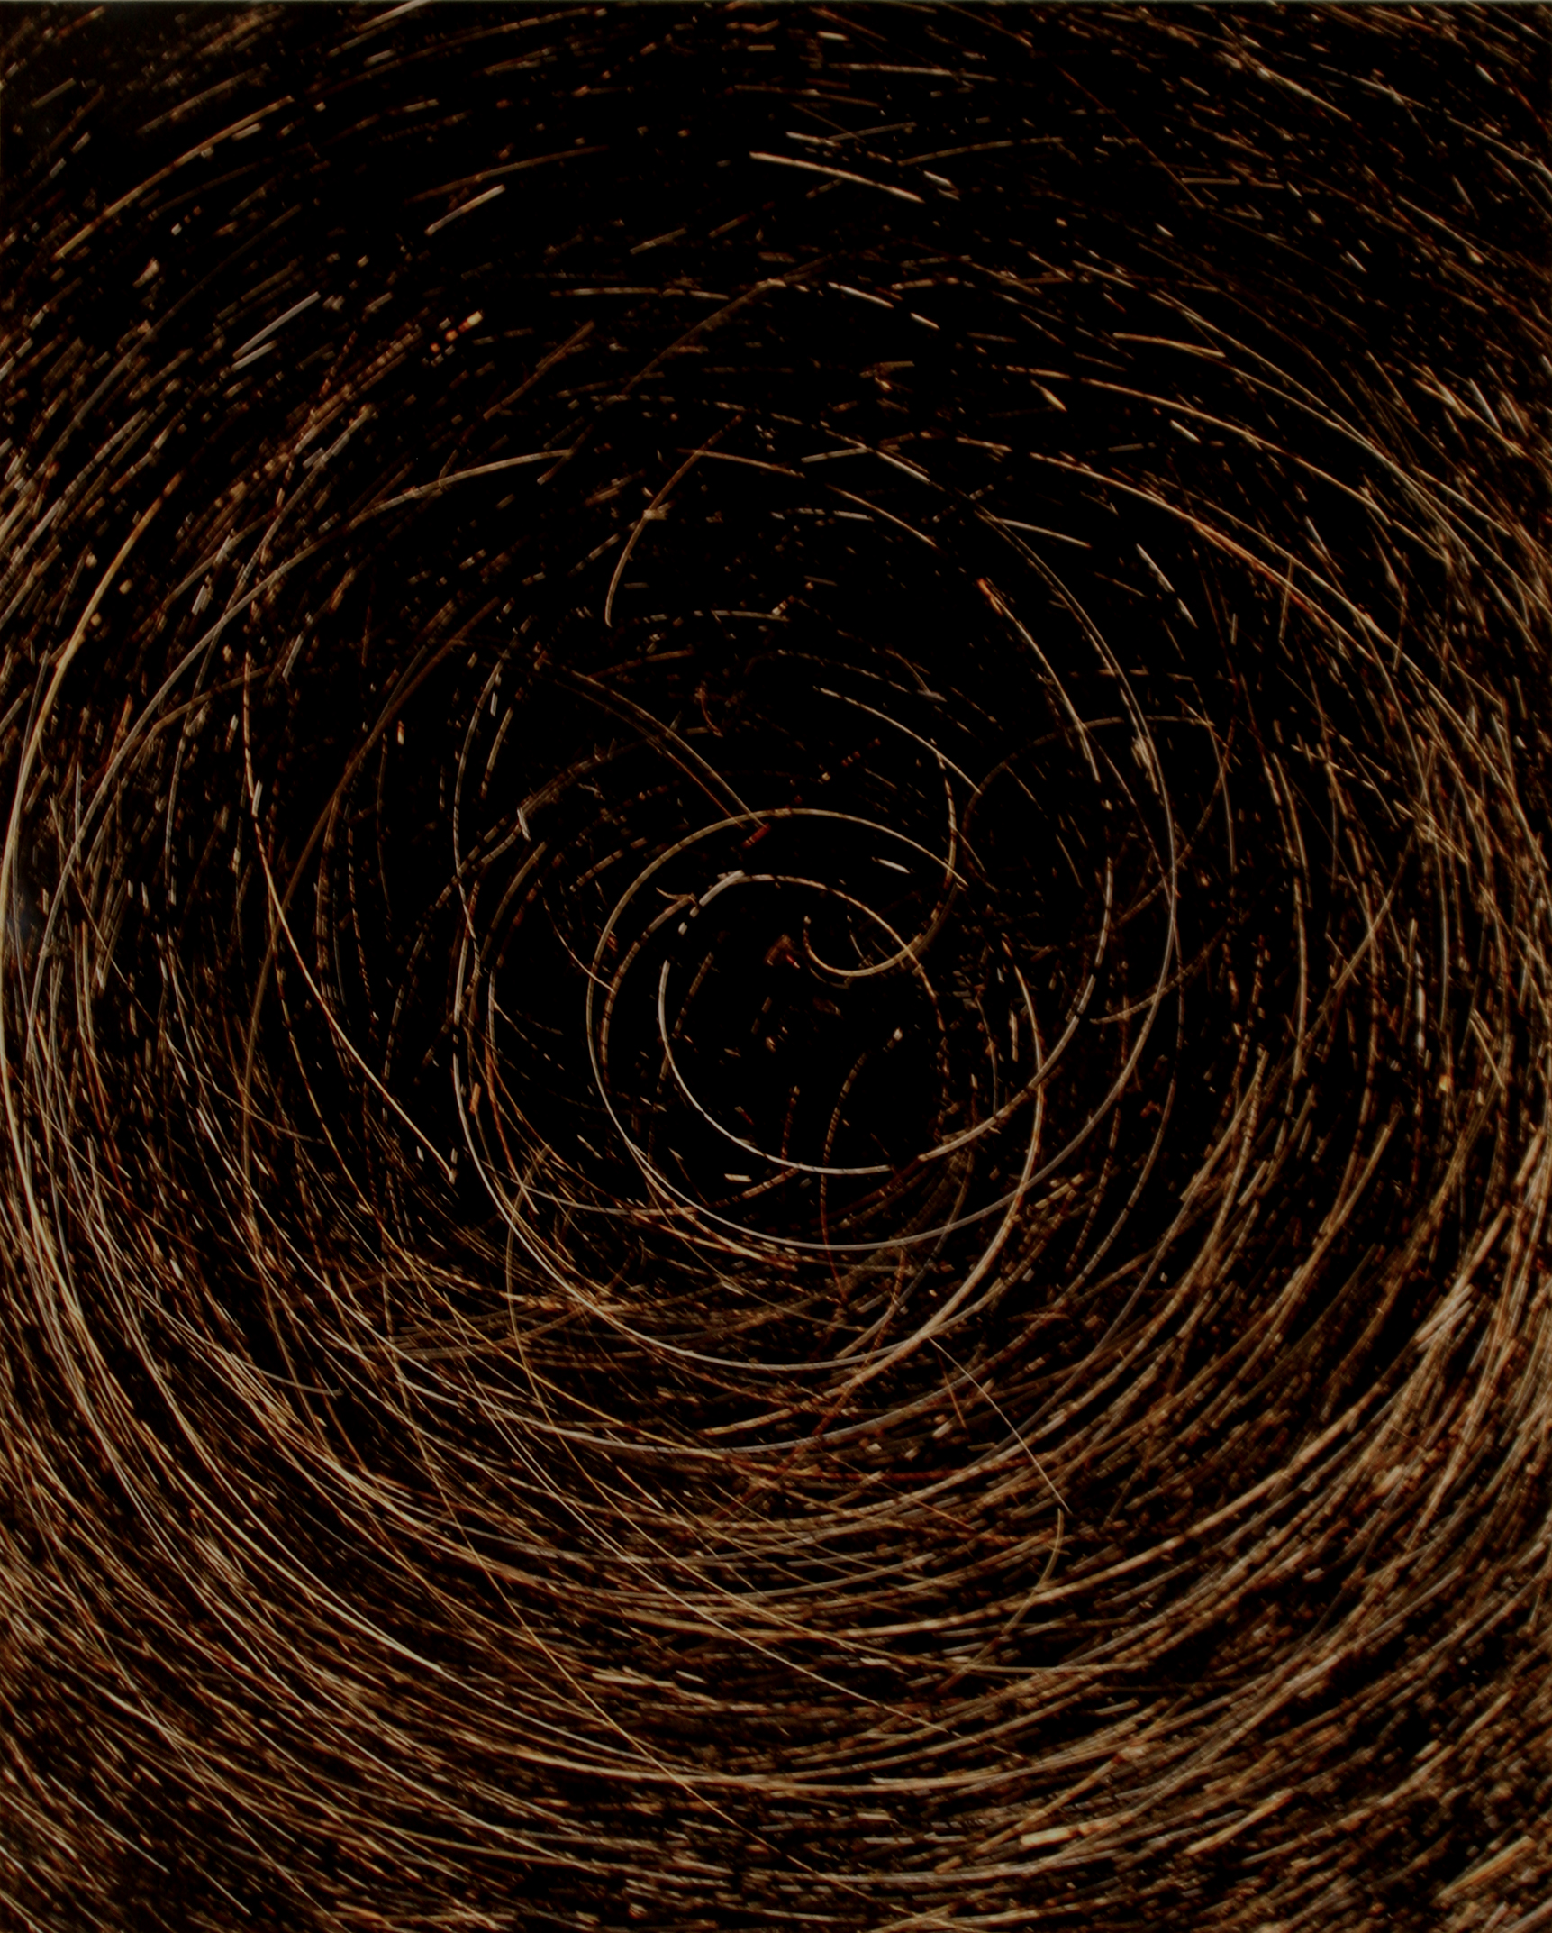
Notes:
Marco Breuer (German, born 1966) received his academic training at the Fachhochschule Darmstadt (1988-92) and the Lette-Verein Berlin (1986-88)

Slide 7
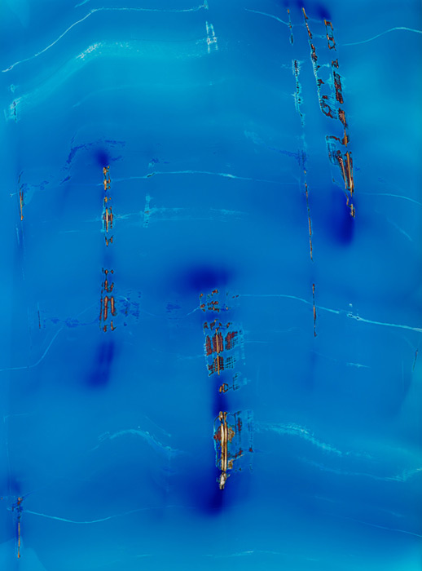
Notes:
Marco Breuer
Untitled (C-1228), 2012 Chromogenic Paper, burned 39 3/16″ × 28 15/16″ Unique

Slide 8
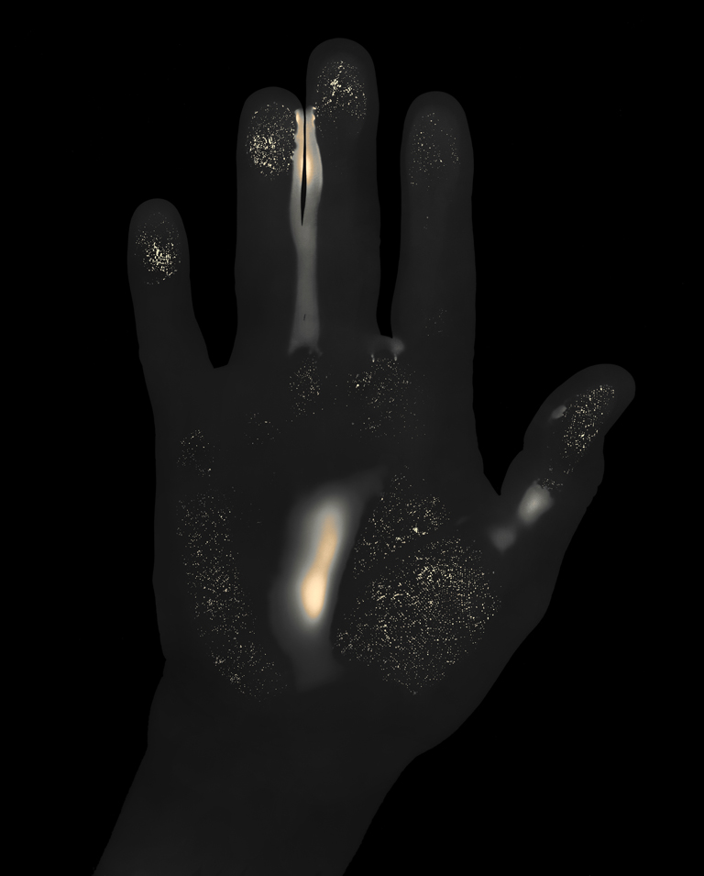
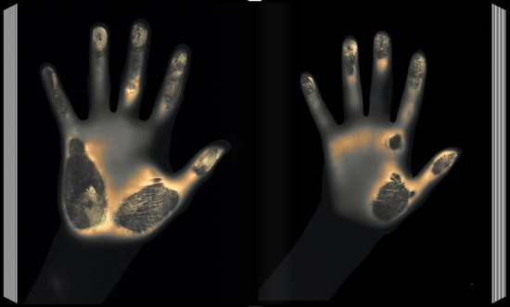
Notes:
Gary Schneider, Hands heat grams

Slide 9
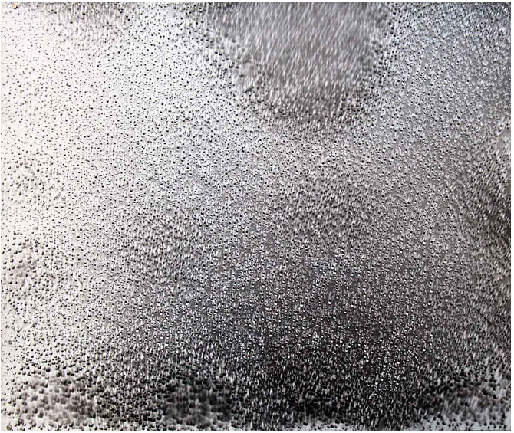
Notes:
Klea McKenna, Rain Study (Puna) 1, 2014
Photogram of rain on gelatin silver fiber paper, 20 x 24”

Slide 10
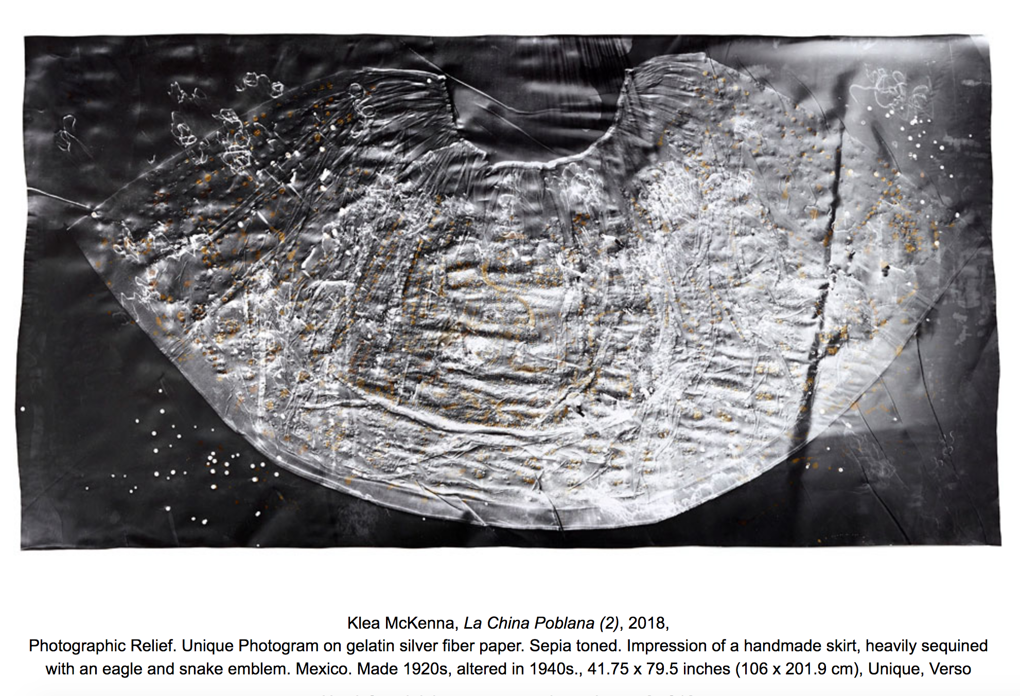
Notes:
Klea McKenna,

Slide 11
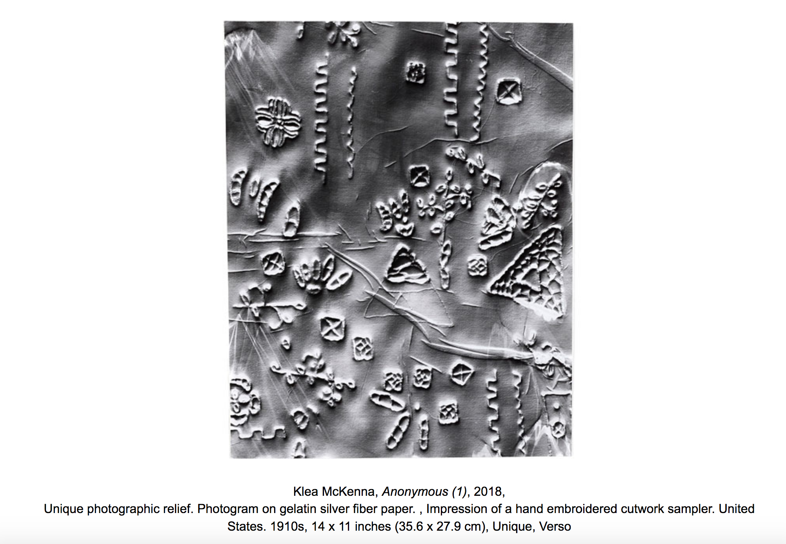
Notes:
Klea McKenna,

Slide 12
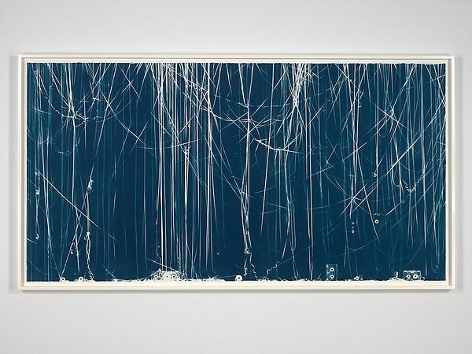
Notes:
Christian Marclay (American, born 1955) Memento (Soul II Soul), 2008
Cyanotype
Dimensions: Image: 130.8 x 251.5 cm (51 1/2 x 99 in.) Frame: 139.7 x 259.1 x 5.1 cm (55 x 102 x 2 in.)
“Memento Mori for the cyanotype and the cassette tape”

Slide 13
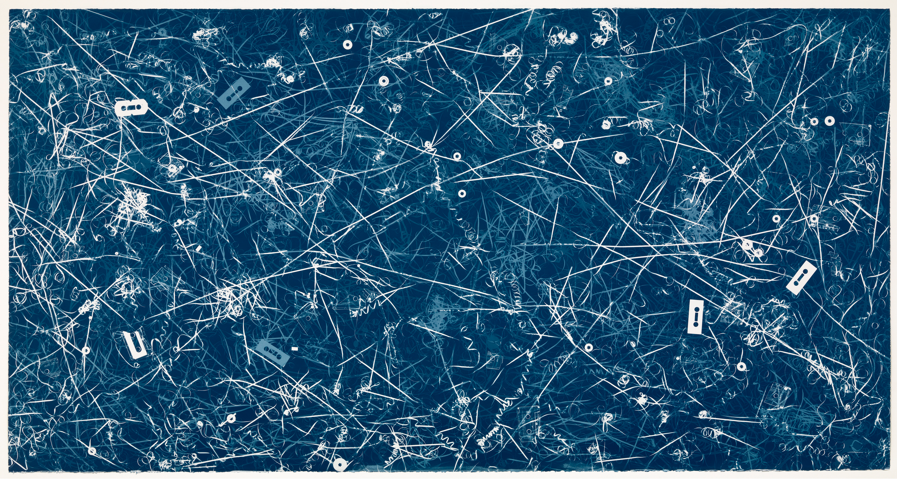
Notes:
Christian Marclay Allover (Genesis, Travis Tritt and others) 2008 Cyanotype, 1308 x 2483mm

Slide 14
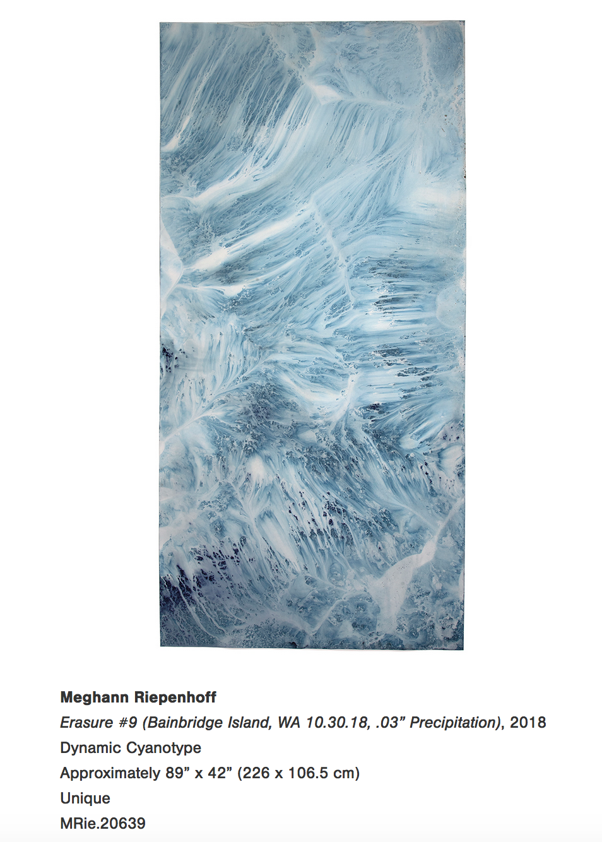

Slide 15
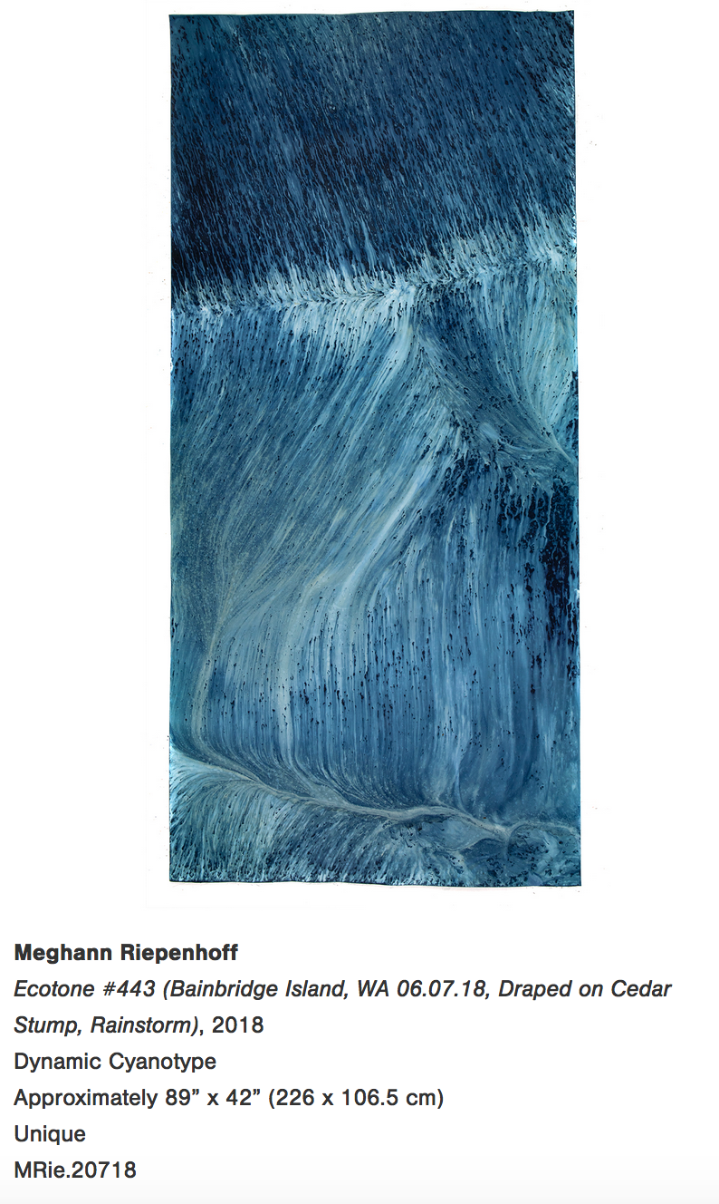

Slide 16
Notes:
Chris McCaw
Sunburned GSP#888 (Strait of Juan De Fuca, new years day), 2016 Eleven Unique Gelatin Silver Paper Negatives 41″ × 12″ (104.1 × 30.5 cm) each element

Slide 17
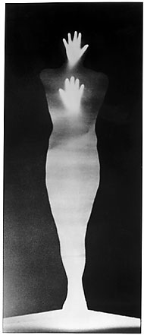
Notes:
Bruce Conner, Angel 1973-5

Slide 18
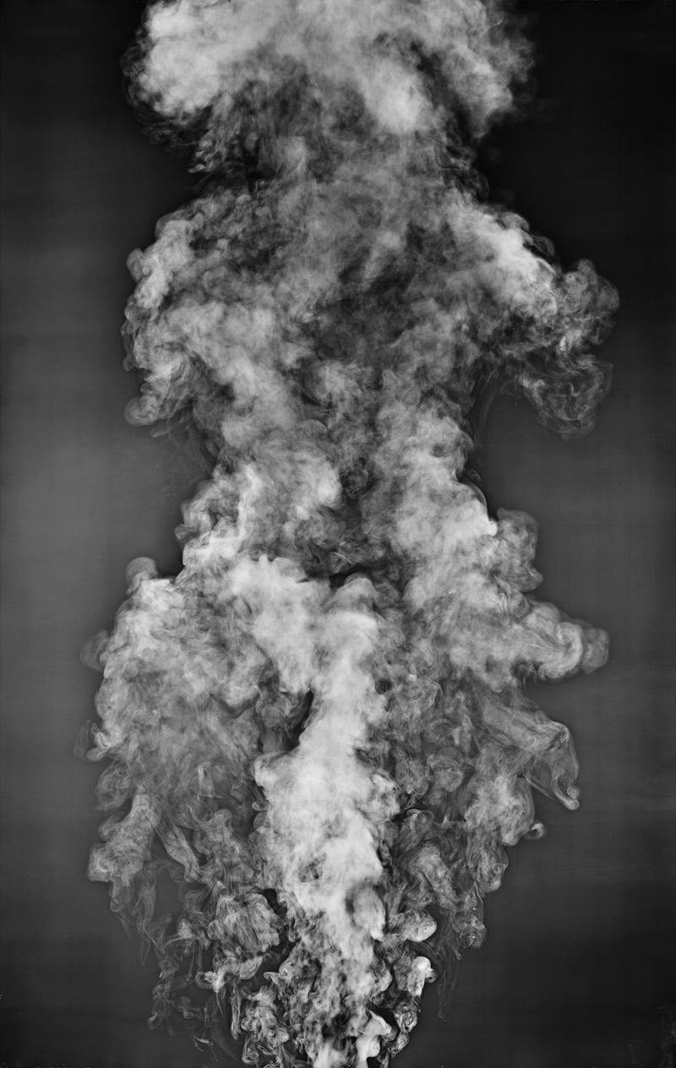
Notes:
Adam Fuss From the series My Ghost 1999 Gelatin silver print photogram 195.3 x 141.3 cm

Slide 19
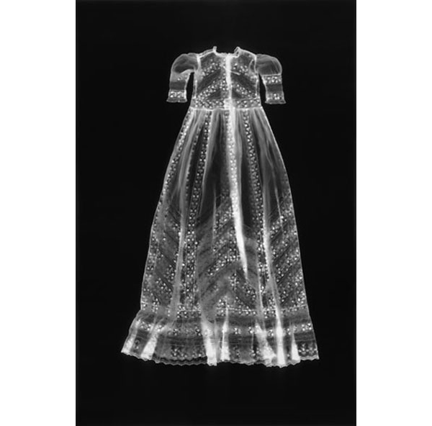
Notes:
Adam Fuss, Untitled (Dress) from My Ghost, 1997
57 X 37.5 in (144.78 X 95.25 cm)
Unique silver print photogram

Slide 20
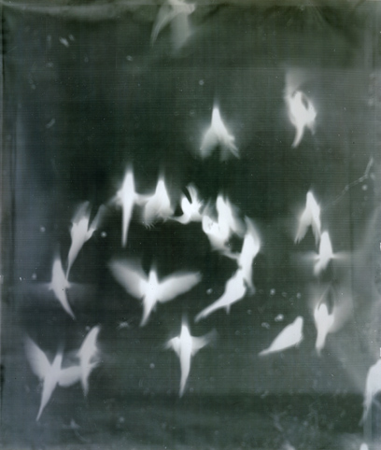
Notes:
Adam Fuss
From the series 'My Ghost' 1999 (Birds in Flight) Gelatin-silver print photogram by Adam Fuss

Slide 21
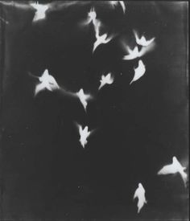
Notes:
From the series 'My Ghost' 1999 (Birds in Flight)
From the series 'My Ghost' 1999 (Birds in Flight) Gelatin-silver print photogram by Adam Fuss 1999

Slide 22
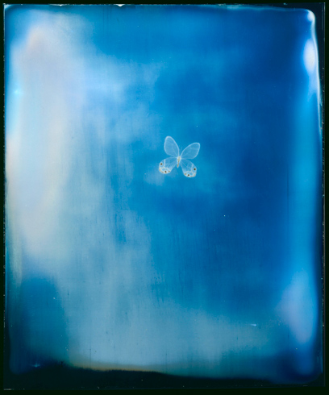
Notes:
From the series 'My Ghost' (Butterfly Daguerreotype), 2001
Daguerrotype by Adam Fuss
The butterfly is a classic symbol of the brevity of life, its flight standing for the passage of the soul. It is captured here in an obsolescent technique, that of daguerreotype. Made on silvered copper plates, daguerreotypes were invented in the 1840s and used mainly for portraiture. Here the plate has been intentionally overexposed, producing a shimmering blue.

Slide 23
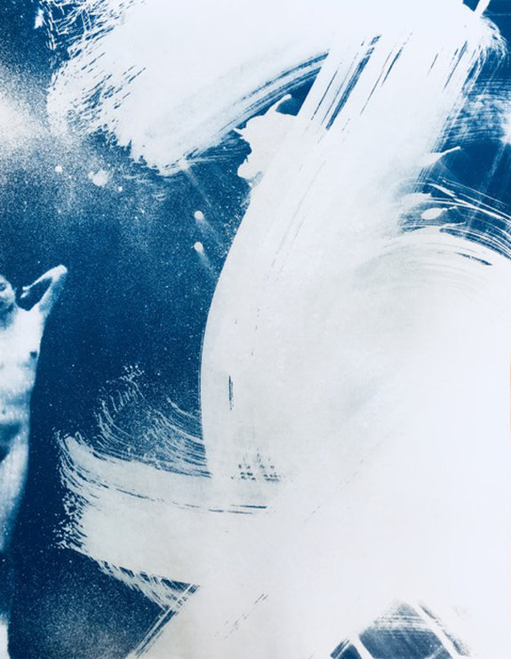
Notes:
Justine Frischmann
Cyanotype 1, 2018 (JUF033)
unique cyanotype on paper
14h x 11w in (35.56h x 27.94w cm)

Slide 24
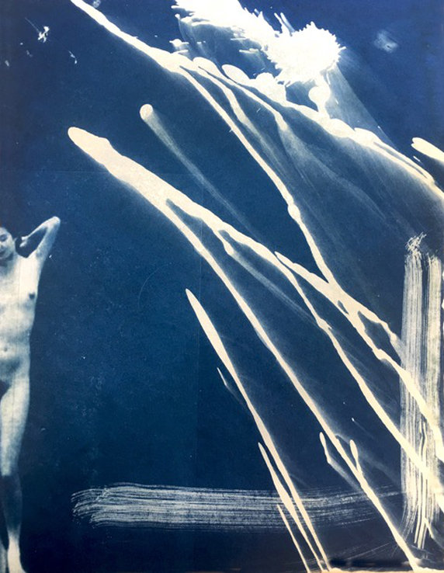
Notes:
Justine Frischmann
Cyanotype 2, 2018 (JUF034)
unique cyanotype on paper
14h x 11w in (35.56h x 27.94w cm)

Slide 25
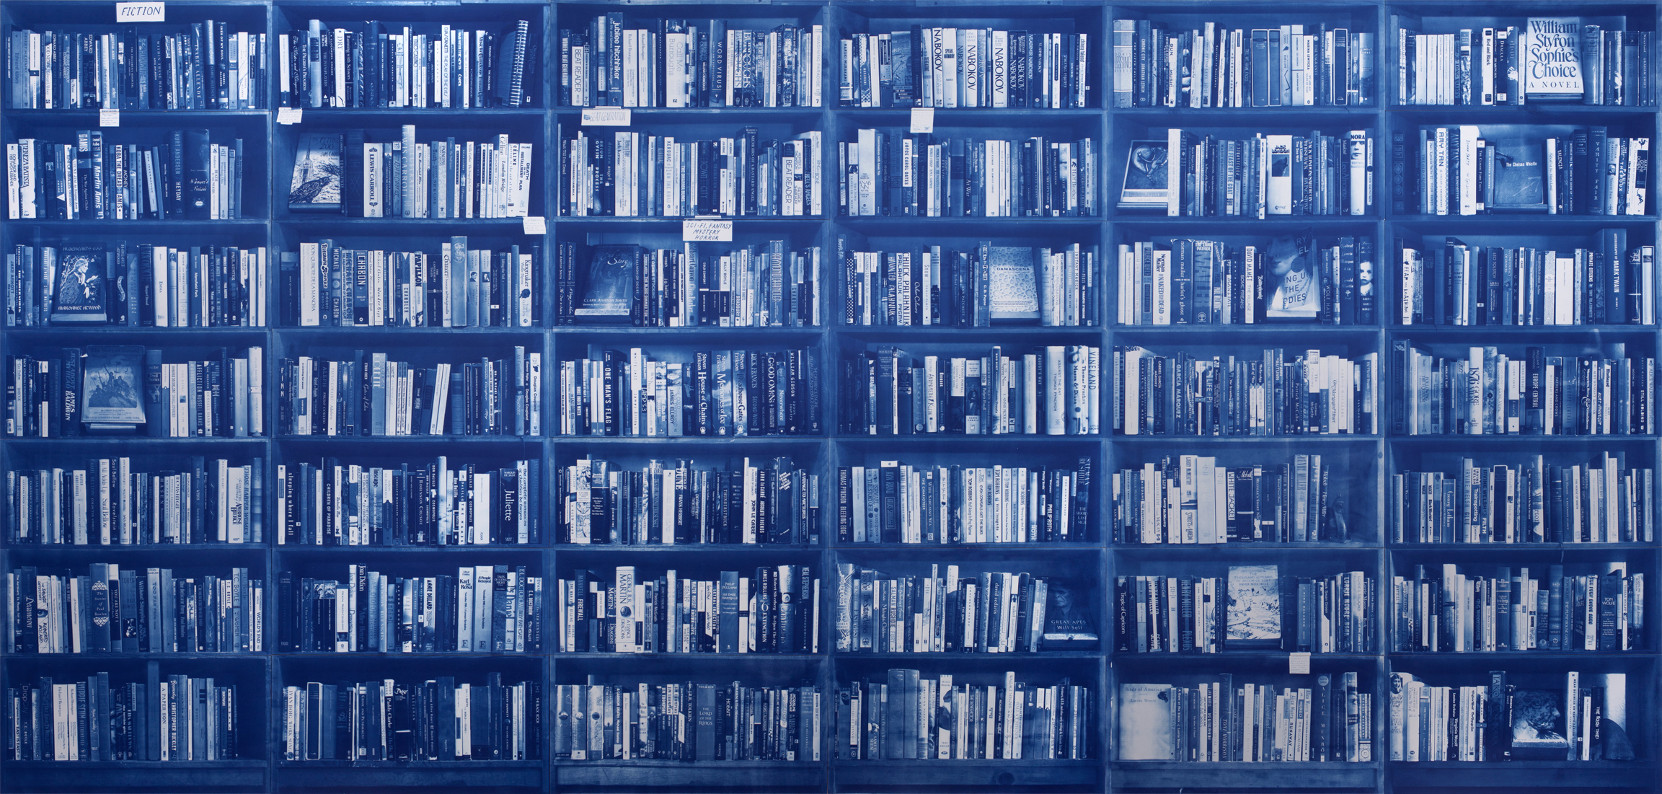
Notes:
Jason Houck, “Wouldn’t you Like to?” Adobe Books Installation, San Francisco, August 5-28, 2016
The bookstore on June 6, 2016
Cyanotypes on Arches Palatine paper

Slide 26
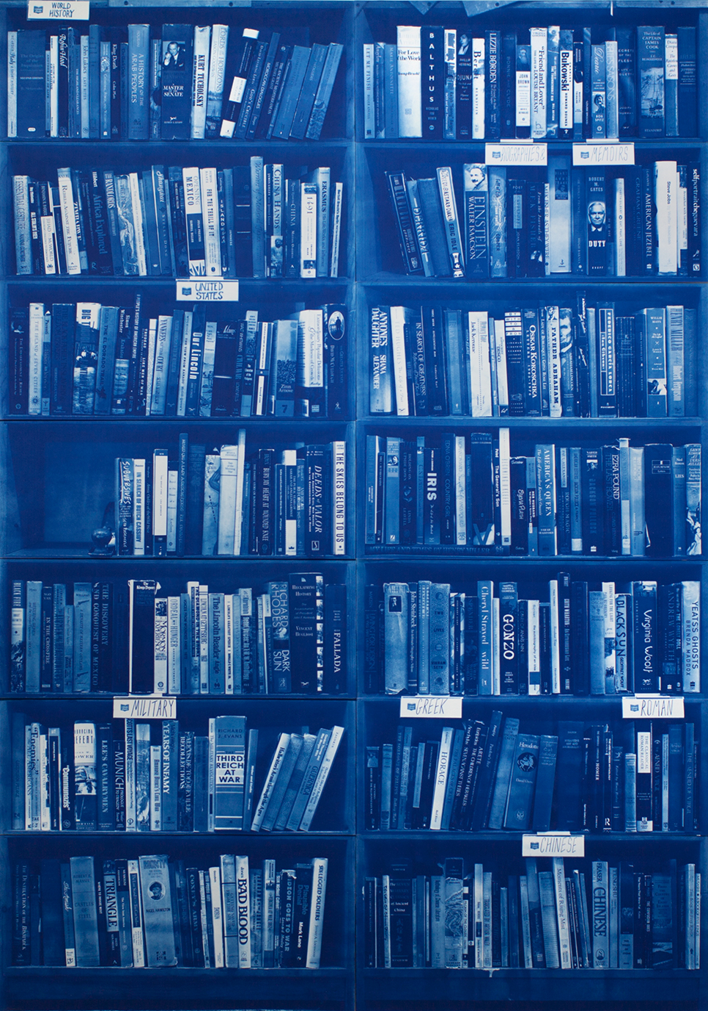
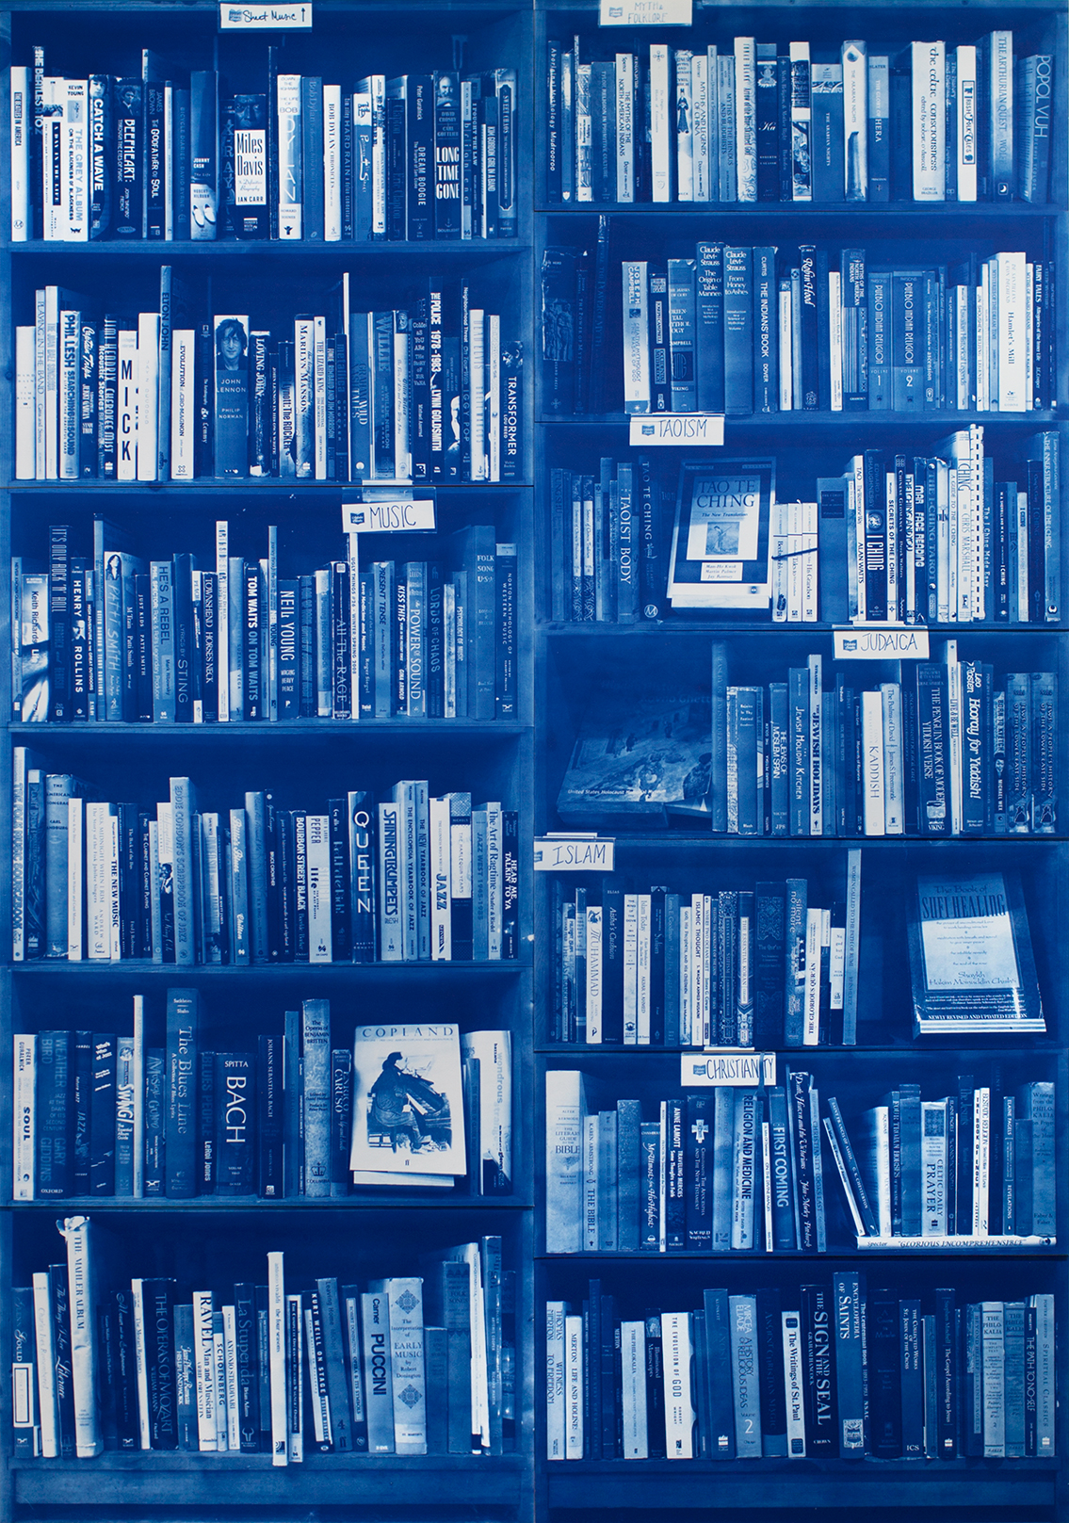
Notes:
Jason Houck, “Wouldn’t you Like to?” Adobe Books Installation, San Francisco, August 5-28, 2016
The bookstore on June 6, 2016
Cyanotypes on Arches Palatine paper

Slide 27
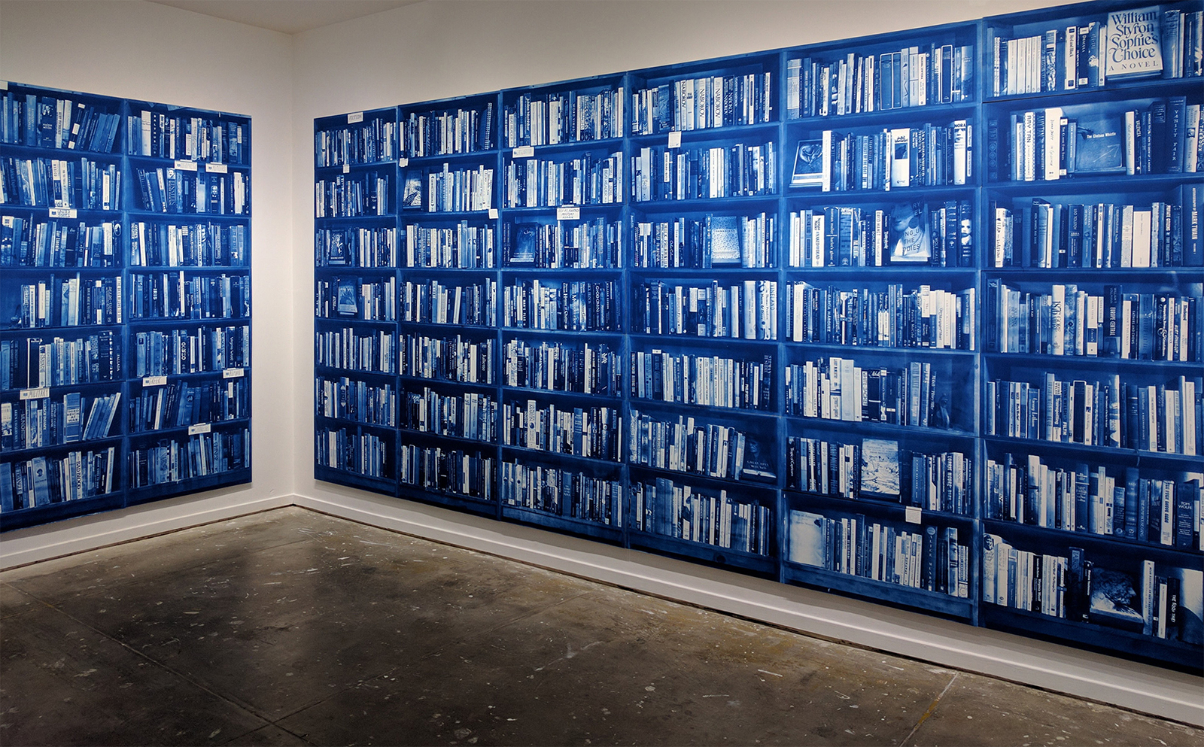
Notes:
Jason Houck, “Wouldn’t you Like to?” Adobe Books Installation, San Francisco, August 5-28, 2016
The bookstore on June 6, 2016
Cyanotypes on Arches Palatine paper

Slide 28
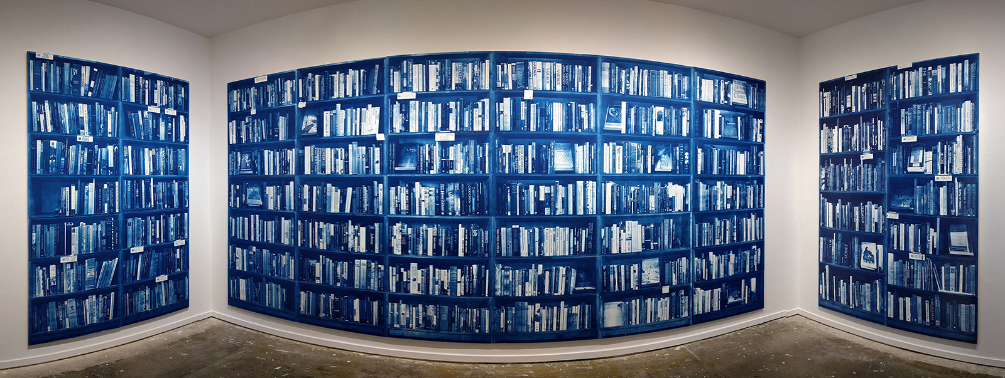
Notes:
Jason Houck, “Wouldn’t you Like to?” Adobe Books Installation, San Francisco, August 5-28, 2016
The bookstore on June 6, 2016
Cyanotypes on Arches Palatine paper

Slide 29
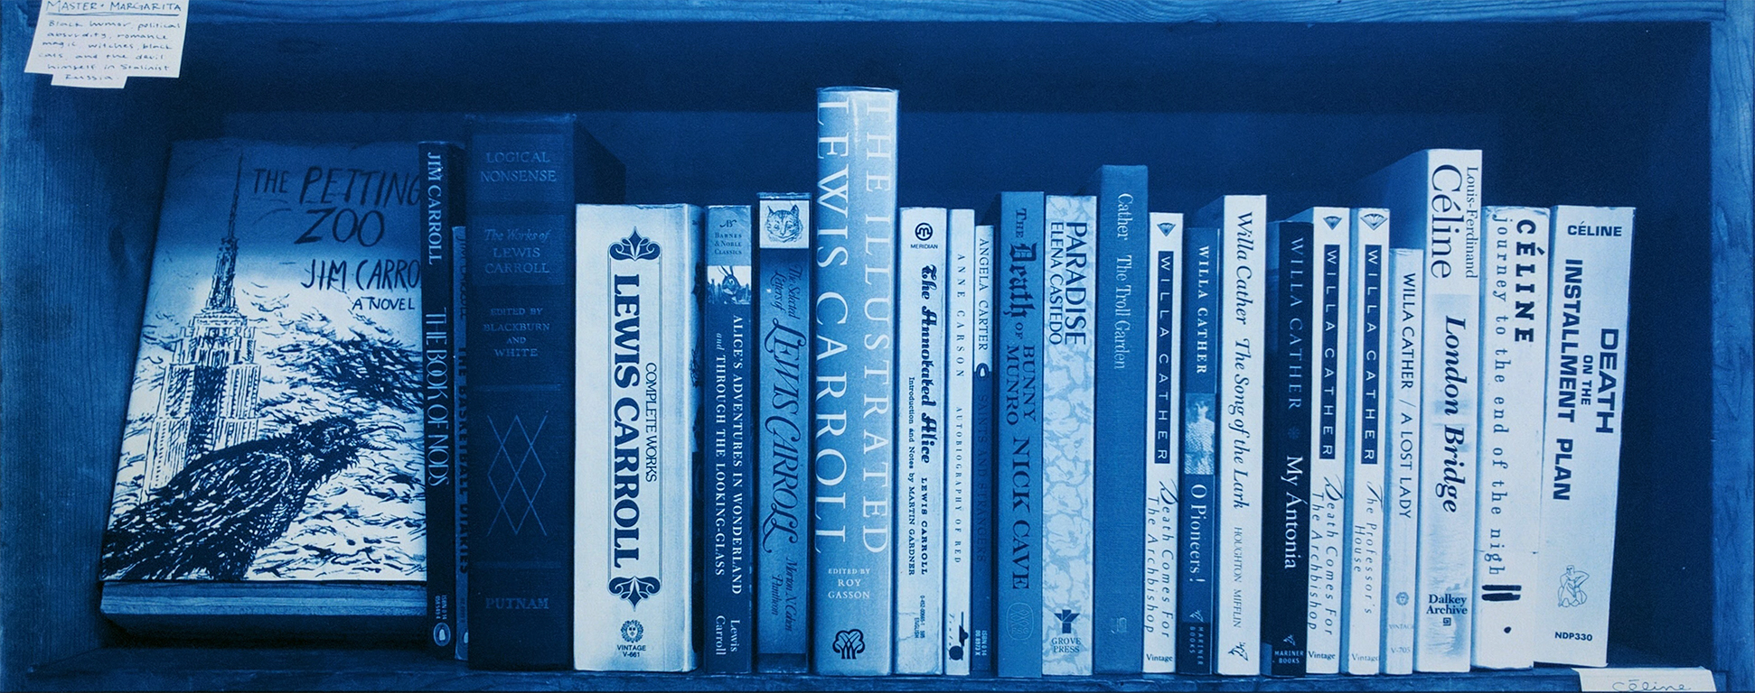
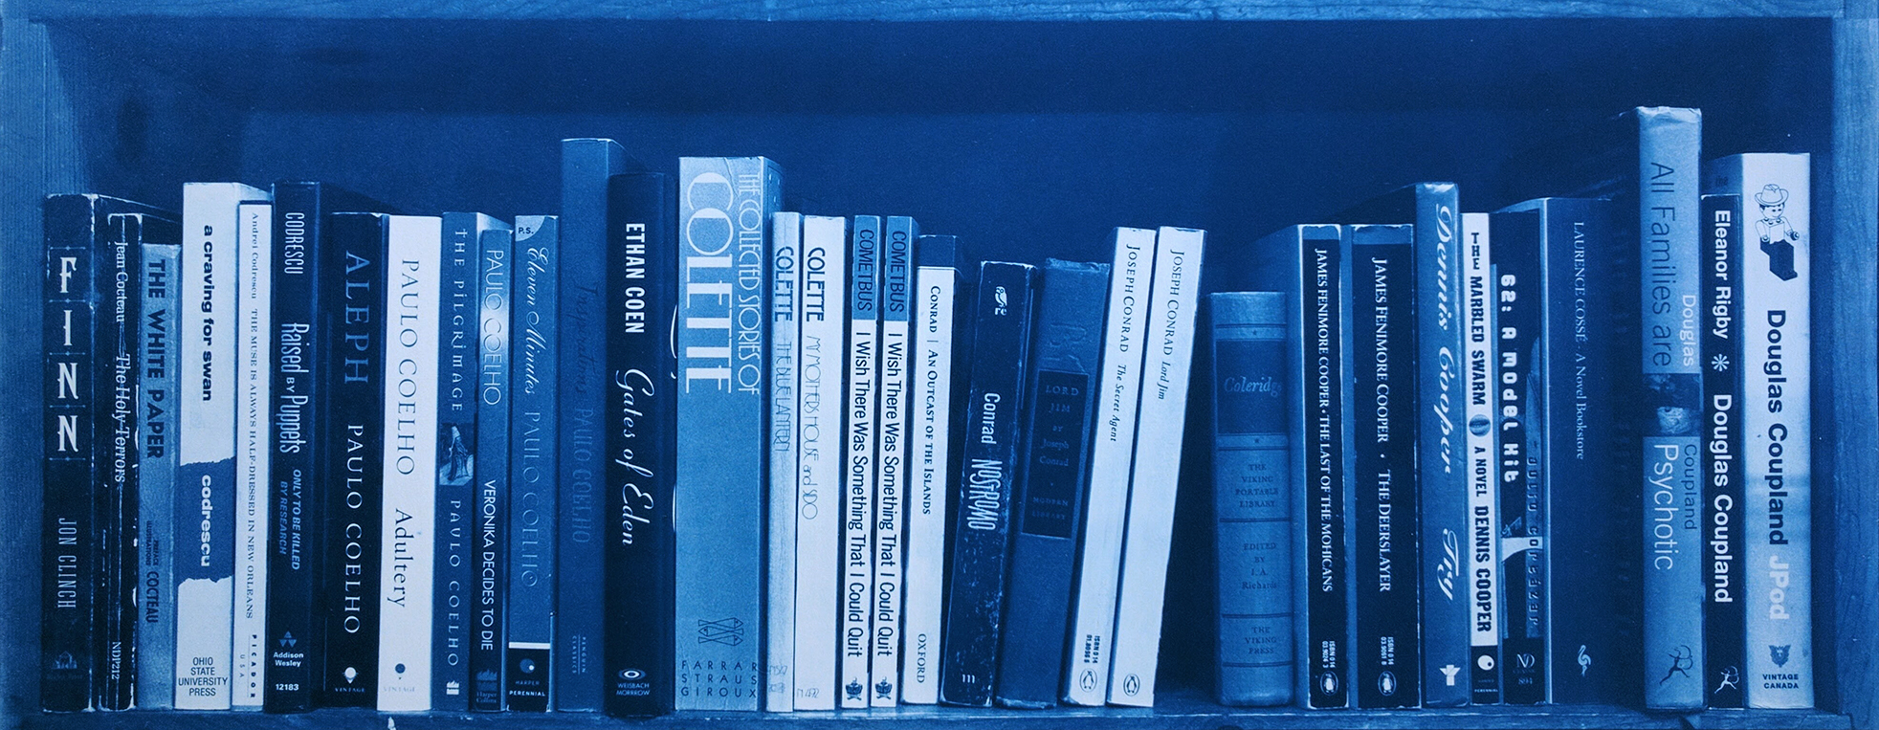
Notes:
Jason Houck, “Wouldn’t you Like to?” Adobe Books Installation, San Francisco, August 5-28, 2016
The bookstore on June 6, 2016
Cyanotypes on Arches Palatine paper

Slide 30
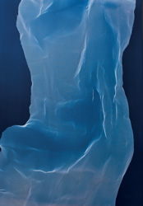
Notes:
James Welling, Torso 3, 2008
James Welling has long engaged a mediated—or in his own words, a “ventriloquist”— photographic practice that frequently takes photographic norms or the representational field itself as its subject. He works with a curiosity chest of photographic possibilities, commenting on the conventions.

Slide 31
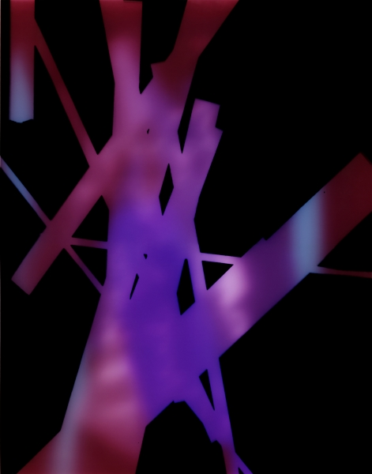
Notes:
James Welling, 202, 2008 Inkjet print 47 1/2 x 40 inches (120.7 x 101.6 cm) 55 3/4 x 48 1/4 inches (141.6 x 122.6 cm) framed Edition of 5
Degradés (1985–2008) recall Color Field painting. The artist places photographic paper beneath an enlarger, which serves as the light source, and by slowly moving a piece of cardboard to generate shadows, he creates subtle variations of brightness and tone. Several of the resulting images contain two or three stacked blocks of color and resemble the iconic paintings of Mark Rothko.

Slide 32
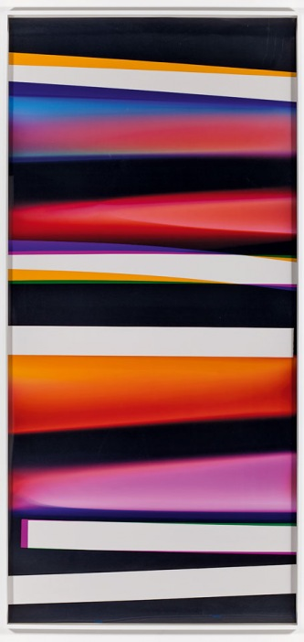
Notes:
Walead Beshty Black Curl (CMY/Five Magnet: Irvine, California, March 26th 2010, Fujicolor Crystal Archive Super Type C, Em. No. 165-021, 05110) 2011 Colour photographic paper, 1307 x 2702mm

Slide 33
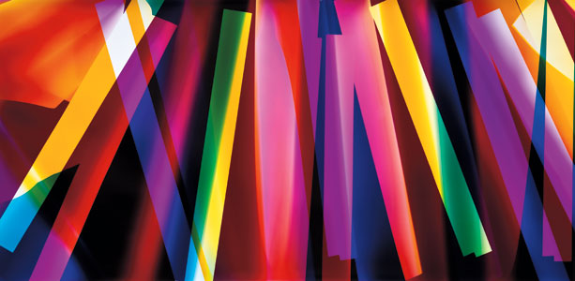
Notes:
Walead Beshty

