Slide 1
Robert Maillart and the Modern Steel-Reinforced Concrete Bridge
Thomas Telford and the Modern Metal Bridge
Engineer as Artist – Efficiency, Economy, Elegance Public Works Projects for Economic development, National needs, and Support of local community
Michael G. Littman Princeton University
June xx, 2023
Notes:
3 revolutions of 18th century – 2 political (American and French) and I economic (British)
New material, new economy, new art form
Structure (bridge to cross river), wagon (vehicle on bridge), roads (network of paths), iron (new processing method – uses coal instead of wood)
Scotsman – one of many in this course

Slide 2
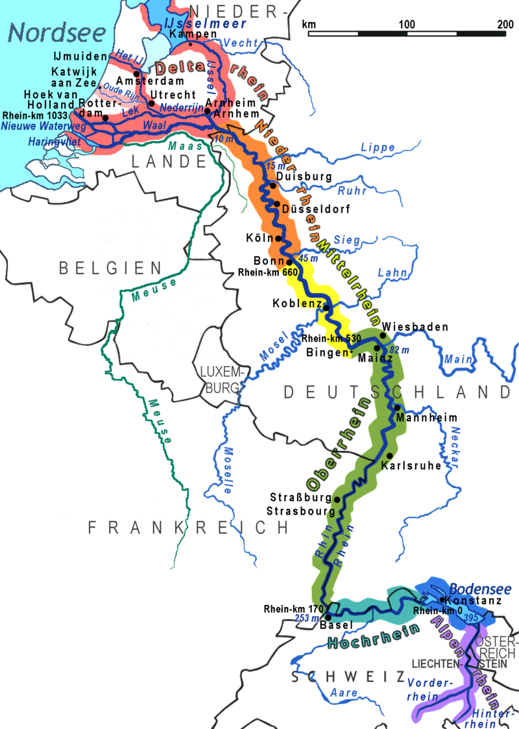
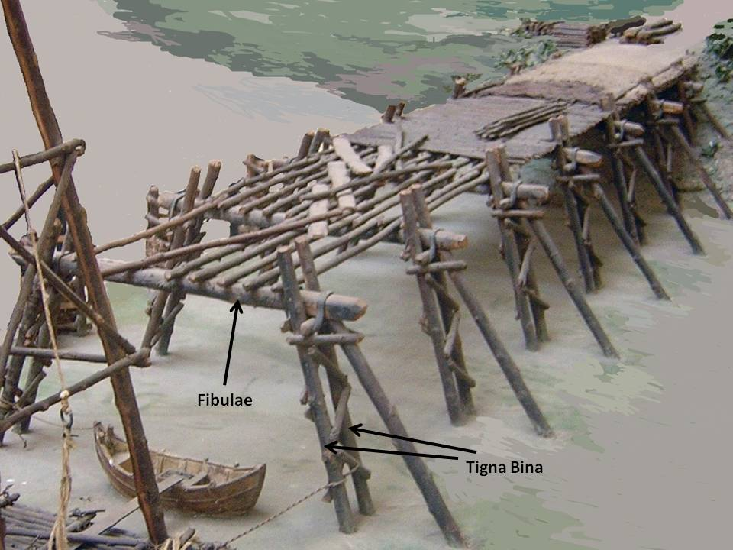
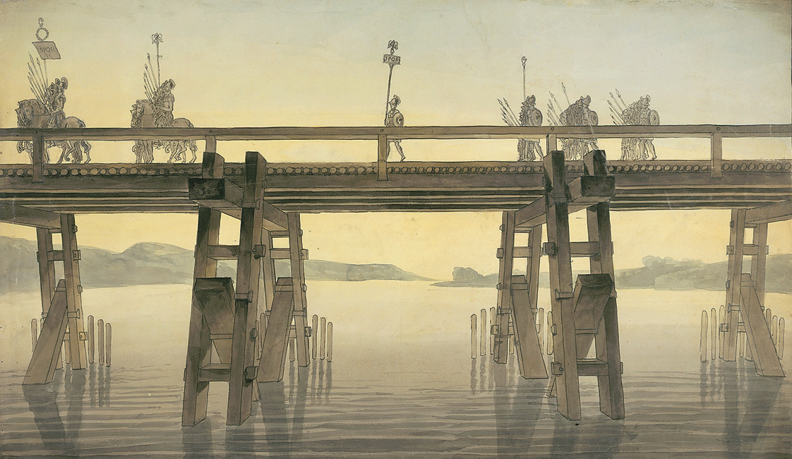
55 BC – First Bridge over Rhine
Rhine source Swiss Alps
Erected in 10 days! Julius Caesar conquers Gaul.
River provides drinking water, and is Nature’s Transportation, Information, Power Network.

Slide 3
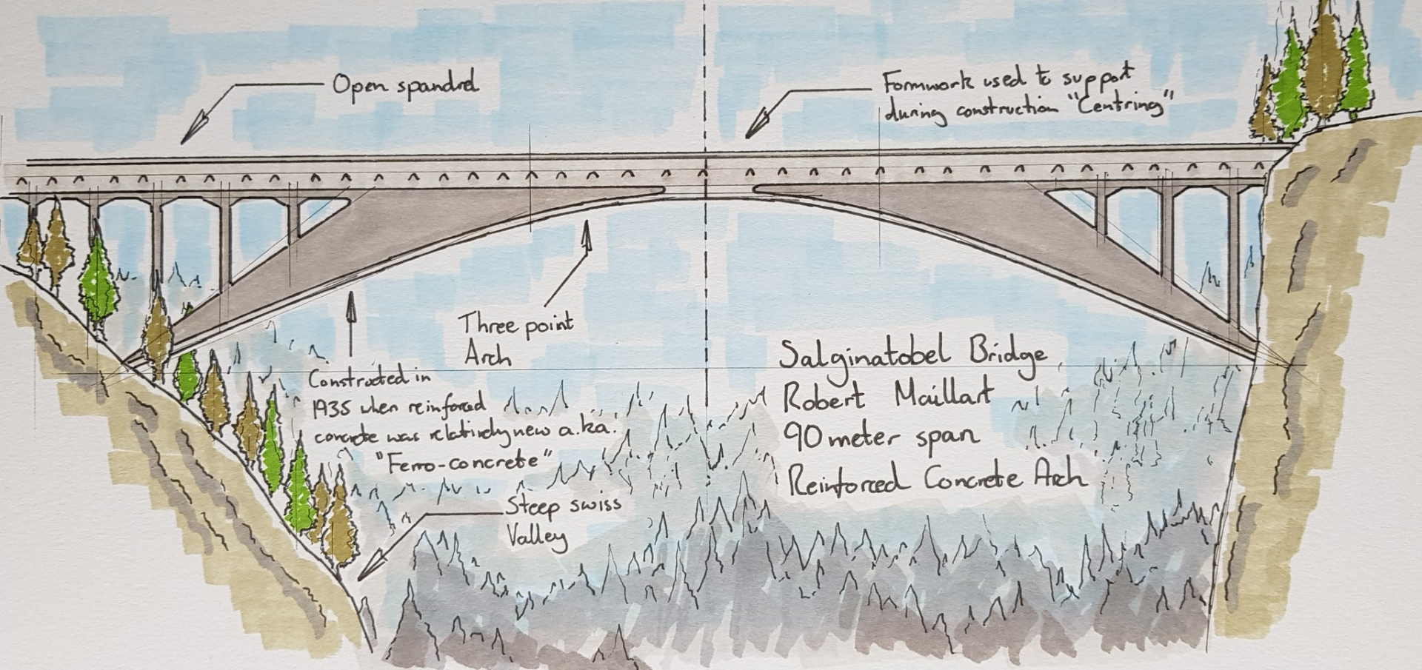
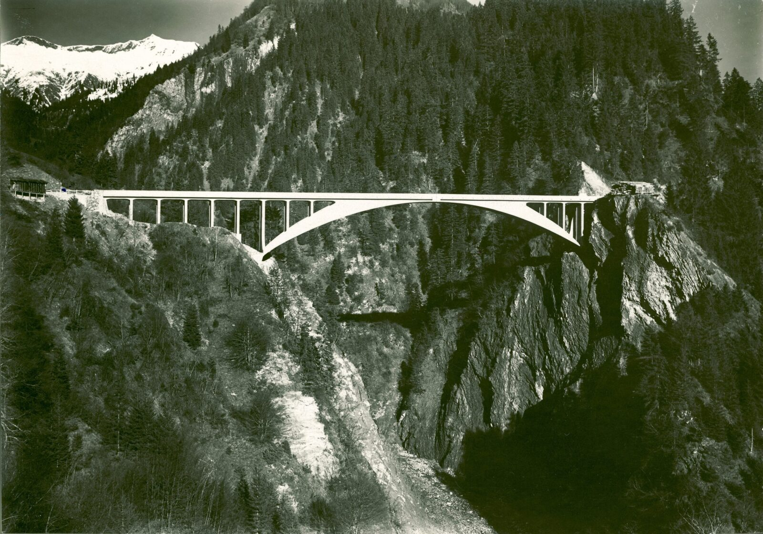
Three Hinged Arch – Hollow Box Construction
Rhine source Swiss Alps
1935 – First Steel-Reinforced Concrete Bridge as World Heritage Site
River provides drinking water, and is Nature’s Transportation, Information, Power Network.

Slide 4
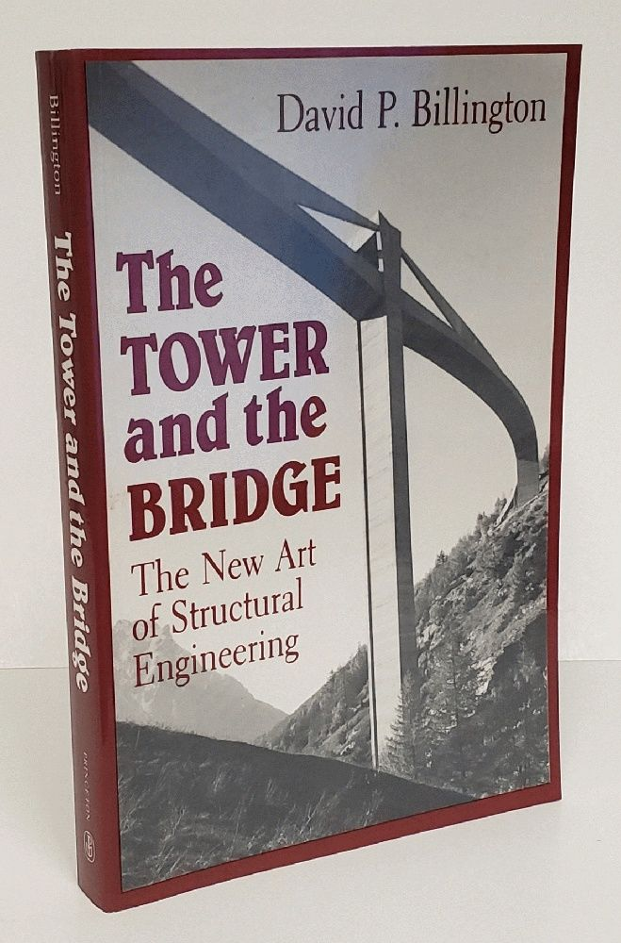
Three Hinged Arch – Hollow Box Construction
1935 – First Steel-Reinforced Concrete Bridge as World Heritage Site
Notes:
3-4-5
3 revolutions of 18th century - American, French, and British
New material allows for a new form
New opportunity due to industrialization – economics and politics
New art form – structural art
Telford – the most important civil engineer of his time

Slide 5
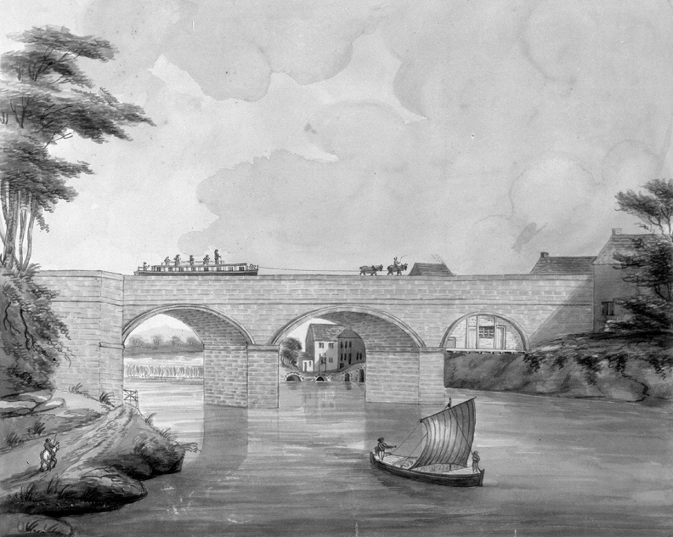
English Canal and Aqueduct
First Navigable Aqueduct - 1761

Slide 6
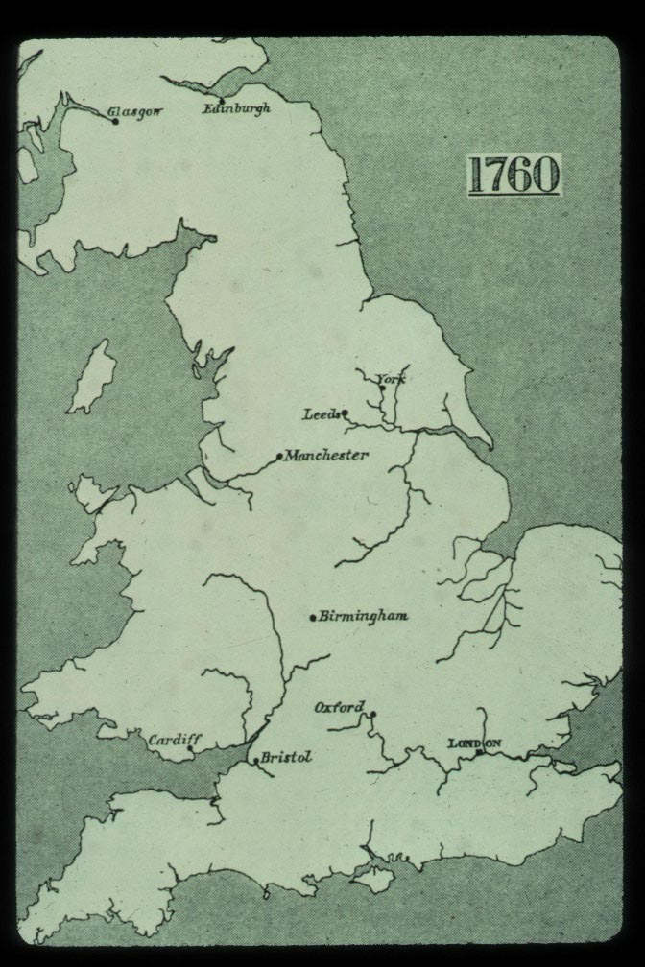
Barton Aqueduct
English Canal and Aqueduct
First Navigable Aqueduct - 1761

Slide 7
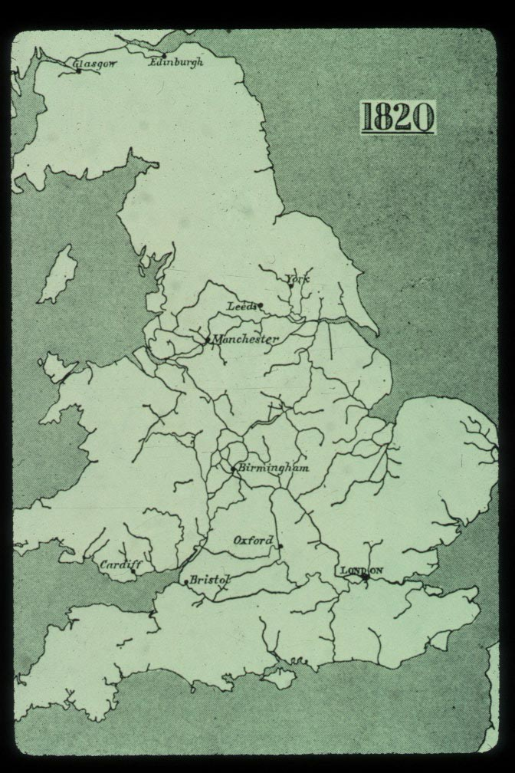
Eskdale
Barton Aqueduct
Restructuring of Nature

Slide 8
Eskdale
British Metal Forms
Science - new material INEXPENSIVE IRON
Social - new economy INDUSTRIALIZATION
Symbolic - new vision STRUCTURAL ART
Restructuring of Nature

Slide 9
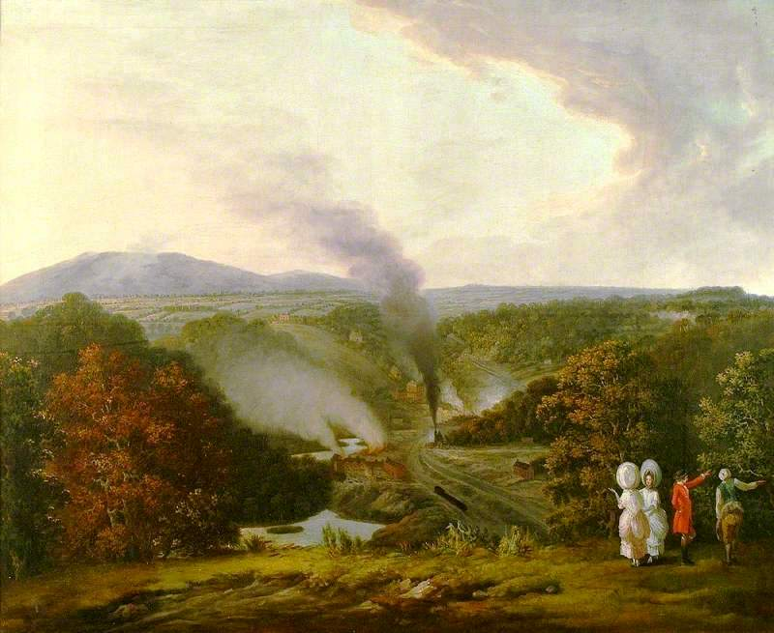
British Metal Forms
Science - new material INEXPENSIVE IRON
Social - new economy INDUSTRIALIZATION
Symbolic - new vision STRUCTURAL ART
‘Afternoon View at Coalbrookdale’
Where industrial revolution begins
Notes:
By William Williams

Slide 10
INDUSTRIALIZATION*
Natural resources – coal & iron ore
Factory system – citizen wealth
Island isolation – strong Navy
*Arnold Toynbee’s analysis
‘Afternoon View at Coalbrookdale’
Where industrial revolution begins
Notes:
Parliament (House of Lords and House of Commons) formed by Treaty of Union (England, Wales, Scotland) – early 1700’s
Parliament of United Kingdom of Great Britain and Ireland – by 1800 Unification
Arnold Toynbee

Slide 11
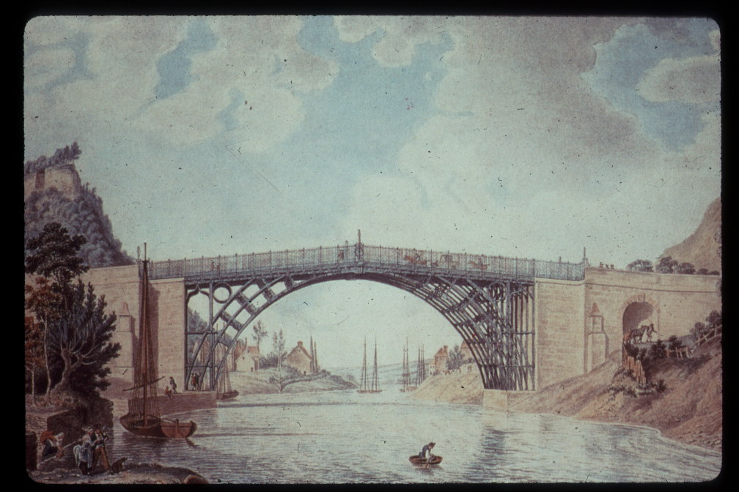
INDUSTRIALIZATION*
Natural resources – coal & iron ore
Factory system – citizen wealth
Island isolation – strong Navy
*Arnold Toynbee’s analysis
The Iron Bridge of 1779

Slide 12
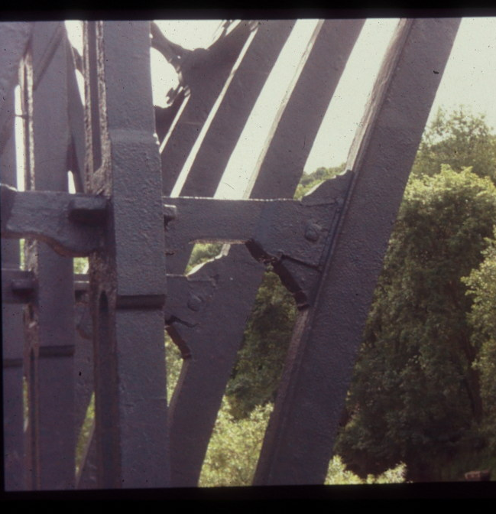
The Iron Bridge of 1779
Joints typically used in wood: Dovetail, Mortise and Tenon
Notes:
Dovetail, and Mortise and Tenon joints - carpentry

Slide 13
Joints typically used in wood: Dovetail, Mortise and Tenon

Slide 14
Processes
Transformation and Relationship
Notes:
Transformation – raw materials (iron ore and coal) to pure metal and waste gases
Relationship – equality between ingredients and products

Slide 15
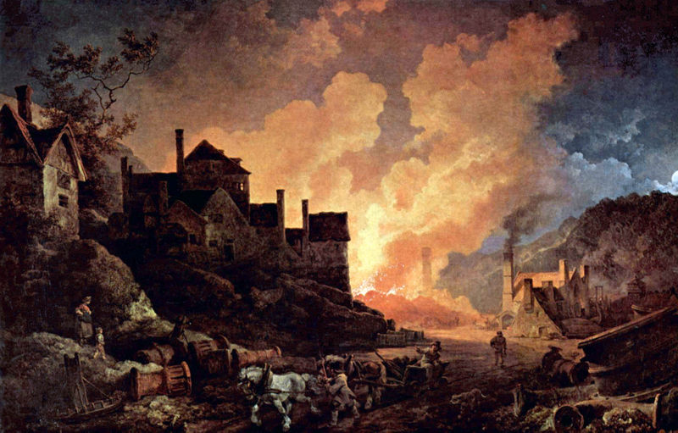
Processes
Transformation and Relationship
‘Coalbrookdale at Night’
Notes:
Madeley Wood Furnaces, painted by Philip James de Loutherbourg in 1801 and known as Coalbrookdale at night
The Madeley Wood Company was formed in 1756 when the Madley Wood Furnaces, also called Bedlam Furnaces, were built beside the River Severn, one mile west of Blists Hill.
The Bedlam Furnaces were owned by this company, which held mineral leases in Madeley Parish, enabling it to extract coal and iron ore. The works were taken over by Abraham Darby III of the Coalbrookdale Company in 1776. When the company was reorganised in 1797, the Madley Wood Works became separate from Coalbrookdale, continuing (in conjunction with the Ketley ironworks) in the hands of the Reynolds family who had been partners at Coalbrookdale since the 1760s. After Joseph Reynolds decided to concentrate on his bank, the Madeley Wood Works passed to the Anstice family, one of whom had managed it, and their business became another Madley Wood Company.
Upon its opening in 1790, the ironworks had access to the Shropshire Canal, the Blists Hill section of which ran immediately to the east of the Blists Hill works site. Proximity of raw materials and the means of transporting the finished product persuaded the company to build a blast furnace at Blists Hill in 1832.
Additional furnaces were added in 1840 and 1844, making a total of three, and the site remained active in the production of pig iron until 1912 when the ironworks ceased production, following the blowing in of two of the furnaces.

Slide 16
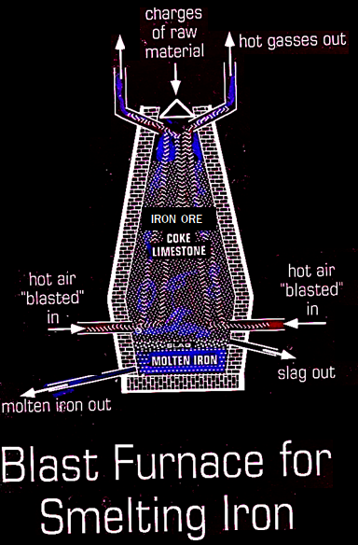
Processes
Transformation and Relationship

Slide 17
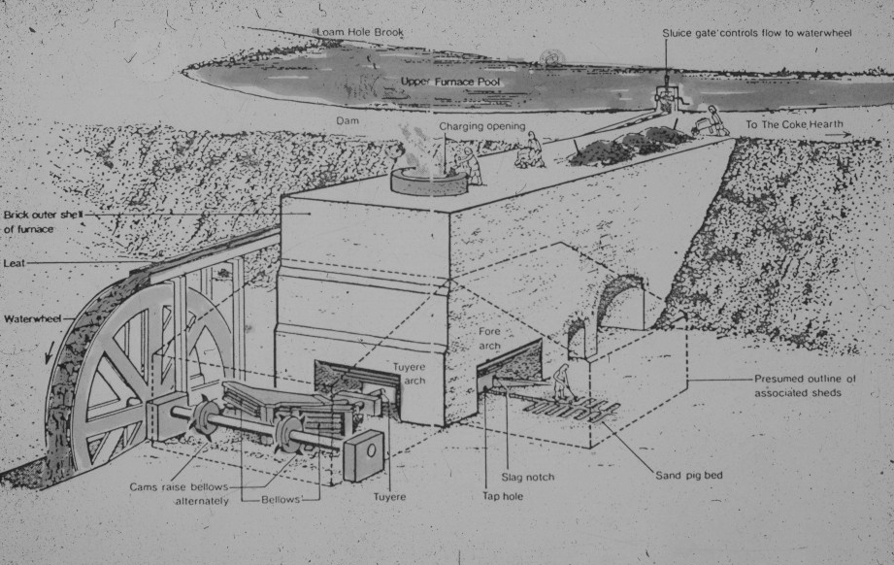

Slide 18
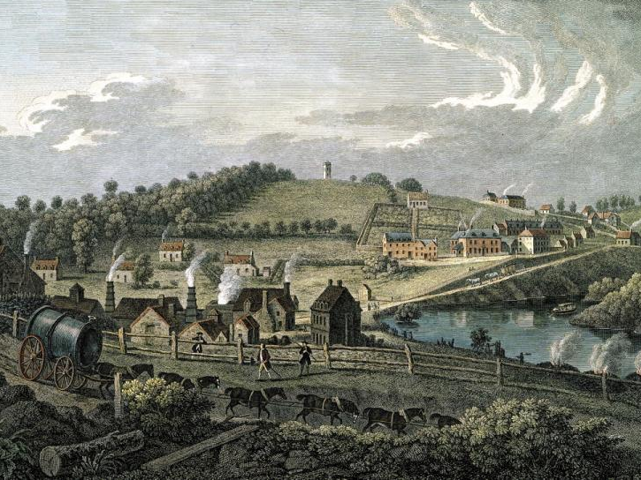
‘Upper Works at Coalbrookdale’
Notes:
Upper Works at Coalbrookdale by Francois Vivares – earliest engraving known -- 1758

Slide 19
Iron Bridge
Great Flood of 1795

Slide 20
Iron Bridge
Great Flood of 1795
Shropshire County Engineer Thomas Telford

Slide 21
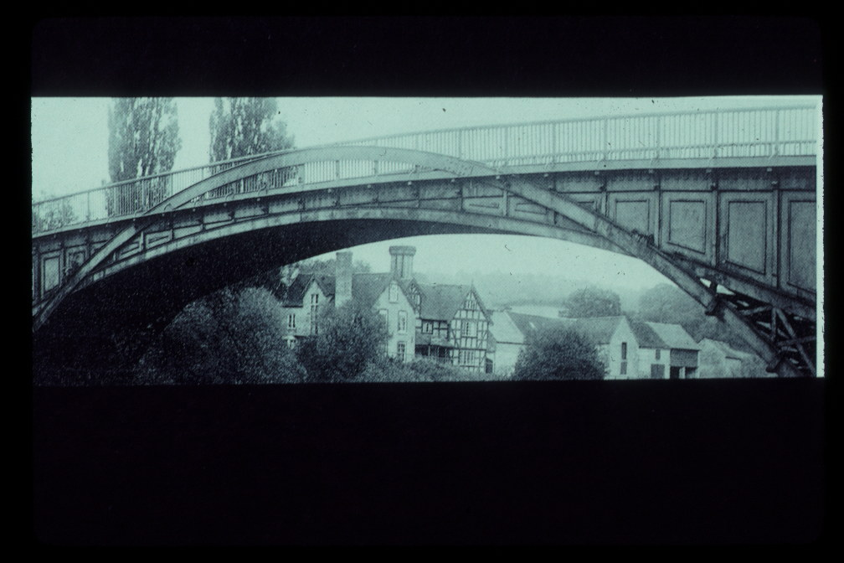
Bildwas – Telford’s First Iron Bridge (30% longer using half as much iron)
MORE EFFICIENT BRIDGE Minimum Materials
Shropshire County Engineer Thomas Telford

Slide 22
IRON
Stronger than wood and stone
More permanent than wood
Lighter structures than stone
Bildwas – Telford’s First Iron Bridge (30% longer using half as much iron)
MORE EFFICIENT BRIDGE Minimum Materials

Slide 23
Crushing Stress
IRON
30,000 lbs
30,000 lbs
Stronger than wood and stone
More permanent than wood
Lighter structures than stone
10 square-inch
1 square-inch
Notes:
Stone = 100 lbs / cu-ft
Iron = 450 lbs / cu-ft

Slide 24
Crushing Stress
Where is the load?
Gravity load is 30,000 lbs;
Stress is force / area (psi);
Materials fail when stress exceeds limit
30,000 lbs
30,000 lbs
10 square-inch
1 square-inch

Slide 25
Crushing Stress
Where is the load?
30,000 lbs
30,000 lbs
10 square-inch
1 square-inch

Slide 26
Crushing Stress
Where is the load?
30,000 lbs
30,000 lbs
10 square-inch
1 square-inch

Slide 27
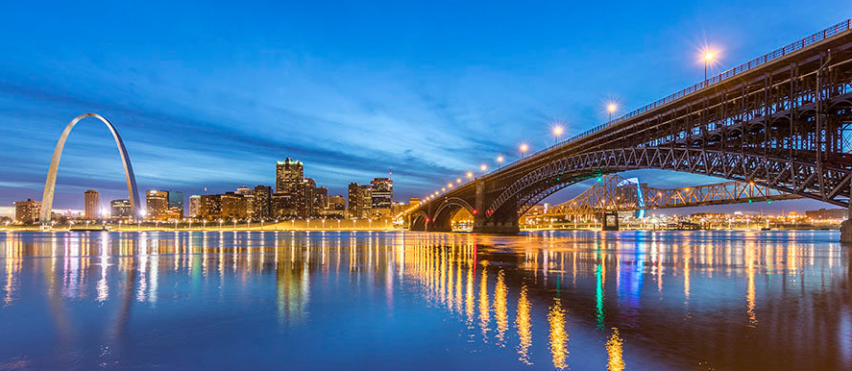
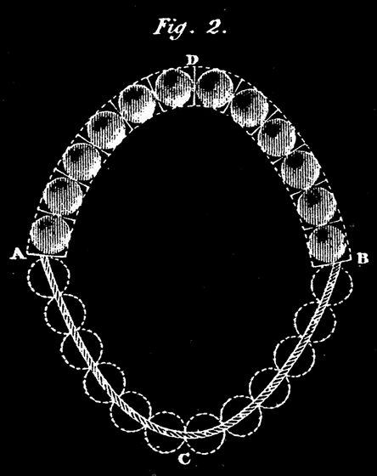
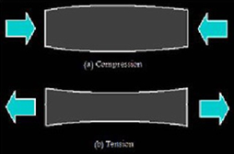
Where is the load?
Two arches hold it up
ARCH versus CABLE
Arch – compression
Cable – tension

Slide 28
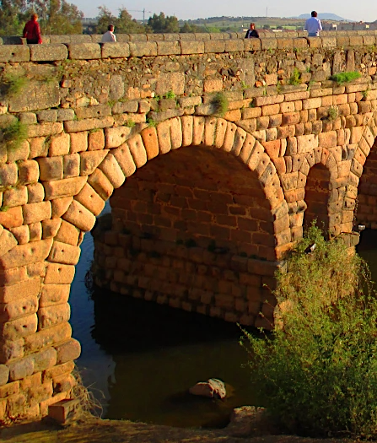

Slide 29
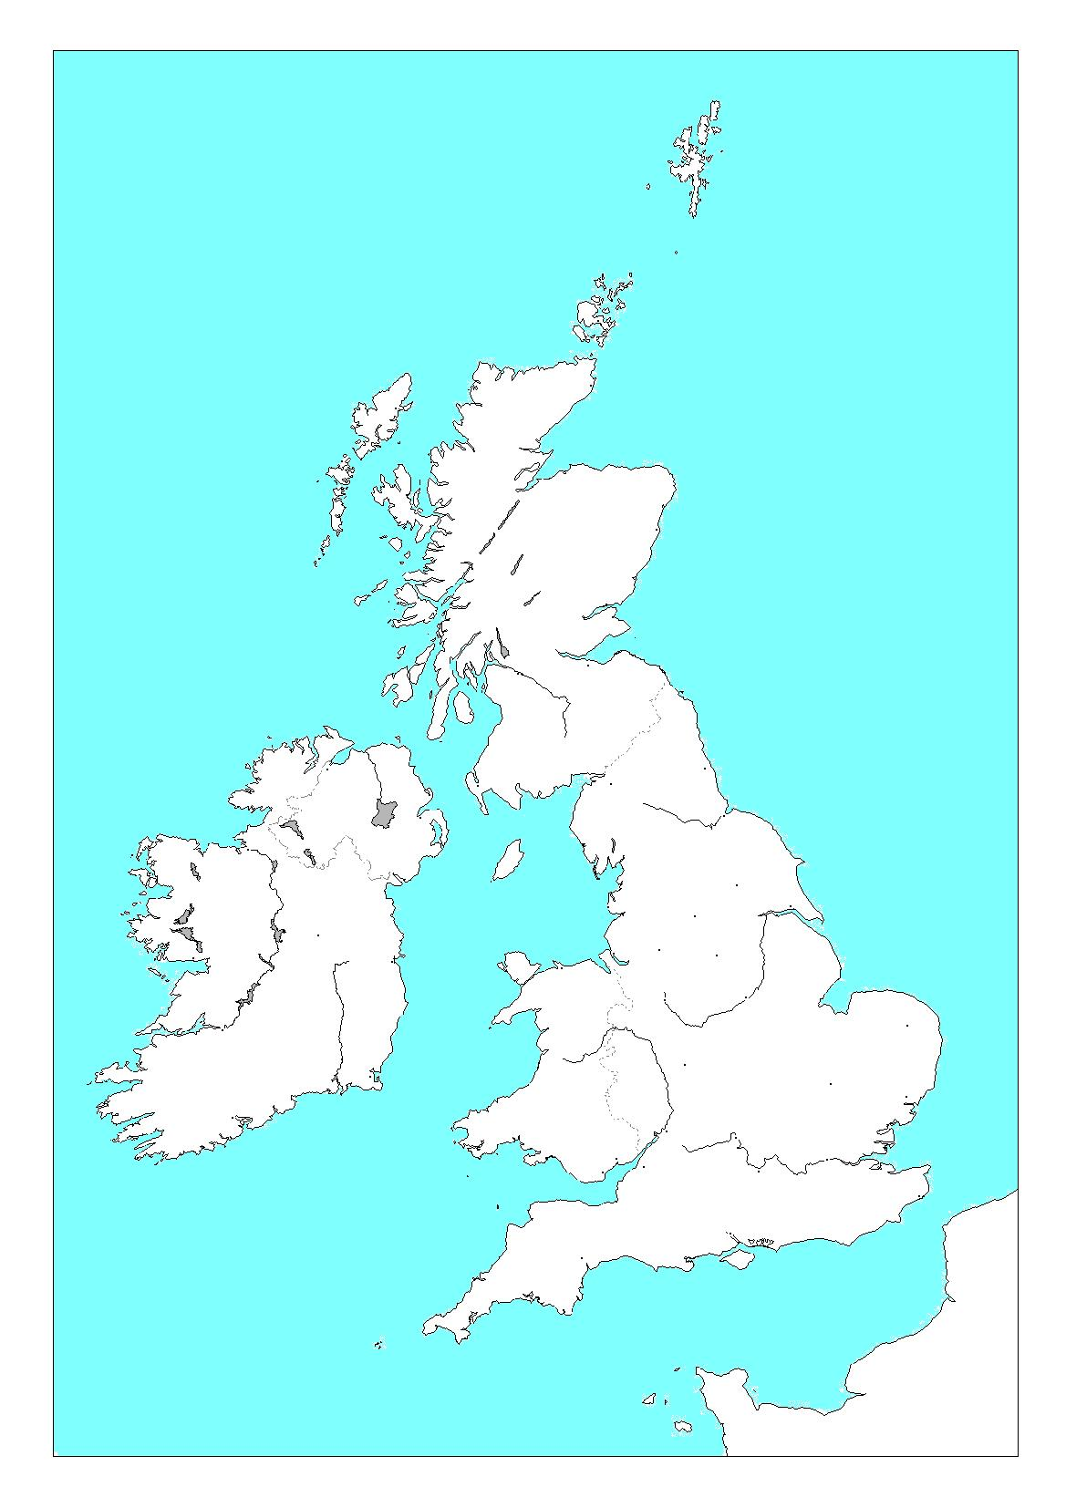
Thomas Telford (1757 – 1834)
Stonemason and Architect
Surveyor and Engineer
Eskdale
Iron Bridge
London

Slide 30
Thomas Telford (1757 – 1834)
Stonemason and Architect
Surveyor and Engineer
Bonar
1796 – Bildwas – 130 foot arch
1805 – Llangollen – short arches
1810 – Bonar – 150 foot arch
Llangollen
Bildwas

Slide 31
Thomas Telford (1757 – 1834)
Stonemason and Architect
Surveyor and Engineer
Bonar
1796 – Bildwas – 130 foot arch
1805 – Llangollen – short arches
1810 – Bonar – 150 foot arch
Llangollen
Bildwas

Slide 32
Thomas Telford (1757 – 1834)
Stonemason and Architect
Surveyor and Engineer
1796 – Bildwas – 130 foot arch
1805 – Llangollen – short arches
1810 – Bonar – 150 foot arch
Llangollen Aqueduct
Notes:
Pontcysyllte – 18 stone piers – 127 feet tall

Slide 33
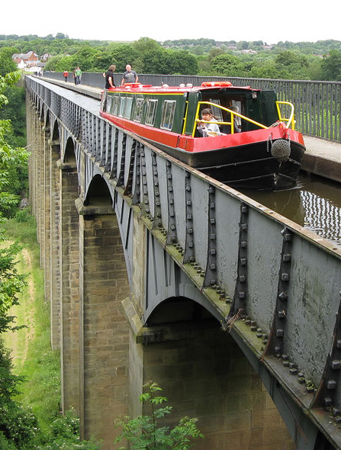
Llangollen Aqueduct

Slide 34
Bonar
Llangollen
Bildwas

Slide 35
Thomas Telford – later works
Craigellachie
1814 – Craigellachie – 150 foot arch
1826 – Menai – 580 foot suspension
Menai

Slide 36
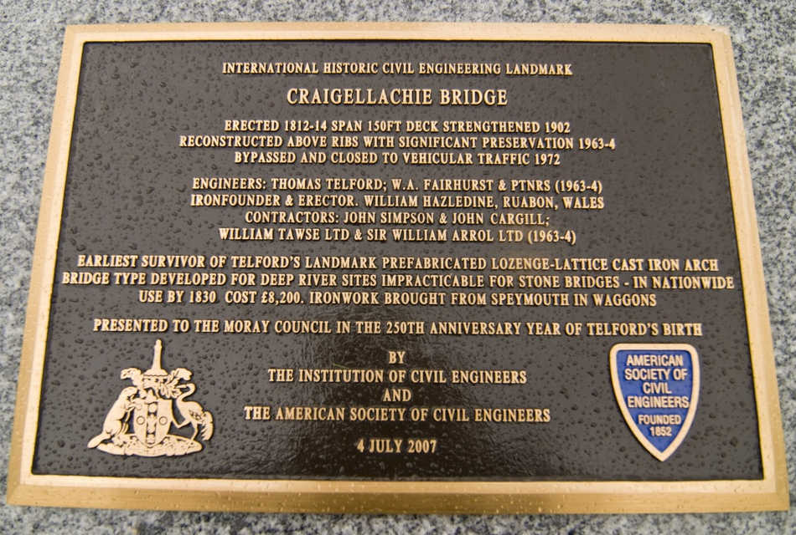
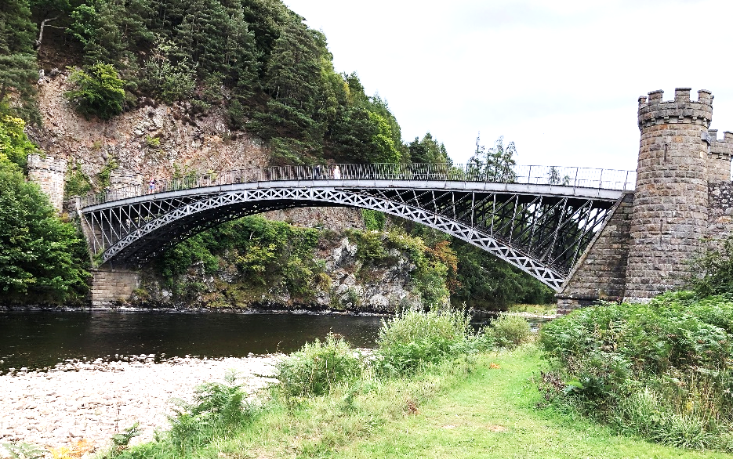
Thomas Telford – later works
“Earliest survivor of Telford’s Cast Iron Arch Bridge”
1814 – Craigellachie – 150 foot arch
1826 – Menai – 580 foot suspension

Slide 37
“The bridge is of iron, beautifully light, in a situation where the utility of lightness is instantly perceived. … The only defect, and a sad one it is, is that the railing for the sake of paltry economy is of the meanest possible form, and therefore out of character with the rest of the iron work.” -- Robert Southey
“Earliest survivor of Telford’s Cast Iron Arch Bridge”

Slide 38
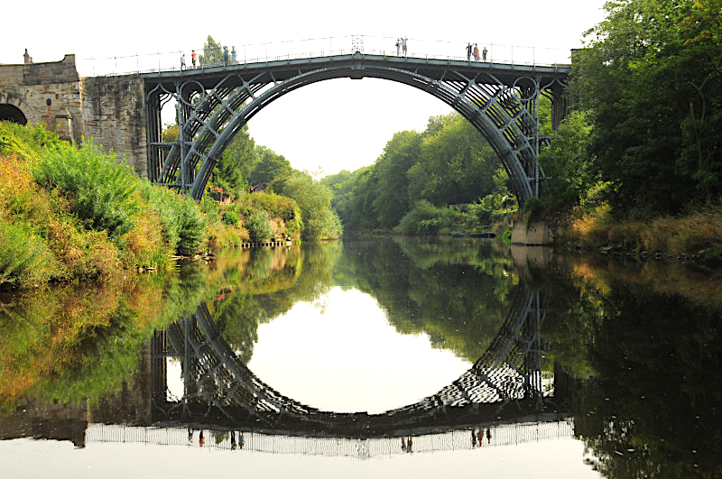
“The bridge is of iron, beautifully light, in a situation where the utility of lightness is instantly perceived. … The only defect, and a sad one it is, is that the railing for the sake of paltry economy is of the meanest possible form, and therefore out of character with the rest of the iron work.” -- Robert Southey

Slide 39
*
method:
mutilated
* Telford’s Analysis in Encyclopedia Britannica

Slide 40
*
mutilated
method:
mutilated
method:
* Telford’s Analysis in Encyclopedia Britannica

Slide 41
Menai bridge Telford wanted to build

Slide 42
Menai bridge that Telford built
Menai bridge Telford wanted to build

Slide 43
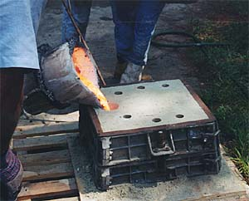
Cable versus Arch
Menai bridge that Telford built
Menai bridge Telford wanted to build
Wrought Iron
Cast Iron

Slide 44
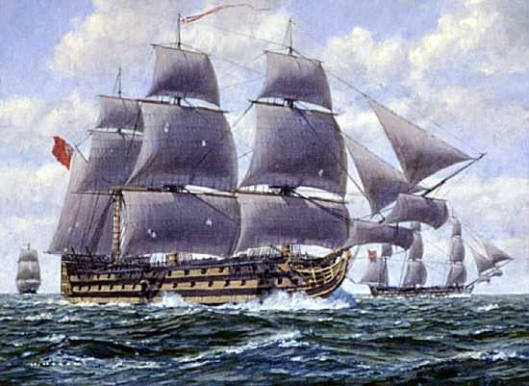
Cable versus Arch
Menai bridge that Telford built
Menai bridge Telford wanted to build
Politics and Economics
Lord Nelson’s Ship – HMS Victory

Slide 45
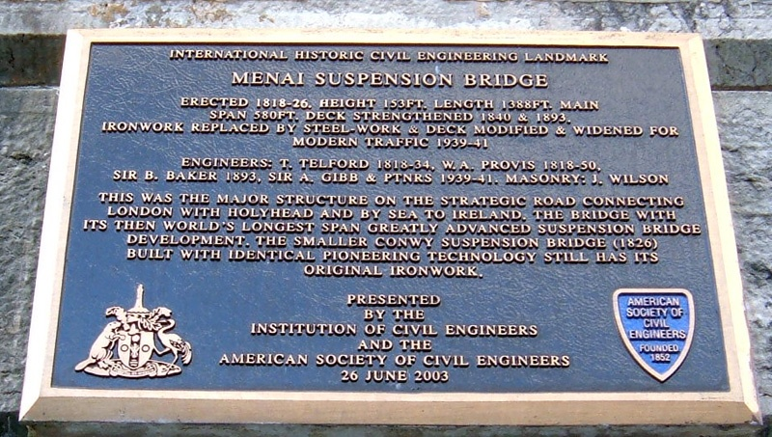
Menai bridge that Telford built
“This was the major structure on the Strategic Road connecting London with Holyhead, and by sea with Ireland.”
Lord Nelson’s Ship – HMS Victory

Slide 46
Craigellachie
Dublin
Menai
Iron Bridge
London
“This was the major structure on the Strategic Road connecting London with Holyhead, and by sea with Ireland.”
Roads are Lines of Communication Connects London to Dublin

Slide 47
Craigellachie
Cable Suspension Bridge
Dublin
Menai
Iron Bridge
How does it work?
London
Cable supported TOWER in COMPRESSION
Deck supported CABLE in TENSION
Roads are Lines of Communication Connects London to Dublin

Slide 48
Structures
Cable Suspension Bridge
How does it work?
Transformation and Relationship
Cable supported TOWER in COMPRESSION
Deck supported CABLE in TENSION
Science – Economics – Art
Where is the load? Total deck weight = qL

Slide 49
Structures
STRUCTURAL ART
minimum materials EFFICIENCY
minimum cost ECONOMY
maximum expression ELEGANCE
Transformation and Relationship
Science – Economics – Art
Where is the load? Total deck weight = qL

Slide 50
L
d
Structures
STRUCTURAL ART
minimum materials EFFICIENCY
minimum cost ECONOMY
maximum expression ELEGANCE
Transformation and Relationship
Science – Economics – Art
What is the form? Flat; “Beautifully Light”

Slide 51
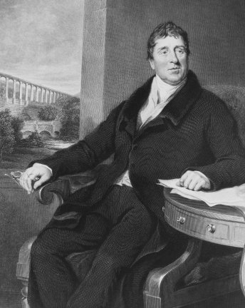
L
d
STRUCTURAL ART
minimum materials EFFICIENCY
minimum cost ECONOMY
maximum expression ELEGANCE

Slide 52
“Telford’s is a happy life: everywhere making roads, building bridges, forming canals and creating harbours – works of sure, solid, permanent utility; everywhere employing a great number of persons.” -- Robert Southey (1819)
STRUCTURAL ART
minimum materials EFFICIENCY
minimum cost ECONOMY
maximum expression ELEGANCE

Slide 53
Key Ideas
What is the innovation? . Flat and Efficient Iron Bridge
How does it happen? . Telford – Engineer-Artist and . . Public Works Entrepreneur
What is the legacy? . Iconic Structural Art . Economic and Political Security
“Telford’s is a happy life: everywhere making roads, building bridges, forming canals and creating harbours – works of sure, solid, permanent utility; everywhere employing a great number of persons.” -- Robert Southey (1819)

