Slide 1
Mechanical and Aerospace Engineering
Applications
Structures
Machines
Networks
Processes
Disciplines
Tools

Slide 2
Mechanical and Aerospace Engineering
Applications
Structures
Machines
Networks
Processes
Disciplines
Tools

Slide 3
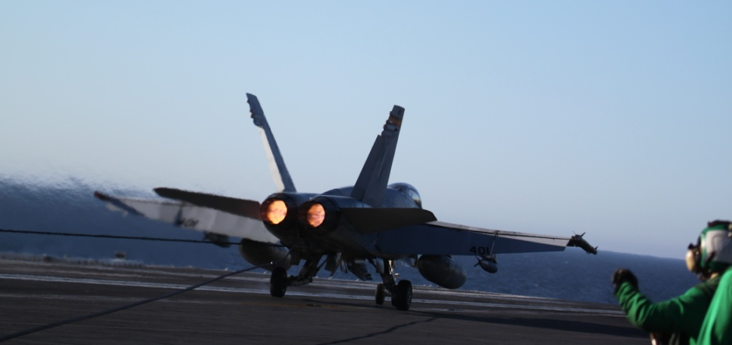
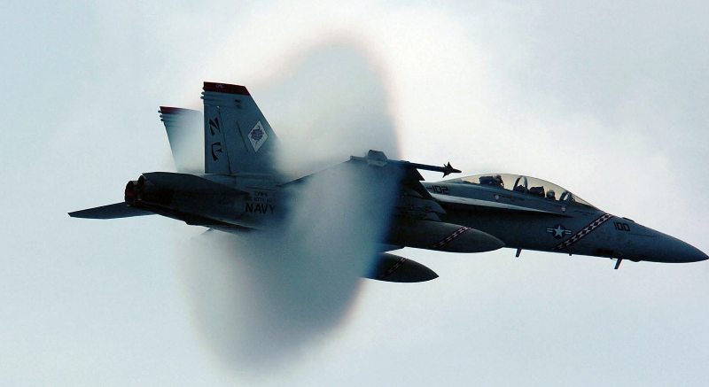
Mechanical and Aerospace Engineering
Energy
Fluids
Dynamics and Controls
Aero and Astro
Materials
Applied Physics

Slide 4
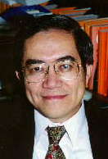
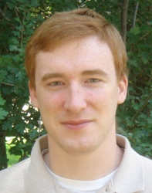
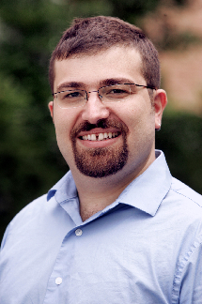
IW Advisor
MAE 530 / 531
MAE 426
MAE 228
Anglinger Center
Climate Engr’ing
MAE 309
MAE 353
MAE 427
NAE
NEW
Turbulent Combustion; Engine; Theory
Fundamentals of combustion LAB
Combustion Plasma LAB
Plasmas Control
Nuclear Policy; Global Security
Fundamentals of Combustion – swirling flames
Improved Engine; Alternative Fuels; Fire
Combustion Plasmas; New materials formed in flames, Supersonic Combustion
Carbon Mitigation; Energy and Environment Policy; Nuclear Policy
Sustainable Energy Program
Energy Faculty

Slide 5
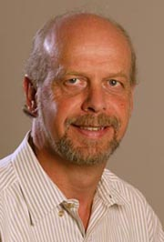
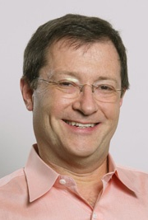
MAE 322
MAE 423
MAE 335
MAE 221
MAE 224
MAE 222
MAE 305
NAE
NAE
NAS
Wind and Water; Turbulence;
LAB
Fundamentals of Fluids LAB;
Microfluids
Entrepreneur; Mechanical Design
Turbulence LAB - Superpipe
Fluids Faculty
Turbulence and Boundary Layer Interactions
Aquatic Propulsion -- eel ; manta ray ; porpoise
Fundamentals of fluids – buoyancy, surface tension
Design Optimization: Sailboats to Airplanes
High Speed Wind Tunnel

Slide 6
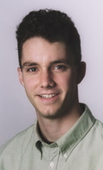
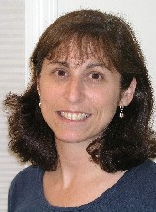
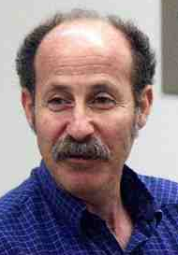
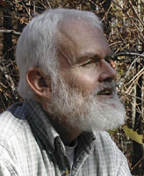
MAE 412
MAE 433 LAB
CEE 102
IW Advisor Applied Math
MAE 433
MAE 434
MacArthur
Computer Modeling Theory – Control of fluids
Theory + LAB;
Computational Biology; flocking
LAB – Microcomputers, Telescope and Laser Design
Theory (dynamics) + RHEX robot;
Poet
D & C Faculty
Underwater Robotics and Swarms
Insect Locomotion
Control of Fluids; Reduced Order Modeling
Robotics, Automation, and Optical System Control

Slide 7
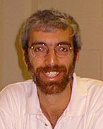
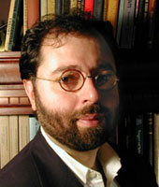
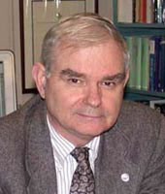
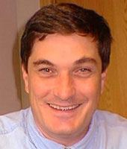
MAE 206
MAE 432
MAE 332
MAE 321
IW Coordinator
MAE 331
MAE 345
MAE 431
Satellites - Computer modeling - Telescope LAB – Astrophysics; Rock Climber, juggler
CFD Computer Modeling LAB; Boeing Fellow; Airplane design
E&M Modeling and LAB; Large-scale vacuum tanks; thrusters; 3D acoustics; Knight
Computer modeling and control of dynamical systems;
Control of disease; LEM control designer
Aerospace Faculty (NASA & FAA)
Terrestrial Planet Finder
Electric Propulsion; Thrusters
Apollo LEM Guidance and Navigation (Stengel)
Robotics and Intelligent Control Program

Slide 8
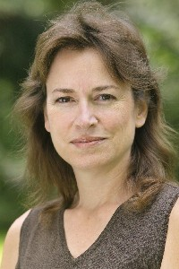
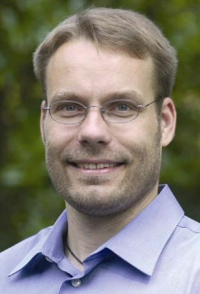
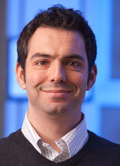
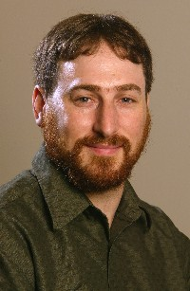
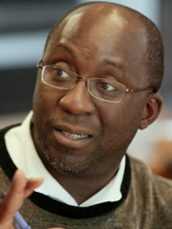
Anglinger Center ELE 431
MSE 301
MAE 244
MAE 223
MAE 424
MAE 324
NAS
Theory (Quantum Chemistry) + Computer Model
Computational materials; biomaterials
Biocompatible materials; low tech soln’s for 3rd world
LAB – Energy & Materials; electrochemistry
Energy storage LAB – batteries; acoustic lens
Materials Faculty
High Temperature and High Strength Materials
Material Selection and Design; Nano-scale and Bio-materials
Laser Processing of Materials; Compact Energy Sources
Crack and Fracture; Coatings and Thin Films

Slide 9
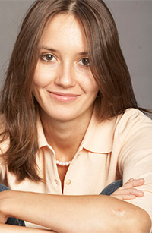
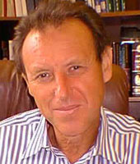
IW Advisor MAE 521
MAE 328
MAE 511
MAE 527
Femtosecond Lasers LAB; X-ray production;
X Ray Laser LAB; Wind Surfer
Applied Physics Faculty
Flow Diagnostics using Laser Tagging (Miles, emeritus)
Compact X-Ray Laser
X-Ray Laser for Biological Imaging of Cells
High Speed Wind Tunnel (Miles, emeritus)

Slide 10
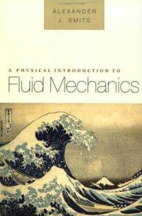
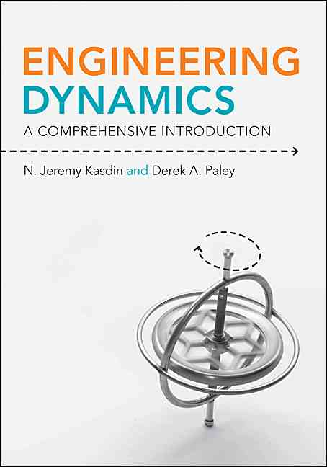
BOOKS by MAE Faculty
MAE 222
MAE 206
MAE 331

Slide 11
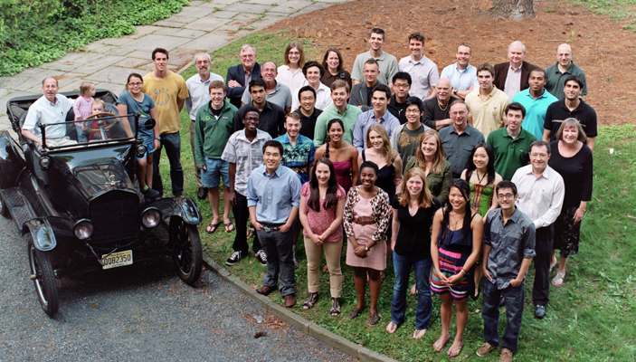
Students and Staff (Jo, Jon, Glenn, Chris, Mike)

Slide 12
Pyne Prize
Churchill Scholarship
Rhodes Scholar
Palmer Prize
Valedictorian
Boo Bicycles
Edmonton Oilers
VIDEOS

