Slide 1
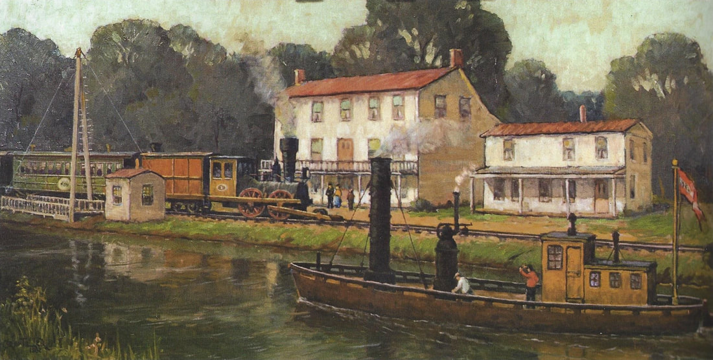
Grif Teller’s Painting of Princeton Turning Basin as it would have looked in 1862. John Bull Locomotive shown on the Camden & Amboy Branch Line. Steamboat on the Delaware & Raritan Canal. Princeton Hotel (left) and Store and Telegraph Office (right).

Slide 2
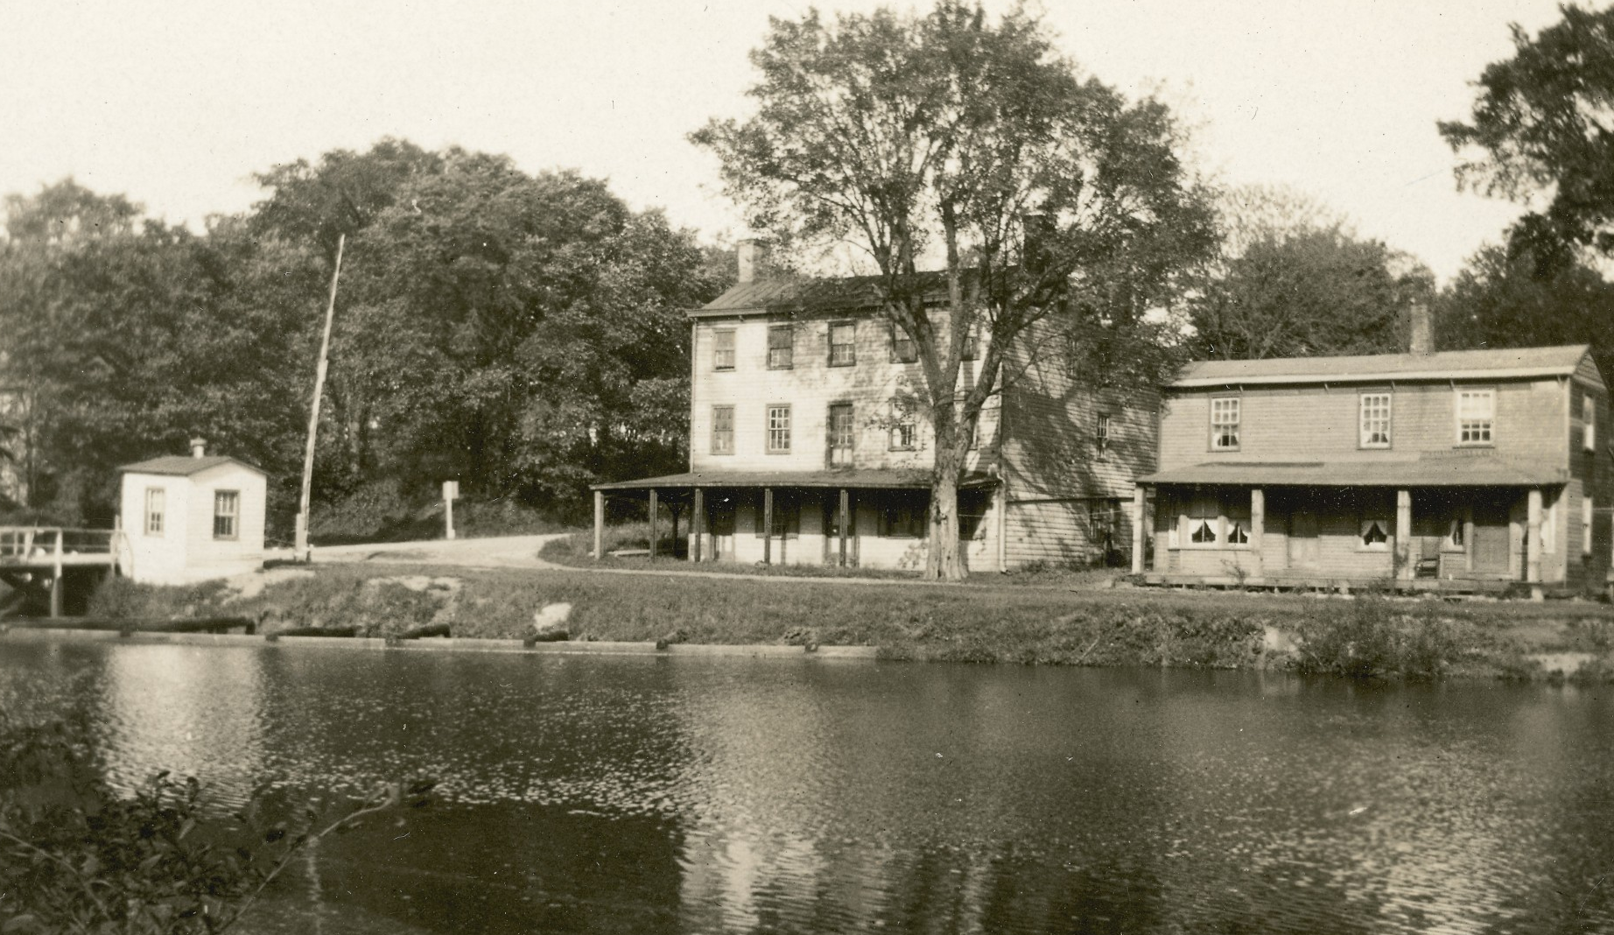

Slide 3
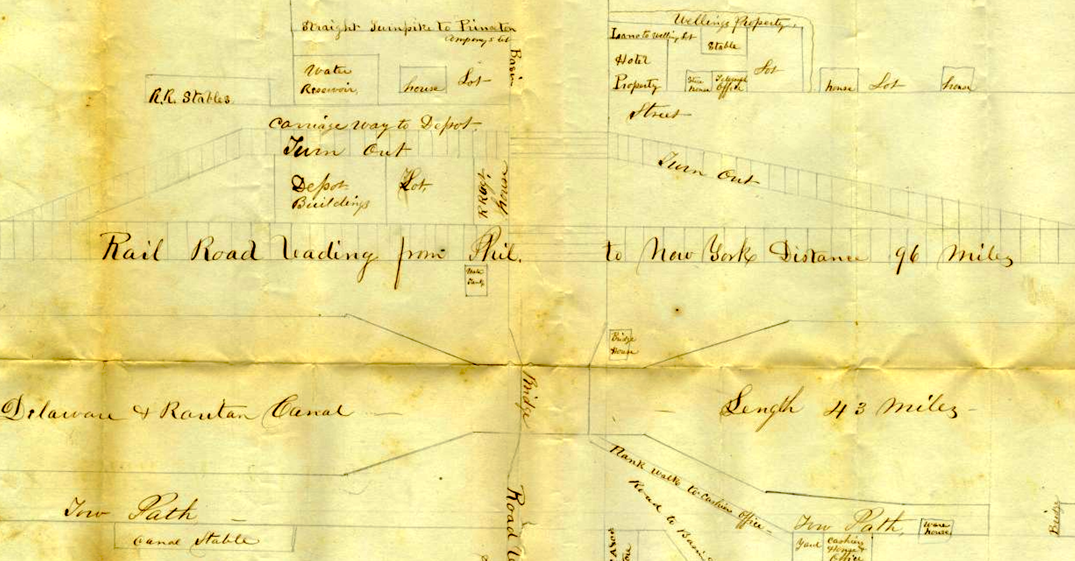
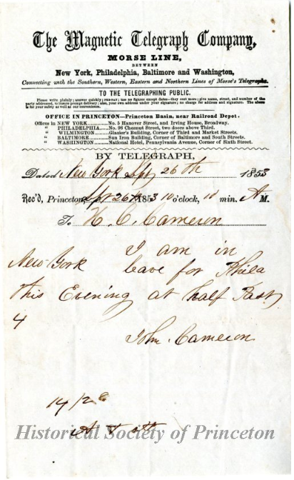

Slide 4
1803 – Trenton to New Brunswick Road – gravel road including straight line segment – now US1
1825 – Erie Canal completed – New York to Buffalo using steamboats and canal boats
1830 – Joseph Henry in Albany rings a bell a mile away using electromagnetism – shows to his High School students
1831 – Mohawk & Hudson Railroad starts operation
1832 – Delaware & Raritan Canal and Camden & Amboy Railroad operational – Princeton Turning Basin
1832 – Joseph Henry comes to Princeton as Professor of Natural Philosophy
1832 – Samuel Morse conceived of an electromagnetic telegraph using a dot-dash code
1836 – Joseph Henry and the Campus Wire – a single wire telegraph from lab to home using earth for return to request his lunch
1838 – Samuel Morse and Alfred Vail demonstrate a telegraph system in Morristown NJ (Speedwell Iron Works)
1840 – Morse patent of Telegraph Signals (US1647)
1844 – Morse, Vail, and Ezra Cornell send a telegraph message between Baltimore and Washington
1846 – Morse patents the Receiving Register (US4453)
1847 – Morse starts the Magnetic Telegraph Company with offices between Phila and NYC – one at Princeton Basin
1848 – Morse reissues 1846 Patent (USRE118) showing receiving magnet – his claim to the relay
1853 – Telegram to Henry Clay Cameron received at Princeton Basin
1857 – Western Union formed
1858 – Transatlantic Telegraph Cable – it lasts only 3 weeks
1861 – Transcontinental Telegraph

Slide 5
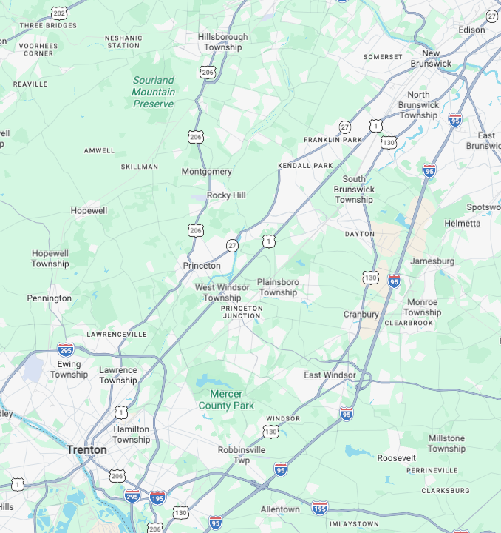
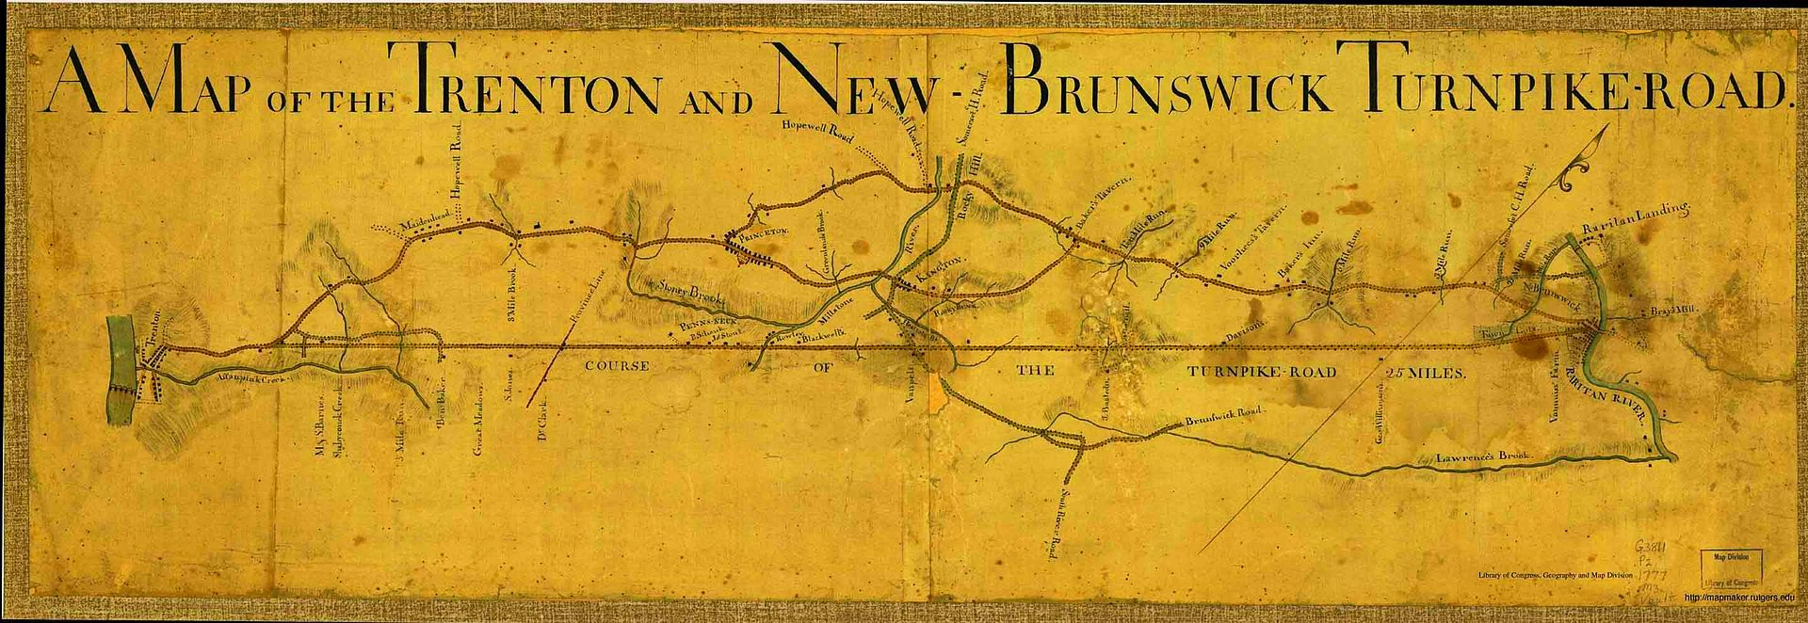
What is now US 1 between Trenton and New Brunswick was originally chartered as the Trenton and New Brunswick Turnpike in 1803. Throughout its history, the Trenton and New Brunswick Turnpike faced stiff competition from canals such as the D&R Canal and railroads such as the Camden and Amboy Railroad. In the later part of the 19th century, the turnpike company folded and the Pennsylvania Railroad took over ownership of the turnpike. When the charter for the Trenton and New Brunswick Turnpike expired in 1903, it became a public road. When the first numbered highways were legislated in New Jersey in 1916, the present day US 1 between New Brunswick and Elizabeth was to become a part of Route 1, a route that was to connect Trenton and Elizabeth.

Slide 6
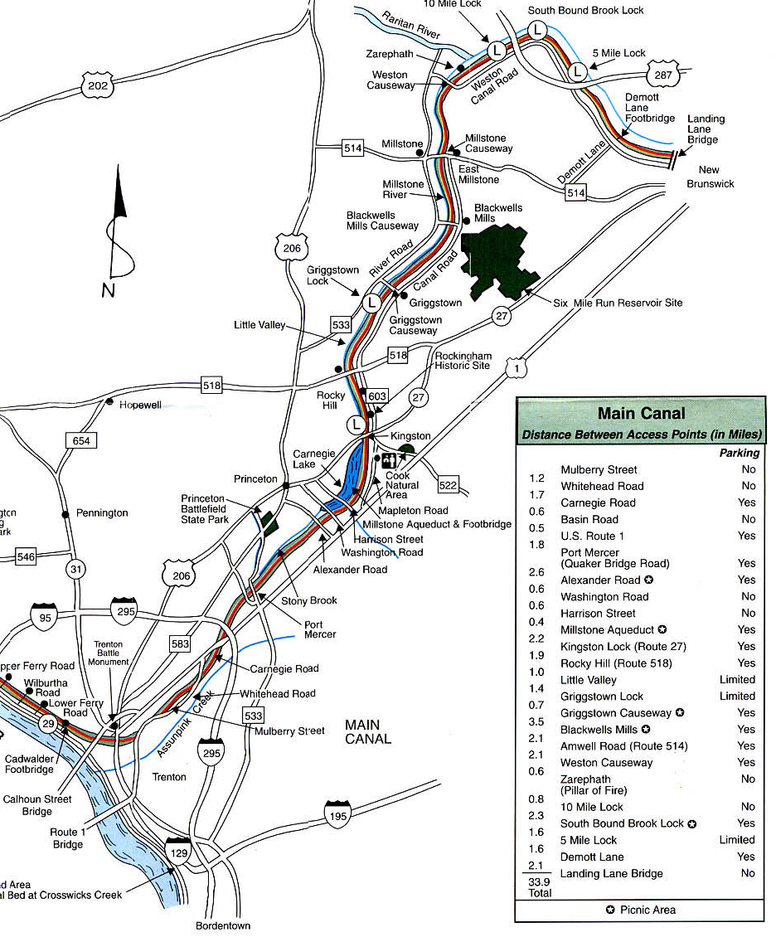

Slide 7
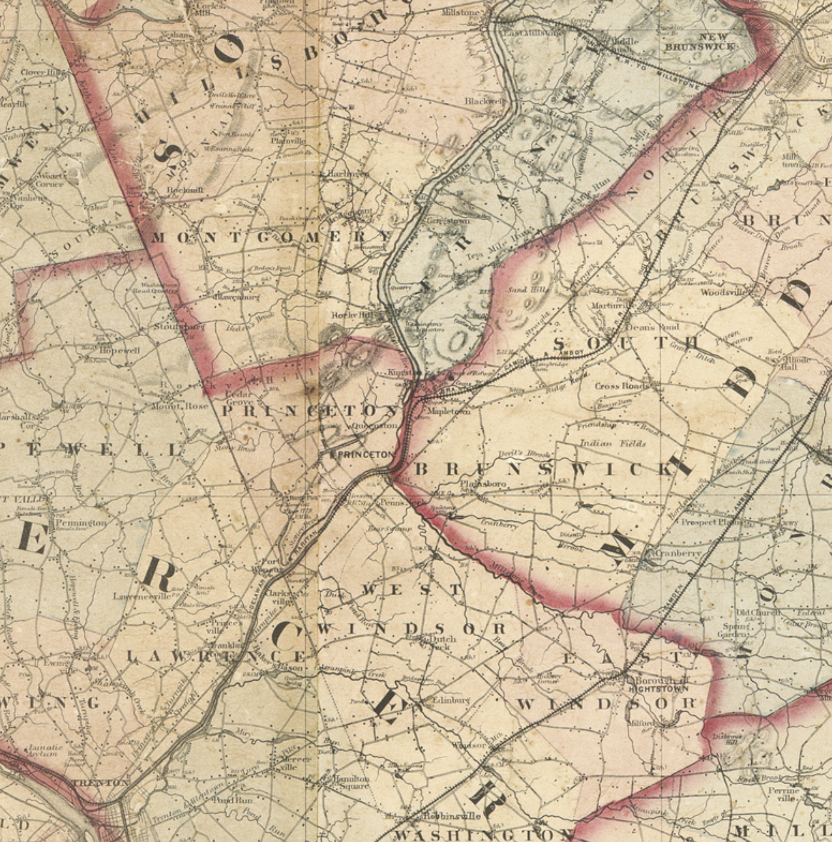

Slide 8
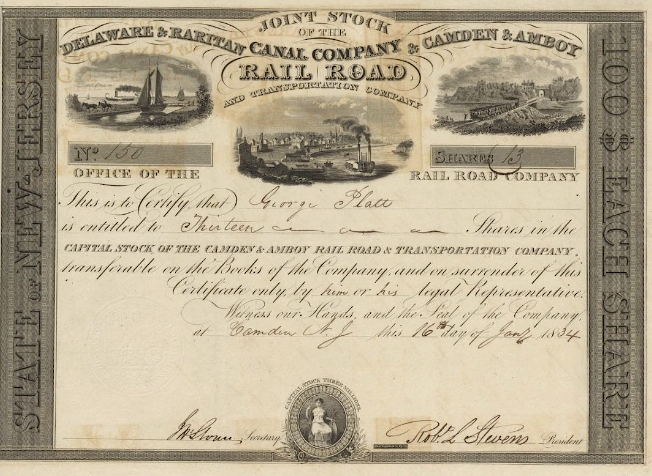

Slide 9
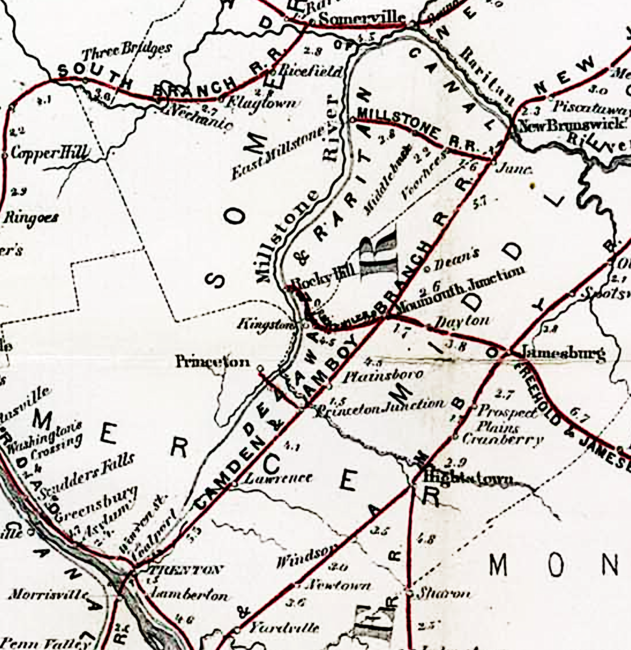

Slide 10
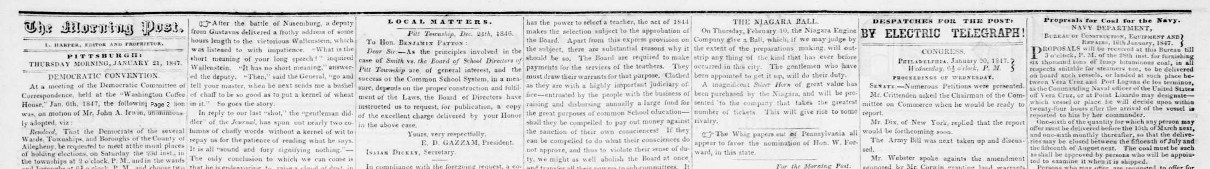
Henry, Morse, and the Telegraph
Discovery by Scientist – Design by Artist-Entrepreneur Radical Innovation: Instant news by wire from afar
1847 newspaper
Many dates – pay attention only to those in boxes
CEE 102: Prof. Michael G. Littman Course Administrator: Conghao (Kevin) Yi cy6164@princeton.edu
Computers for note-taking and course-related searches only
Notes:
MODERN DAY CONNECTIONS WITH THIS TALK
Kao – fiber optics Nobel prize – pulses of light down an optical wire rather than pulses of electricity down a metal wire
Texting – person to person telegrams
Digital (Binary) coding starts with Morse’s telegraph - it is the foundation of modern computer
Note: Morse is not the only one with a Telegraph System – his was the most successful – why was he successful?

Slide 11
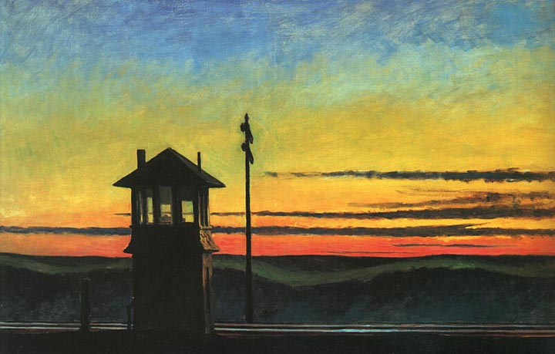
Connecting the Continent 1830 – 1883
Information - Transportation
Edward Hopper’s “Railroad Sunset”
Notes:
1883 – Central, Southern, and Northern Transcontinental Railroads completed – the country is connected
Francis Cabot Lowell and James Francis – what did they do?
Lowell – stole technology from Britain (science); integrated factory (social); young women as workers (symbolic)
Francis – designed water turbine (science); perfected the weir for measuring flow (social); built the lock gate (symbolic)
Last story was about America’s first industry and the planned factory town; Fulton and steamboat was a story of Engineering and Politics;
Today’s story is the best example of the intersection of Engineering and Art
35 year window 1830 – 1865; 1830 first telegraph and first railroad; 1861 telegraph spans US; 1869 RR spans US;
Three themes:
Scientific discovery and engineering design
Economics (private company) and Politics (role of US Congress)
Telegraphy stimulates other innovations
Begin a new time period for the course: Connecting the Continent
Edward Hopper - Telegraph pole; railroad rails; signal tower; Information and Transportation networks linked
Lots of dates – only given to sequence events – remember -> telegraph patent 1840; transcontinental line 1861
Write down text that is boxed

Slide 12
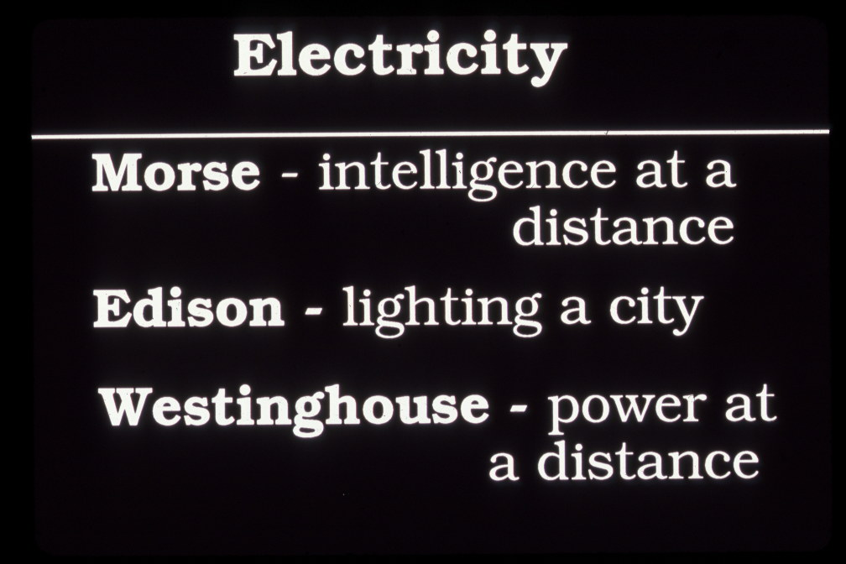
Connecting the Continent 1830 – 1883
Information - Transportation
Marconi – wireless global telegraphy
Edward Hopper’s “Railroad Sunset”
Notes:
INFORMATION - Telegraph – first large scale electrical engineering project in America
POWER Electric Light and Power – second large scale electrical project in America

Slide 13
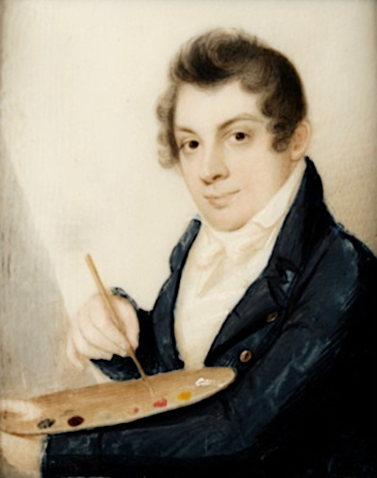
Marconi – wireless global telegraphy
Morse by Morse
Notes:
Yalie class of 1810

Slide 14
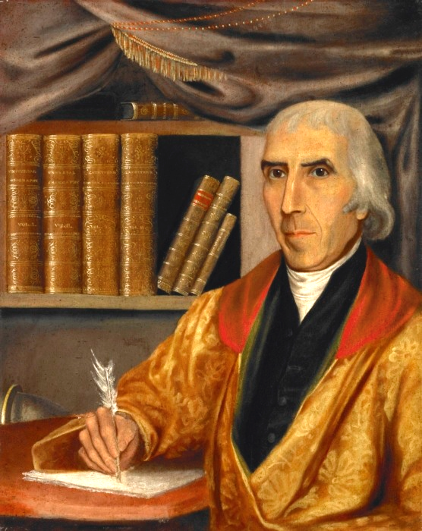
Morse by Morse
Jed Morse (Father - Geographer) by Morse
Notes:
Jedidiah Morse, Geographer – friend of Noah Webster – wrote standard Geography textbook

Slide 15
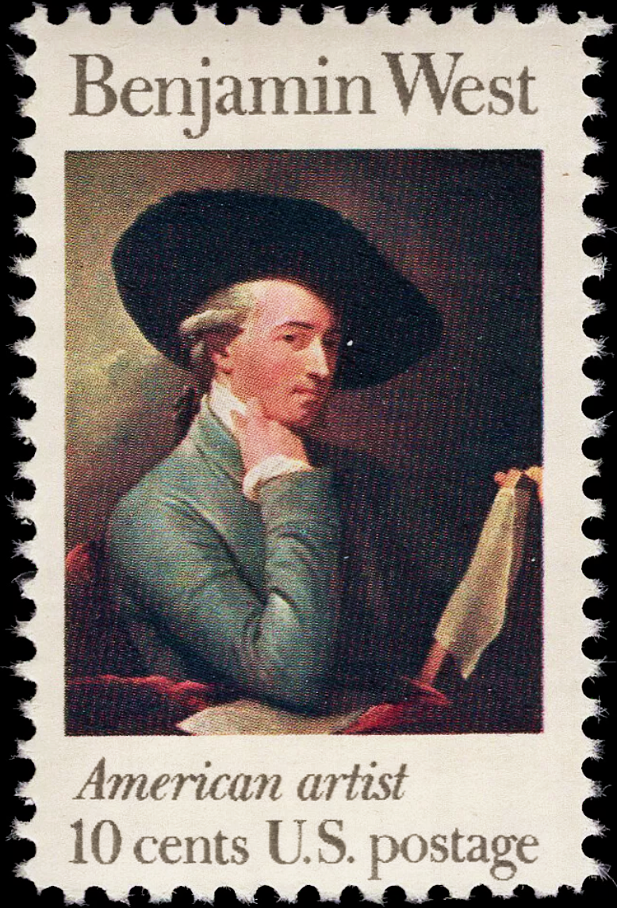
Morse by Morse
West by West
Notes:
Studies with West in 1812

Slide 16
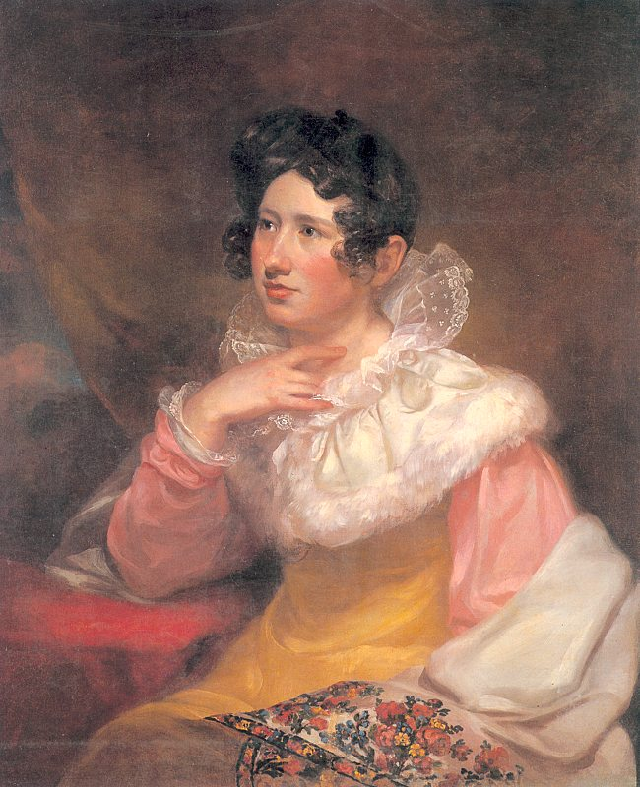
Morse by Morse
Lucretia Morse (his wife) by Morse
Notes:
Wife Lucretia – stylishly dressed – Morse’s mother help with wardrobe; Charleston SC

Slide 17
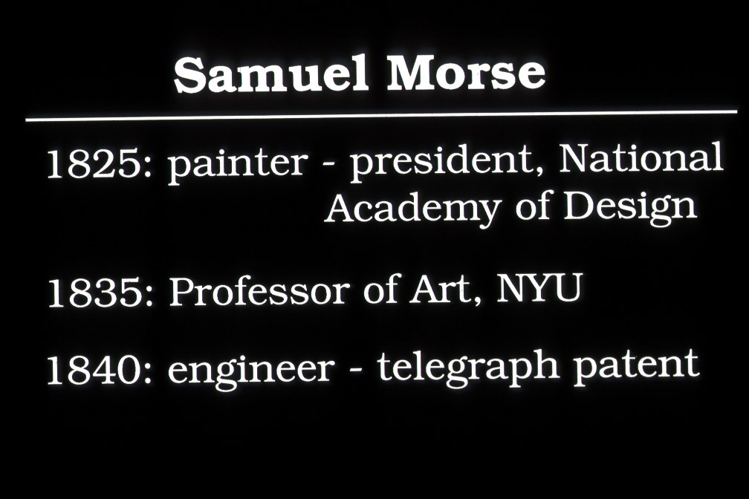
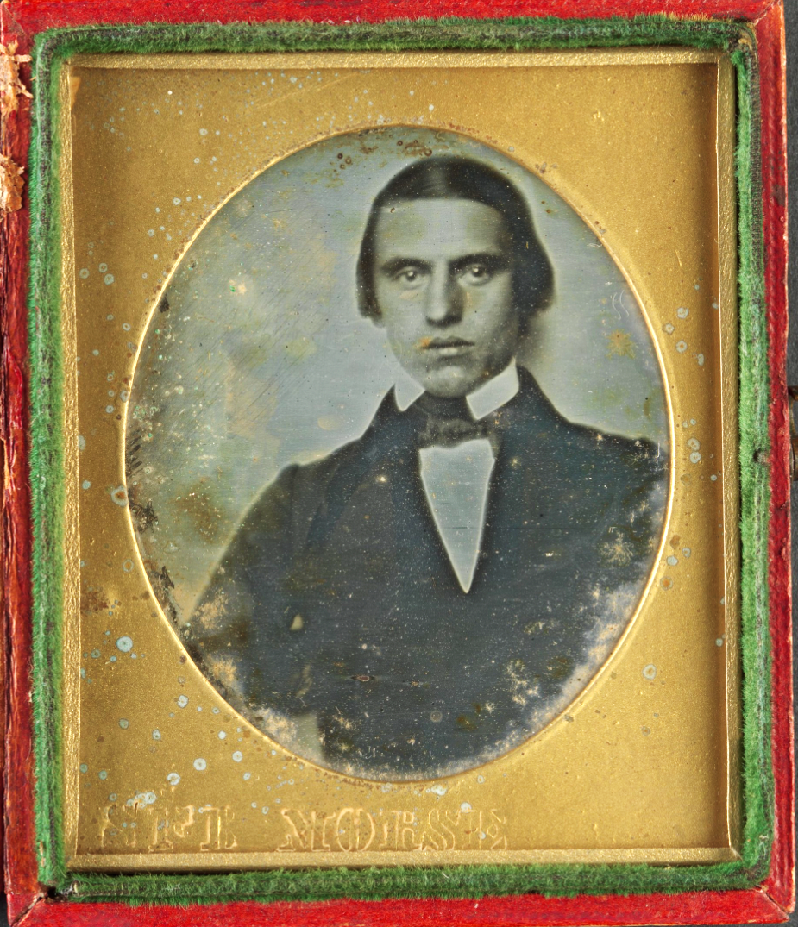
Aside – in 1840 Morse also introduces Photography into America
Morse daguerreotype at the Metropolitan Museum of Art
20-30 minute exposure of unknown sitter
Morse by Morse

Slide 18
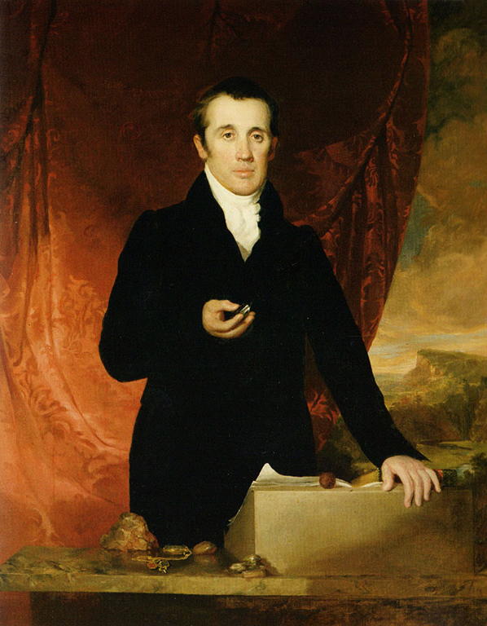
Aside – in 1840 Morse also introduces Photography into America
Morse daguerreotype at the Metropolitan Museum of Art
20-30 minute exposure of unknown sitter
Morse’s painting of his Yale geology professor Benjamin Silliman

Slide 19
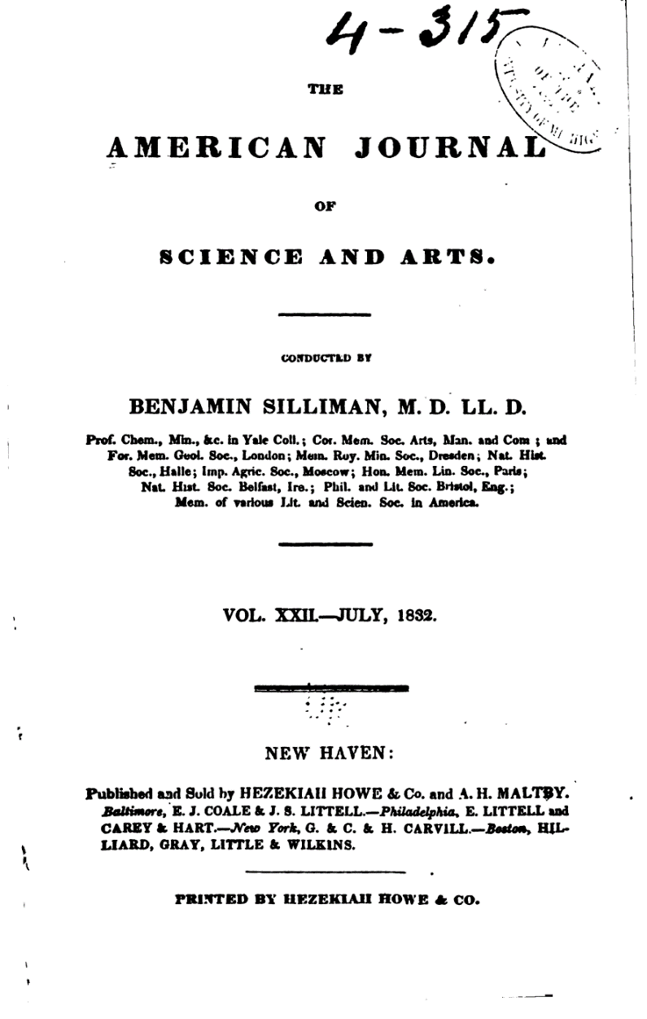
Morse’s painting of his Yale geology professor Benjamin Silliman
Silliman’s Journal of Science
Notes:
Lucretia dies in 1825; Father dies in 1826; Mother dies in 1828; 1829-32 goes to Europe

Slide 20
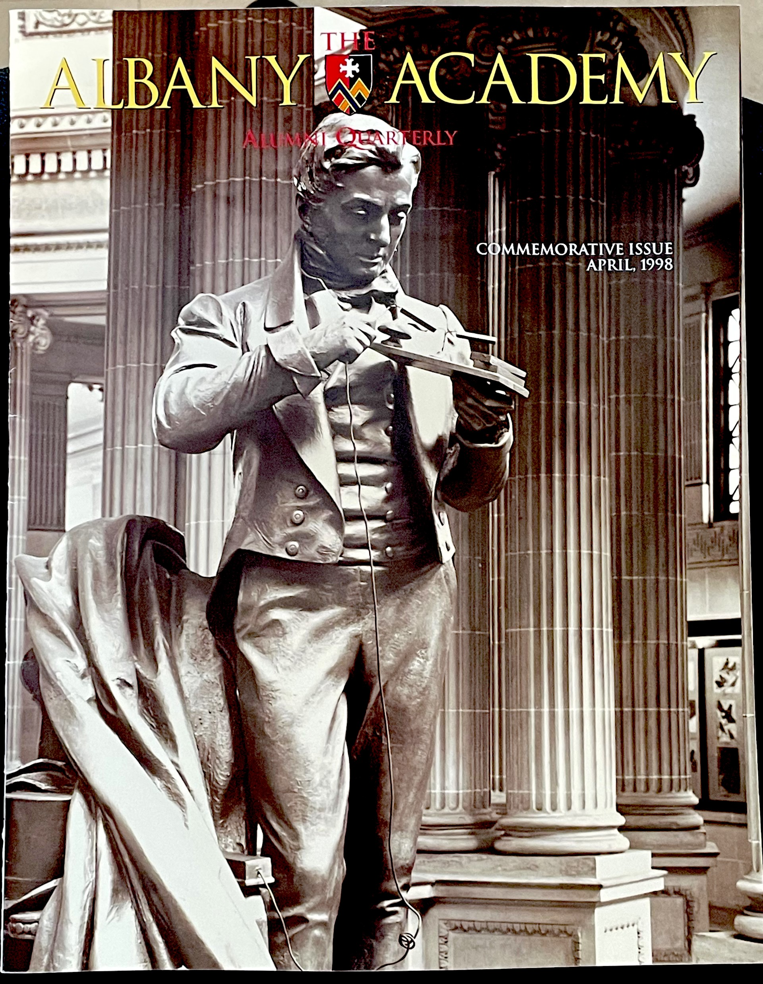
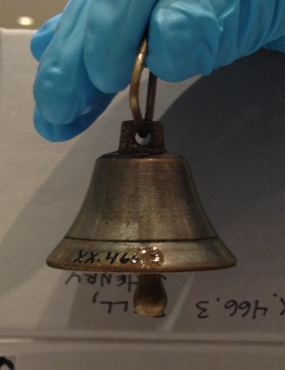
High School Teacher Joseph Henry holding sounding telegraph
Silliman’s Journal of Science

Slide 21
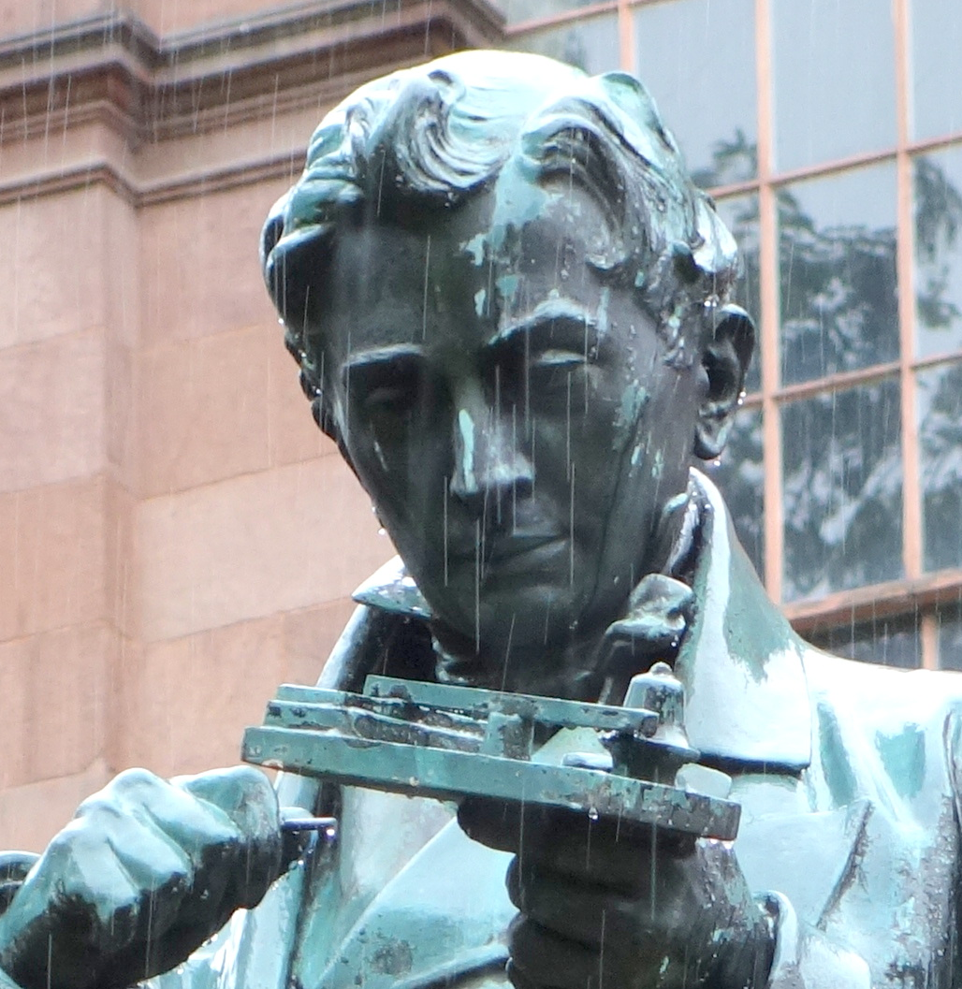
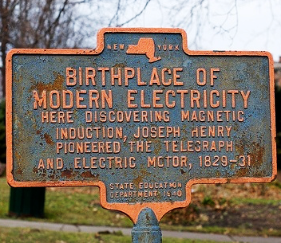
High School Teacher Joseph Henry holding sounding telegraph
APPLICATION OF … GALVANIC MULTIPLIER TO ELECTRO -MAGNETIC APPARATUS …
Silliman 's American Jour. of Science, January, 1831, vol.xix , pp.400 - 408.)
Notes:
Historical marker in downtown Albany, NY, in Academy Park, on Central Avenue and across the street from the State Capitol

Slide 22
Telegraph - Discovery
Electricity linked to Magnetism
First Horseshoe Electromagnet
Henry’s Strong Electromagnet and Sounding Telegraph
1832 Henry comes to Princeton
High School Teacher Joseph Henry holding sounding telegraph

Slide 23
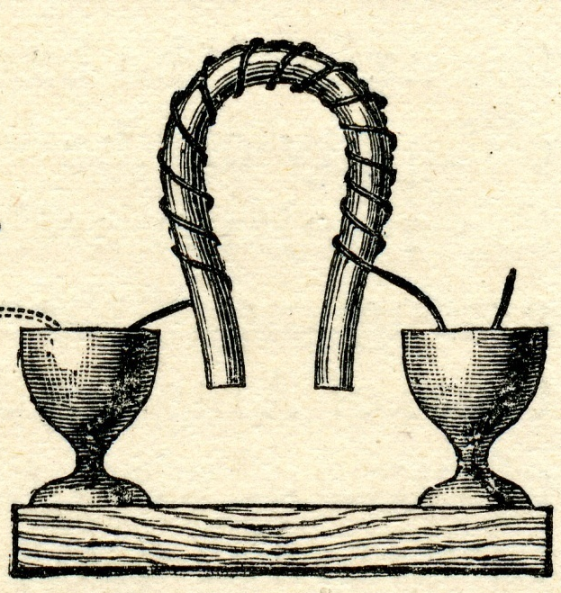
Telegraph - Discovery
Electricity linked to Magnetism
First Horseshoe Electromagnet
Henry’s Strong Electromagnet and Sounding Telegraph
1832 Henry comes to Princeton
Electromagnet in circuit with two copper-zinc-acid batteries and on-off switch

Slide 24
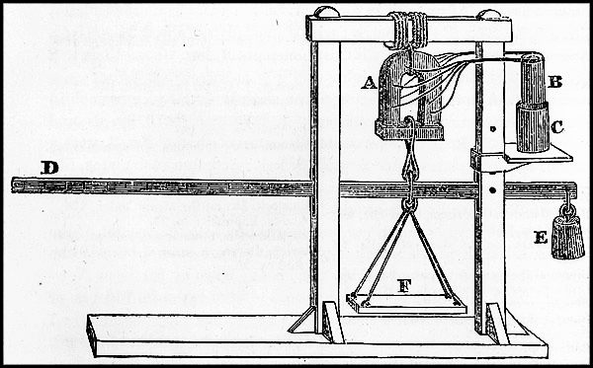

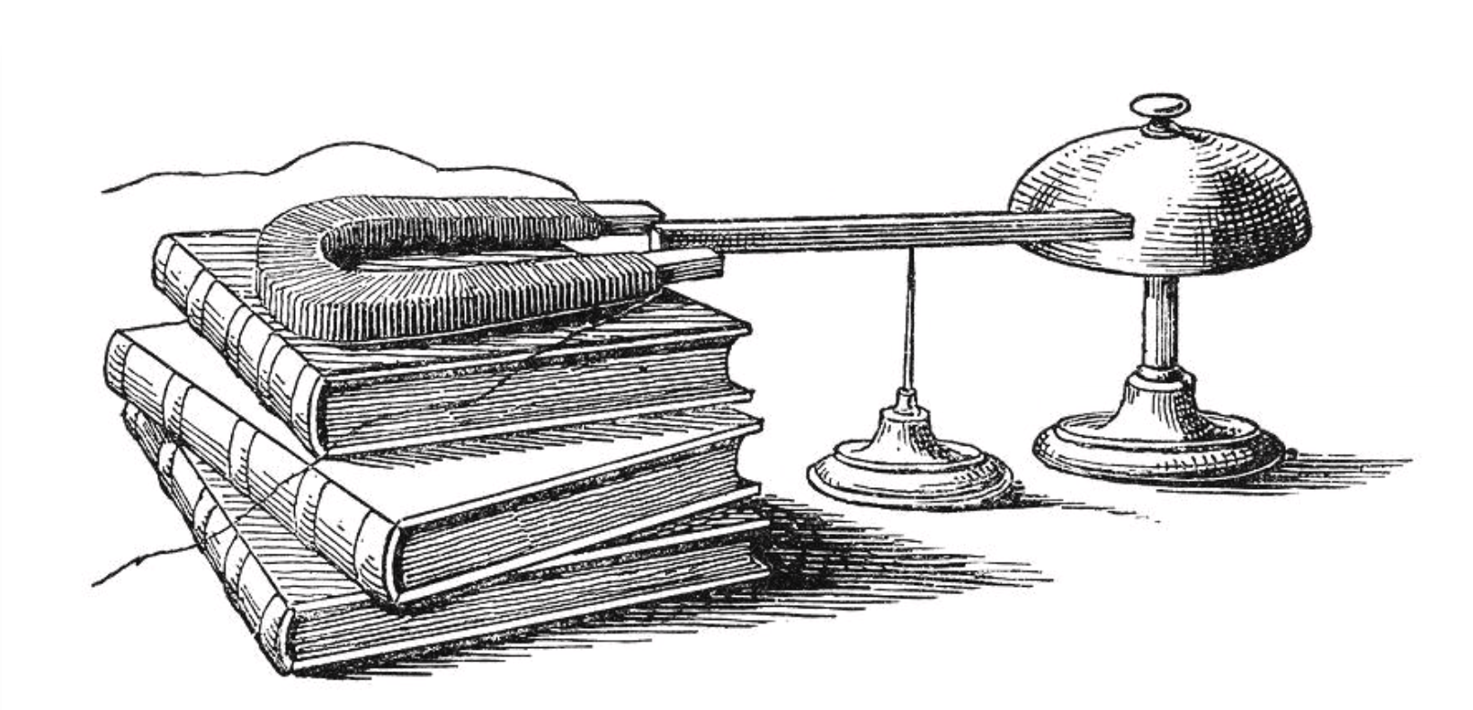
Telegraph - Discovery
Electricity linked to Magnetism
First Horseshoe Electromagnet
Henry’s Strong Electromagnet and Sounding Telegraph
1832 Henry comes to Princeton
Magnetic Field

Slide 25
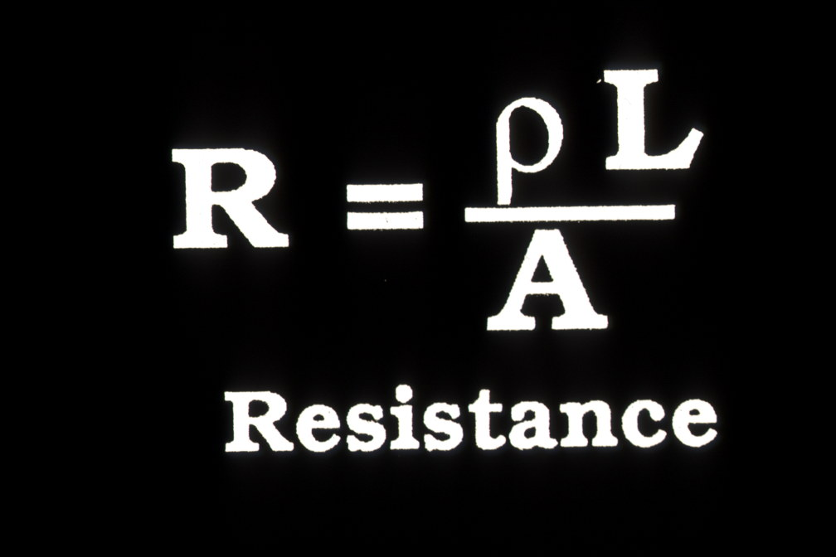
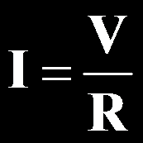
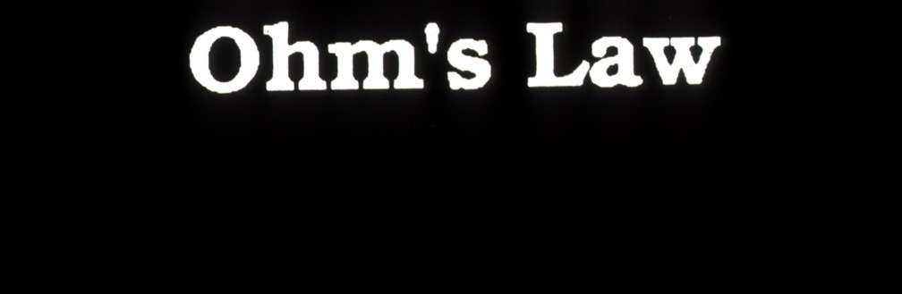
Magnetic Field

Slide 26
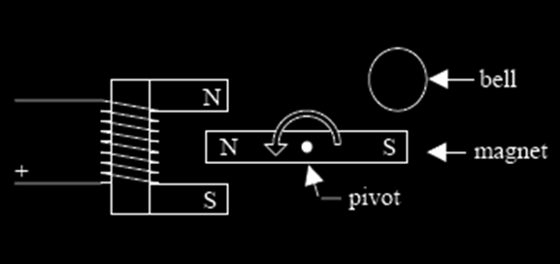
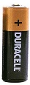
battery
Magnetic Field

Slide 27
battery
Magnetic Field
How does Henry’s sounding telegraph work?
Poles in horseshoe electromagnet reverse when current is reversed

Slide 28
battery
The longer the path, the greater the resistance
Magnetic Field
The greater the current, the stronger the strike – high voltage overcomes high resistance of the long lines
The greater the voltage, the greater the current

Slide 29
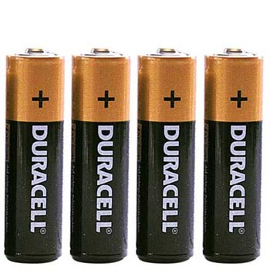
battery
Parallel – more available current
Magnetic Field
The greater the current, the stronger the strike – high voltage overcomes high resistance of the long lines
1 volt and
up to 1 amp
Series – greater voltage

Slide 30
“ The electro-magnetic telegraph was invented by me in Albany in 1830.”
“I think that the first actual line of telegraph using the earth as a conductor was made in the beginning of 1836. A wire was extended across the front campus of the College grounds from the upper story of the Library building to the Philosophical Hall on the opposite side, the ends terminating in two wells. Through this wire, signals were sent from time to time from my house to my laboratory.”
battery
Magnetic Field
The greater the current, the stronger the strike – high voltage overcomes high resistance of the long lines
- Joseph Henry

Slide 31
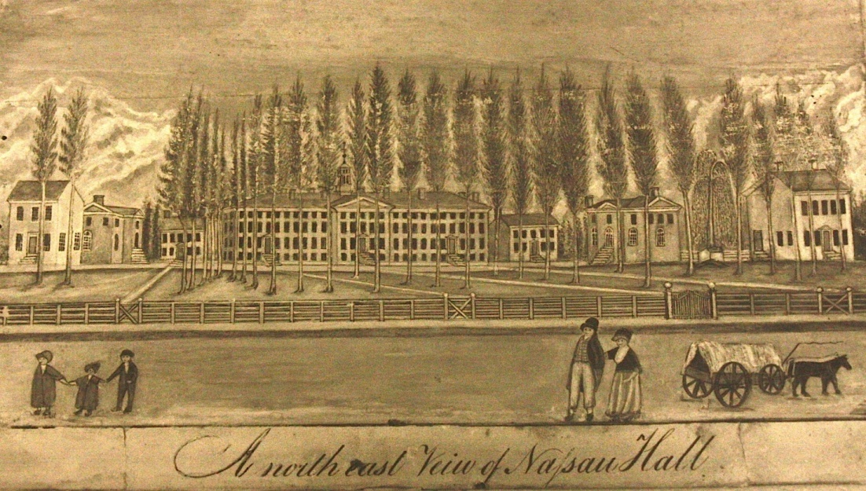
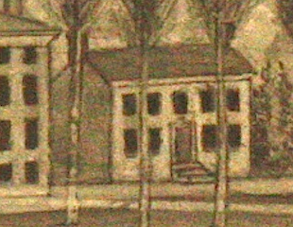

Philosophical Hall
Library
“ The electro-magnetic telegraph was invented by me in Albany in 1830.”
“I think that the first actual line of telegraph using the earth as a conductor was made in the beginning of 1836. A wire was extended across the front campus of the College grounds from the upper story of the Library building to the Philosophical Hall on the opposite side, the ends terminating in two wells. Through this wire, signals were sent from time to time from my house to my laboratory.”
- Joseph Henry
Joseph Henry’s House in 1836

Slide 32
Philosophical Hall
Library
Telegraph - Design
1832 – Morse’s shipboard idea
1836 – Gale and Vail help out
1838 – Morse shows Van Buren
1842 – Henry helps Morse
Joseph Henry’s House in 1836

Slide 33
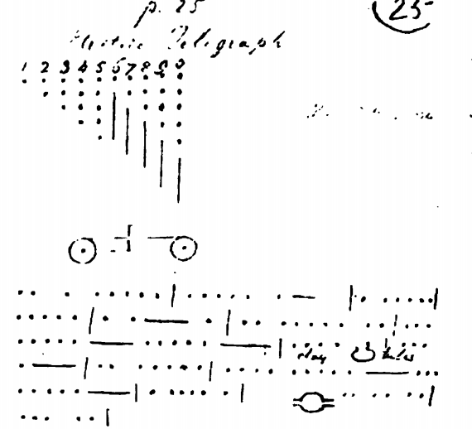
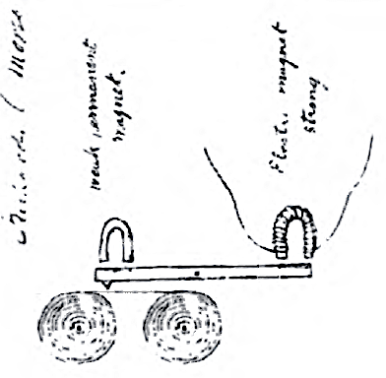
CODE
Telegraph - Design
1832 – Morse’s shipboard idea
1836 – Gale and Vail help out
1838 – Morse shows Van Buren
1842 – Henry helps Morse
PRINTER

Slide 34
CODE
Telegraph - Design
1832 – Morse’s shipboard idea
1836 – Gale and Vail help out
1838 – Morse shows Van Buren
1842 – Henry helps Morse
Digital signals in use today – WiFi, Ethernet

Slide 35
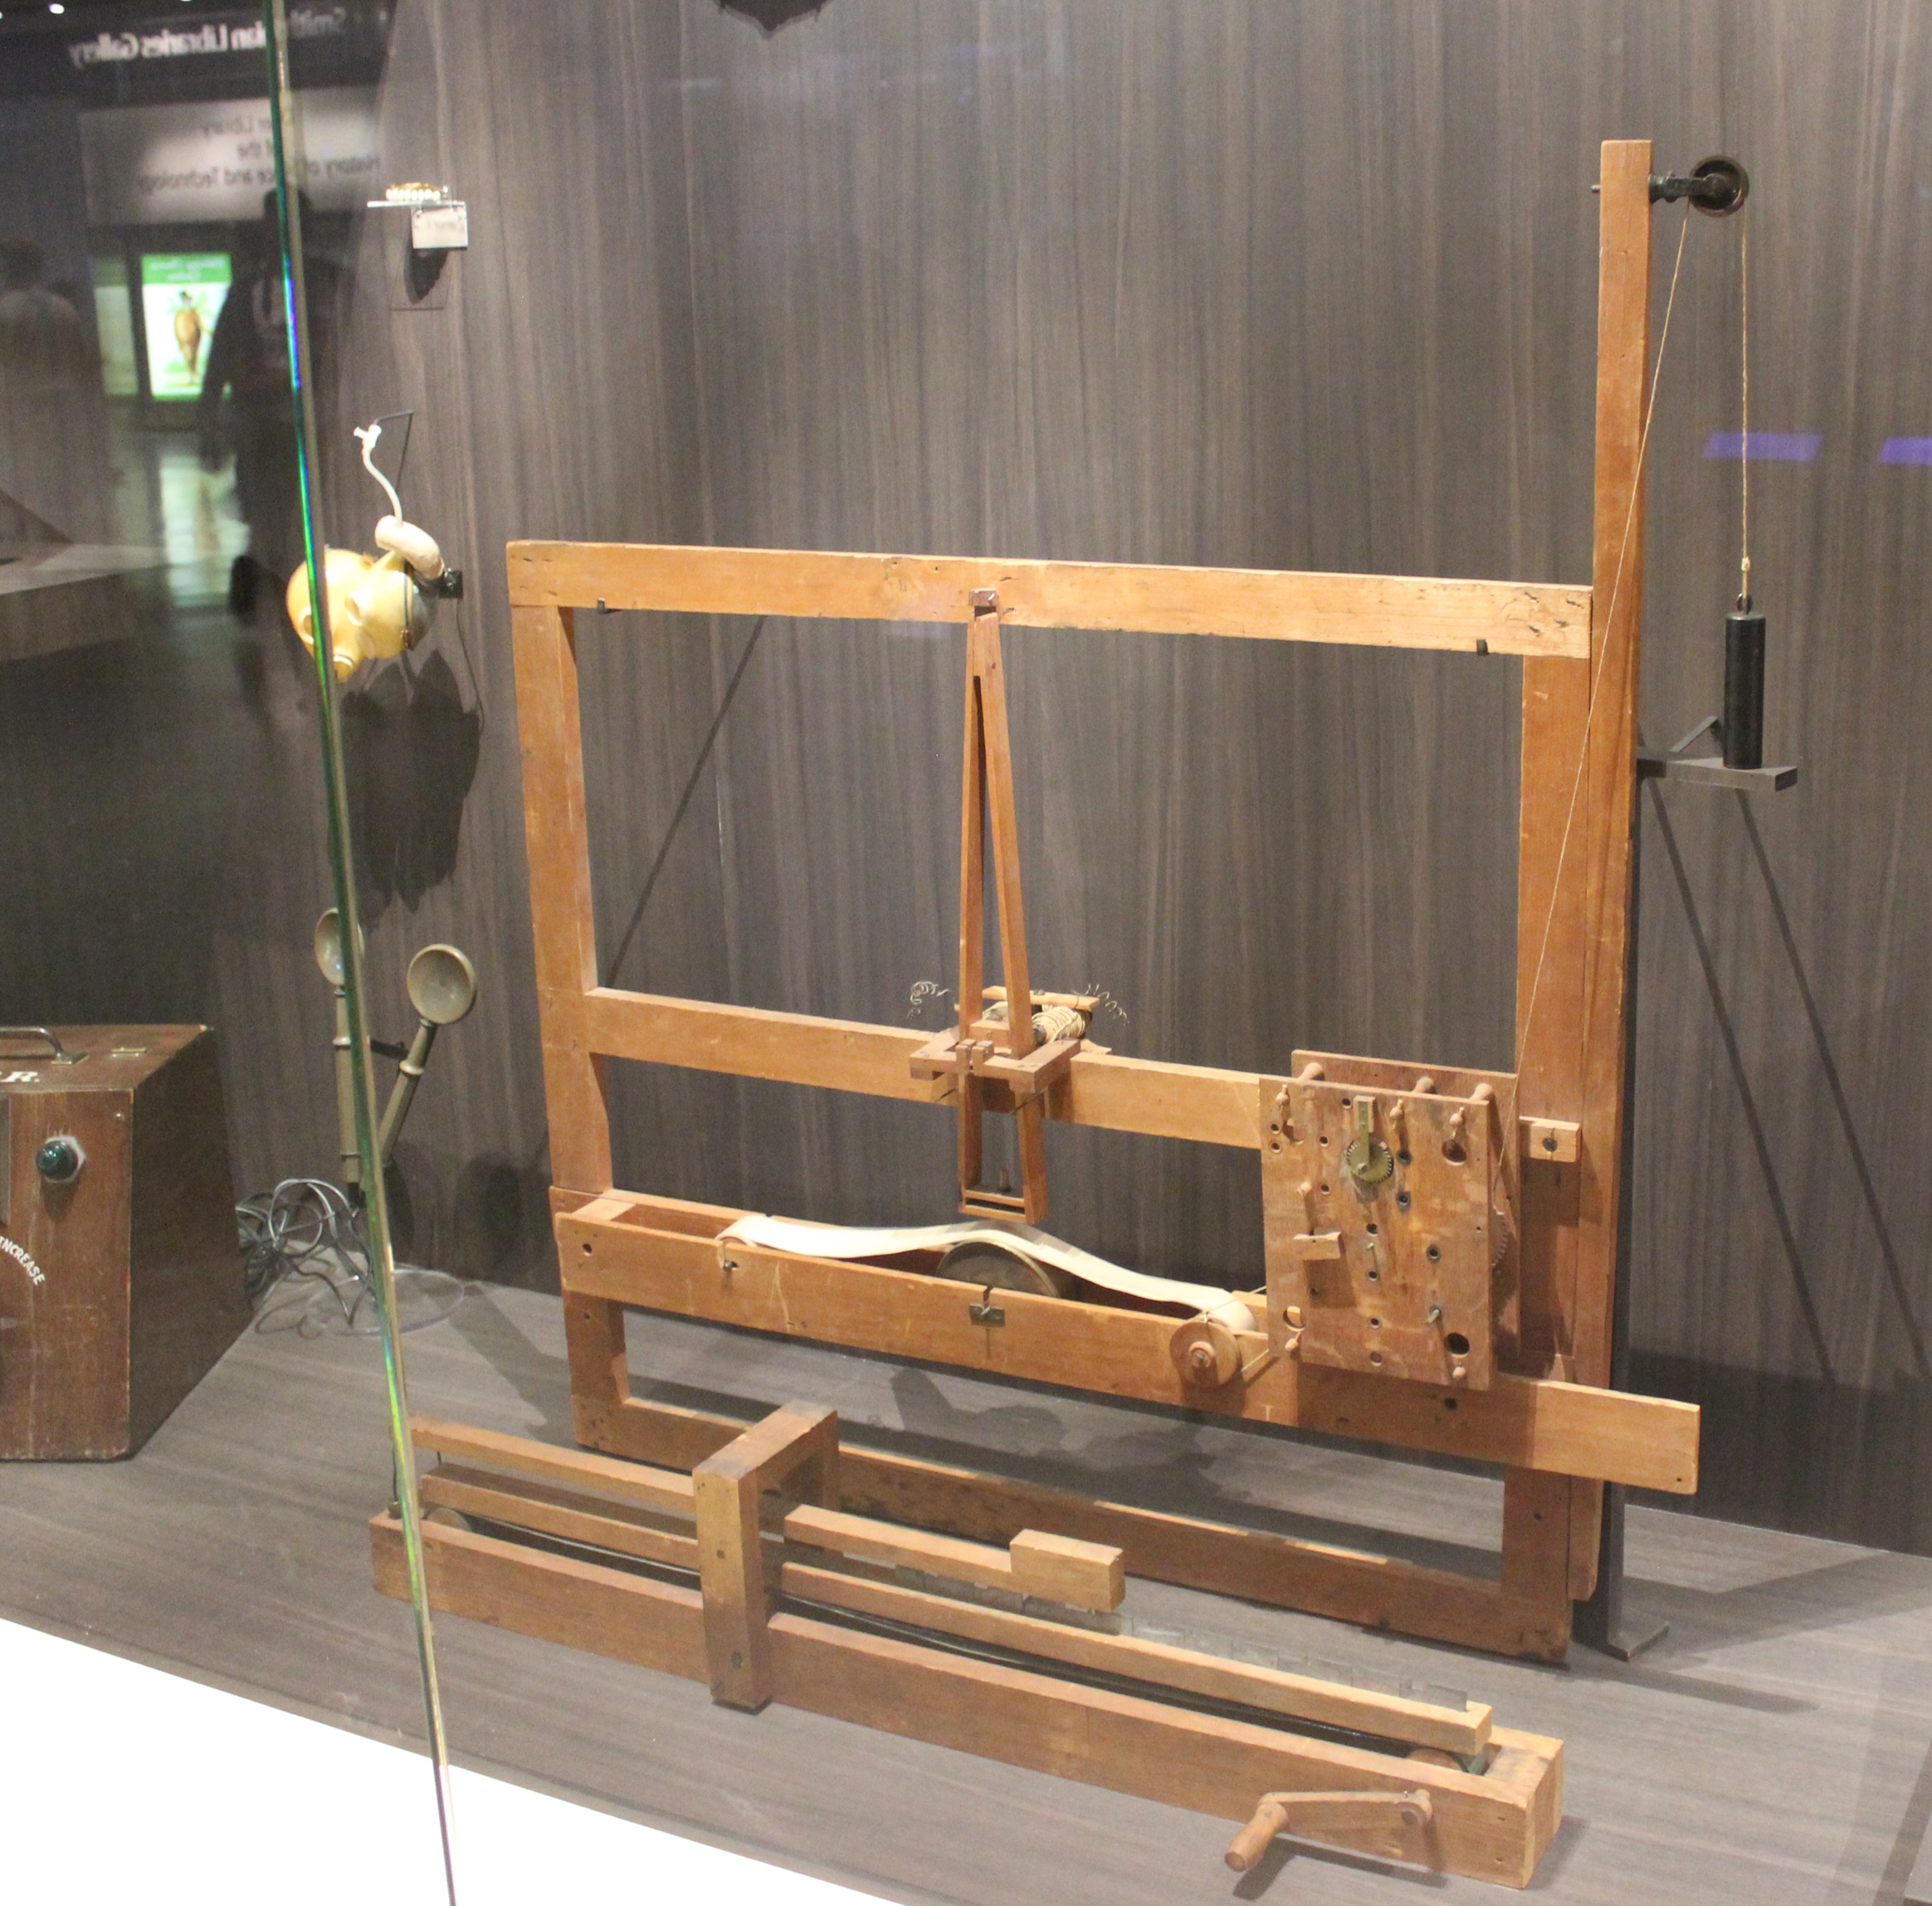
Telegraph - Design
1832 – Morse’s shipboard idea
1836 – Gale and Vail help out
1838 – Morse shows Van Buren
1842 – Henry helps Morse
Morse’s original telegraph on display at the Smithsonian

Slide 36
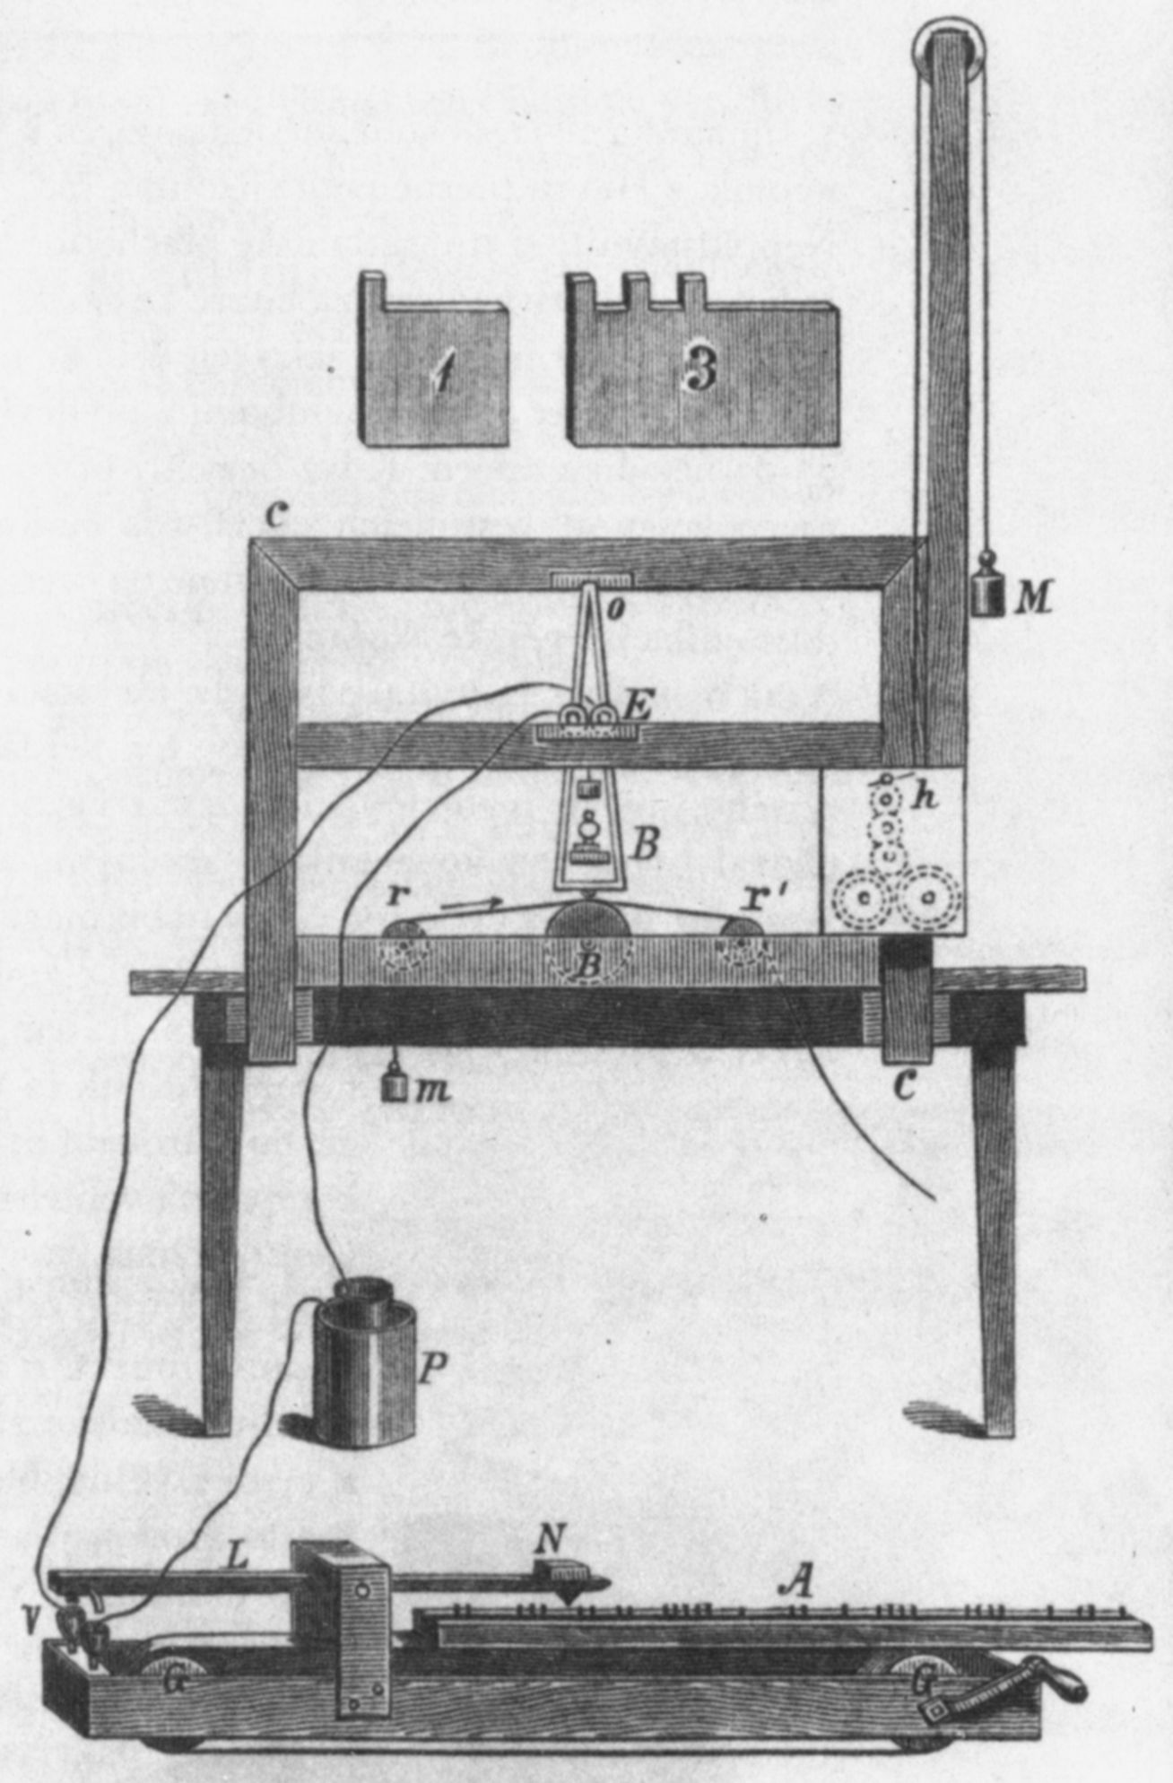
MORSE’S PRINTING TELEGRAPH
Telegraph - Design
1832 – Morse’s shipboard idea
1836 – Gale and Vail help out
1838 – Morse shows Van Buren
1842 – Henry helps Morse

Slide 37
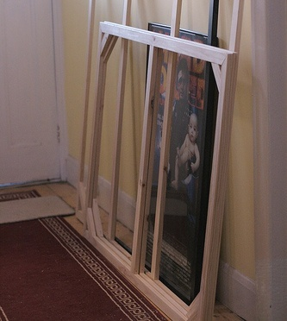
MORSE’S PRINTING TELEGRAPH
ARTIST’S CANVAS STRETCHER

Slide 38
MORSE’S PRINTING TELEGRAPH
Copper-Zinc Battery (Galvanic Cell)

Slide 39
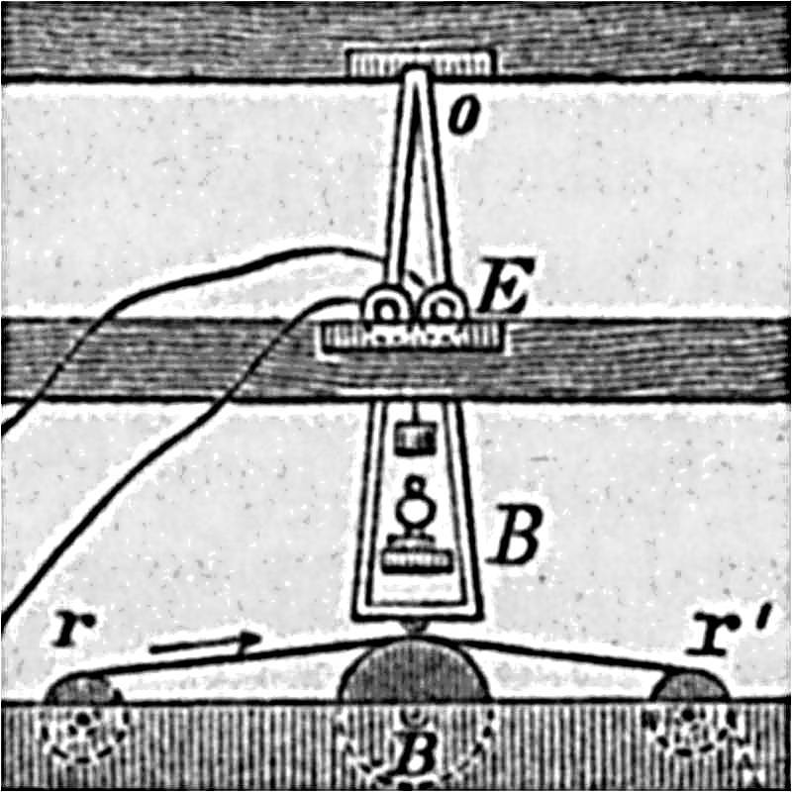
MORSE’S PRINTING TELEGRAPH
ELECTROMAGNET
PEN HOLDER FRAME DEFLECTED BY ELECTROMAGNET
PEN
MOVING PAPER TAPE

Slide 40
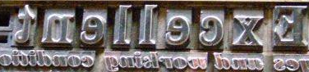
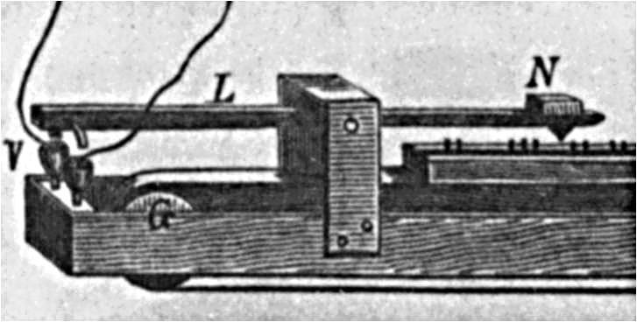
MORSE’S PRINTING TELEGRAPH
MOVEABLE TYPE HOLDER
CONTACTS USING MERCURY

Slide 41
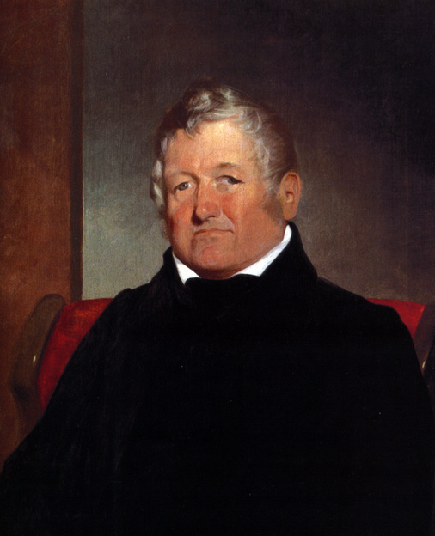
MOVEABLE TYPE HOLDER
Judge Vail – Morse Investor
Alfred Vail – Morse Partner
CONTACTS USING MERCURY

Slide 42
Telegraph - Design
1832 – Morse’s shipboard idea
1836 – Gale and Vail help out
1838 – Morse shows Van Buren
1842 – Henry helps Morse
Judge Vail – Morse Investor
Alfred Vail – Morse Partner

Slide 43
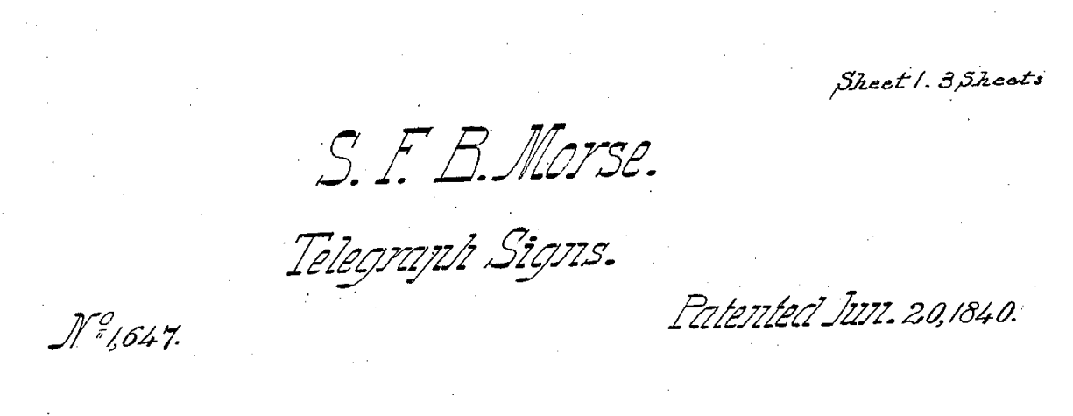
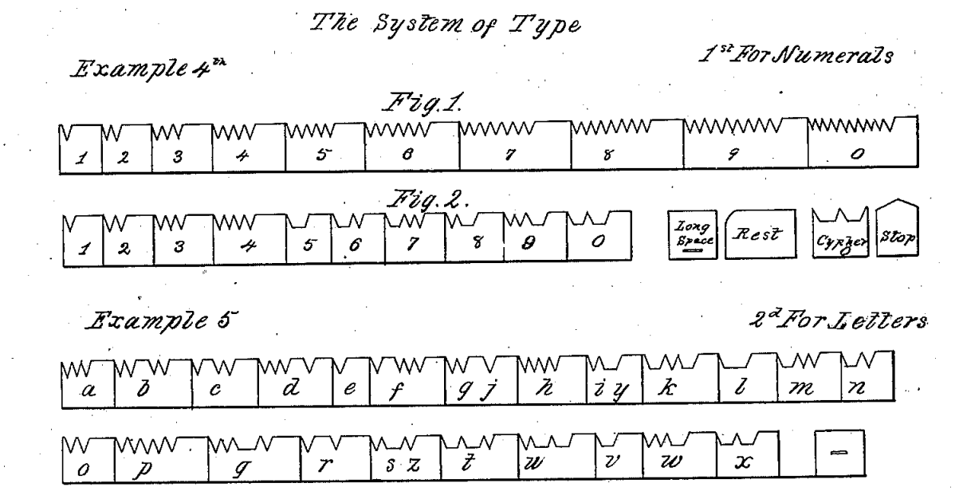
Morse patents a Binary Code
Judge Vail – Morse Investor
Alfred Vail – Morse Partner

Slide 44
TELEGRAPH - Early
Congress - $30,000 to Morse
Morse - hires Vail & Cong. Smith
Smith - hires Ezra Cornell
38 miles connecting Baltimore to Washington
Morse patents a Binary Code

Slide 45
TELEGRAPH - Early
Congress - $30,000 to Morse
Morse - hires Vail & Cong. Smith
Smith - hires Ezra Cornell
38 miles connecting Baltimore to Washington
Telegraph Wires along B&O RR Right-of-Way

Slide 46
TELEGRAPH - Early
Congress - $30,000 to Morse
Morse - hires Vail & Cong. Smith
Smith - hires Ezra Cornell
38 miles connecting Baltimore to Washington
Ezra Cornell
Notes:
On May 24, 1844, Samuel F. B. Morse dispatched the first telegraphic message over an experimental line from Washington, D.C. to Baltimore. The message, taken from the Bible, Numbers 23:23 and recorded on a paper tape, had been suggested to Morse by Annie Ellworth, the young daughter of a friend who also was the head of the US Patent Office.

Slide 47
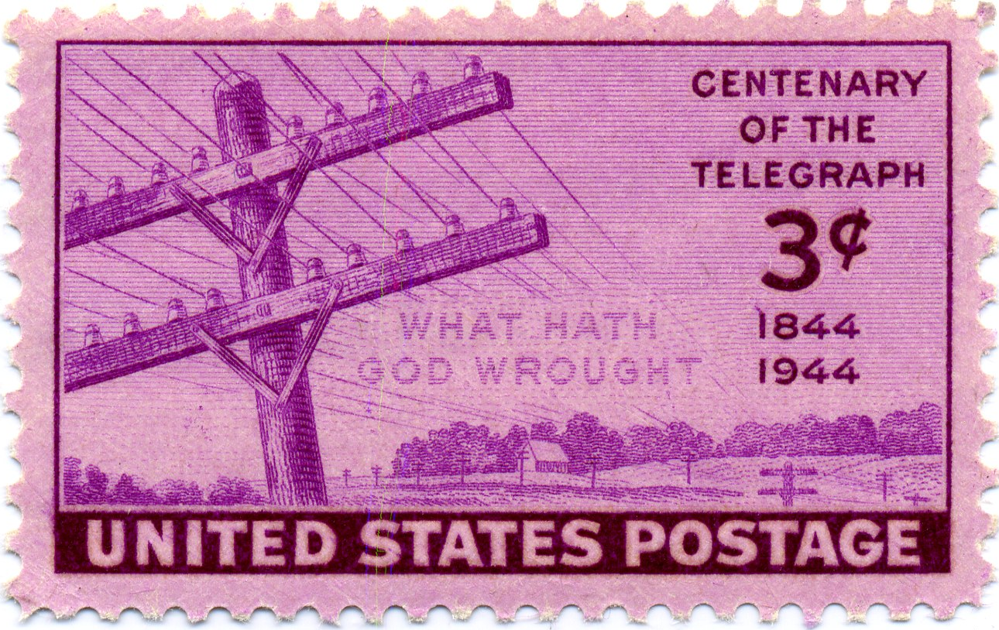
May 24, 1844 at 8:45am
● ▬ ▬ ● ● ● ●
Ezra Cornell
MORSE CODE – dots and dashes embossed on moving tape

Slide 48
Science and Engineering
Discovery Scientist rings bell at a distance
Development Gov’t Grant, Private Company
Design Artist gives telegraph language and plans wide-area network
May 24, 1844 at 8:45am
● ▬ ▬ ● ● ● ●
MORSE CODE – dots and dashes embossed on moving tape

Slide 49
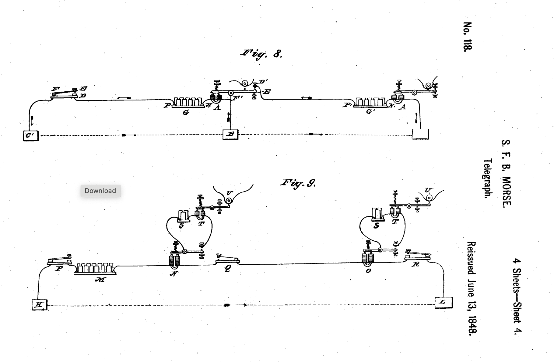
May 24, 1844 at 8:45am
Morse Relay USRE118 in 1848
● ▬ ▬ ● ● ● ●
MORSE CODE – dots and dashes embossed on moving tape

Slide 50
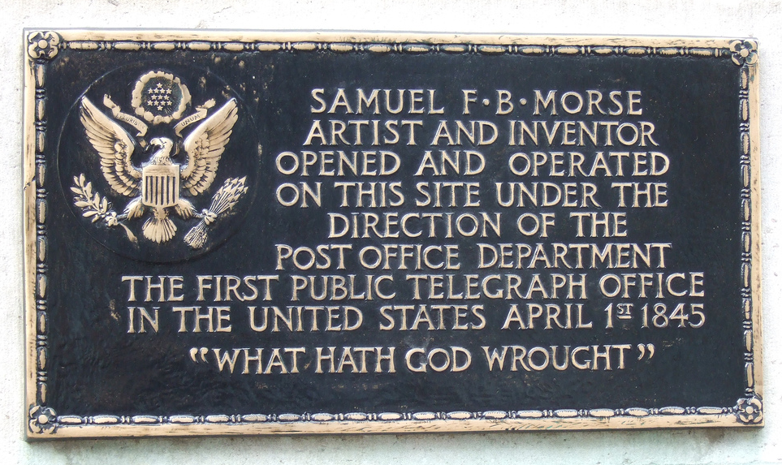
7th and E St, Washington, DC Morse idea - replace Post Office
Morse Relay USRE118 in 1848

Slide 51

7th and E St, Washington, DC Morse idea - replace Post Office
Telegraph Lines in 1853
CONNECTING CITIES
Notes:
Turners, NY (Now Harriman) to Port Jervis, NY was the first time that Telegraph signals were used to control trains. See Innovators chapter on Telegraph.

Slide 52
TELEGRAPH - Later
1845 – independent companies; wire services; patent disputes
1856 – Western Union – Cornell becomes the major stockholder
1861 – Western Union completes Transcontinental Telegraph Line
1872 – Stearns invents Duplex Telegraph
Port Jervis
Telegraph Lines in 1853
CONNECTING CITIES
Notes:
Companies in 1853 – Library of Congress

Slide 53



TELEGRAPH - Later
1845 – independent companies; wire services; patent disputes
1856 – Western Union – Cornell becomes the major stockholder
1861 – Western Union completes Transcontinental Telegraph Line
1872 – Stearns invents Duplex Telegraph

Slide 54

TELEGRAPH - Later
1845 – independent companies; wire services; patent disputes
1856 – Western Union – Cornell becomes the major stockholder
1861 – Western Union completes Transcontinental Telegraph Line
1872 – Stearns invents Duplex Telegraph
CONNECTING THE CONTINENT
Pacific Telegraph Act of 1860
(Pony Express ends service)
Notes:
The first transcontinental telegraph line was built in 1861 by the Western Union Telegraph Company. The line extended from Omaha, Nebraska to Carson City, Nevada and was the first high-speed link between California and the rest of the United States. It reached the West Coast eight years in advance of the transcontinental railroad. The original line was operated until May 1869 when the transcontinental railroad was completed and the telegraph lines were then moved to follow its route. The laying of the transcontinental telegraph line. Although the telegraph ushered in the age of instantaneous, global communications, laying the line was quite a primitive feat. Donkeys and wagons were used to bring in equipment and supplies such as wire and insulators.The telegraph, invented by Samuel Morse in the 1830s, was a major advance in the speed of communications. Before its invention, the time it took to send a message depended on the speed of horses or ships. For instance, it took 45 days to send a message from New York to San Francisco by ship, and over 20 days to send a message by overland stagecoach from St. Louis to San Francisco. The famous Pony Express took 11 days from St. Joseph, Missouri to Sacramento, California.
Just before the start of the Civil War, Congress offered a subsidy to any company agreeing to build the transcontinental telegraph. The project was so risky that government support was necessary to convince investors to undertake it. On 20 September 1860, Hiram Sibley, president of Western Union, submitted a bid for $40,000 to build the line. Building began in Salt Lake City, Utah and moved both east and west. The Pony Express continued to cover the missing links as construction proceeded. The wire used was galvanized iron “of the best quality.” Insulators were an iron holder embedded in glass which in turn were enclosed in wooded forms. Poles were to be found “en route” (not so easily accomplished on the treeless plain). Western end materials were shipped around the Cape Horn to San Francisco. A wet cell provided 50 volts of power over a distance of 800 km (497 miles), which was unusually long because of low leakage due to low humidity.
The line was finished in October, 1861, just a few months after the onset of the Civil War. On 24 October, Stephen J. Field, Chief Justice of California and brother of Atlantic cable promoter Cyrus Field, sent a message to Abraham Lincoln assuring him of California’s loyalty to the Union and promising that the telegraph line would “be the means of strengthening the attachment which binds both the East and the West to the Union.” Like the advent of many technologies, the age of the telegraph signaled the demise of previous methods of communication. Once the telegraph connected the United States the famed and legendary Pony Express discontinued service.

Slide 55


TELEGRAPH - Later
1845 – independent companies; wire services; patent disputes
1856 – Western Union – Cornell becomes the major stockholder
1861 – Western Union completes Transcontinental Telegraph Line
1872 – Stearns invents Duplex Telegraph
US Capitol in 1861
Smithsonian Castle in 1862
Notes:
US Capitol in 1861

Slide 56

Ben Franklin
Joseph Henry
Peter Cooper
US Capitol in 1861
Telegraph Register
Samuel Morse
Smithsonian Castle in 1862
Christian Schussele’s “Men of Progress”

Slide 57


Ben Franklin
Joseph Henry
Peter Cooper
Telegraph Register
Samuel Morse
Christian Schussele’s “Men of Progress”

Slide 58


Ben Franklin
Joseph Henry
Peter Cooper
Vail telegraph register at Cornell
Telegraph Register
SIBLEY COLLEGE at CORNELL
Samuel Morse
Christian Schussele’s “Men of Progress”

Slide 59


Vail telegraph register at Cornell
SIBLEY COLLEGE at CORNELL
Mathew Brady daguerreotype of his photography teacher, Samuel Morse
Notes:
College of Engineering has Vail register – purchased with funds from Sibley and Cornell

Slide 60





Telegraphers
Mathew Brady daguerreotype of his photography teacher, Samuel Morse
Notes:
Steam Engine stimulates Fulton, Stephenson, Ford

Slide 61
Telegraphers
Key Ideas
Scientific Strong Electromagnet Binary (dot-dash) Code
Social Government Investment Private Telegraph Company Wire Services inform Public
Symbolic Artist as Innovator

