Slide 1
Front Fork Assembly
Alison, Amber, Brandon, Cordi, Victoria
Notes:
Speaker: Victoria
Someone can change the theme please its kinda ugly rn lol -Amber

Slide 2
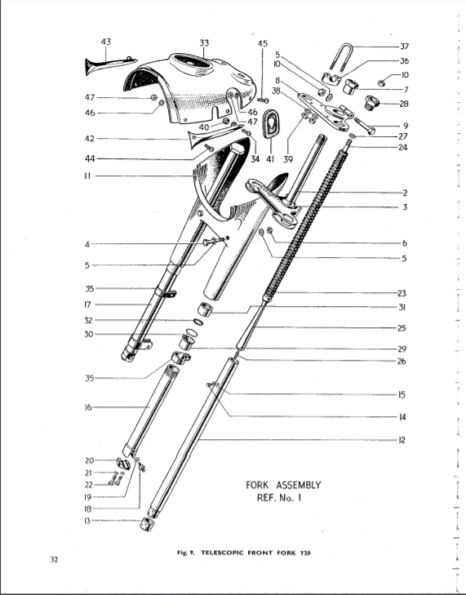
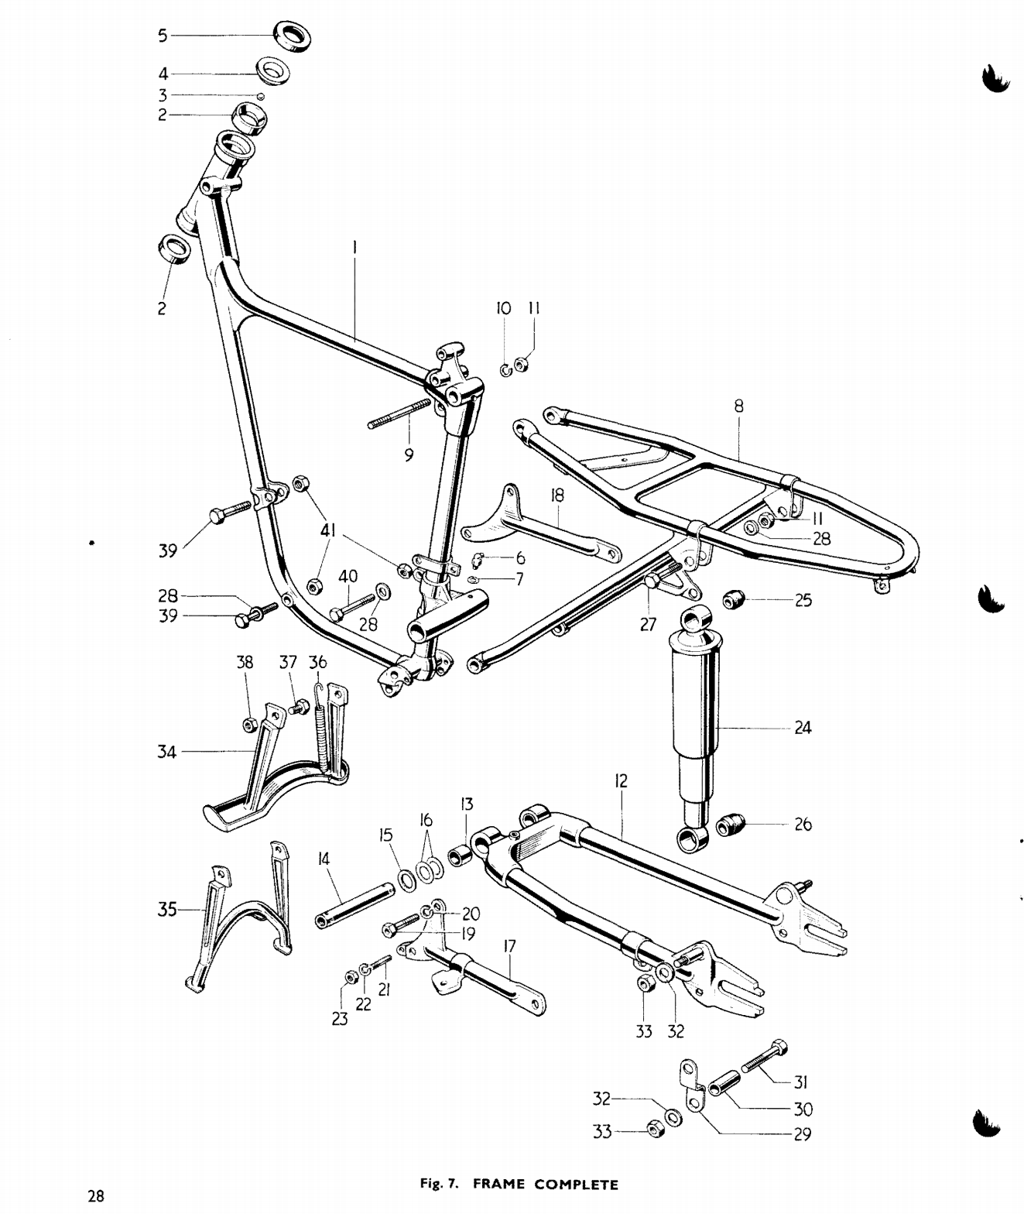
Notes:
Speaker: Brandon
Notes:
This is the tigercub model of what we were working on
General, the purpose of a front fork and front frame
HIGHLIGHT what we were working on

Slide 3
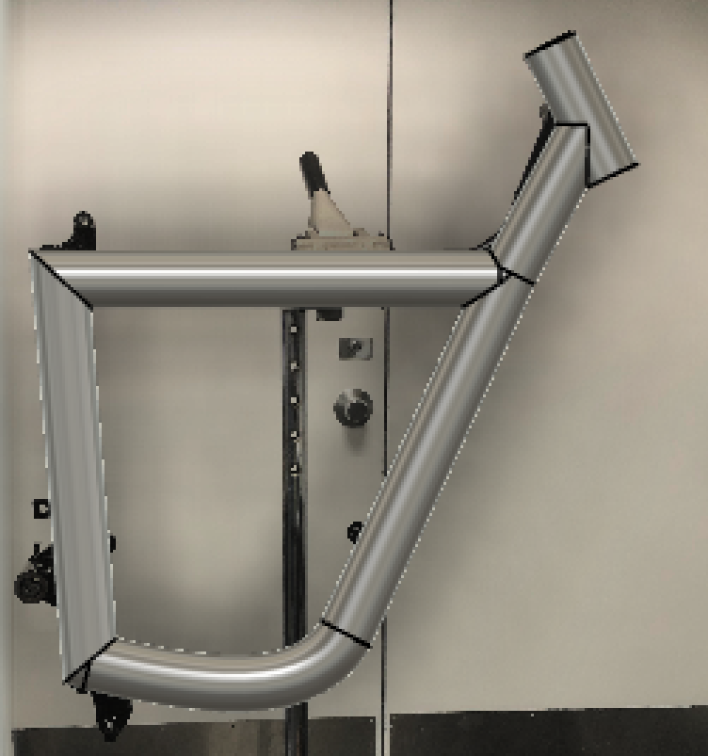
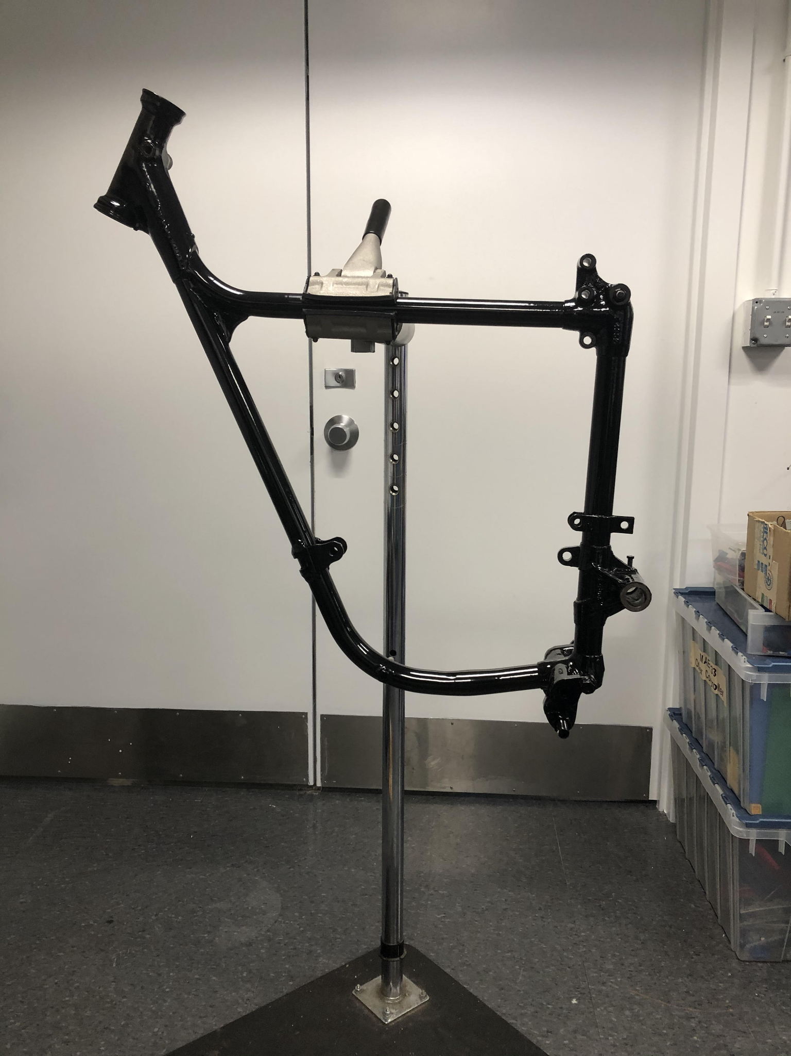
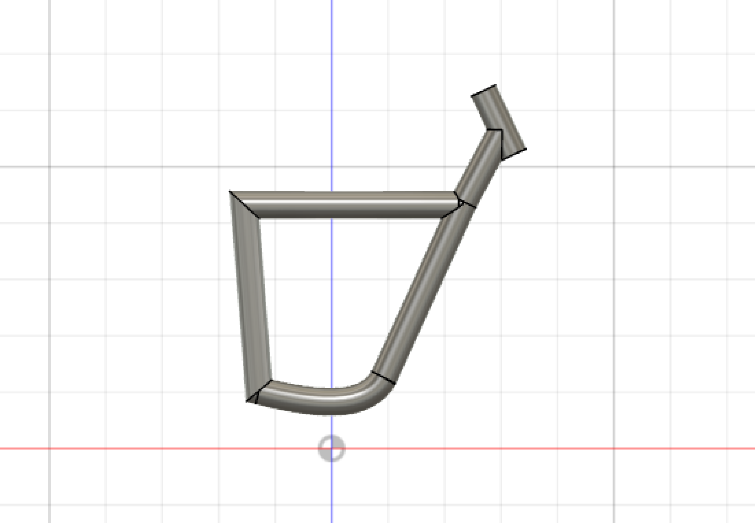
Frame
Notes:
Victoria

Slide 4
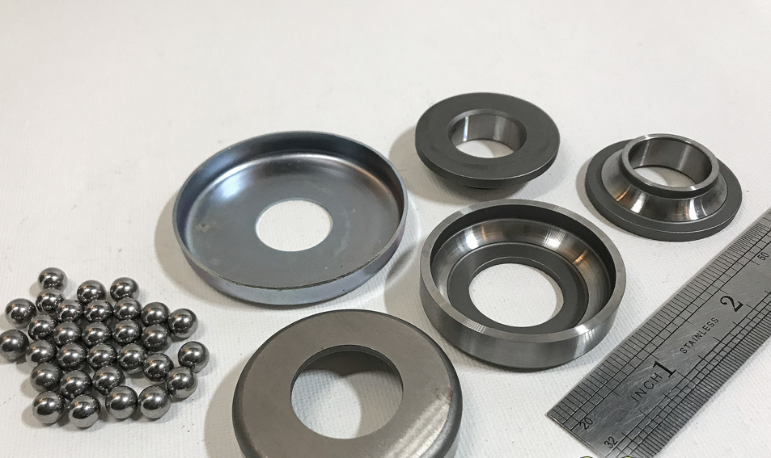
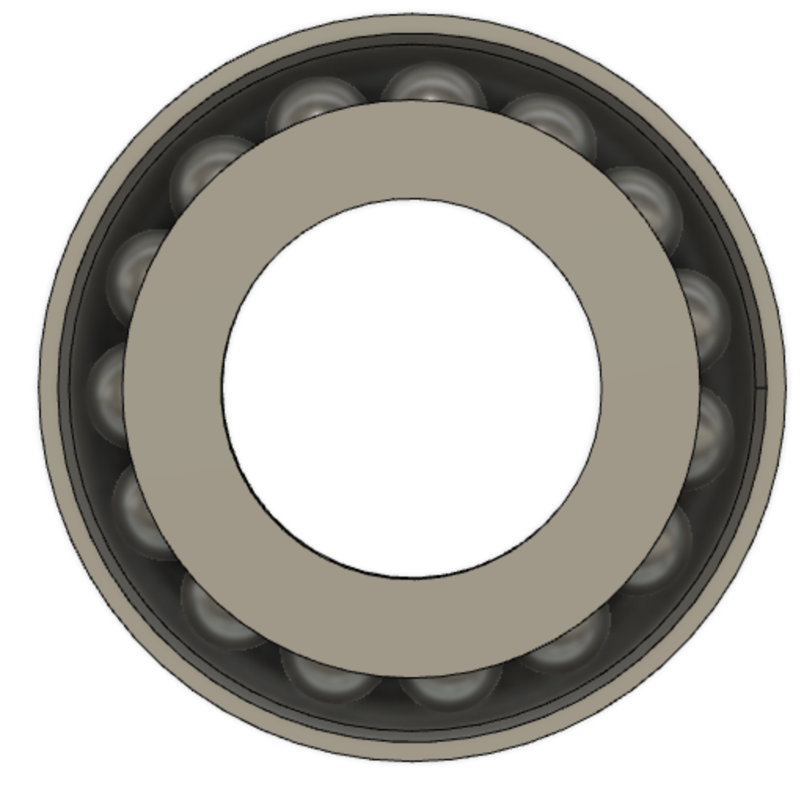
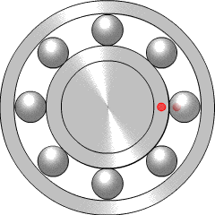
Ball Bearings
Notes:
Cordi Shares her animation
What does the ball bearing do, parts of the ball bearing, challenges

Slide 5
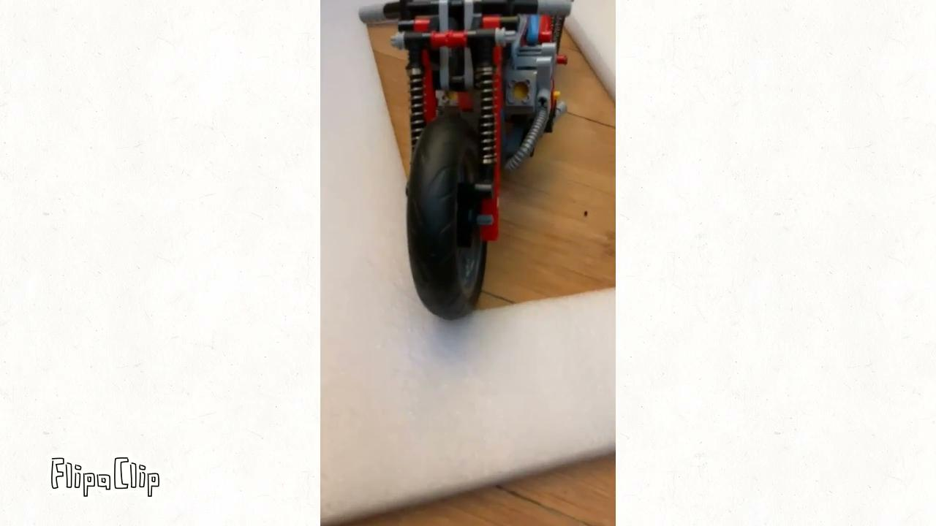
Notes:
Amber
A kinda rinky-dink animation of the oil/restrictor rod/spring. I think it’s moderately accurate now? Oil flows past restrictor, fork tube and stanchion move with respect to one another, spring compresses. Ignore the fact that the stanchion wiggles, I misunderstood when I was first making it. Obviously not to scale. The oil gets way too close to the top. -Amber (if Brandon’s animation ends up better can just replace)
Explains what the suspension and front fork is all about

Slide 6
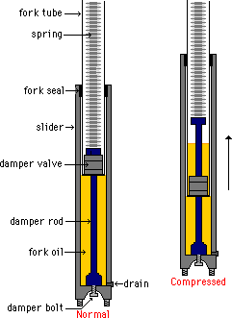
Oil Mechanics Deep Dive
Stanchion
Description
Oil flows past restrictor
Fork tube and stanchion move with respect to one another
Spring compresses
Factors of Damping
Oil viscosity
Geometry of restrictor
Spring coefficient
Restrictor
Fork Tube
This diagram has been edited from source to reflect our system
Notes:
Alison
https://www.youtube.com/watch?v=_CO4j-OaiYw&t=876s
https://www.youtube.com/watch?v=mgR4PJwEHMg

Slide 7
Notes:
Victoria
https://www.google.com/url?sa=i&url=https%3A%2F%2Fwww.tein.co.jp%2Fe%2Fspecial%2Fni_toryu%2F&psig=AOvVaw1KZNfA272qSA-p2fVtLMwr&ust=1619891204782000&source=images&cd=vfe&ved=0CAIQjRxqFwoTCLCA1rbFpvACFQAAAAAdAAAAABAD
https://www.google.com/url?sa=i&url=https%3A%2F%2Fwww.tein.co.jp%2Fe%2Fspecial%2Fni_toryu%2F&psig=AOvVaw1KZNfA272qSA-p2fVtLMwr&ust=1619891204782000&source=images&cd=vfe&ved=0CAIQjRxqFwoTCLCA1rbFpvACFQAAAAAdAAAAABAI

Slide 8
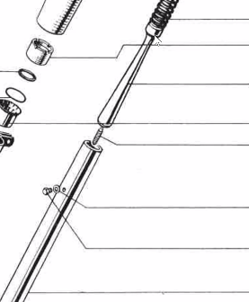
A Conversation about Damping
Newer design has a pear shaped restrictor so the dampening changes as a function of how far the stanchion is with respect to the fork tube
(cross sectional area of restrictor changes along vertical axis)
Underdamping:
Wheel jumps up off the ground
Overdamping:
Uncomfortable
Rigid body system
Notes:
Amber will talk about damping
Alison will talk about restirctor rod

Slide 9
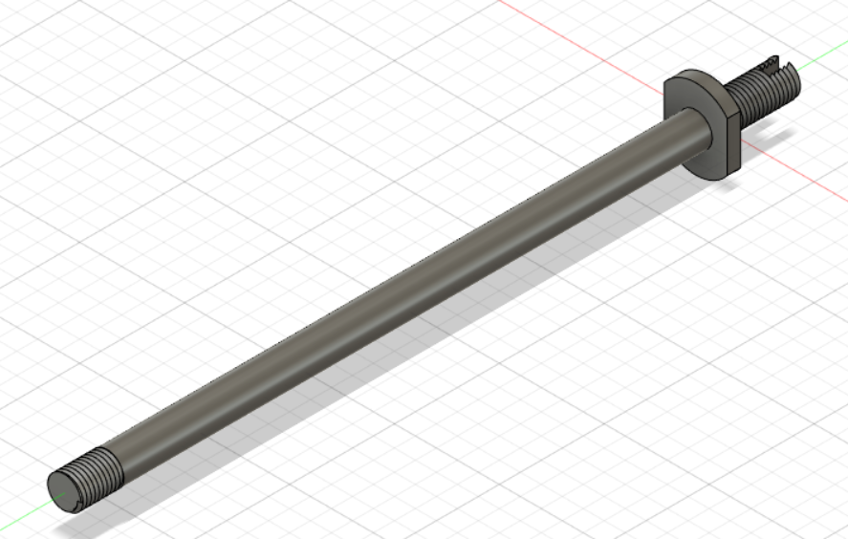
Stanchion:
modeled by Brandon
Restrictor rod: modeled by Alison
Fork tube in stanchion: readapted slider animation in Fusion 360 by Prof Littman
Spring: modeled by Victoria
Notes:
Image link: http://oldmanhonda.com/MC/Rforks.html
Brandon: Joints ---> Slider1 ----> Edit joint limits ----> animate

Slide 10
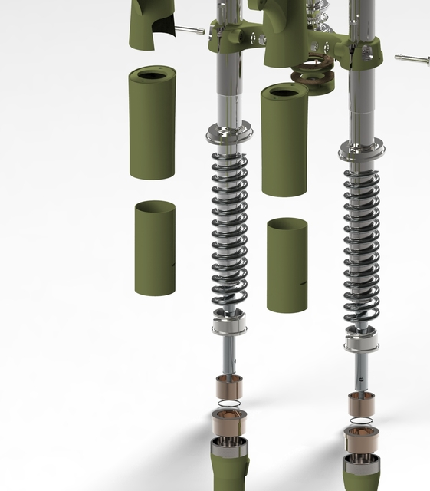
Suspension Rig
Spring
Stanchion
Restrictor Rod
Nut
Steel Washer
Fork Tube
Axle Clamp
Notes:
Current picture from: https://grabcad.com/library/m72-motorcycle-project-front-fork-assembly-1
Brandon
Show Animation on Fusion 360
This can be replaced/supplemented with our personally constructed model if it can be assembled in a comprehensive way
Insert brandon’s slider animation somewhere around here?
Animations from Fusion360:
Slider?
Oil?
Spring
(can always add more slides I just don’t know what we have and what works rn)

Slide 11
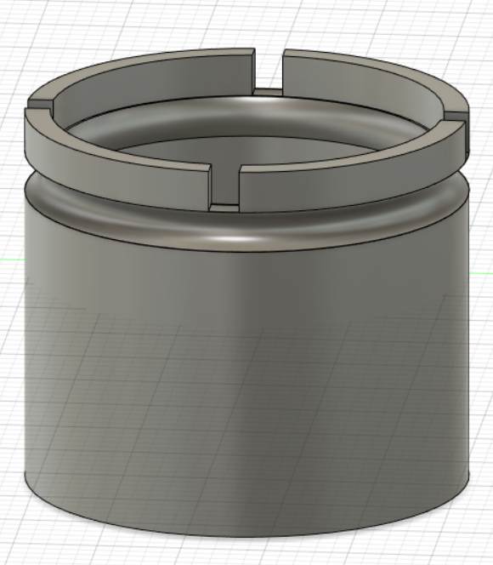
Connections
Functions
Squeezes the bush
Notches on crown for tightening
Prevents unnecessary oil leakage
Dust excluder sleeve nut
Oil seal
Steel washer
Notes:
Amber

Slide 12
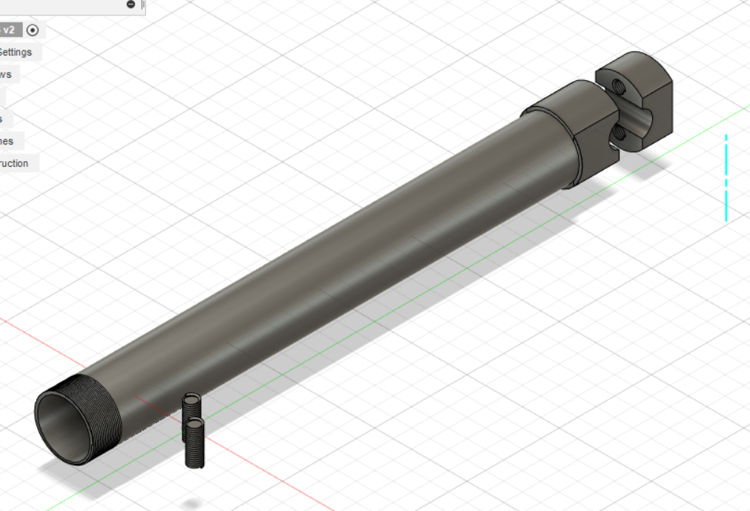
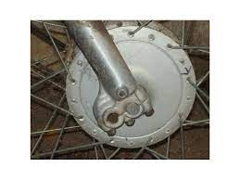
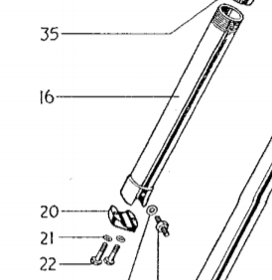
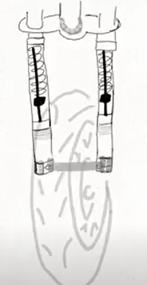
The Fork Tube
Holds the oil
Sheaths the stanchion
(Not our motorcycle)
Oil drain stud (not modeled) allows the front fork oil to be replace for maintenance and balancing damping effect
Notes:
Amber
Image link: https://www.google.com/url?sa=i&url=https%3A%2F%2Fwww.autoevolution.com%2Fnews%2Fa-quick-guide-to-motorcycle-rake-trail-and-offset-part-2-final-84056.html&psig=AOvVaw0uCTIfuenqSzEYemYMNW-h&ust=1619032533834000&source=images&cd=vfe&ved=2ahUKEwiZ-d6pxI3wAhXvejABHTIRAtUQr4kDegUIARDNAg

Slide 13
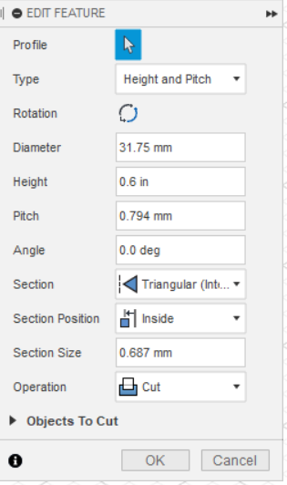
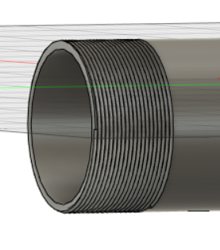
Modeling Threads!
32 turns per inch
Notes:
Victoria
How to cut a coil to create threading because the original threading didn’t work

Slide 14
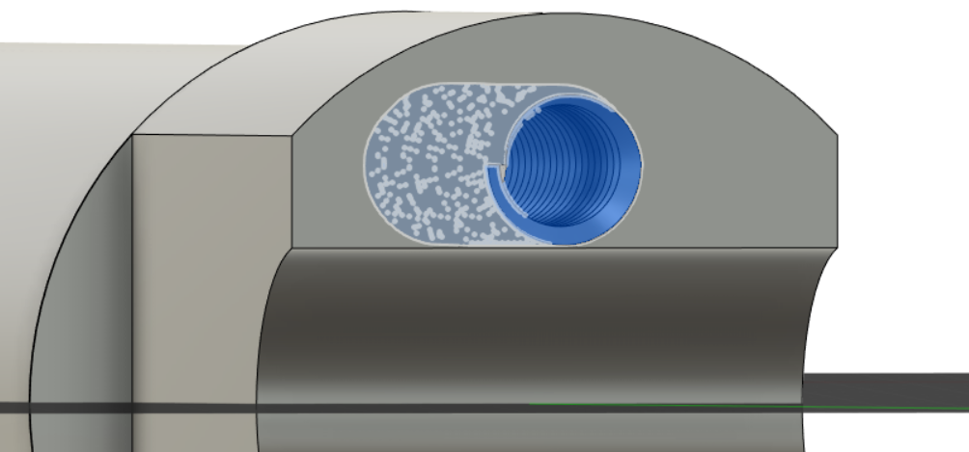
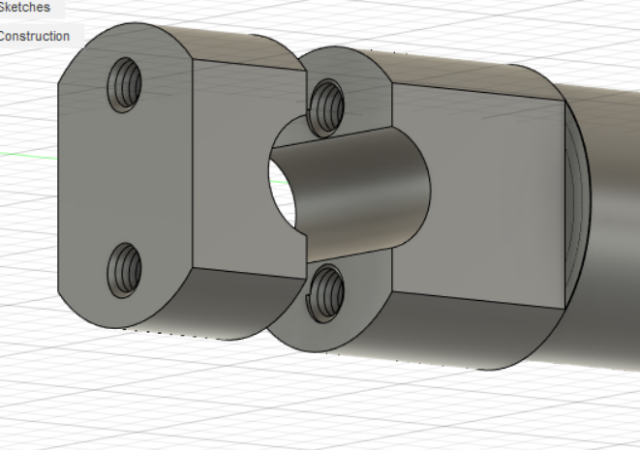
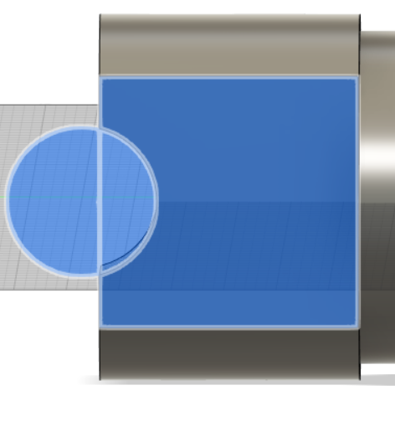
Axle Clamp
Fit to standard bolt
(Not our motorcycle)
Axle clamp:
off center
by design
Notes:
Cordi
Image link (again): https://www.google.com/url?sa=i&url=https%3A%2F%2Fwww.autoevolution.com%2Fnews%2Fa-quick-guide-to-motorcycle-rake-trail-and-offset-part-2-final-84056.html&psig=AOvVaw0uCTIfuenqSzEYemYMNW-h&ust=1619032533834000&source=images&cd=vfe&ved=2ahUKEwiZ-d6pxI3wAhXvejABHTIRAtUQr4kDegUIARDNAg

Slide 15
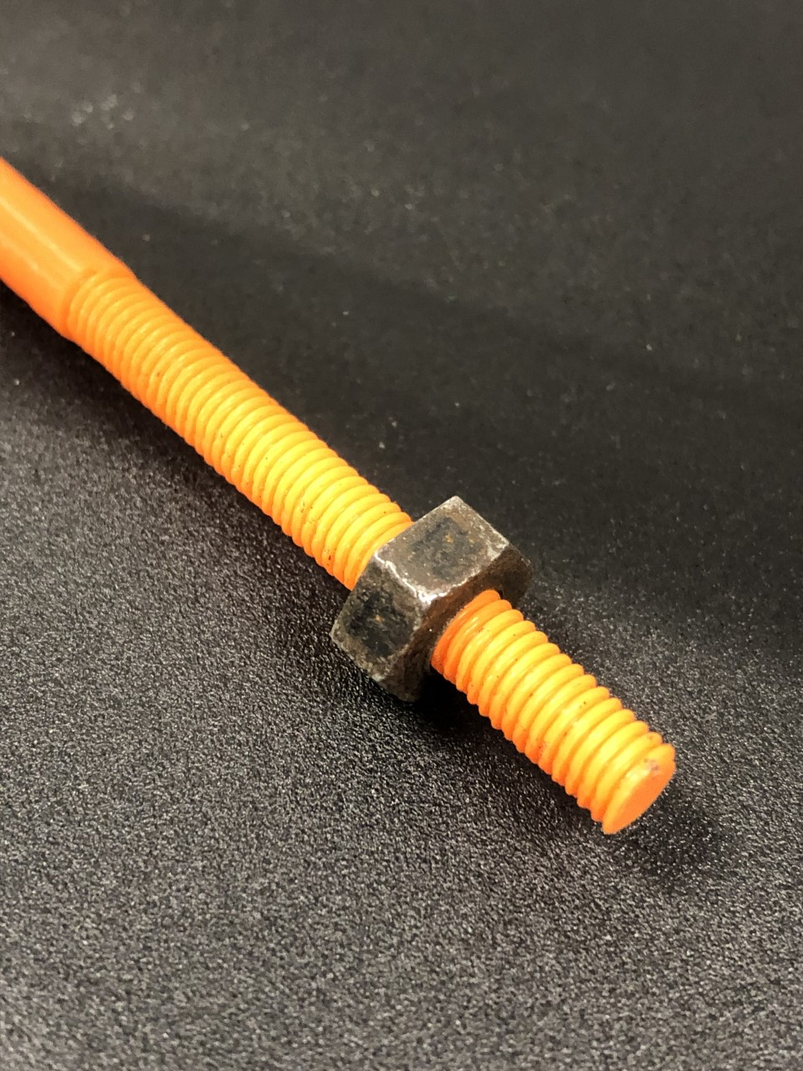
3D Printed Parts
The models we designed in fusion perfectly mesh with the actual Triumph parts!
Notes:
Brandon
What are we gonna do about the cnc mills and 3d printers

