Slide 1
ENGINE GROUP
Presented By:
Alex Niemiec, Kai Honda, Israel Adeboga

Slide 2
CONTENTS
1
Summary of What Was Done With The Engine Disassembly, Cleaning, and Reassembly
2
Problems we Faced During Disassembly of the Bike
3
Explanation About How our Engine Works
4
Information About Shifting Gears and the Ratio for Each Gear the Bike Drives in
5
Engine Systems
- Ignition, Lubrication, and Materials

Slide 3
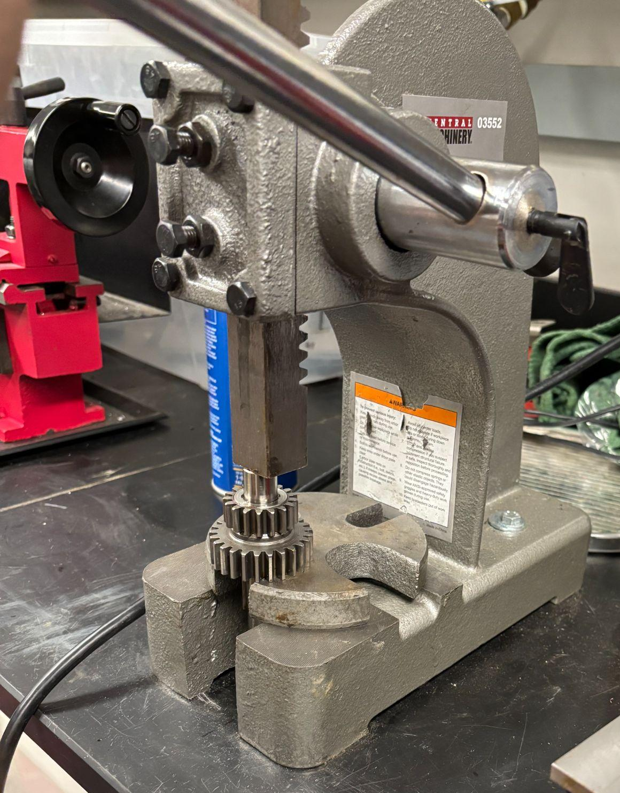
01: Summary of What Was Done With The Engine - Disassembly
To access the internal components of the engine, we began by removing the outer covers, the cylinder head, and the barrel. Due to the age and low mechanical tolerances of the engine, many parts had seized or fused through corrosion or heat expansion. Special tools were required to separate these components. For example, an arbor press was used to apply controlled pressure for removing parts pressed onto shafts, while a gear puller was essential for detaching gears from the mainshaft and layshaft without damaging the splines.
Once disassembled, each component was carefully assessed for wear, damage, and functionality. Vintage engines like this often suffer from rust, scoring, or mechanical deformation that newer engines might not show, so evaluation required both measurement and visual inspection.

Slide 4
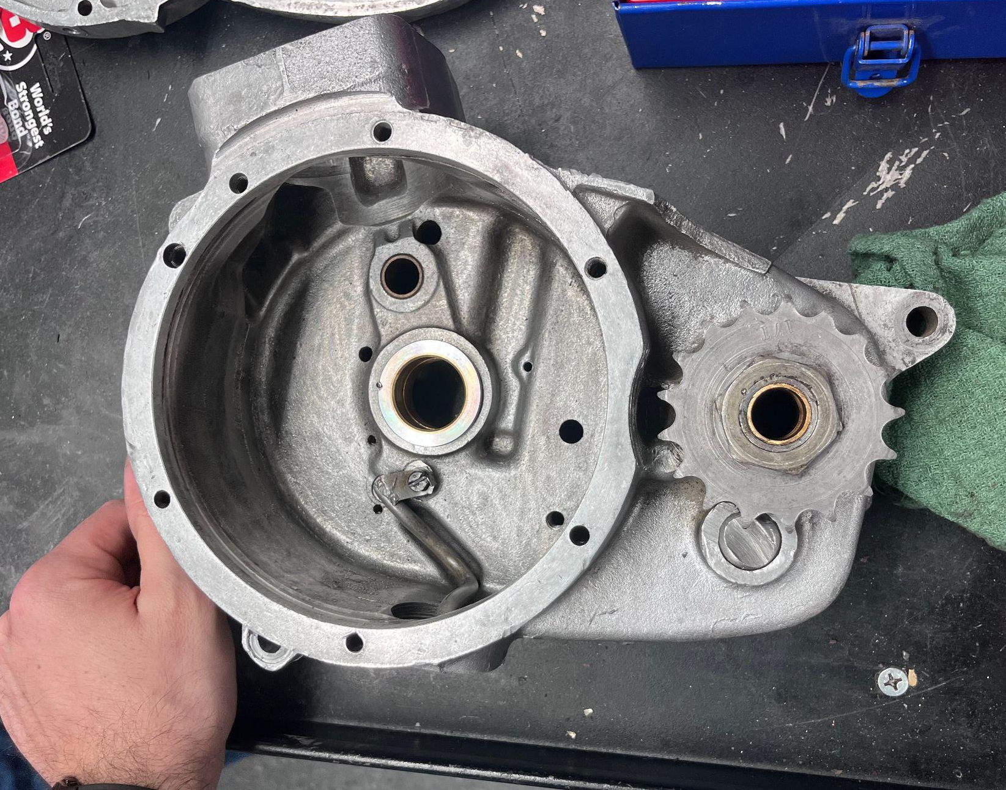
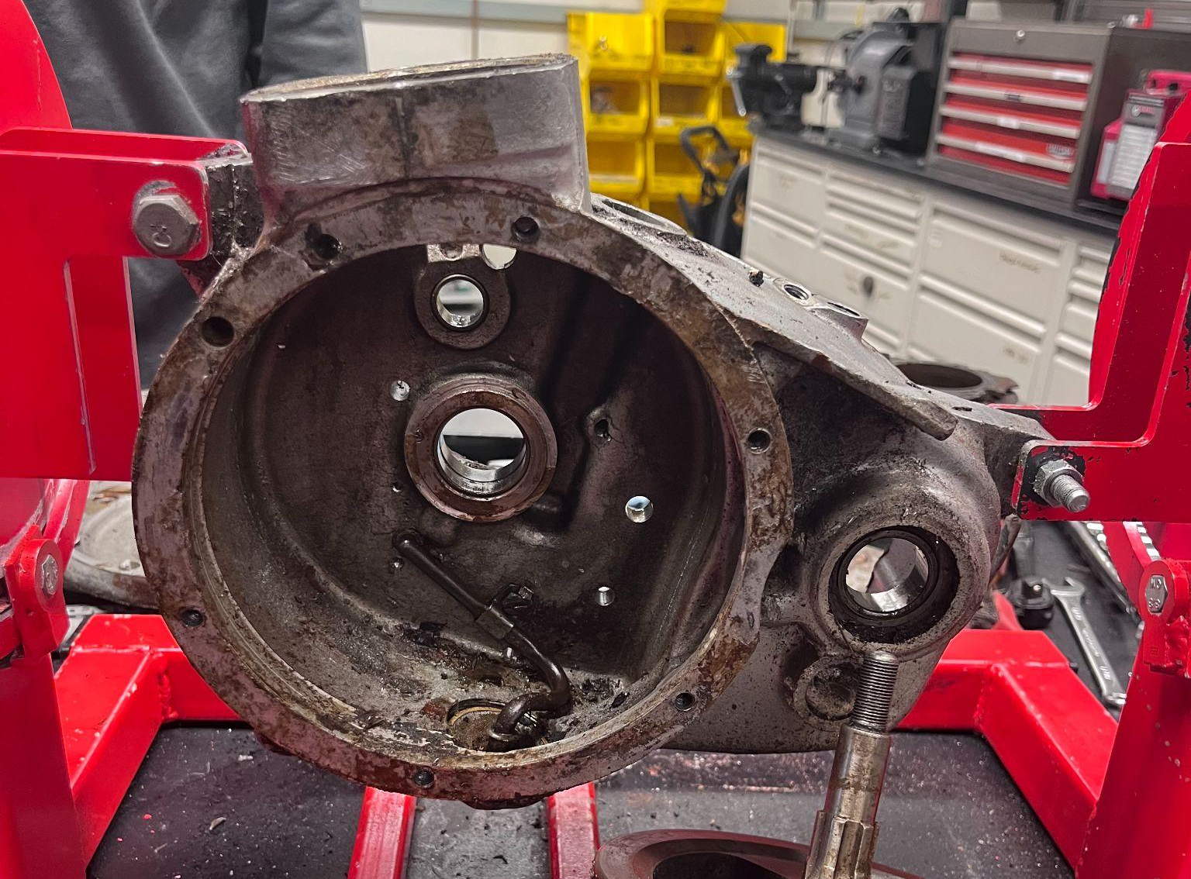
01: Summary of What Was Done With The Engine - Cleaning
After disassembly, all salvageable parts were cleaned using a combination of ultrasonic cleaning and hand scrubbing. Small and intricate parts such as valve springs, gear teeth, and bushings were immersed in an ultrasonic parts cleaner. This machine uses high-frequency sound waves in a cleaning solution to dislodge dirt, oil, and rust particles at a microscopic level.
Larger components like the crankcase, barrel, and head were manually scrubbed at the degreasing parts cleaner, then sandblasted in the MAE workshop. Sandblasting uses compressed air to propel abrasive particles (typically aluminum oxide) at surfaces, removing paint and corrosion and leaving a clean, matte surface ready for reassembly. Post-cleaning, all parts were coated with WD-40 to prevent flash rusting from moisture exposure.

Slide 5
01: Custom Gasket Fabrication – Laser Cutting with CorelDRAW
Original gaskets had deteriorated over time and could not be reused. To replace them, we used CorelDRAW to digitally trace the outlines of the gasket surfaces. These outlines were then used to instruct a laser cutter to precisely cut new gaskets from gasket paper. This method ensured a perfect seal between metal components such as the crankcase halves, preventing oil leakage and maintaining engine compression. Laser cutting offers a much higher level of precision compared to manual cutting, especially for complex gasket geometries around bolt holes and coolant passages.
After we had made those we began to look for the parts that we needed to replace and lay everything out so we could begin assembling the engine in the opposite order that we took everything apart.

Slide 6
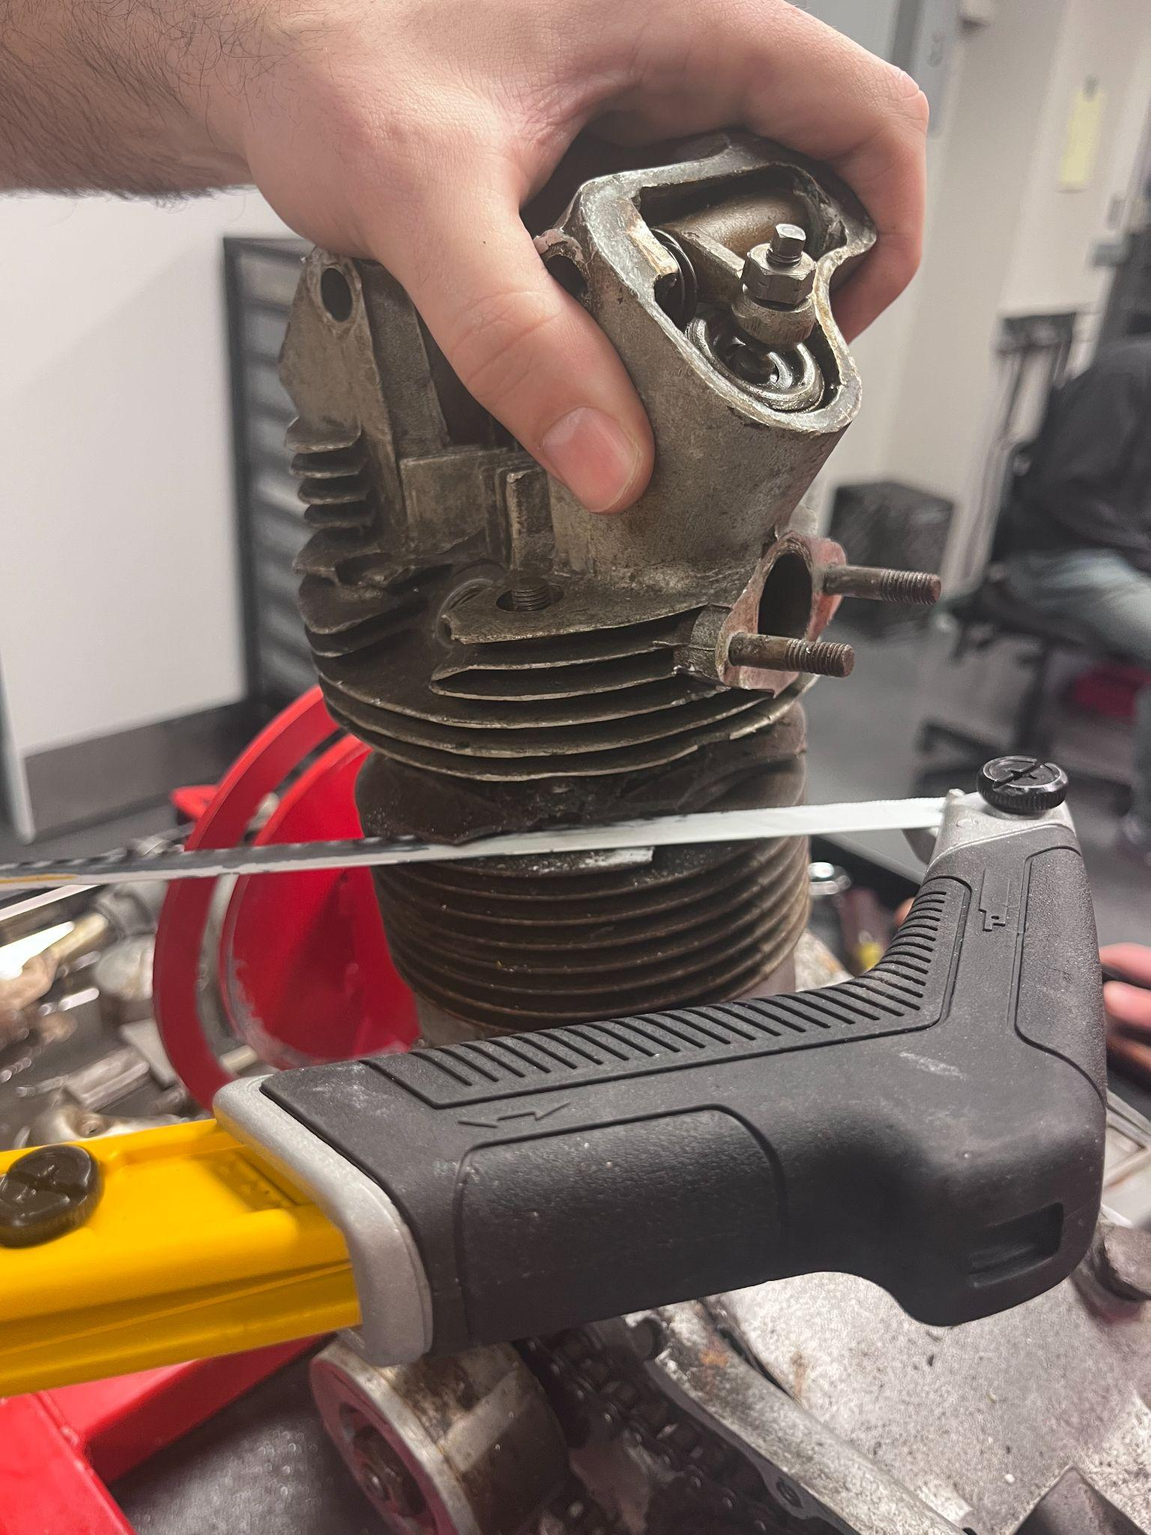
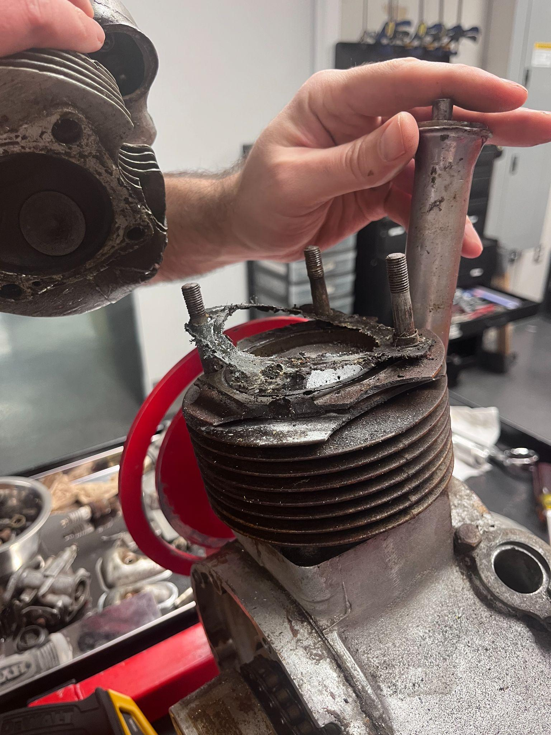
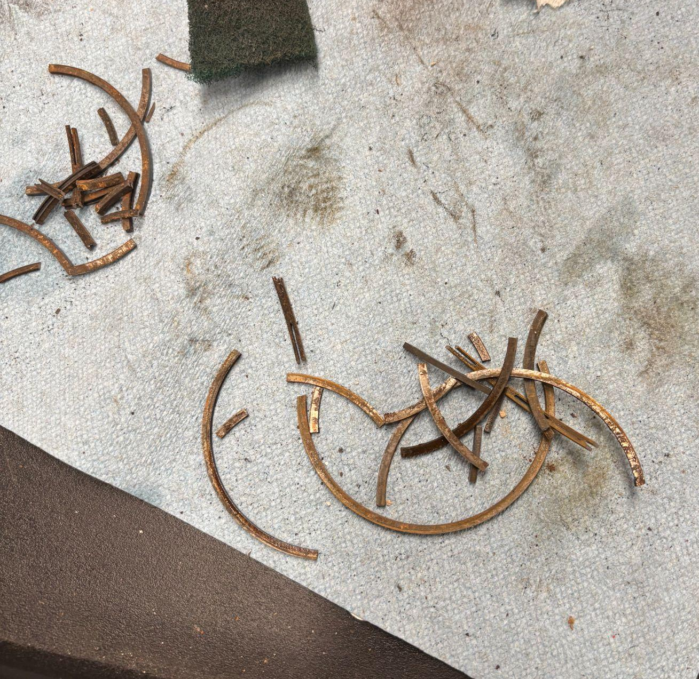
02: Challenges Faced – Seized Parts, Heat Damage, and Improvisation
The first obstacles we faced was removing parts as many of them were rusted solid onto the engine making it hard to remove them originally. We had to make use of time and WD-40 to help remove some of the rust which made it easier to try to clean with a wire brush.
The next obstacle we faced was when we tried to remove the head because it was fused to the barrel of the bike due to studs rusted into the engine casing. To fix this we ended up sawing through the stud which freed the head off the barrel and allowed us to remove the stud using vice grips to twist the stud free.
Another obstacle was the piston as the bike had obviously overheated at some point. Scorch marks on the cylinder wall and fused piston rings confirmed this, reflecting the consequences of heat mismanagement and poor lubrication. Overheating can cause aluminum components like pistons to melt or warp so we had to source a new piston that matched the original’s tolerances – tight enough to maintain compression, loose enough to allow thermal expansion.

Slide 7
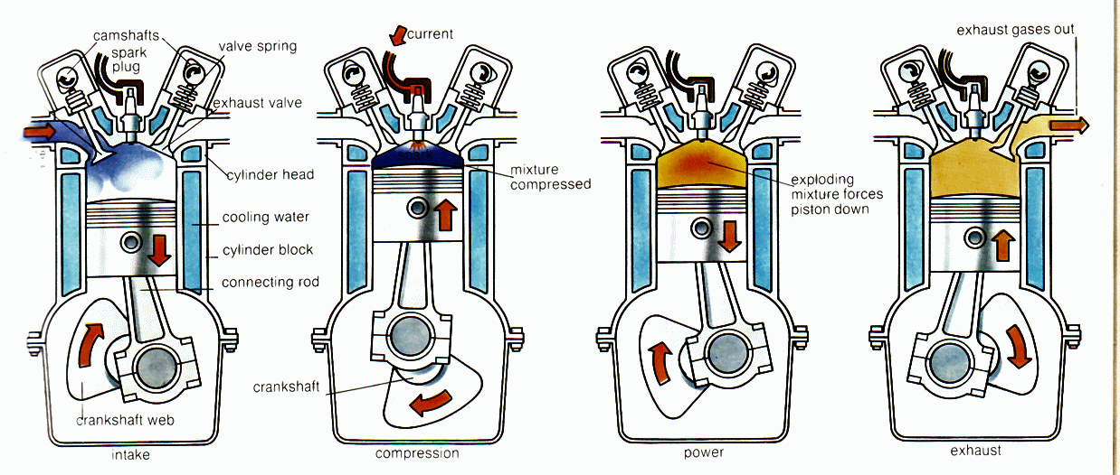
03: The Four-Stroke Engine Cycle
The Tiger Cub engine operates on the four-stroke Otto cycle. This consists of four piston strokes (one full cycle) across two crankshaft revolutions:
Intake Stroke: The intake valve opens while the piston moves down, drawing in a mixture of air and vaporized fuel.
Compression Stroke: Both valves close as the piston rises, compressing the mixture.
Power Stroke: A spark from the ignition system ignites the compressed mixture, rapidly expanding gases that drive the piston down.
Exhaust Stroke: The exhaust valve opens, and the upward motion of the piston expels the burnt gases.
This cycle converts chemical energy of the fuel into thermal energy which then creates an increase in temperature and thus pressure (according to ideal Gas Law: PV = nRT) so this energy becomes the linear mechanical energy of the piston, into the rotational mechanical energy of the crankshaft through controlled combustion. The flywheel’s stored rotational energy and the force from the previous power stroke provide enough inertia to carry the crankshaft through the other strokes and ultimately turns the transmission, which drives the rear wheel. Therefore if our engine is running at 6000 rpm we would have 3000 power strokes every minute since there is one power stroke every two crankshaft revolutions.

Slide 8
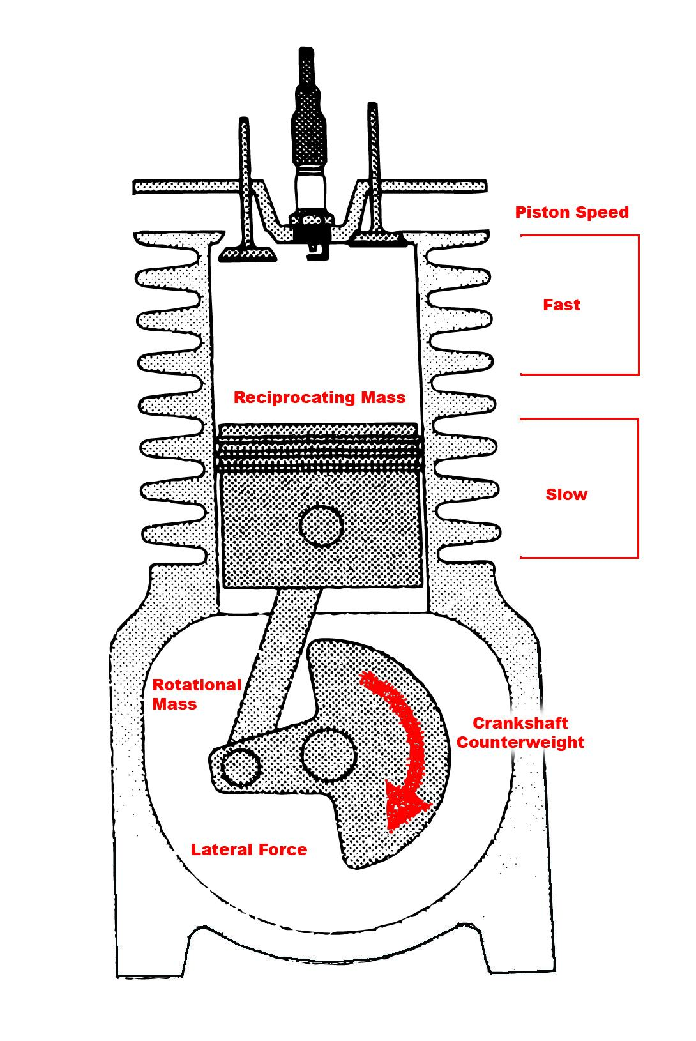
03: Crankshaft + Mechanical Energy Conversion
The crankshaft is central to the engine’s operation, converting the piston’s linear motion into rotary motion. This is achieved through the connecting rod, which links the piston to an offset on the crankshaft called the crank pin. The mechanical principle behind this conversion is torque:
τ = r x F
τ (torque): rotational force applied to the crankshaft
r: distance from crank center to crank pin (crank radius)
F: force exerted by the piston (from combustion)
Maximum torque occurs just after combustion, when gas pressure in the cylinder peaks.
In the Tiger Cub’s single-cylinder engine, the crankshaft also functions as a flywheel. This dual role is crucial for smoothing the engine’s power delivery, which would otherwise be erratic due to only one power stroke every two revolutions. The crankshaft's inertia stores energy during combustion and releases it between strokes, maintaining steady engine rotation and improving overall ride smoothness.
Flywheel behavior is governed by rotational kinetic energy:
KE_rotational ​= 1/2 * I * ω²
I: moment of inertia of the crankshaft
ω: angular velocity

Slide 9
04: Transmission and Gear Ratios
The Tiger Cub transmits power from the engine to the rear wheel through a manual four-speed constant-mesh gearbox, controlled by a quad-plate clutch and a system of sliding dog gears.
When the rider pulls the clutch lever, the quad-plate clutch (made of four alternating friction and steel plates) disengages the crankshaft from the gearbox, allowing smooth gear changes.
Inside the gearbox, all gear pairs are constantly meshed, but only one pair is connected at a time. Selector forks, moved by a rotating gear selector drum, slide dog gears along splines on the shaft. These dog gears engage with the selected gear pair by locking their dog teeth, transmitting power through that ratio.
Gear ratios are calculated as:
Gear Ratio = Teeth on Driven Gear ÷ Teeth on Drive Gear
Lower gears (e.g., 1st) give higher torque for acceleration.
Higher gears (e.g., 4th) provide lower torque but greater speed efficiency.
The final output passes through the output shaft → chain → rear wheel, completing the power transfer.
https://youtu.be/wCu9W9xNwtI?si=DjEZgfK2rtUVTcll

Slide 10
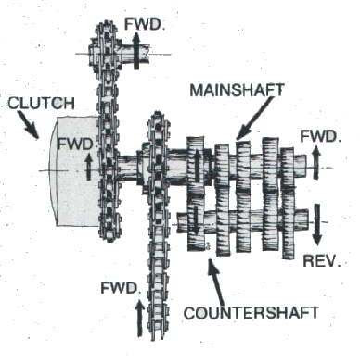
04: Explanation of Camplate/Shifter Forks, and Gear Ratios of our Bike
Our engine has four different gears which are ordered from bottom to top as 1st (low), 2nd, 3rd, and 4th (top). Neutral is in between 1st and 2nd gear and is where the engine is disconnected from the wheels as no gear is actually engaged. Inside the gearbox there is a camplate which is what actually shifts inside the bike allowing for the movement of the shifter forks which causes the gears to slide into their respective spot for each gear of the bike.
The gearbox ratios for each of the four gears are:
1st (low) 20.0 : 1
2nd 13.8 : 1
3rd 8.8 : 1
4th (high) 6.7 : 1
Using an equation of:
(rpm x tire circumference x 60) / (gearbox ratio x 5280 x 12)
We can determine the top speed of each gear of the bike.
Thus the top speeds for each gear should be:
1st (low) 22.3 mph
2nd 32.3 mph
3rd 50.7 mph
4th 66.6 mph
Our tire has a diameter of 25 inches meaning its circumference is ~ 78.54 in.

Slide 11
04: Combustion Chemistry + Air-Fuel Ratios
Our engine is a 199cc engine, this is a measurement of the displacement of the engine, which refers to the total volume swept by all the pistons inside the cylinders during one full cycle (typically two crankshaft revolutions for a 4-stroke engine). Generally, larger displacement = more air-fuel mixture = more power output.
So with each engine cycle we burn just under 200 cubic centimeters of fuel/air mixture. This mixture however is actually very little fuel relative to air. The stoichiometric air-fuel ratio for gasoline is approximately 14.7:1 (by mass). That means 14.7 grams of air for every 1 gram of fuel—ideal for complete combustion. However, engines often run richer (lower air ratios) for stability or performance. Our engine, for example, idles at around 13.5:1 and runs as rich as 12.2:1 under heavy load to reduce knocking.

Slide 12
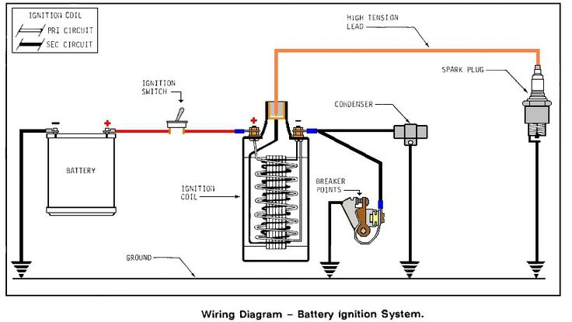
05: Ignition System
Our engine uses a contact breaker points ignition system, common in older motorcycles. This system works by opening and closing electrical contacts (called breaker points) in sync with engine rotation. When the breaker points are closed, current flows through the primary coil of the ignition system, generating a magnetic field around an iron core.
When the points open, the current is suddenly interrupted. According to Faraday’s Law of Electromagnetic Induction, a rapidly changing magnetic field induces a voltage in nearby windings. As the magnetic field in the primary coil collapses, it creates a fast change in magnetic flux through the secondary coil. The many more turns in the secondary coil amplify the induced voltage to tens of thousands of volts. This high-voltage pulse travels to the spark plug, jumping the gap and igniting the air-fuel mixture at the precise moment during the compression stroke.
Lenz’s Law explains that the induced voltage opposes the change that caused it, which is why a capacitor (condenser)is used to absorb the self-induced voltage in the primary and prevent arcing across the breaker points.
Timing here is critical. Sparking at the wrong time can lead to inefficient combustion or even engine damage: too early (advanced) = rough running / possible engine damage, too late (retarded) = weak combustion, loss of power . In the Tiger Cub, ignition timing is mechanically adjusted via a cam-driven points assembly, which must be set up correctly for the engine to fire properly.

Slide 13
05: Lubrication System
Lubrication is critical in any internal combustion engine to reduce friction, dissipate heat, and prevent direct metal-to-metal contact between moving parts. The 1960 Tiger Cub uses a dry sump lubrication system, which differs from the more common wet sump design by storing oil in a separate external oil tank rather than in the engine crankcase.
From this tank, oil is pumped under pressure through a network of galleries and internal passages to reach essential engine components such as the crankshaft bearings, camshaft lobes, and piston walls. These components rely on a continuous, pressurized oil supply for smooth operation and longevity.
A scavenge pump then collects excess oil from the crankcase and returns it to the oil tank. This prevents oil from pooling in the crankcase, which would otherwise increase resistance to the crankshaft's rotation and reduce efficiency.
Oil viscosity plays a key role in engine protection. If the oil is too thin, it won't provide adequate lubrication; if it's too thick, it may not flow properly, especially at low temperatures.

Slide 14
05: Materials and Manufacturing
Each engine component was selected for specific mechanical, thermal, and chemical properties:
Piston – Aluminum Alloy Lightweight and thermally conductive, aluminum helps dissipate heat rapidly, reducing the risk of detonation (engine knock).
Crankshaft – Forged Steel Forged steel offers excellent strength and fatigue resistance, ideal for handling repeated high-torque loads over time.
Valve Seats – Hardened Steel Designed to withstand high temperatures and resist erosion from combustion gases, ensuring long-lasting valve operation.
Cylinder Walls – Cast Iron Cast iron is durable and wear-resistant. Its natural porosity allows it to absorb and slowly release oil, improving lubrication and reducing friction. While modern engines may use coatings like Nikasil, vintage engines like the Tiger Cub relied on plain cast iron.
Emerging nanomaterials are set to transform engine components:
Nano-Coatings for Enhanced Durability - Materials like nano-tungsten carbide and nano-ceramics can be applied to pistons and cylinders, reducing friction and wear, thereby extending component life.
Advanced Lubricants with Nanoparticles - Incorporating nano-molybdenum disulfide into engine oils lowers friction, enhances fuel efficiency, and reduces engine wear.
Lightweight Nanocomposites - Carbon nanotubes and nanographene offer high-strength, lightweight alternatives for structural components, improving durability without adding weight.
Self-Healing Materials - Innovations like self-healing polymer coatings can repair minor wear and tear within the engine, reducing maintenance requirements.

Slide 15
THANK
YOU
This project offered a rare opportunity to experience mechanical engineering in its raw, hands-on form. We didn’t just learn how engines work – we learned how to problem-solve, diagnose, and engineer solutions under real-world constraints. Challenges like seized pistons, rusted fasteners, and warped parts pushed us to think creatively and adapt tools and techniques.
Most of all, we gained a deep respect for the craftsmanship of vintage motorcycle engineering. The Triumph Tiger Cub may not have the technology of a modern bike, but it offers simplicity, elegance, and an intimate learning experience that no simulation or textbook can replicate.
Special Thanks to Professor Littman and Jonathan Prevost for an amazing semester. Truly one of the best classes taught at Princeton.

