Slide 1





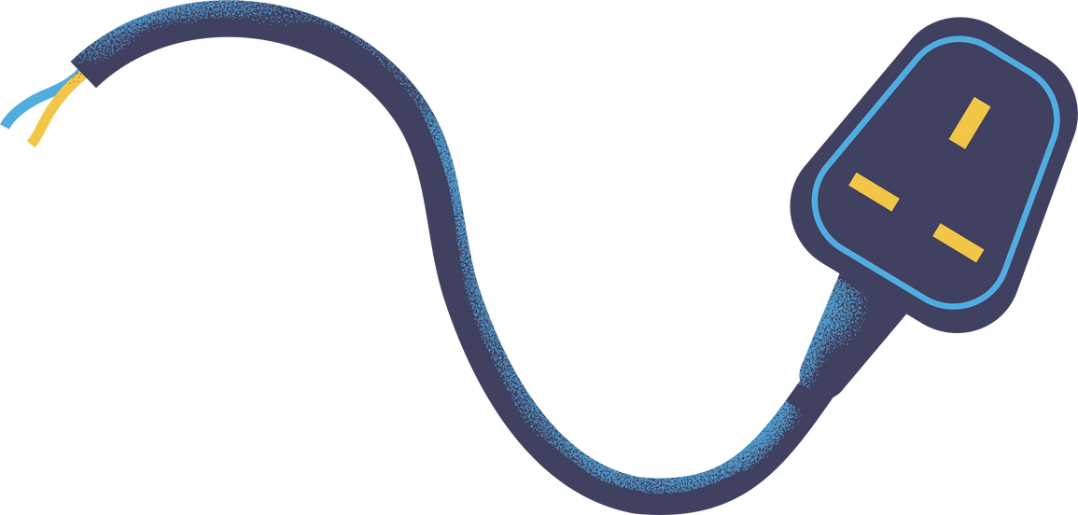

Electrical Team
David, Pierce, and Amelia
A semester summary and technical review

Slide 2
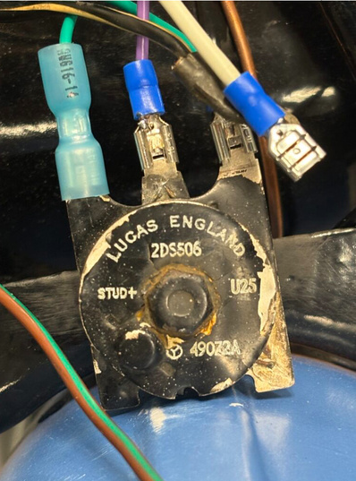
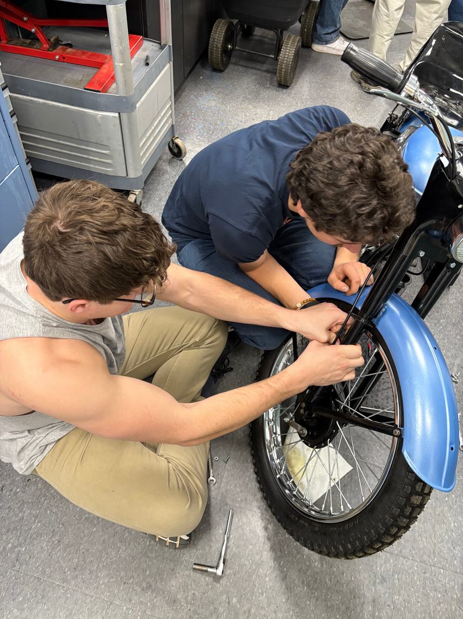
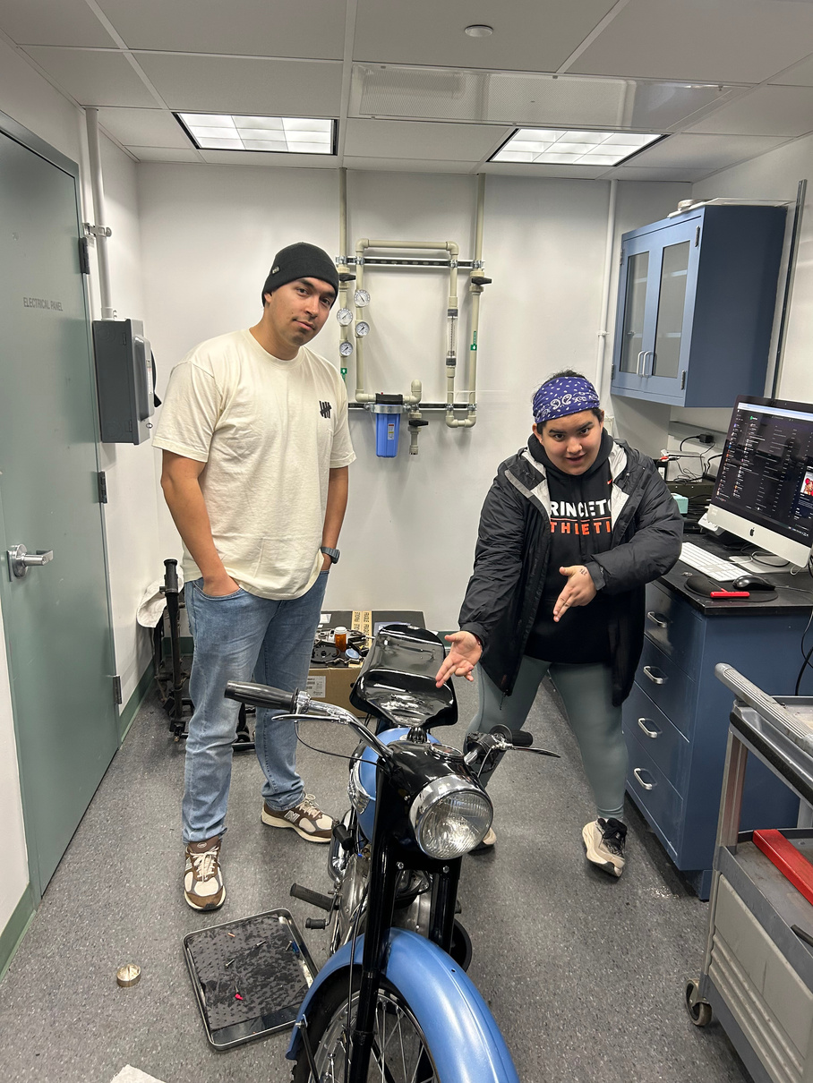
Our work this semester
-Completing the wiring harness according to the Tiger Cub manual
-Wiring brake lights and fixing brake cables
-Wiring/attaching the dipper switch
Attempting to adjust and fix the carburetor
-Replacing the carburetor more than once
-Cleaning the pilot jets and other airways in the carburetor
-Checking/adjusting engine timing
-Checking battery power

Slide 3
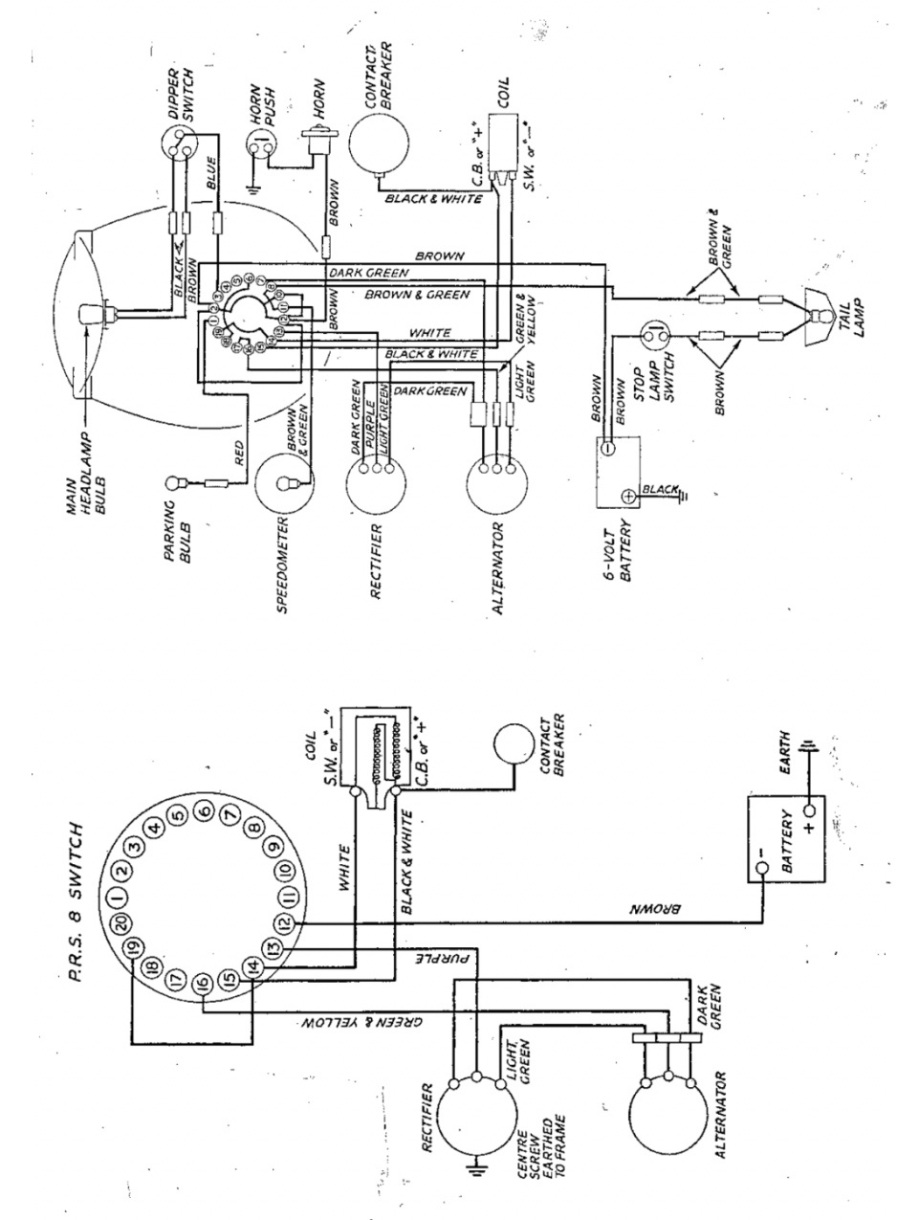
Some visuals...

Slide 4
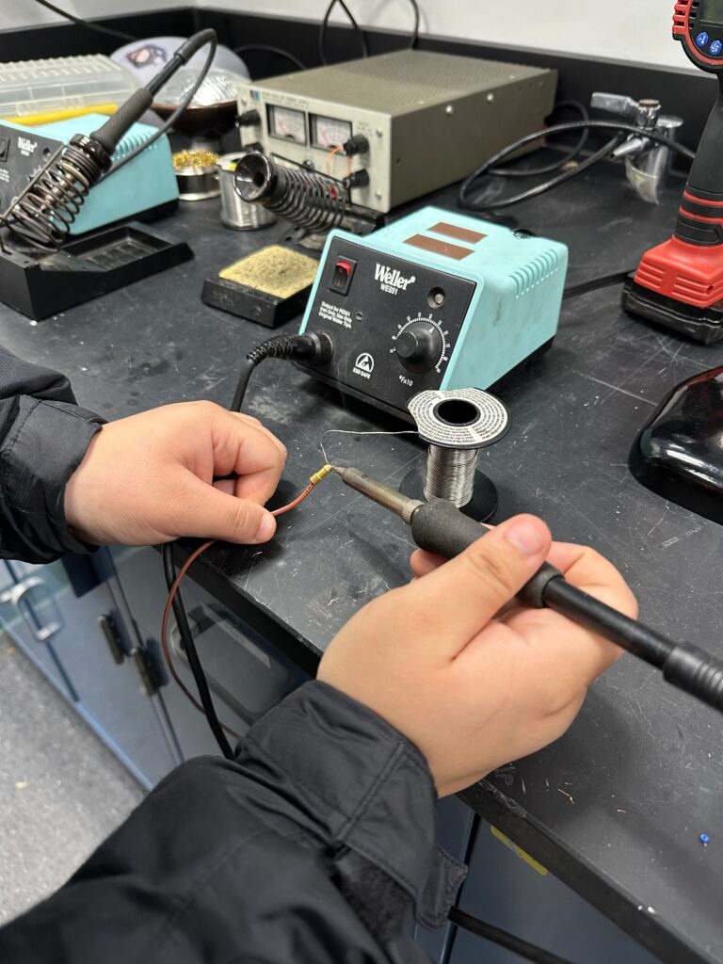
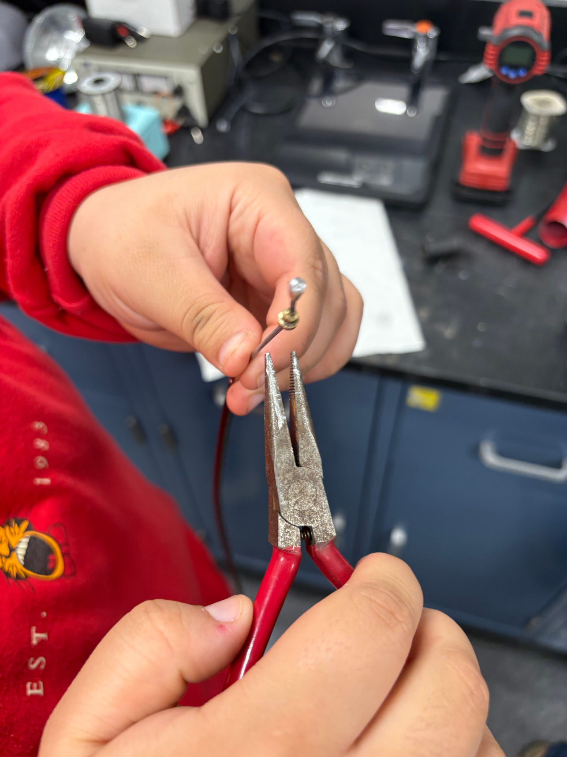
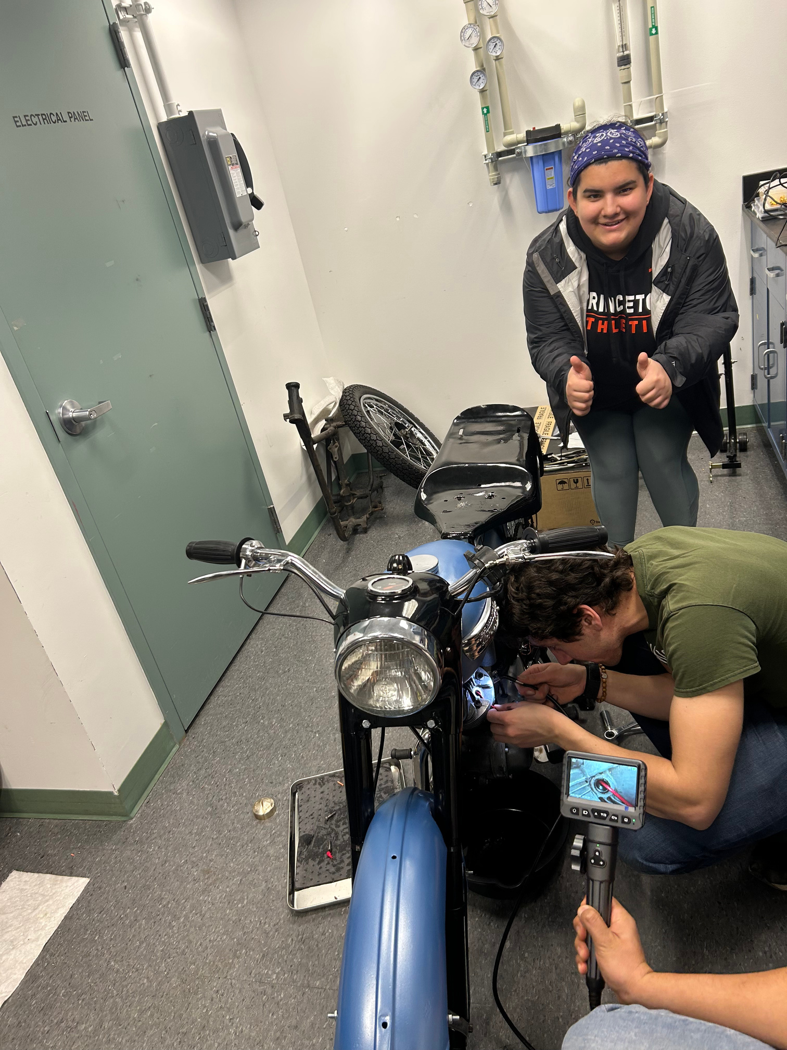
More visuals...

Slide 5
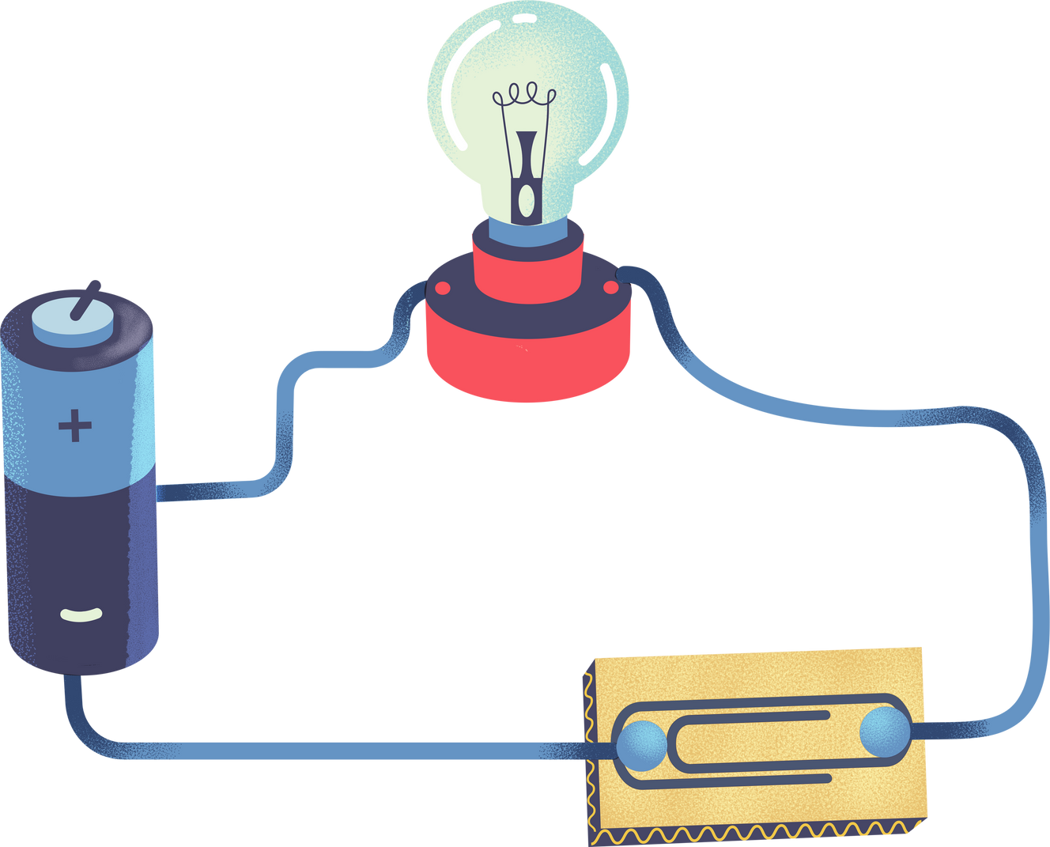

You already know Ohm’s Law, V=IR
The other crucial circuit rules are Kirchhoff's Laws.
  The sum of currents passing to/from a circuit junction must be 0. In other words, the current going through a junction must equal the current coming out.
  The sum of voltage differences across some circuit “loop” must be 0. The voltage supplied by the battery must be equal the sum of the voltages lost over resistors in a loop.
Key Background Information on Circuits

Slide 6



Key Background Information on Circuits
Electromagnets
Turns out that current flowing through a wire generates a magnetic field. This is an intrinsic property in electromagnetism. Changing electric fields create magnetic fields. Changing magnetic fields create electric fields. A charged wire produces an electric field. When that charge moves (i.e. has a current), that electric field changes producing a magnetic field.
  The Right-Hand Rule
  Biot-Savart Law, strength of the magnetic field depends on the strength of the current and distance to the wire.
  Coils of wire create electromagnets

Slide 7
The Alternator
  The alternator is what charges the battery during use. It is able to convert the mechanical energy of the motion of the motorcycle into electrical energy. It uses the same principle as every other power source based in mechanical energy: Faraday’s Law.
  Faraday’s Law states that if there is some closed circuit loop for which the magnetic flux passing through that loop changes, a current will be induced on that loop from the electric field produced by the changing magnetic field and it will be equivalent to the rate of change of that magnetic flux.
    Flux is defined as the flow rate of something per unit area.
  Mathematically, ɛ (EMF, essentially voltage) = - dɸ/dt

Slide 8


WITH THE HELP OF YOUR TEACHER OR CARER,
test whether your suggestions and drawings will make the bulb light using actual batteries, a small lightbulb, and wires.
The alternator pt. 2
  Alternating Current vs Direct Current
    AC is the product of most power generation and makes it easier to distribute high voltage across long distances with less power loss.
    DC is more used with most electronic appliances.
  AC is changed to DC in a rectifier.
  Diodes
    Think of diodes as one-way current valves. They permit current to flow in one direction while blocking the other.

Slide 9

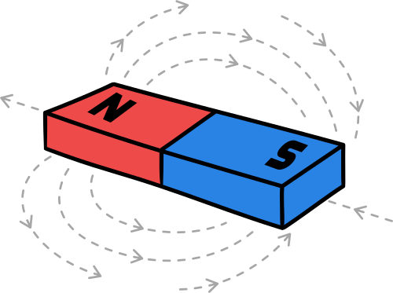
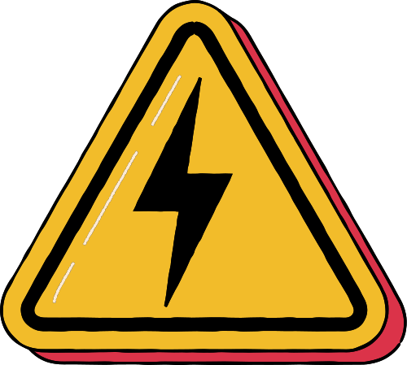
Demonstration Time!

Slide 10
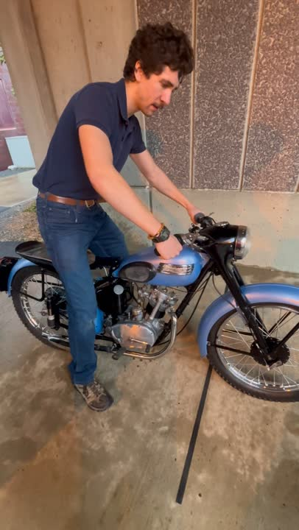
It Runs!

Slide 11
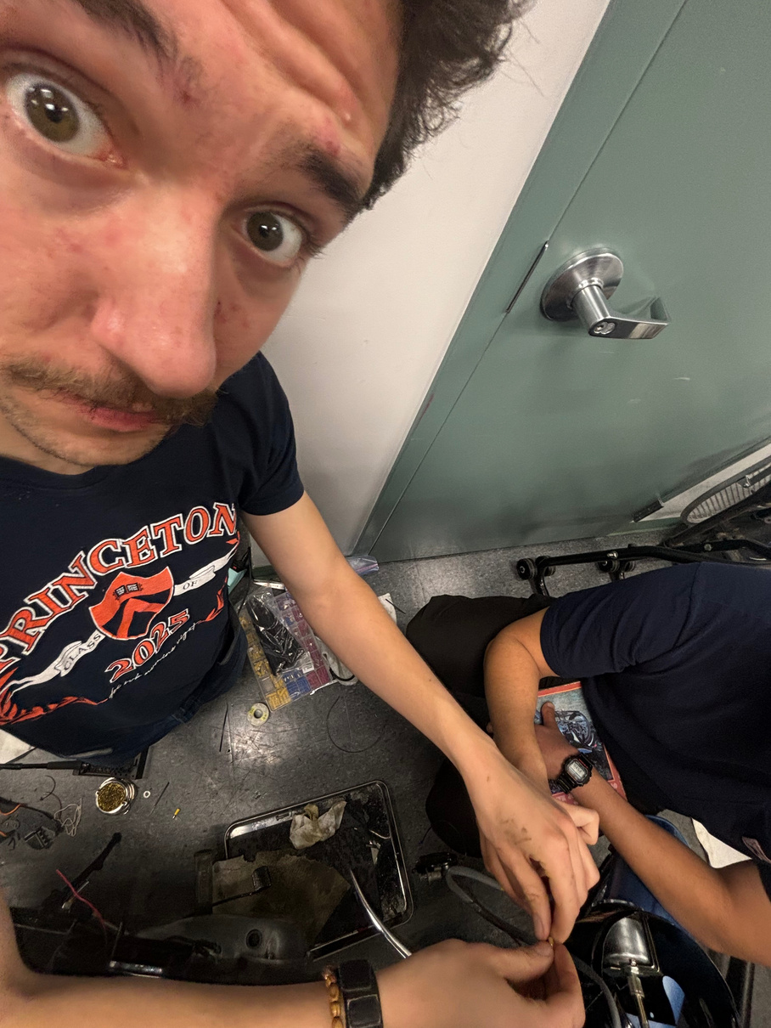
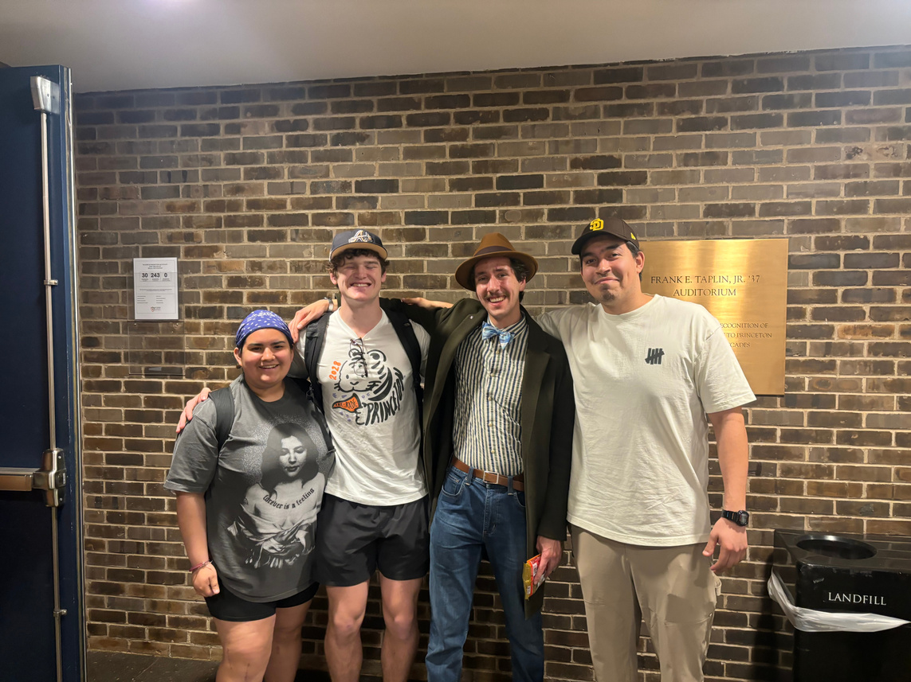

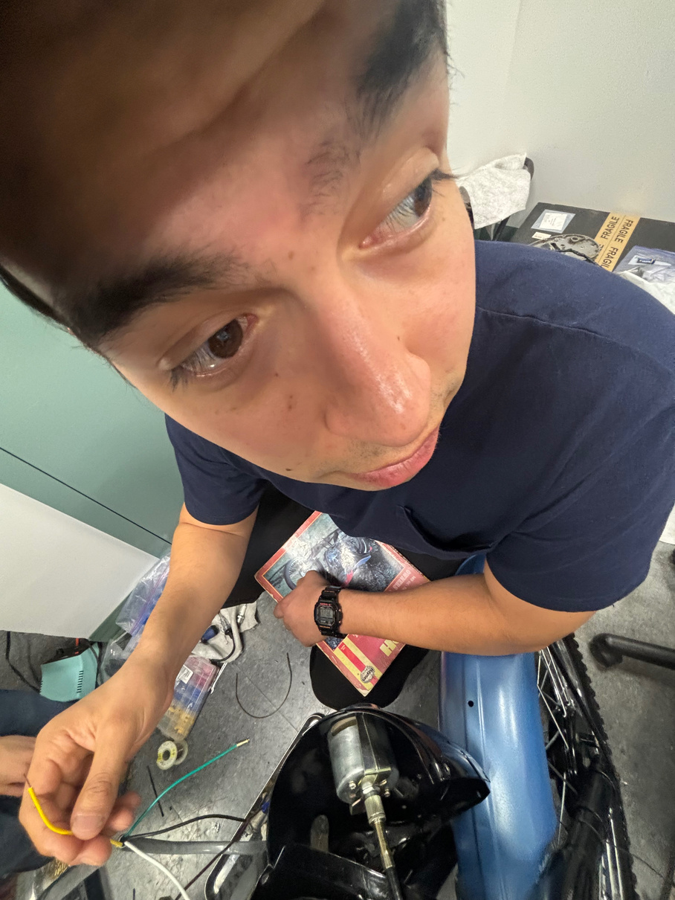

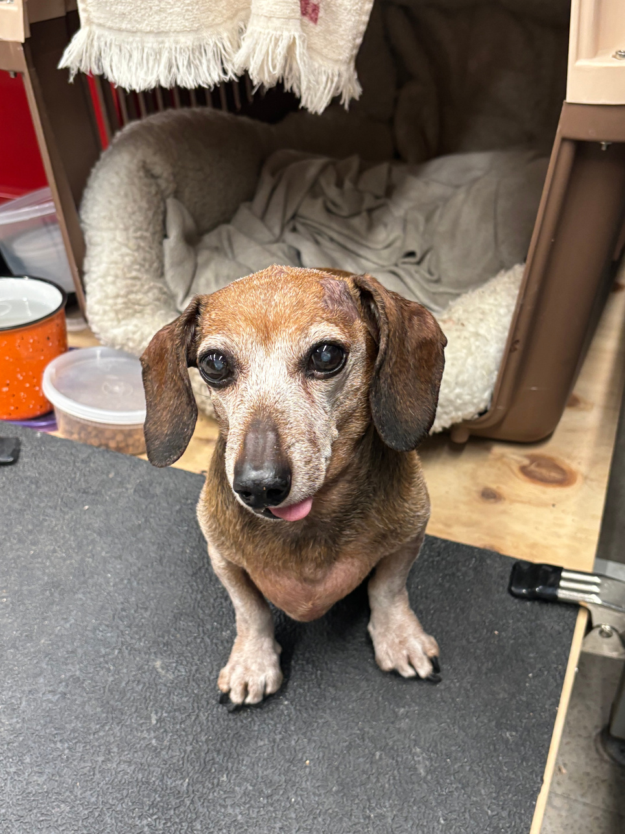
Thank you!
Electrical team out...

