Slide 1
Nanometers to Motorcycles
Heat transfer across scales
Aditya Sood
Assistant Professor, MAE & PMI

Slide 2
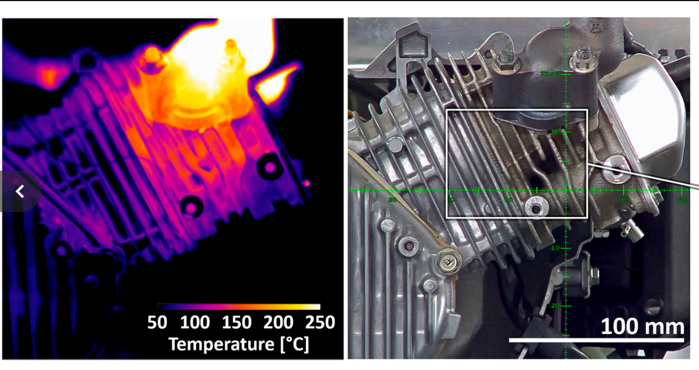
Heat transfer matters in motorcycles
Wissink et al., PNAS (2020)
Extreme temperatures in the combustion chamber: gases can get as hot as ~2,200 C!
Leads to high temperatures in the engine block → heat transfer to chassis
critical for: safety, mechanical integrity, comfort

Slide 3

Zoom into the nanoscale: what is heat?
Tec-science.com

Slide 4
“phonons”
Really high frequency atomic vibrations that carry heat in electrical insulators

Slide 5

How is heat conducted in metals?
Tec-science.com

Slide 6
electrons
Charges carry heat (and electricity!) in metals

Slide 7
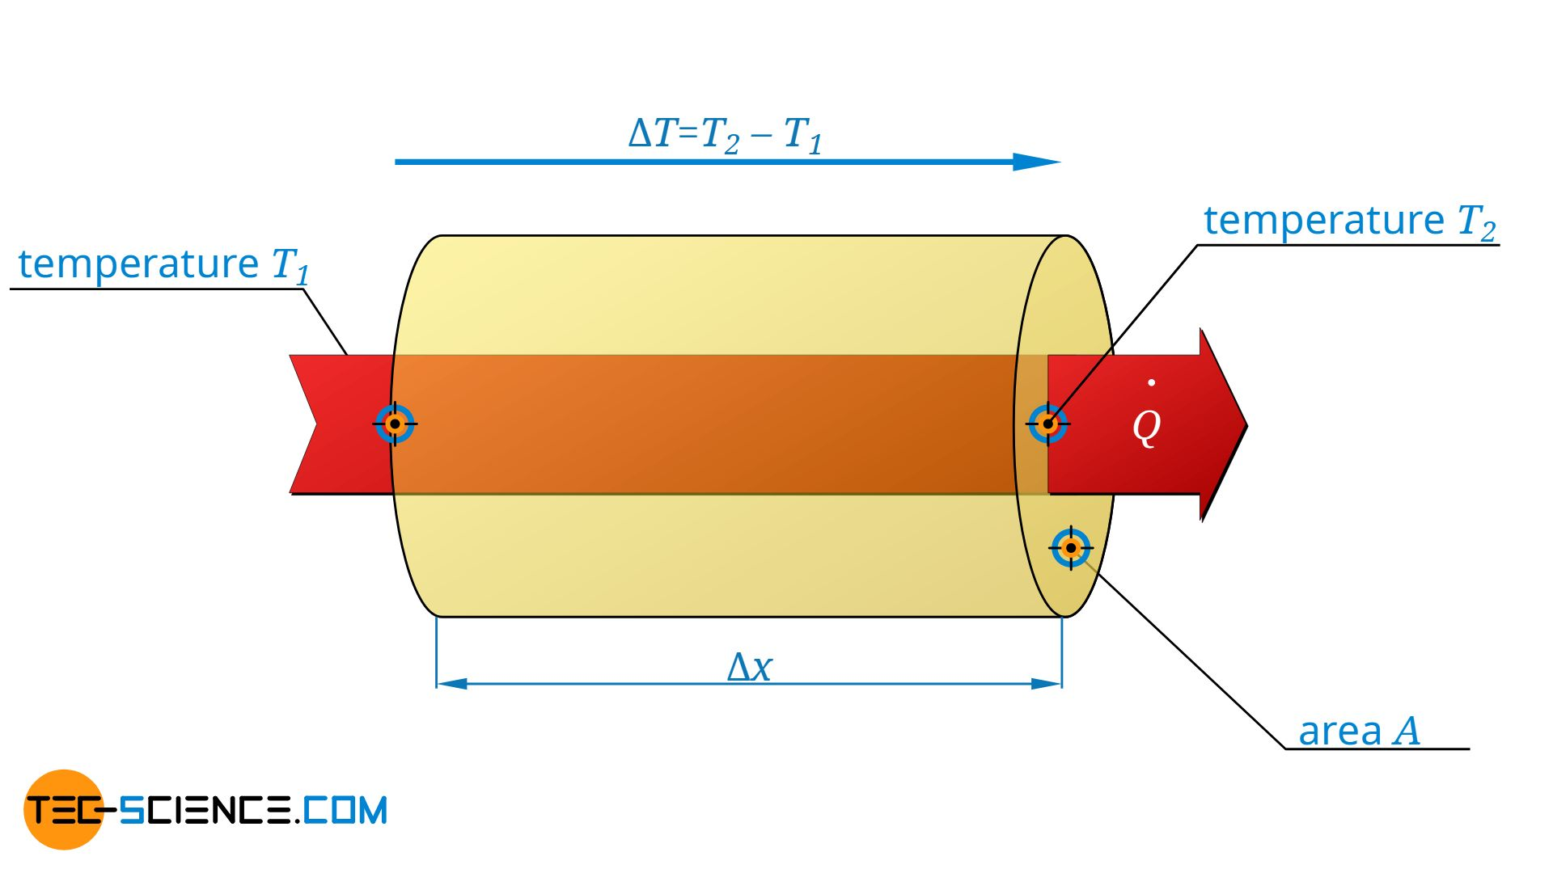
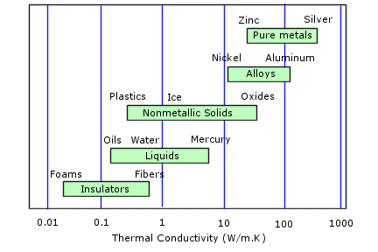

Bulk vs nanoscale: heat conduction
Bulk: Fourier Law
$$q=−κ.\frac{ΔT}{Δx}$$
Solidworks.com

Slide 8
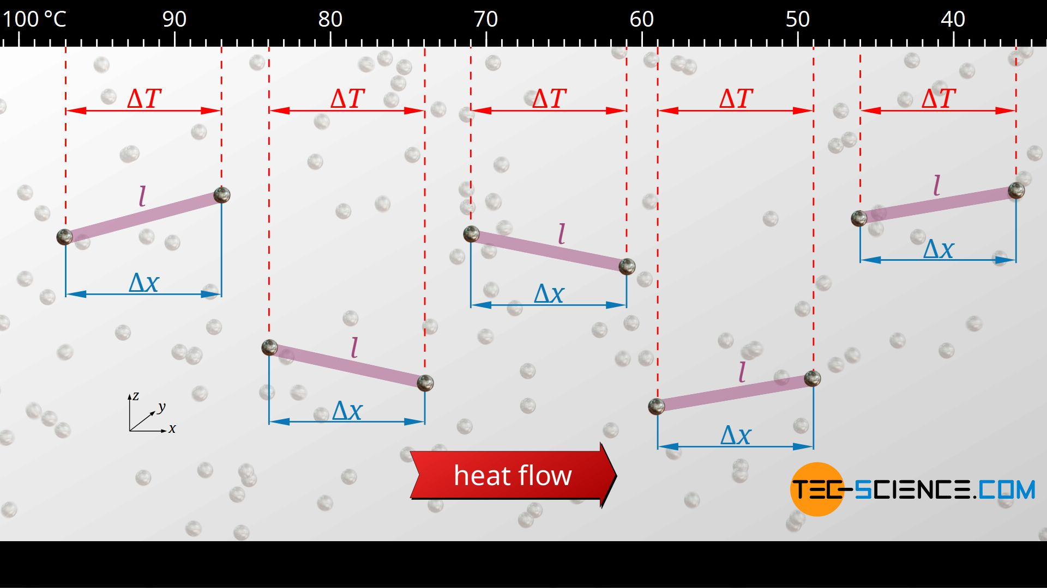
Bulk vs nanoscale: heat conduction
But this breaks down for nanoscale materials!

Slide 9
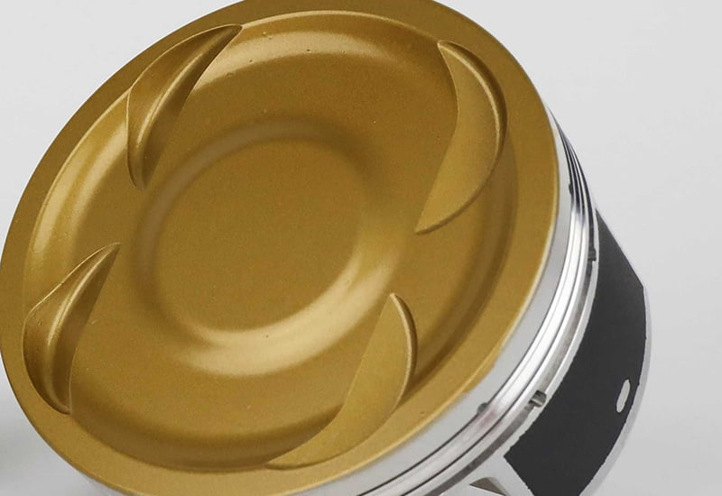
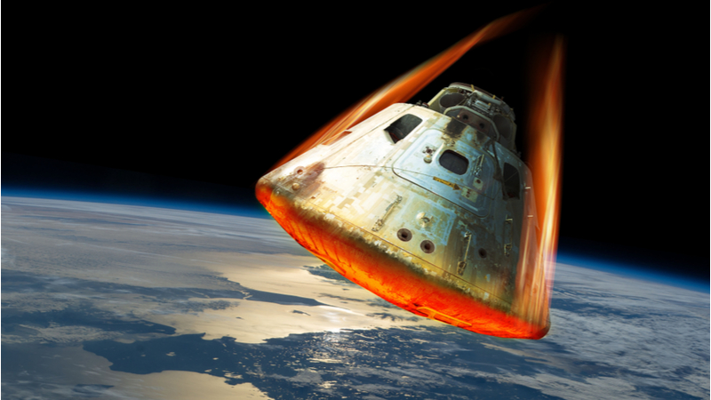
1. Thermal barrier coatings
Piston crown
Need:
Mechanically rigid (dense) thermal insulators
Must insulate the piston from the hot combusting gases!
  Retain heat in the gas: efficiency
  Reduce thermal expansion and fatigue
Jepistons.com
Imeche.org

Slide 10
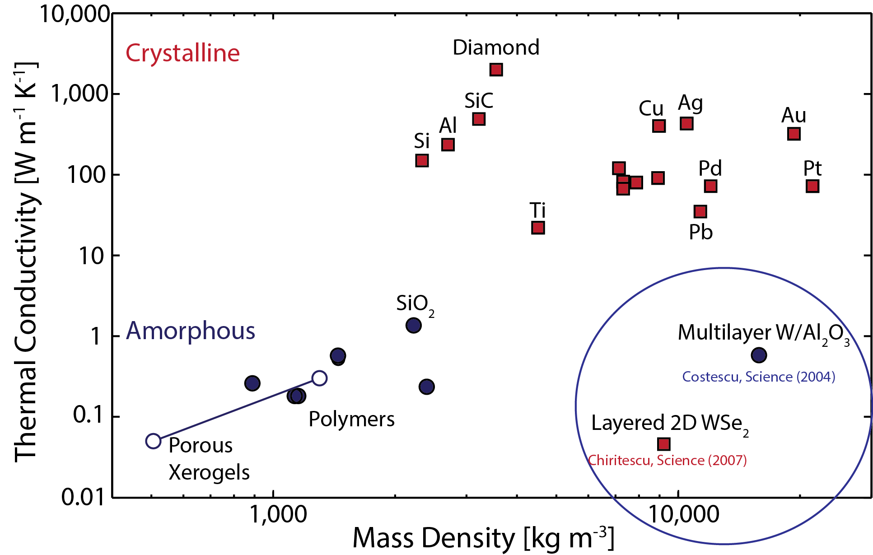
This is not easy! Materials design challenge
Where we want to be!
Barako, PhD dissertation
Stanford University
Most thermal insulators are mechanically soft – bad!

Slide 11
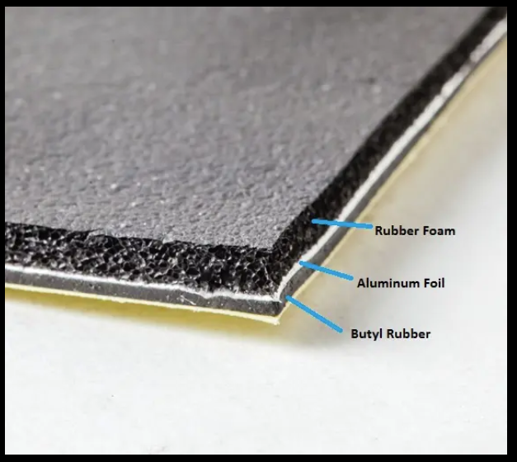
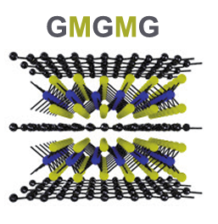
Inspiration from acoustics
Multilayers block sound:
acoustic impedance
Extend this idea to the atom scale!
Alternate light and heavy atoms
Alibaba.com
Sood et al., ACS Nano (2021)

Slide 12
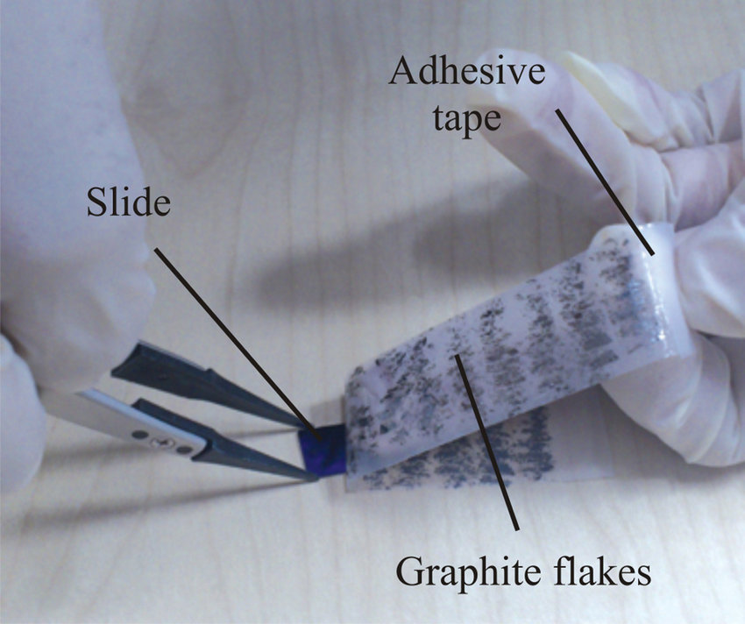
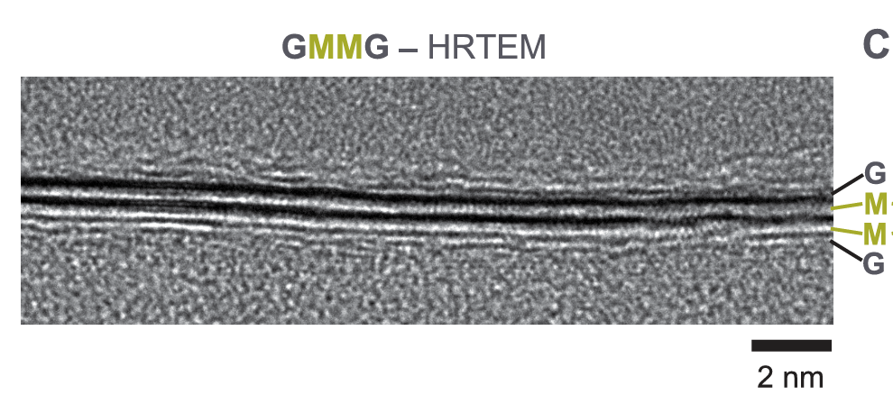
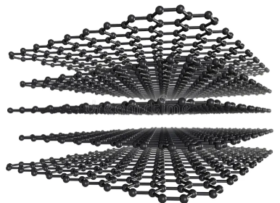

Fascinating world of 2D materials
“Exfoliation”
Nanowerk.com

Slide 13
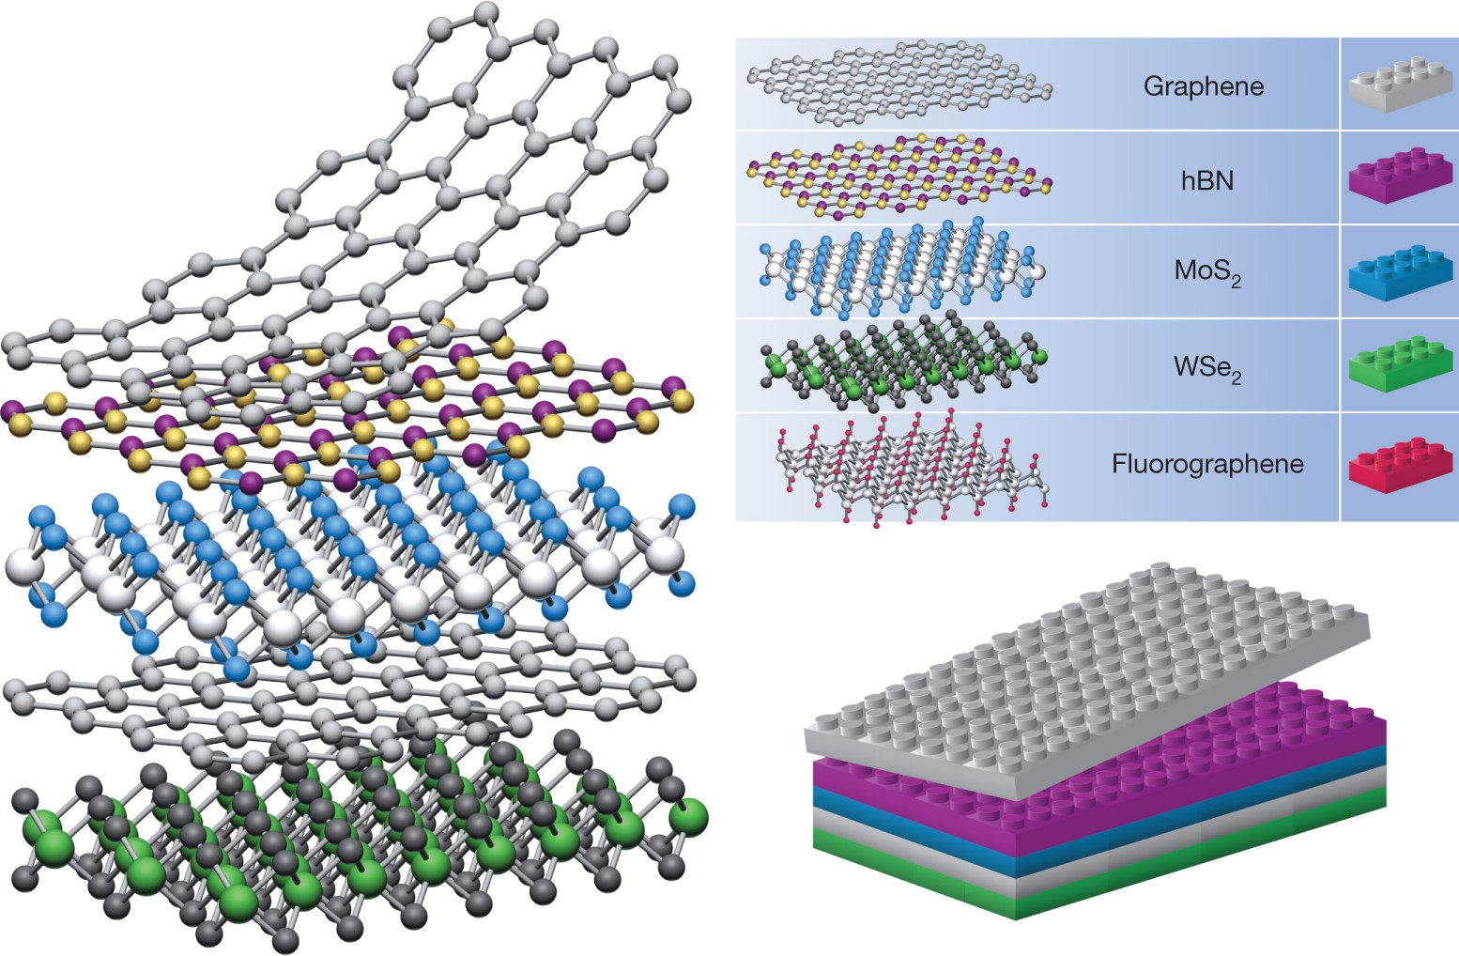
Atomic LEGO blocks
Geim and Grigorieva, Nature (2013)

Slide 14
Does this actually work?
YES! Atomic-scale picture of an atomic sandwich

Slide 15
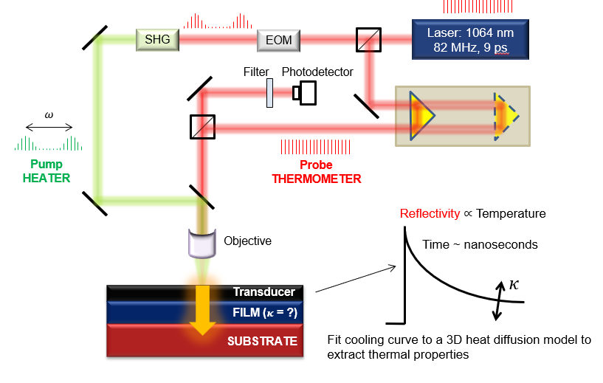
How we measure thermal properties at the atomic scale

Slide 16
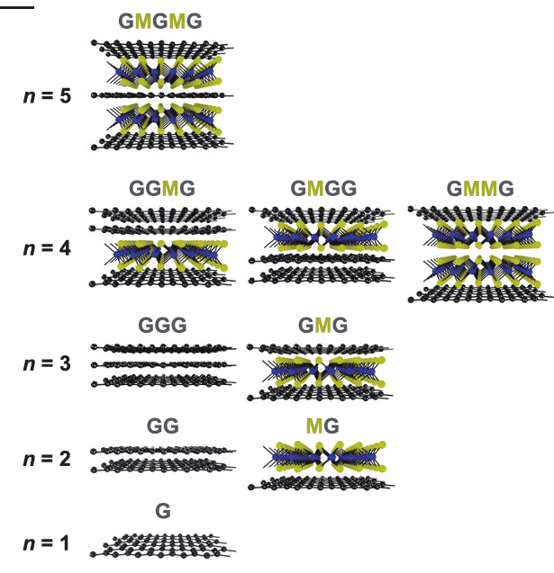
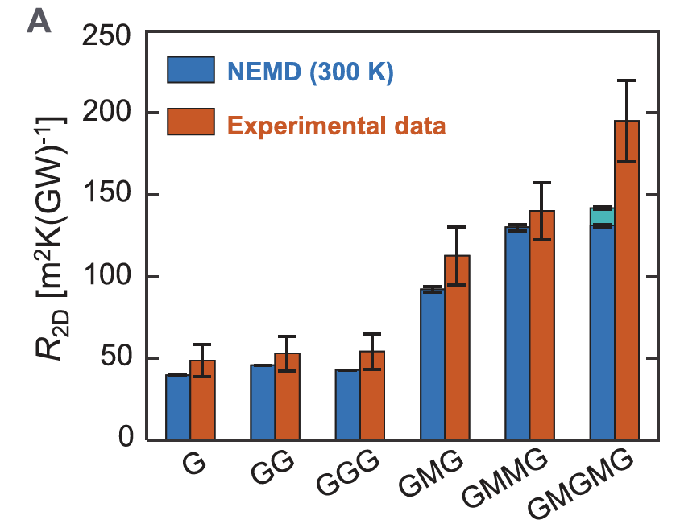
Does this actually work?
YES!
Thermal conductivity measured to be ~0.02 Wm⁻¹K⁻¹ : LOWER THAN AIR!!

Slide 17
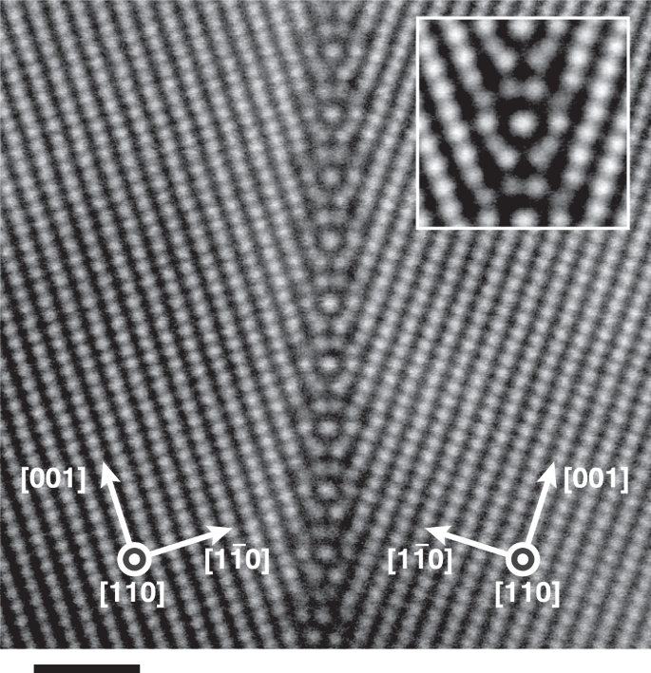
2. Good thermal conductors
Often, we don’t want to block heat, but conduct it away quickly before something heats up. E.g. in the engine block
Need:
Really good thermal conductors
Challenge:
Most real materials have defects
Seki et al., Nat Comm (2023)

Slide 18



Seeing is believing: how defects block heat
Grain structure Thermal conductivity [Wm⁻¹K⁻¹]
Model
Normalized K
Data
20 $μ$m
20 $μ$m
Sood et al., Nano Lett (2019)
Distance from GB (µm)

Slide 19
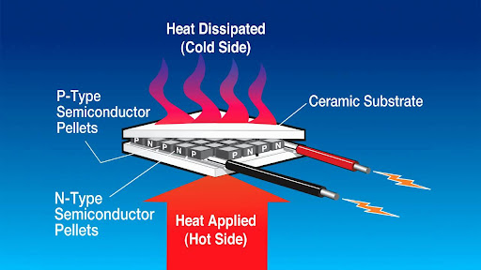
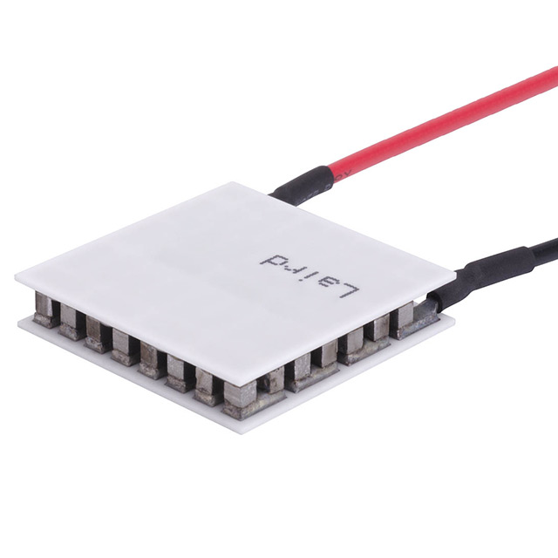

3. Waste heat recovery → generate electricity
Thermoelectric materials: recover waste heat. Fully solid-state!
Conversion efficiency: $zT=\frac{S^{2}σ}{κ}$
Wissink et al., PNAS (2020)
digikey

Slide 20
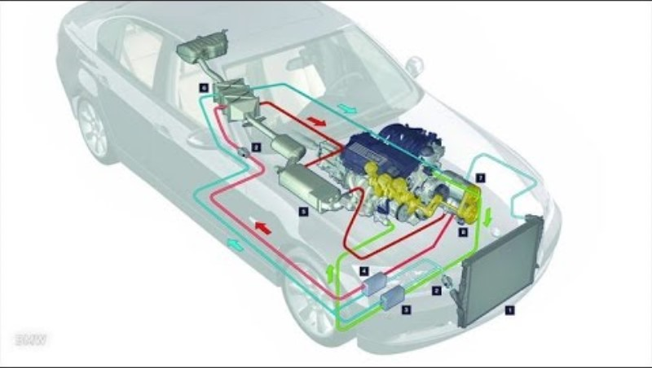
https://youtu.be/FChXGlt-WAM?si=6Qt9aPalyBcDzRgf

Slide 21
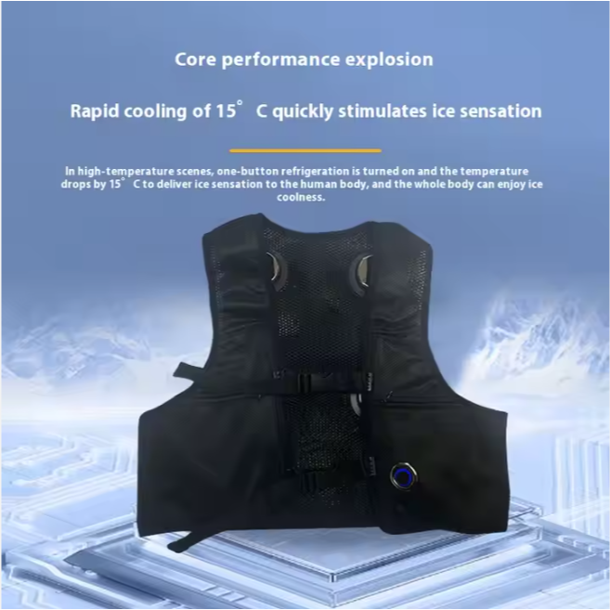
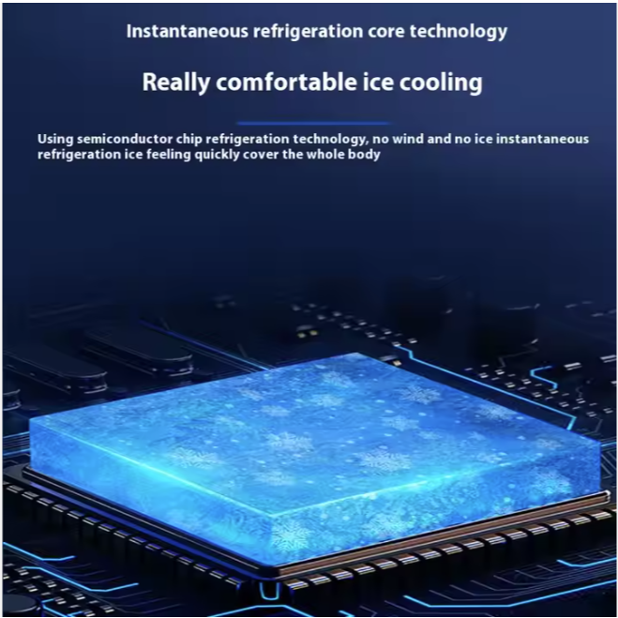
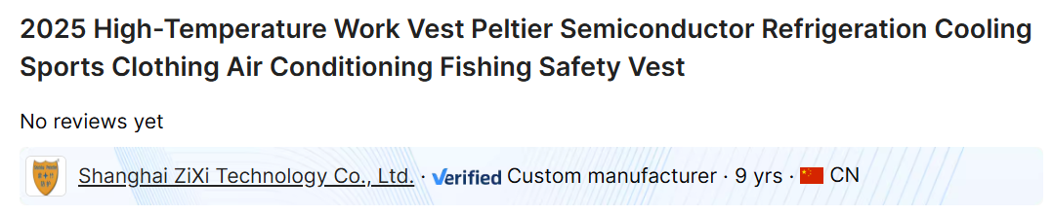
Or run this in reverse: a ‘cool’ motorcycle jacket
Alibaba.com

