Slide 1
Engine Group
FRS 106 - Spring 2026
Ben, David, Eugene, Nathan

Slide 2
Our Process

Slide 3
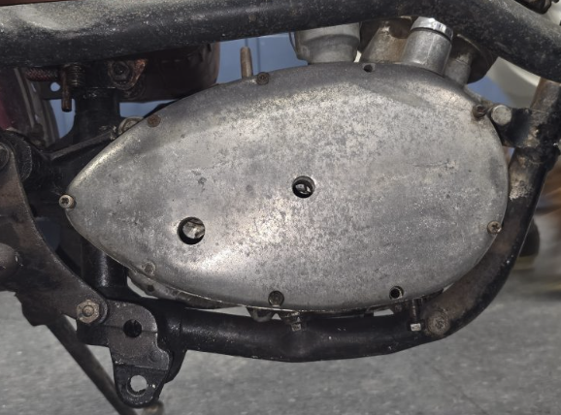

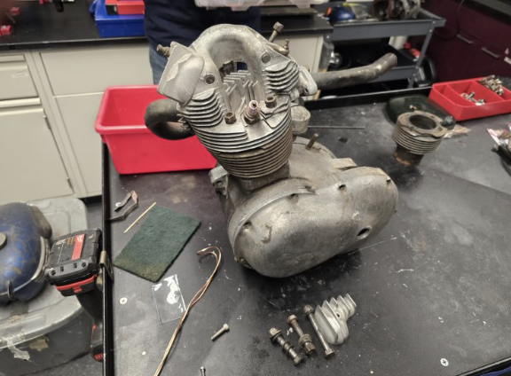
Inspection
Looking at the engine
Finding its model and year – Tiger Cub 1958 – and working with the associated manual
  T20C

Slide 4
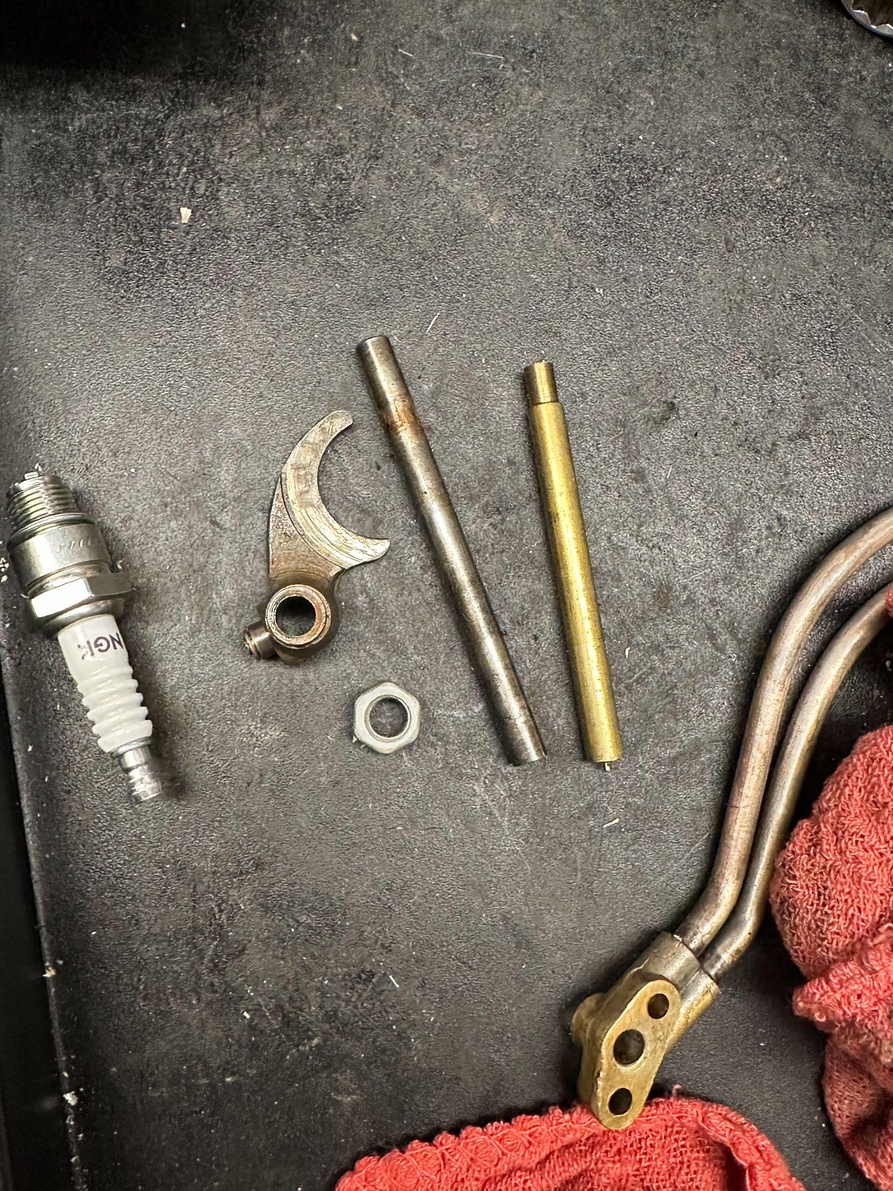
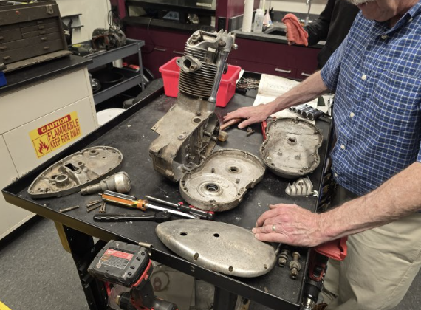
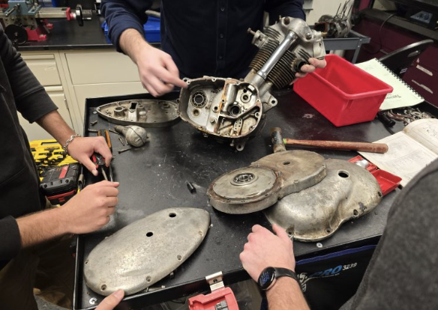
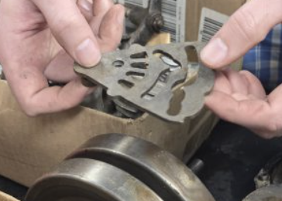
Disassembly
Unbolting the engine
Separating top end from bottom end
Removing crankshaft, piston, transmission, camshaft, etc.
Notes:
Some fasteners required whitworth wrenches – specialized tools on a different measurement system than metric or the U.S. customary system
After the engine unit was removed from the frame, the cylinder head was unbolted and lifted off.
The cylinder and piston were also removed from the lower end of the engine.
Disassembely of the cylinder head began with the removal of the rocker covers. Next, the rocker arms were removed.
The valves were removed by compressing the valve springs with a C-clamp and a special tool while the clips holding the spring in place could be removed.

Slide 5
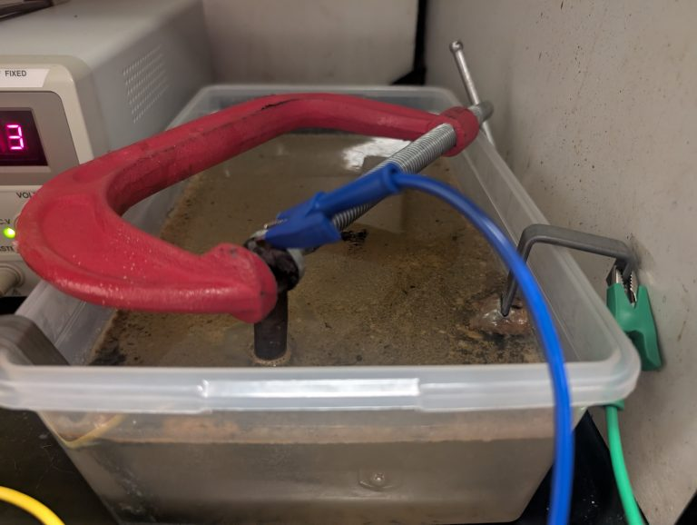
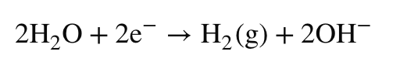
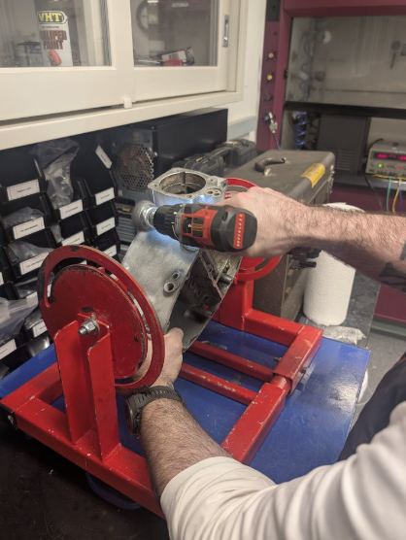
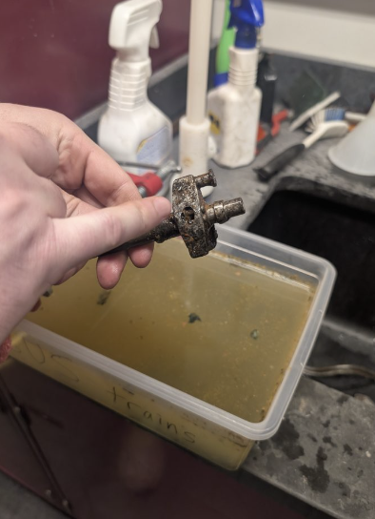
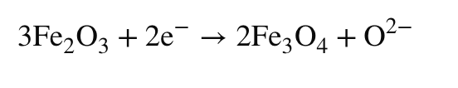
Cleaning
Electrolysis cleans rust from iron and steel via reduction and oxidation using a water-and-soda solution, a power supply (charger), and a sacrificial metal piece.

Slide 6
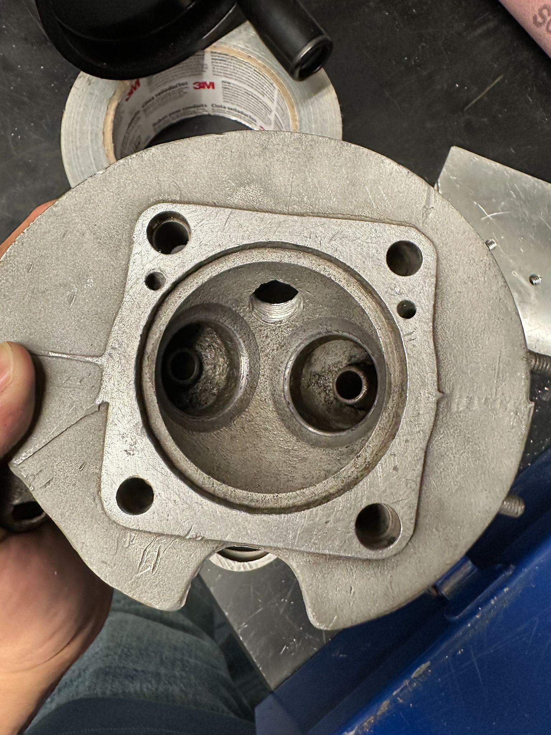
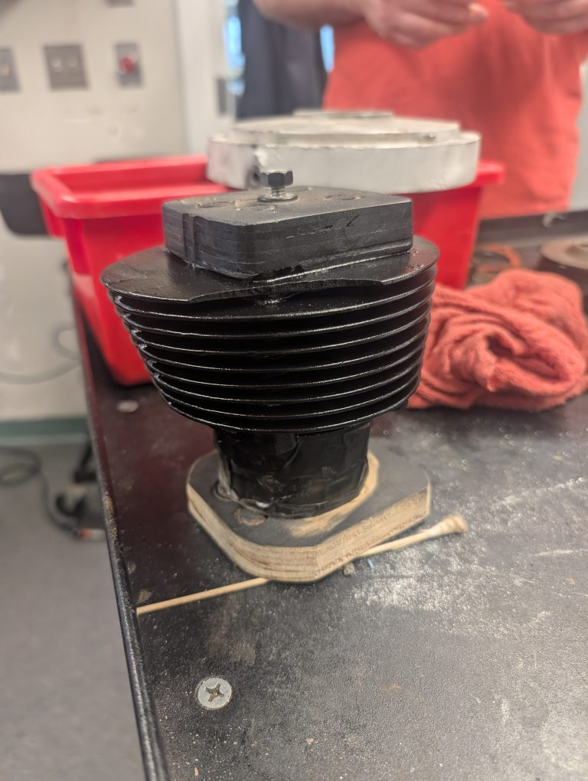
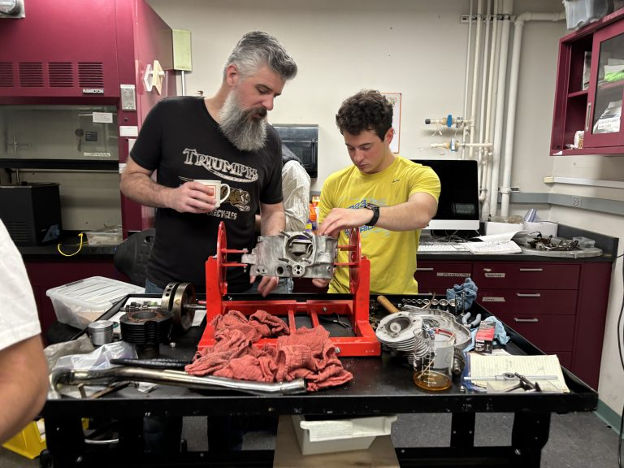
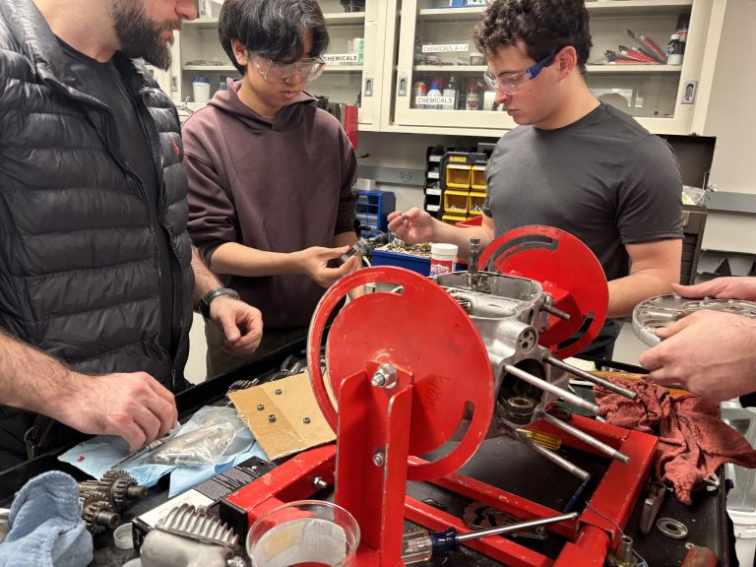
Reassembly

Slide 7
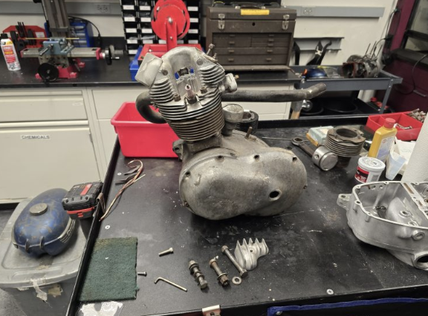
Heat Transfer of Fins by Convection

Slide 8
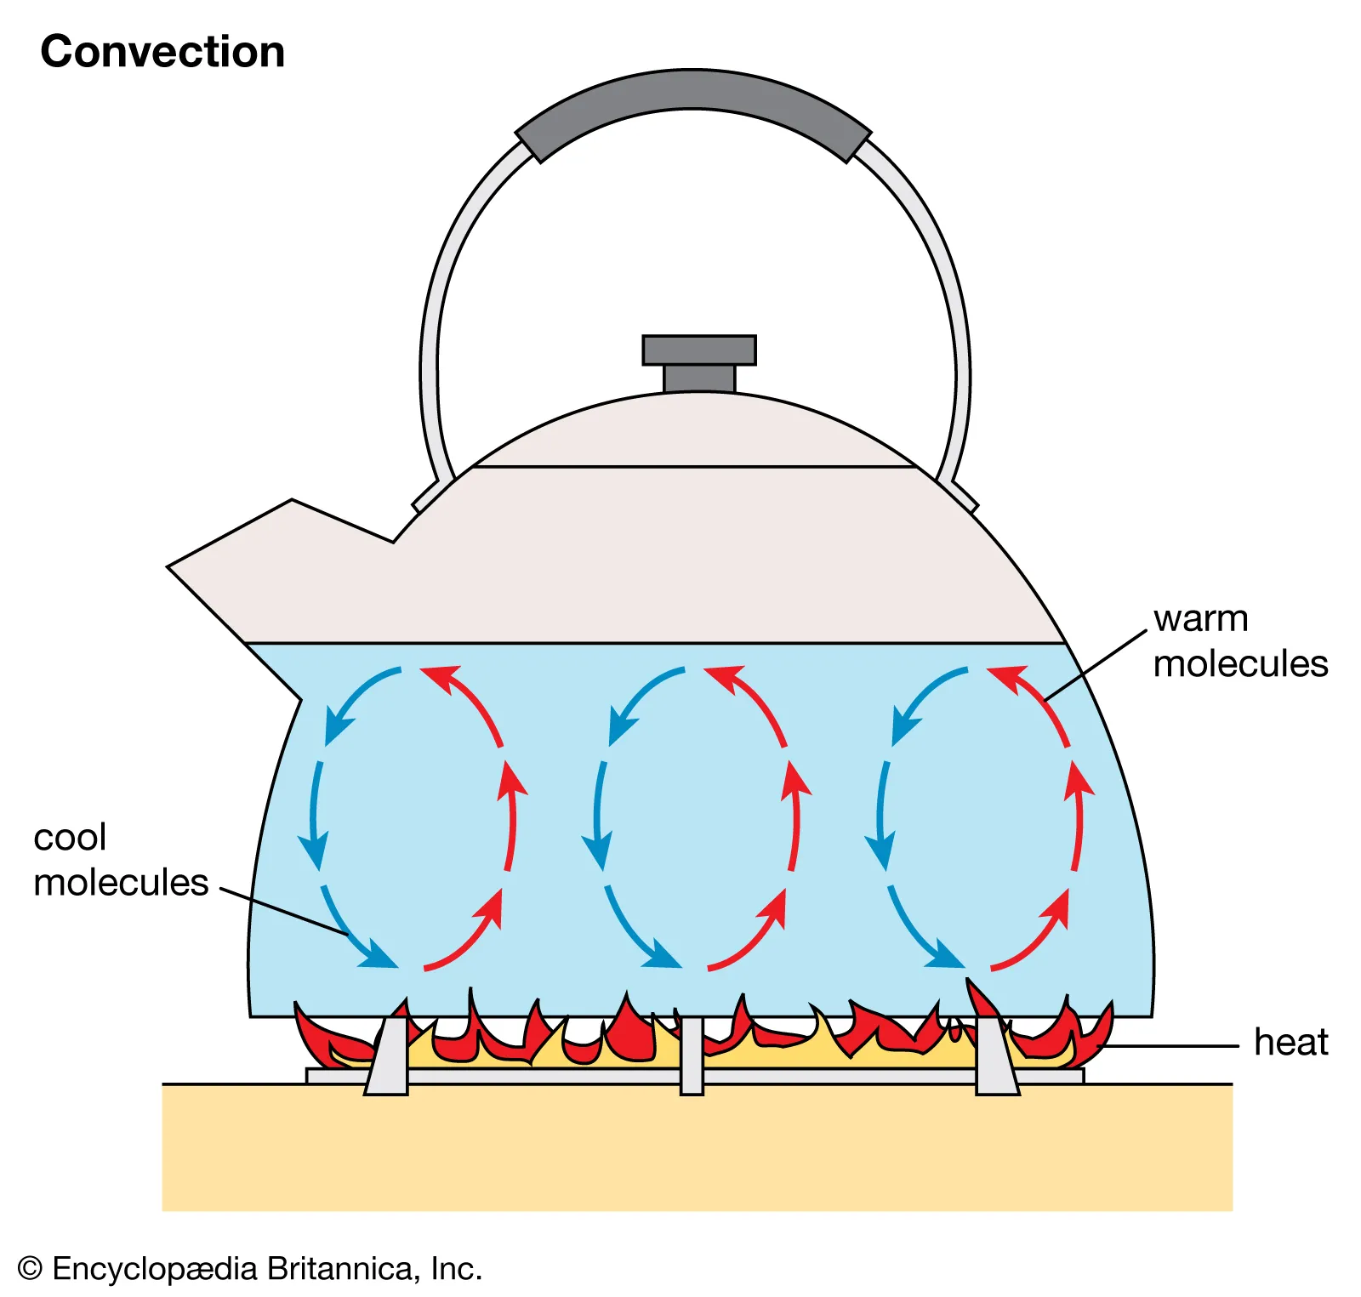
Natural Convection
Transfer of heat through the movement of fluids
Heated particles expand - lower density and rise
Cooler molecules sink and replace heated particles due to density change

Slide 9
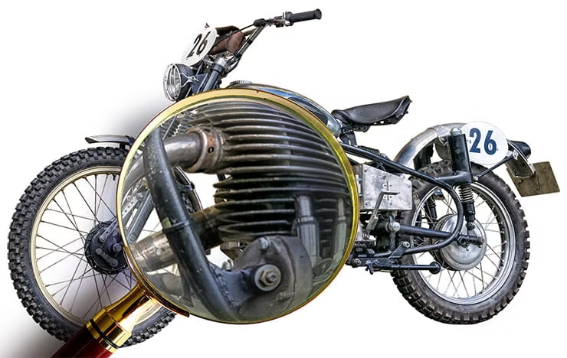
In a motorcycle
Forced Convection - air is circulated from motorcycle moving
Air molecules hit the hot fin, energy transfer
Heated molecules get carried away by airflow
Replaced by cool air

Slide 10

How much heat does our fins dissipate?
Convection governed by Newton’s Law of Cooling
Q - heat transfer rate
h - convection coefficient
A - surface area
T - temperature

Slide 11
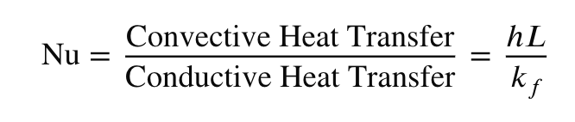
What is h?
Not constant and depends on the airflow
Can be found by looking at the Nusselt Number which relates the convective heat transfer to conductive
Notes:
eugene

Slide 12

Reynolds Number
Nusselt Number is a function of Reynolds number and Prandtl number
Re determines if the air flow is laminar or turbulent

Slide 13
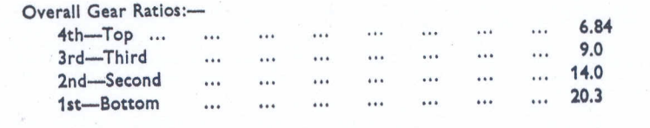
Max velocity of Tiger Cub
The top speed of the engine is 6000 RPM

Slide 14
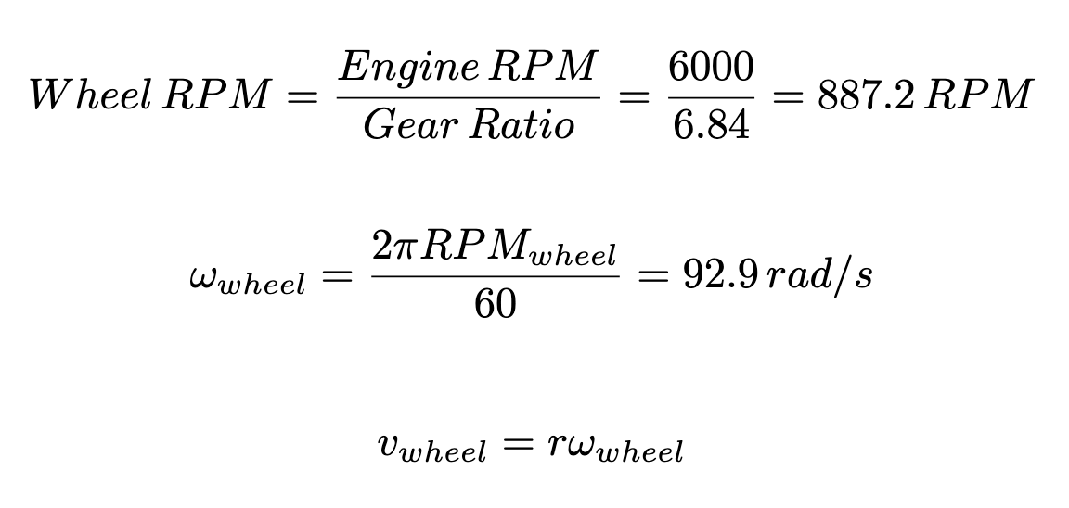
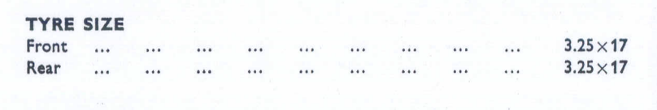

Slide 15
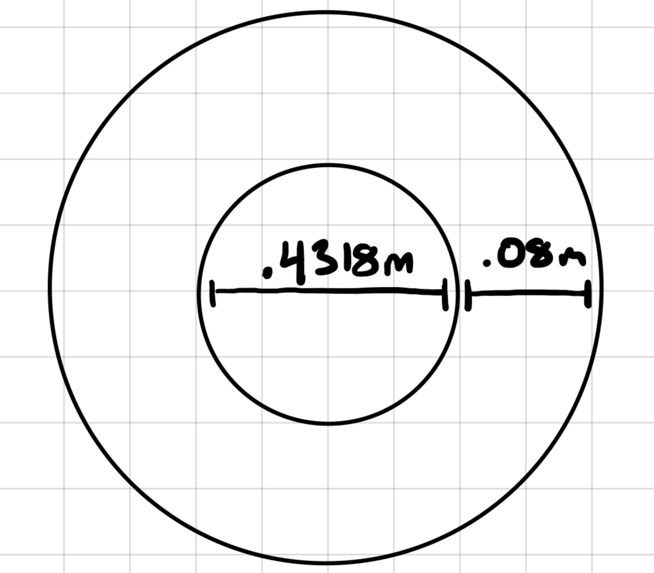
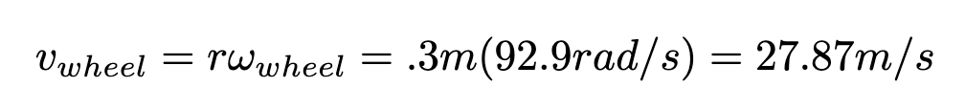
Tire Width = 3.25” = 0.08255 m
Rim Diameter - 17” = 0.4318 m
.4318 + 2(.08255) = 0.597m
r = 0.597/2 = 0.3 m

Slide 16
Calculating Re
Density of air = 1.225 kg/m^3
Dynamic viscosity of air = 1.8E-5 Pa*s
Characteristic Length = Distance between fins = .18” = 0.004572 m
Velocity = 27.87 m/s
Re = 8672
Approximately 10^4

Slide 17
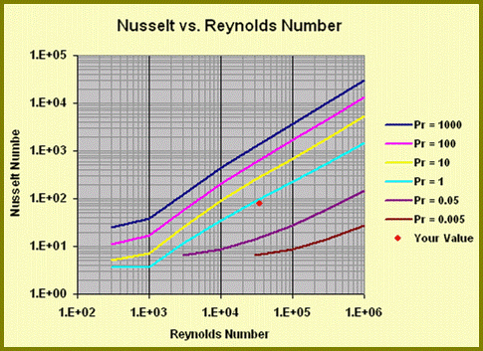
Pr of Air = .7
Re = 1E4

Slide 18

Finding h
Nu = 50
Characteristic Length = Distance between fins = .18” = 0.004572 m
k = thermal conductivity of air = 0.026 W/m*K
h = 284.3 W/m^2*K
Notes:
eugene

Slide 19
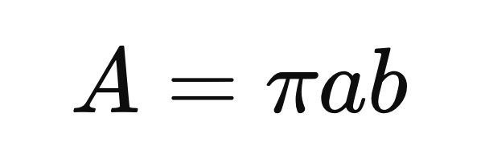
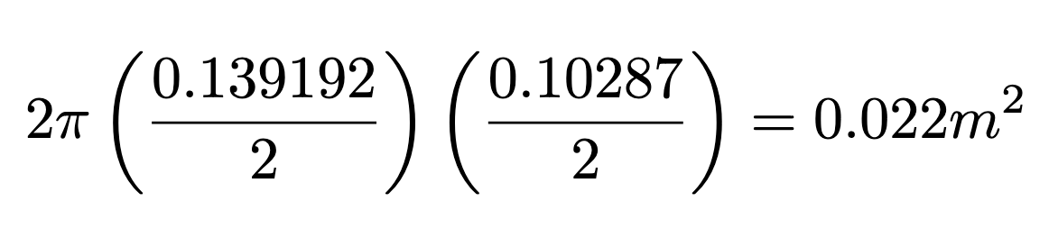
Surface Area of a fin
Assume fin cross section is an ellipse
Major Axis Diameter = 5.48” = 0.139192m
Minor Axis Diameter = 4.05” = 0.10287m
Air flows on both sides of the fin so multiply by 2

Slide 20
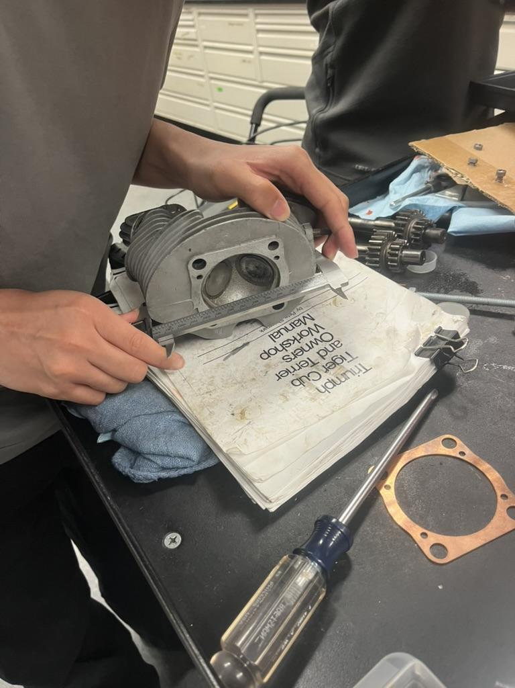
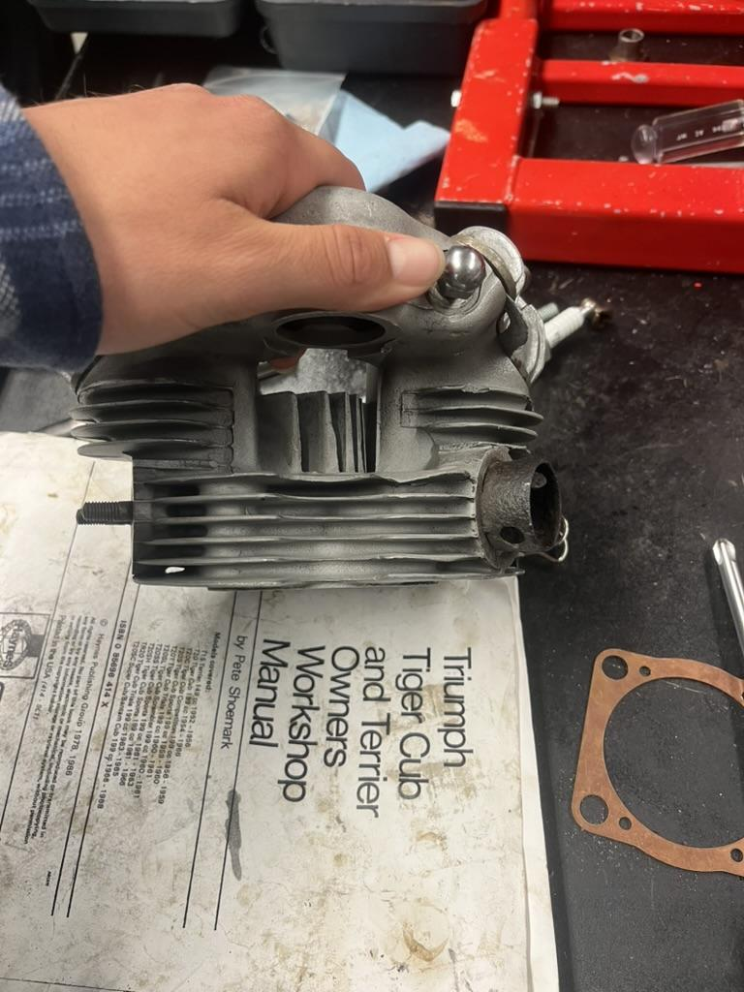
Measuring the Axes and Counting Fins

Slide 21
Heat dissipated by 1 fin through convection
Assuming:
Riding in room temperature (20 Celsius = 293.15K)
Fin heats up to 100 Celsius = 373.15K

Slide 22
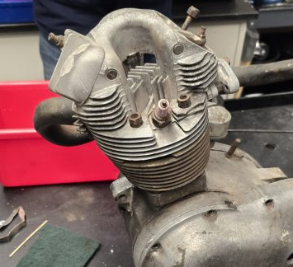
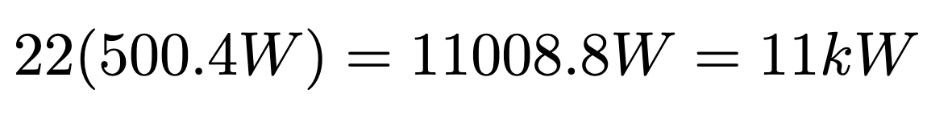
Heat dissipated by the head through convection
15 full fins
A bunch of little fins - assume thats equivalent to 7 full fins

Slide 23
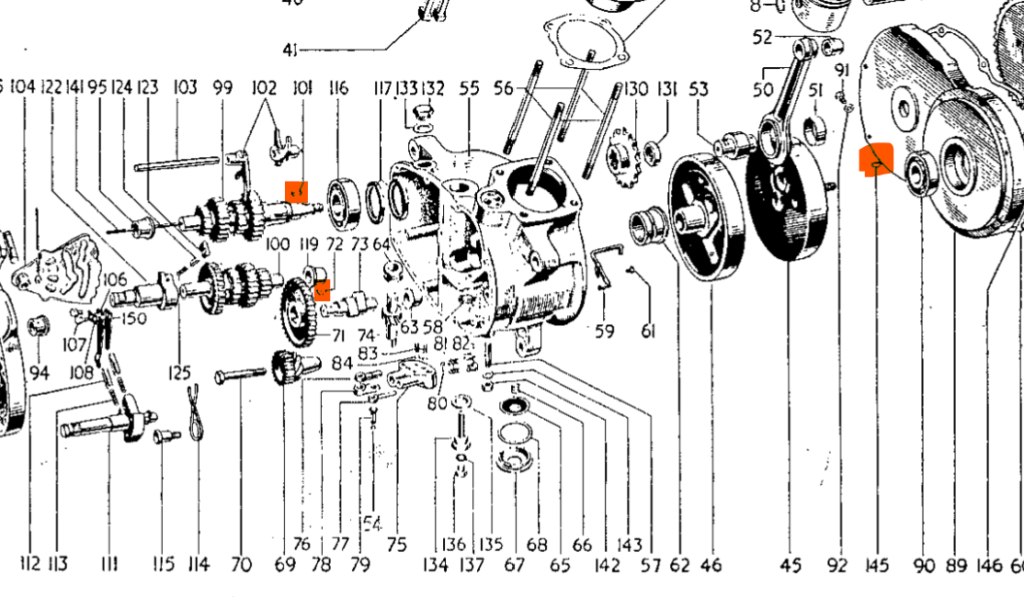
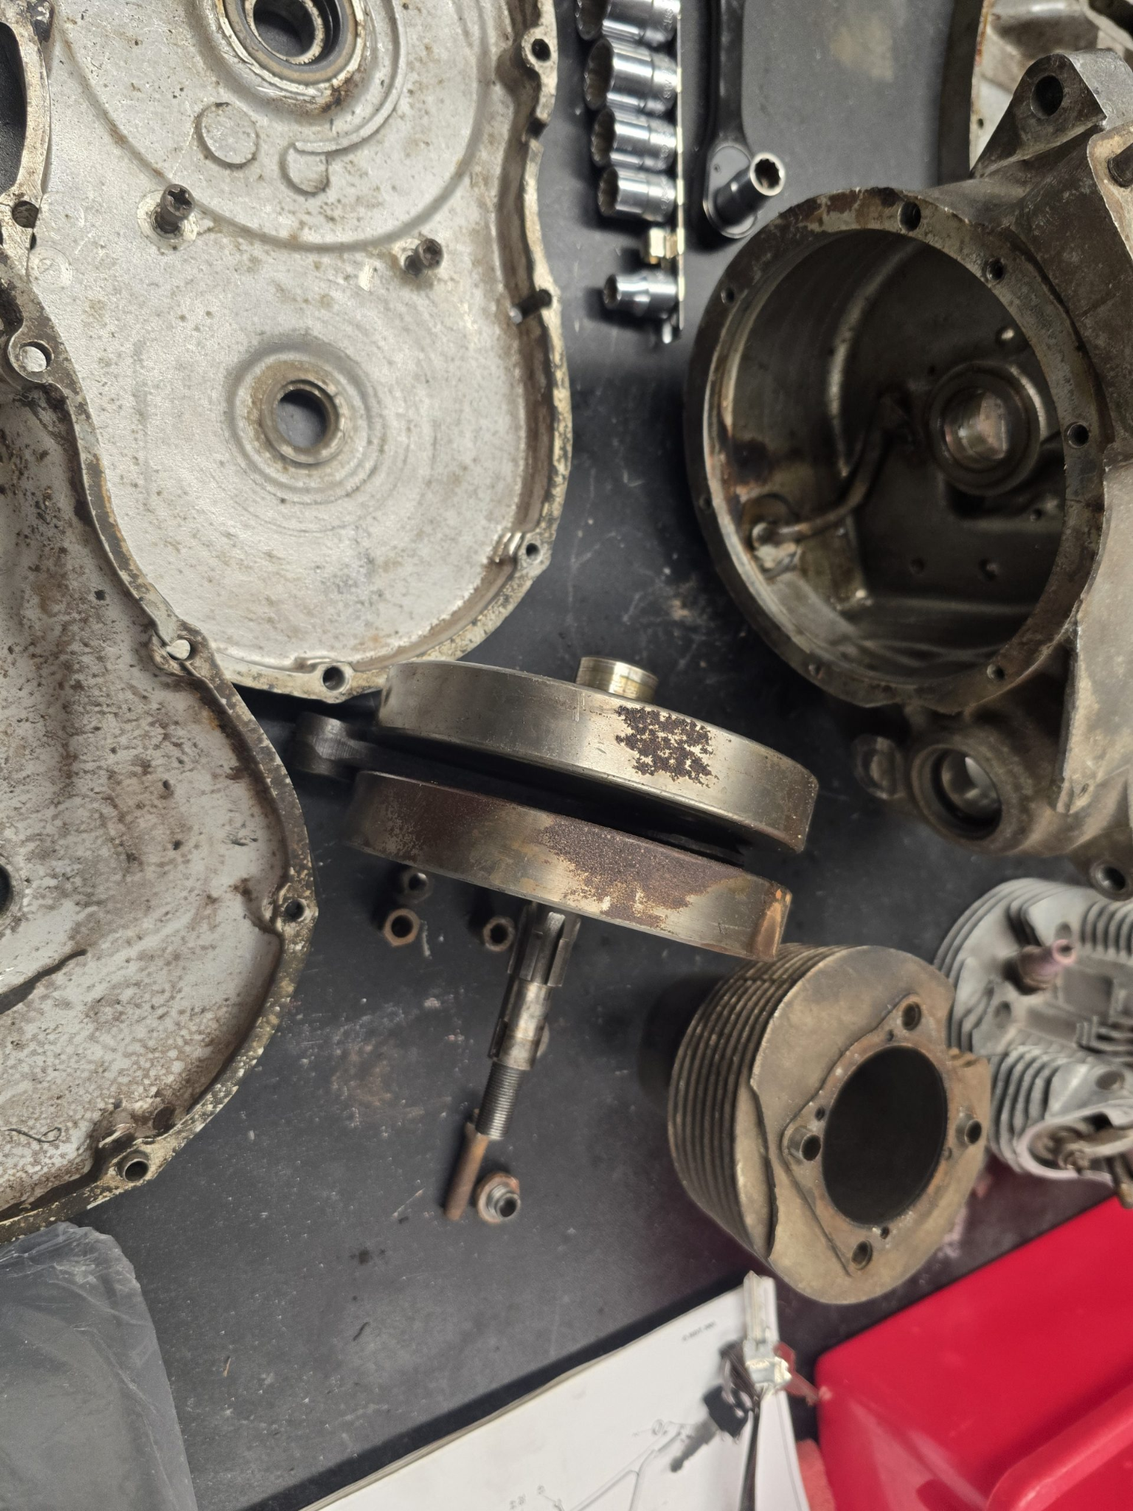
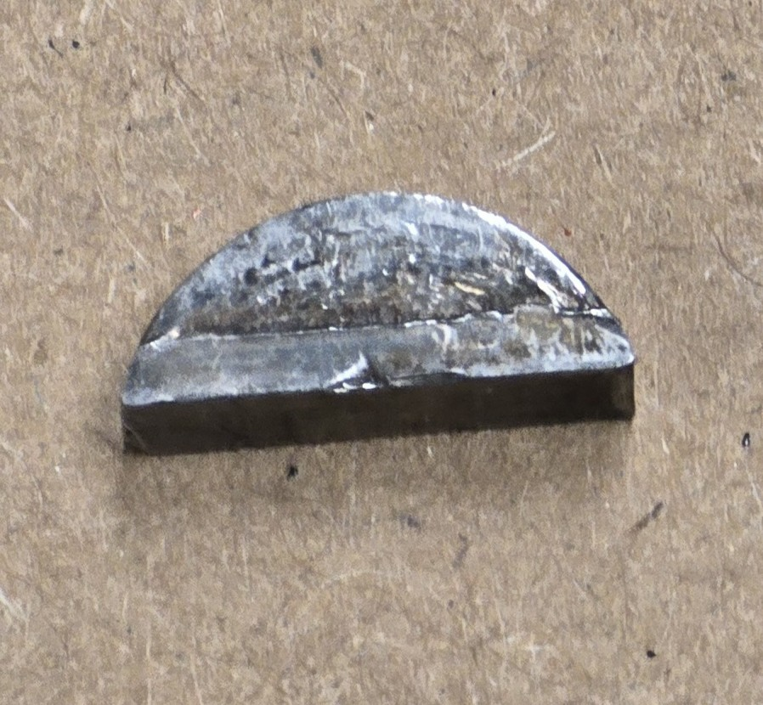
The Woodruff Key
One of the most visually unimpressive but mechanically important parts.
Notes:
We were quickly intrigued by this tiny, roughly cut piece of metal. When we asked about it - we learned that it is an incredibly important part that ensures the bike moves. Without it, the engine will create energy, but none of that energy would make its way to the wheels. There are several of these little guys and each of them serves a similar purpose. We will primarily focus on one. It sits in the the crankshaft and transfers power to the drivetrain. First, a little more on their function:

Slide 24
Function of the Woodruff Key
Locks rotating parts together.
It prevents components from spinning independently on the shaft. (like sprockets or the flywheel)
Transfers torque through a tiny contact point.
Because it is the singular point of contact between two rotating parts, it serves as a critical point that ensures power transfer.
Maintains alignment and timing
It keeps components in the correct angular position which is critical for things like ignition timing or gear alignment.
Can act as a mechanical fuse
Under shock loads, it may shear before more expensive parts fail.
Notes:
Imagine a bar sitting inside of a ring. You can rotate the bar, but without sufficient friction or some sort of wedge, it wont rotate the ring. That’s where the woodruff key sits. There is a tiny little grove in the shaft, and a tiny groove on the opposite side in the ring - which fits together like a lock and key.
Noted
Noted
What this means in action is what I described already - when this piece shears in half, no power is transferred from the engine through to the wheels. Effectively stopping the bike in its tracks.
Let’s take a moment to visualize this:

Slide 25
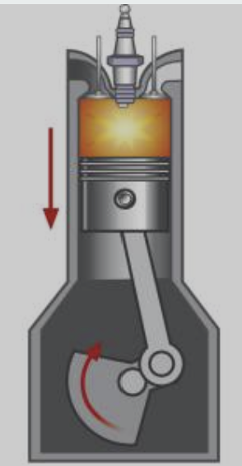
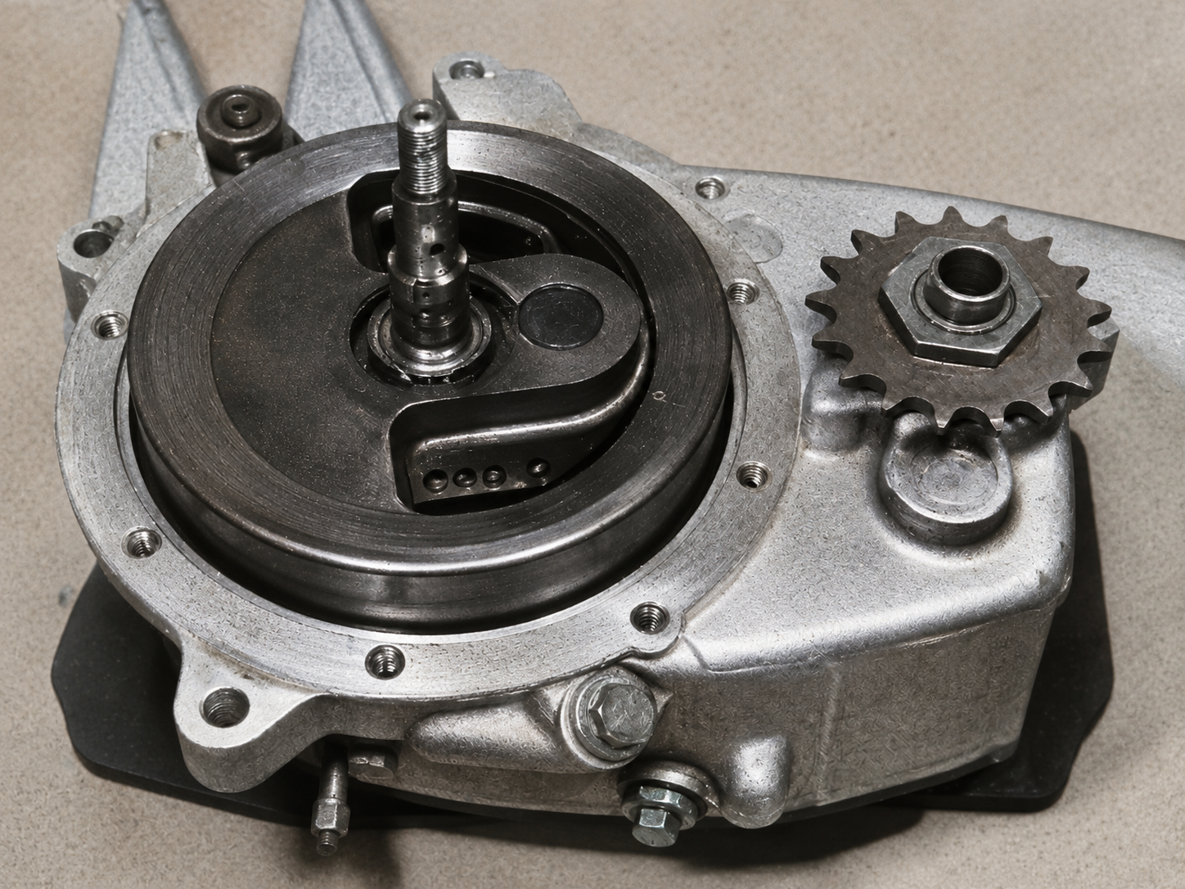
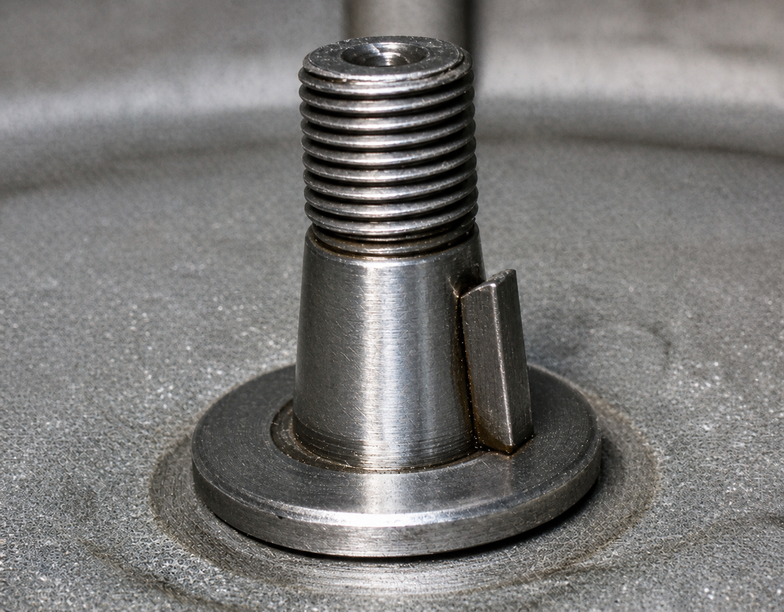
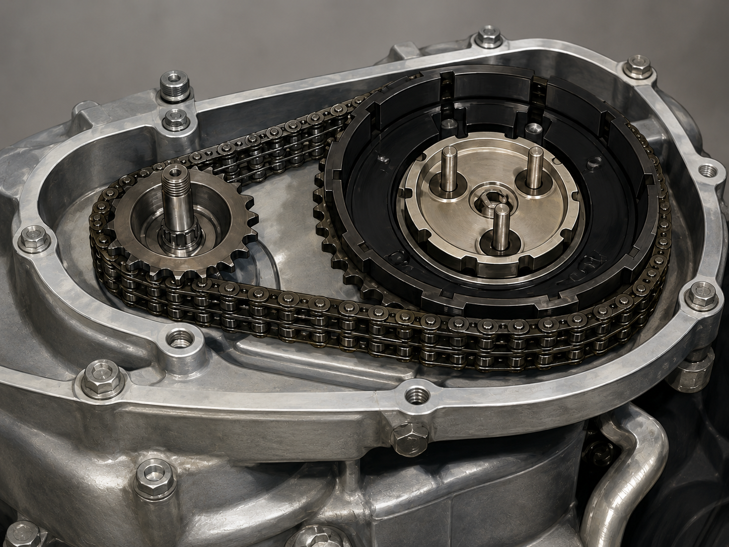
From Explosion to Rotation
Combustion creates force. Fuel ignites in the cylinder, pushing the piston downward and driving the crankshaft.
The crankshaft converts this into rotation while the flywheel smooths the motion, reducing the pulsing between each combustion event.
The smoothed rotation leaves the crankshaft (thanks to our woodruff key) and is transferred through the primary drive, clutch, and gearbox where it is ultimately delivered to the rear wheel.
Notes:
Here is how this looks in action - as we know, the piston resides in the cylinder where combustion takes place thrusting the piston downward with the crank arm which rotates the crankshaft. That crankshaft is connected to a flywheel which evens out the rotational force throughout each stroke.

Slide 26
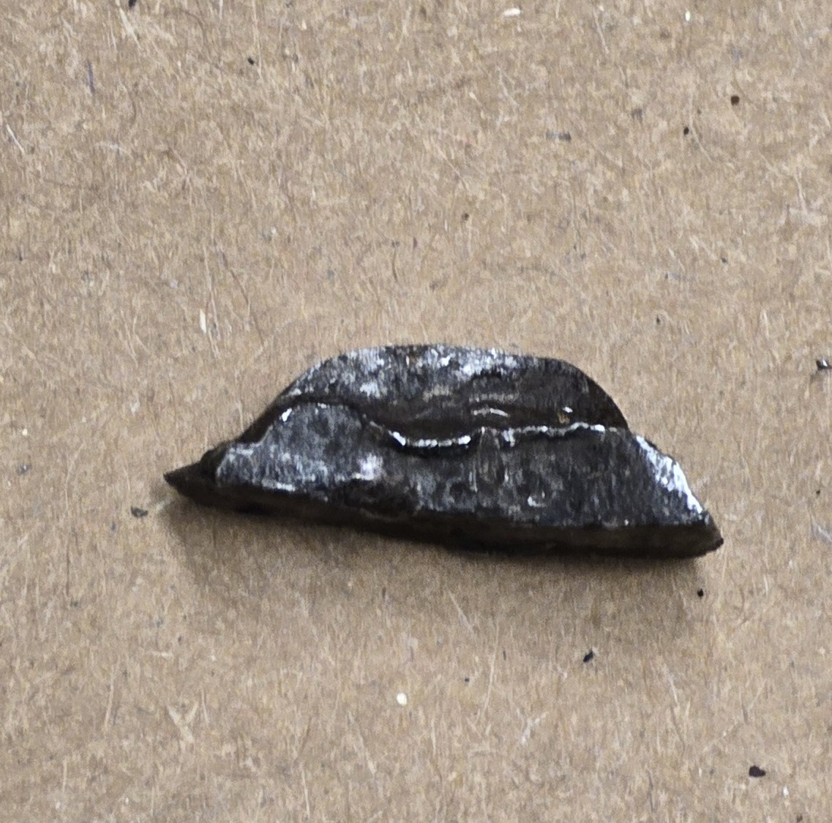
Woodruff Key as a Critical Point of Failure
Calculating maximum shear force
Normal Size: 3/16 in x ⅝ in
Width: 0.1875-0.1885 in
Actual Length: 0.602-0.612 in
AISI 1035 shear strength
(52,000 -54,000 psi)
Tfailure = r x A
Ffailure = ~52,000 x 0.112875
Ffailure = 5,869.5lb
Taking the minimums:
A=width x length
A=0.1875 x 0.602
A= 0.1129in^2
Shear area: ≈ 0.113in^2
Convert to Torque
T = F x r
T = 5,080 x 0.3125
T = 1,834.2 lb-in
Convert to lb-ft:
1,834.2/12 = 152.85 lb-ft
Notes:
This tiny piece can also become a critical point of failure. When disassembling our engine, we found that one of the woodruff keys was indeed crushed. So we wondered what the tolerance was of this tiny piece of metal.
Using the approximate size of the woodruff keys in our tigergears we have these dimensions. With some calculations, we can see what exactly happened to our little friend. First we calculate the shear area which works out to approximately 0.113 inches squared. Now, if we multiply that by the shear strength gathered from a materials data sheet, we see that the point of failure is approximately 5870 lbs. Converting that into torque we eventually land on 152.85 foot pounds of torque. This level of torque represents a shock value because at peak horsepower, our normal operating torque is about 8.75 foot pounds of torque. A small car generally creates between 100 and 200 foot pounds of torque.

Slide 27
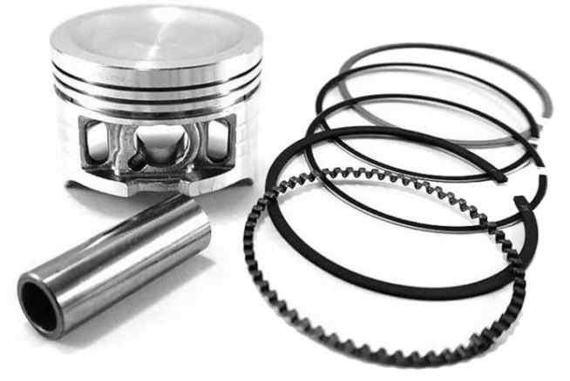
Piston Rings

Slide 28
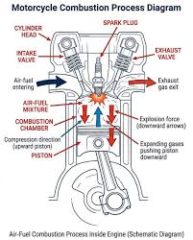
What are Piston Rings, and why do we need them?
A piston is actually slightly smaller than the hole it sits in, this is necessary to allow the piston to move.
Unfortunately, this creates 3 major problems
The gas explosion wants to escape through the gap
The top of the piston gets hot from the combustion
The bottom of the engine is filled with oil that shouldn’t get mixed in the combustion
Oil
Notes:
A piston is actually slightly smaller than the hole it sits in (the cylinder). If they were the exact same size, the metal would expand when hot and the engine would jam. We need that "gap," but the gap creates three problems that rings solve:
When the gas explodes above the piston, it wants to escape through the gap.
The top of the piston is sitting in a literal fire (combustion). It gets incredibly hot, but it has no way to cool down.
The bottom of the engine is splashed with oil to keep things moving. If that oil gets into the "fire" at the top, the engine will smoke and the spark plug will get dirty (fouled).

Slide 29
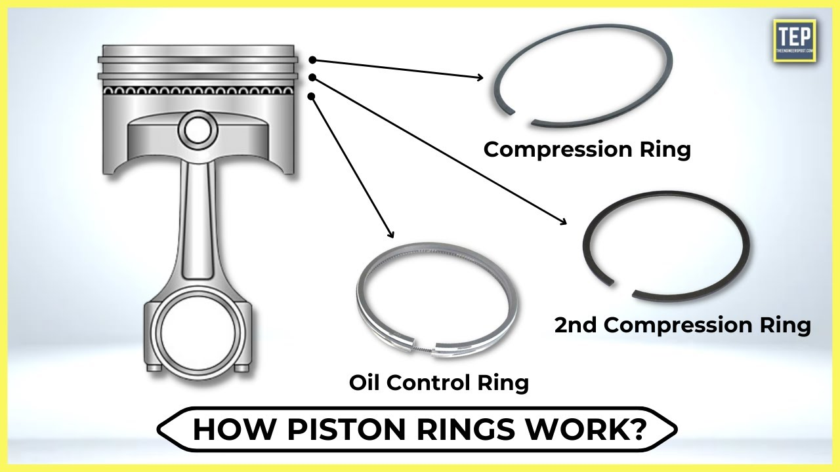
To solve this problem, we need two types of Piston Rings:
There are two different types of oil ring;
Compression Rings and Oil rings.
Compression rings can solve the first problem of force dispersion
oil rings solve the third problem of oil in the engine
Both solve the second problem.
The rings are cast-iron, but the compression rings are solid while the oil control ring has deep grooves in the outer circumference and slots cut through the center

Slide 30
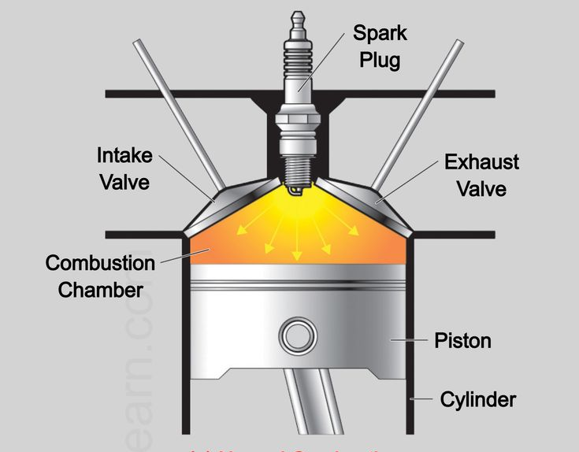
Problem 1: Gas Escape
In a combustion engine, when the gas explodes above the piston, it wants to escape through the gap created by the space between the piston and the barrel.
The Fix: The top rings (Compression Rings) trap that explosion.
This forces the piston down, giving the bike its power.

Slide 31
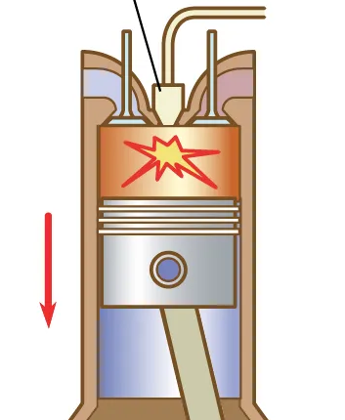
Problem 2: Heat Transfer
The top of the piston is sitting in a literal fire (combustion). It gets incredibly hot, but it has no way to cool down.
The Fix: The rings act as a bridge. They touch both the hot piston and the cool, oil-backed cylinder wall.
The piston rings (both compression and oil) take the heat away from the piston so it doesn't melt. Same as the fins.

Slide 32
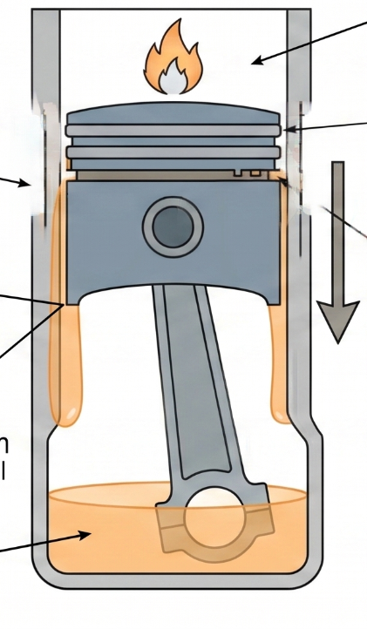
Problem 3: Oil Control
The bottom of the engine is splashed with oil to keep things moving. If that oil gets into the "fire" at the top, the engine will smoke and the spark plug will get dirty (fouled).
The Fix: The bottom ring (Oil Ring) wipes the cylinder wall clean on every downward stroke.
This keeps the oil where it belongs and the fire clean.

Slide 33
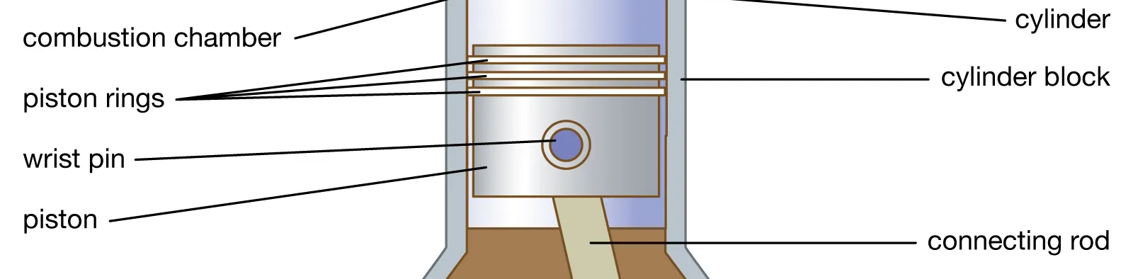
How do the rings actually work?
They use spring tension to expand outward keeping them tight against the walls
They also use gas pressure for the seal: when the engine fires, the high-pressure gas actually gets behind the top ring and pushes it even harder against the wall. The explosion helps the ring seal better.

Slide 34
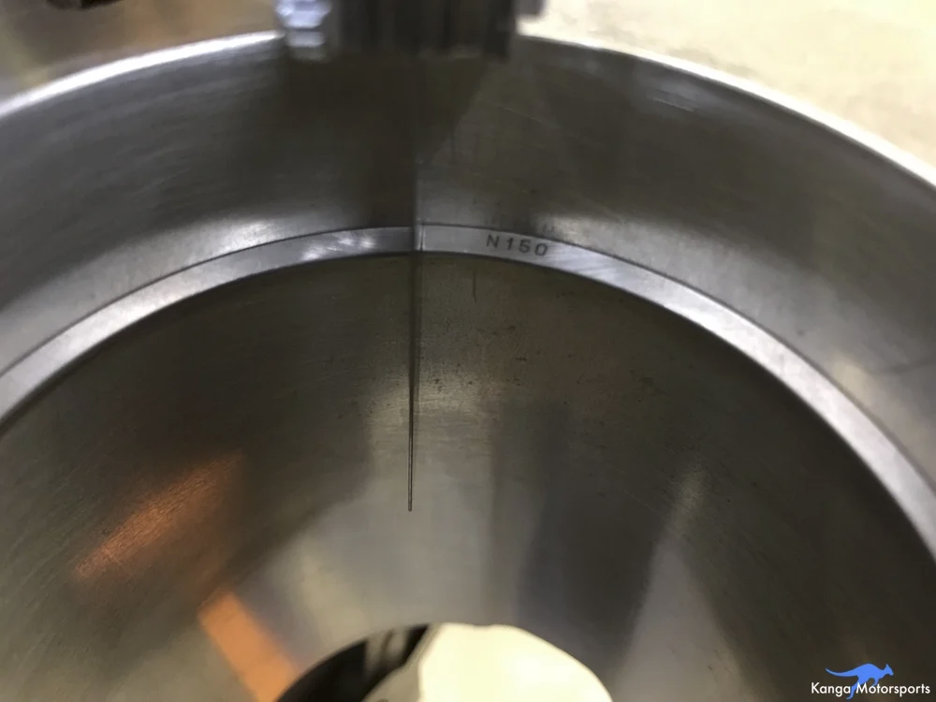
The Ring Gap
The Split Design: Rings aren't solid circles; they have a tiny physical gap to allow for thermal expansion as they heat up.
Risk of Gap Being Too Small:
Ends will collide ("butt") as the metal expands.
Forces the ring outward, creating extreme friction and scoring cylinder walls.
Can lead to a seized engine or shattered pistons.
Risk of Gap Being Too Large
Creates a permanent pressure leak in the combustion chamber.
Blow-by: Exploding gases escape through the gap, causing horsepower loss.
Oil Contamination: Exhaust gases turn engine oil black and acidic.
Notes:
The Ring End Gap is perhaps the most critical measurement in any engine rebuild. While the rings look like complete circles, they are actually "split" with a tiny physical gap between the ends. This gap is necessary because of thermal expansion. As the engine runs, the rings absorb immense heat from the combustion process and physically grow in length. If there were no gap, the two ends would collide as they expanded, causing the ring to buckle, scrape the cylinder walls, or even shatter the piston.
If the gap is too small: The ends will meet and "butt" together when the engine gets hot. Since the metal has nowhere else to go, it forces the ring outward with massive pressure against the cylinder wall. This creates extreme friction, scores the metal, and can "seize" the engine—locking the piston in place instantly.
If the gap is too large: You essentially have a permanent leak in your pressure chamber. On the "power stroke," the exploding gases will whistle right through that gap (called blow-by). This loses you horsepower and blows hot, dirty exhaust gases down into your clean oil in the crankcase, turning it black and acidic very quickly.

Slide 35
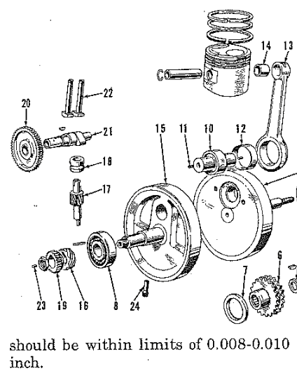
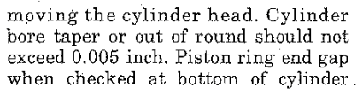
Calculating optimal ring gap
Gap = Bore * Factor
Bore = 63mm = 2.48in
Factor = 0.005 in/bore
Gap = 2.48 * 0.005 = 0.012
Maximum gap of 0.012in, should be smaller for safety

Slide 36
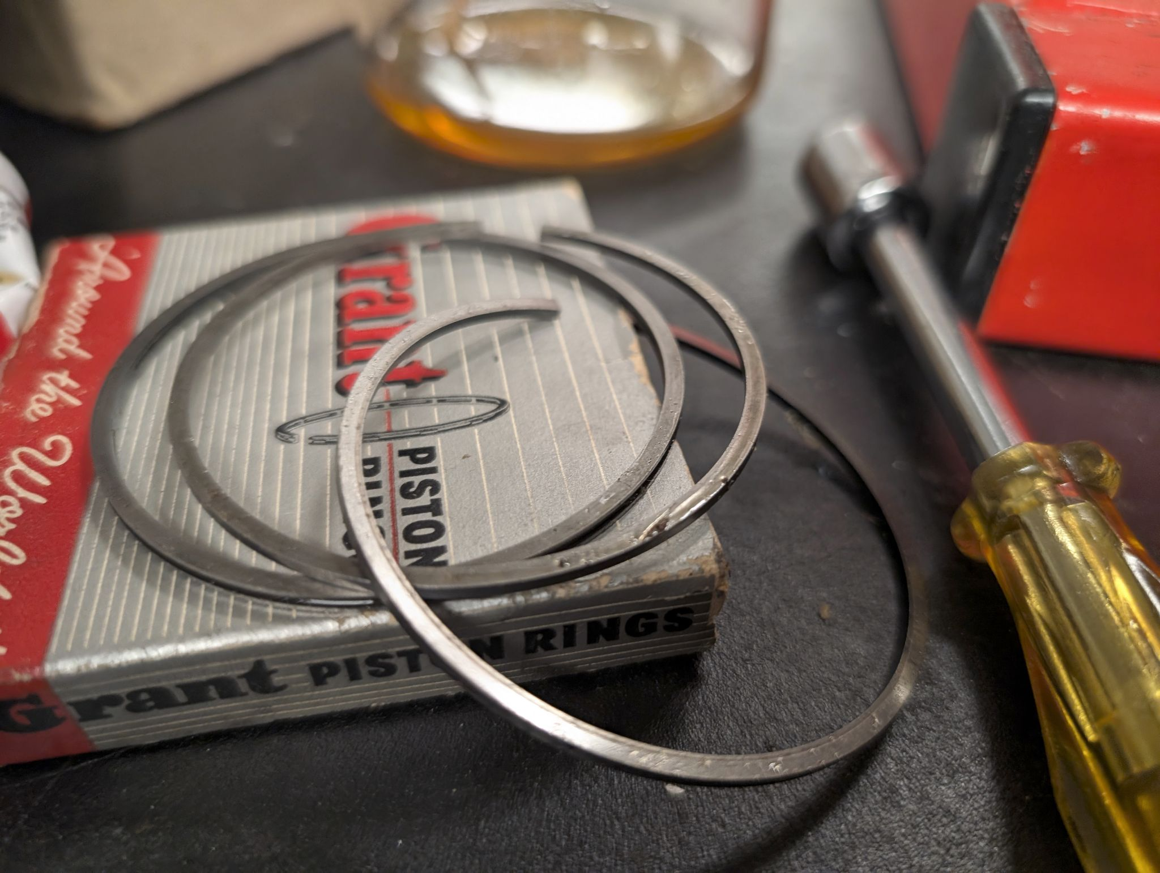

Why Didn’t The Engine Come Together?

Slide 37
Thank You
Thank you to Professor Littman for teaching this class which has been the highlight of our semesters
Thank you to Jon for teaching us so much about the engine and assembling it with us.

Slide 38


Slide 39


Woodruff key resources
Notes:
https://www.fastenal.com/product/details/69314
https://www.reidsupply.com/en-us/industry-news/woodruff-key-sizes-chart
https://www.youtube.com/watch?v=gRhFBQodLDQ

