Slide 1
Tiger Cub 63: Electrical System
Ricky Feig

Slide 2
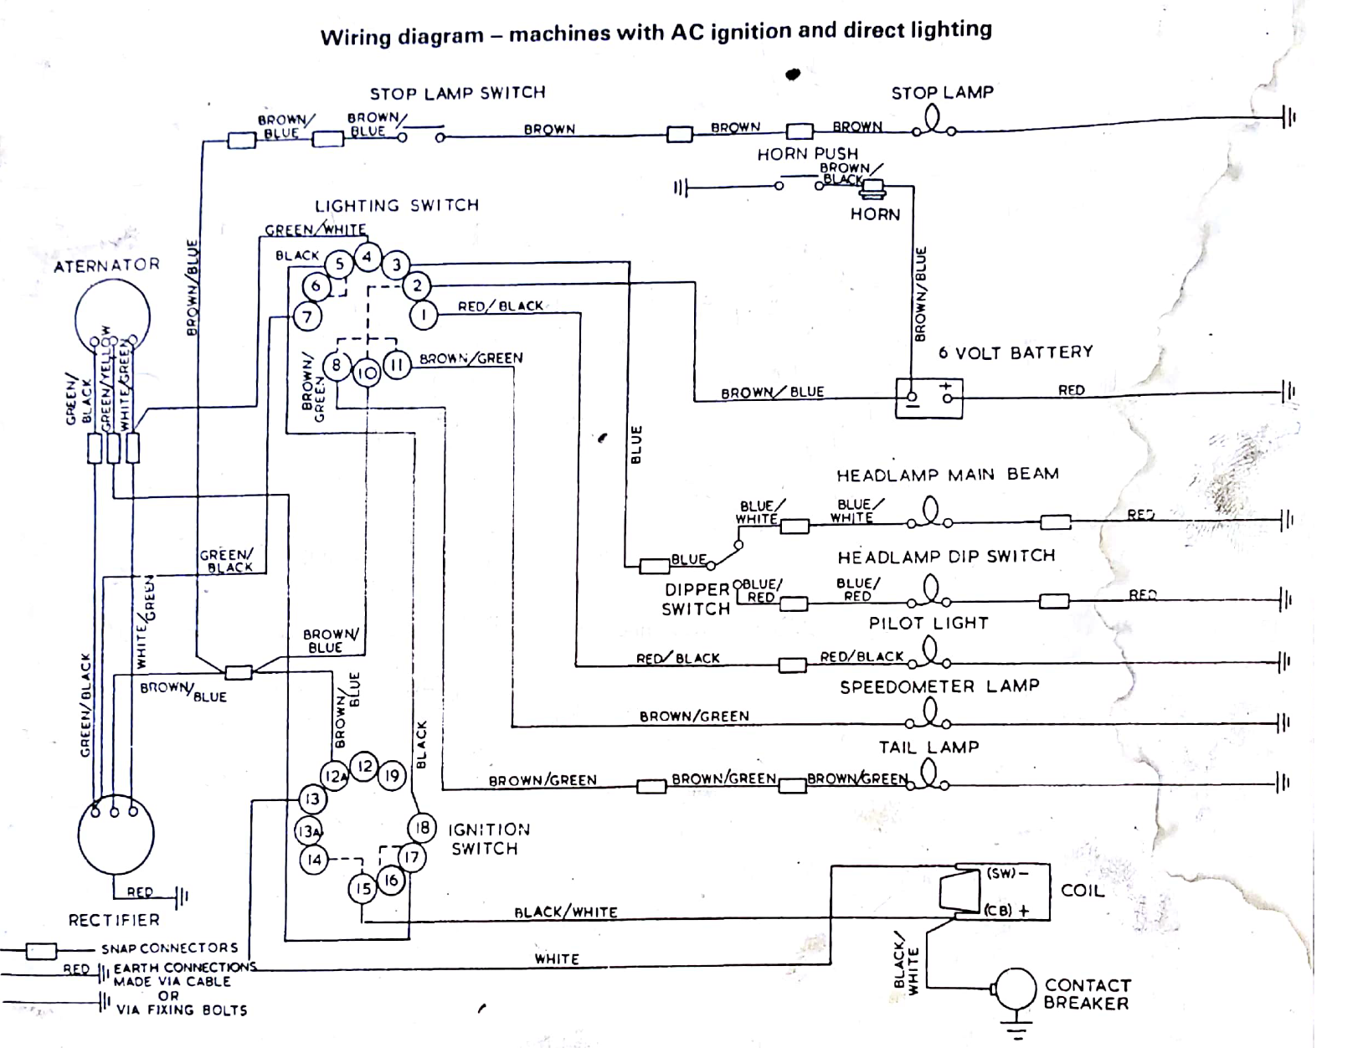
Components:
Lighting and ignition Switch
Wire Harness
Head Lamp and Tail lamp
Stator
Rectifier
Battery
Coil
Contact Breaker
Horn

Slide 3
Stator
Produces electricity
As the motorcycle runs, a magnetic wheel spins and induces electricity in coils in the stator
As the cam spins faster, the induced current increases linearly
Notes:
We ended up using a sealed stator. On the inside there are six coils of wire. Two triplets. The magnet has six poles to correspond to the coils.

Slide 4
Points:
The points ignite the fuel when the engine is approaching top dead center
The capacitor is charged via the battery.
The points timing is controlled by centripetal force.
As the cam spins faster two weights on spring spread apart. This forces the spark to occur sooner in the cycle

Slide 5
Rectifier:
The Rectifier converts AC to DC to charge the battery and run electrical components like the lights and horn

Slide 6
Horn:
The horn was broken
Most likely causes: the timing screw came off and pieces inside got stuck
To repair we had to drill out the rivets and reassemble the inside
Now it works!
Points
Piston
Coil
Notes:
Piston is a permanent magnet
Current runs through horn and creates magnetic field in coil
Piston is pulled down and separates points
Piston is pulled up by the drum acting a spring
Points pushed back together

Slide 7
Questions:
Was there anything you found shocking?

