Slide 1
PDP-8/L Restoration Summer 2014
Chang Bing Yen
Prof. Michael Littman

Slide 2
Brief History
Built in 1960s by Digital Equipment Corporation (DEC)
First desktop minicomputer
First commercially available general purpose computer
Interfaces with ASR-33 Teletype

Slide 3
Initial Conditions
Positive
All required flip-chip modules present
Power supply reformed and functional
Front panel lights and switches functional
All ventilation fans functional
Negative
No standard interface to teletype
Memory not fully functional
Only certain addresses retain written data
Lack of contiguous functional memory addresses for official DEC diagnostic programs

Slide 4
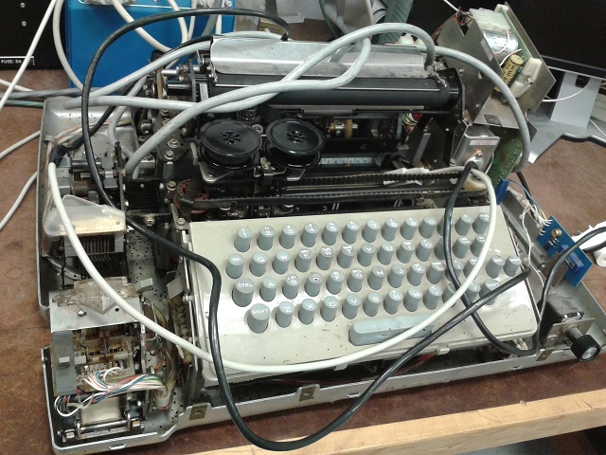
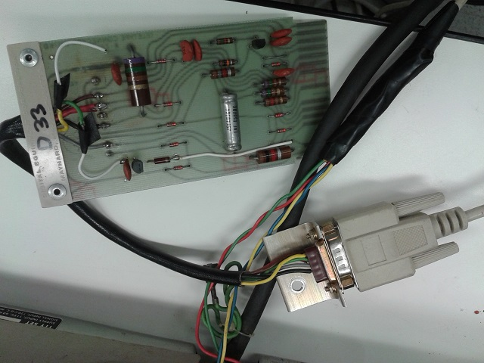
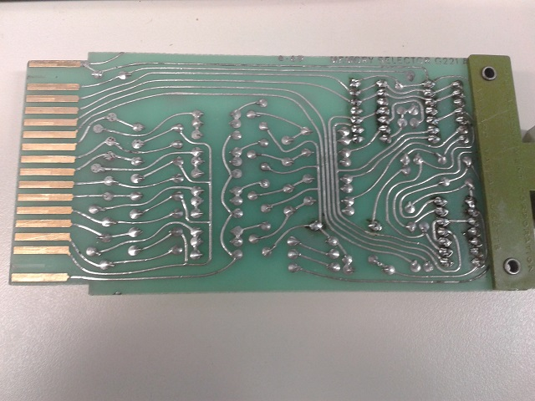
Restoration Efforts Summary
Rewritten AC test program to run at known functional memory addresses
Rewired teletype and interface flip-chip with standard DE-9 connectors
Wrote diagnostic program to test every memory address and print errors
Soldered new capacitors and ICs on two spare G221 (Memory Selector)
One of the two G221 erases memory at its designated location

Slide 5
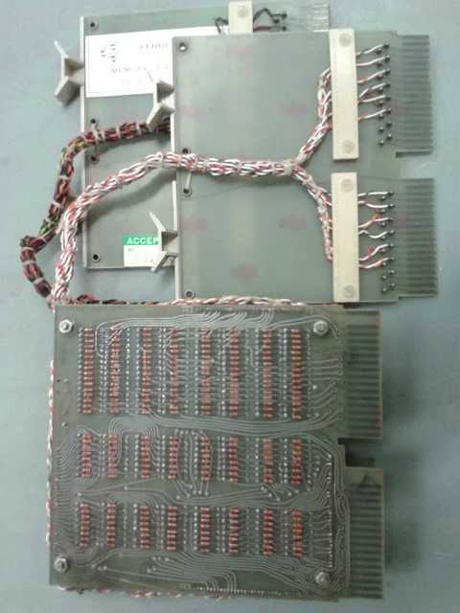
Core Memory Stack Repair
Output of test program shows patterns in malfunctioning memory locations
Swapping G221 positions did not change patterns
Problem traced to faulty diodes on core stack
Soldered with diodes obtained from spare core stack, due to lack of equivalent diodes in stock

Slide 6
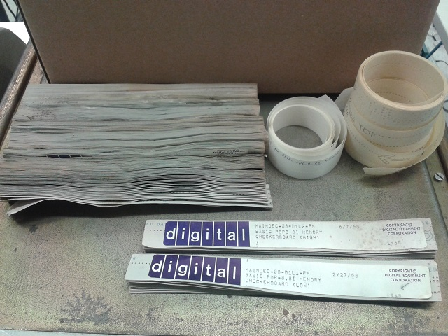
Current Condition
Repaired memory successfully executes RIM loader and BIN loader
Able to load and run paper tape programs, including DEC diagnostics
Passes some of the paper tape DEC diagnostics (Work in Progress)
Current loopback circuit (by previous team) interfaces with modern laptop
Capable of loading RIM-encoded programs from laptop (stored as ASCII data files)
Difficulties with loading BIN-encoded programs from laptop

Slide 7
Print Test Demo

Slide 8
Special Thanks Prof. Michael Littman Keller Center
Website & Documentation
http://www.princeton.edu/ssp/joseph-henry-project/pdp-8l/

