Slide 1
Frames, Forks, and Wheels
Eliza Davis and Emma Wingreen

Slide 2
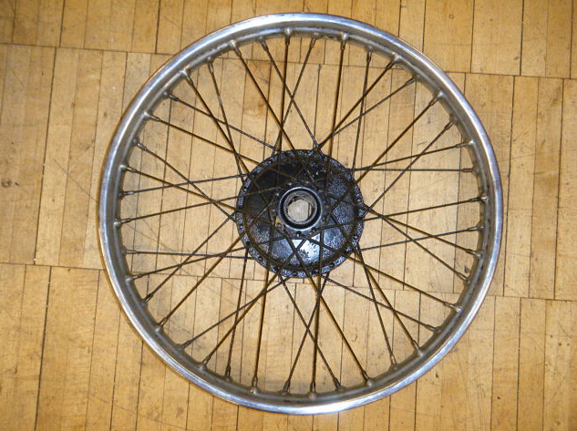
Disassembly of the Wheels
We had to completely disassemble the old wheels, because we only needed the hubs
We bought new rims and new spokes ($$)
Notes:
-Haydn had to despoke the wheel without the proper equipment (and we had to lace the wheels by hand)

Slide 3
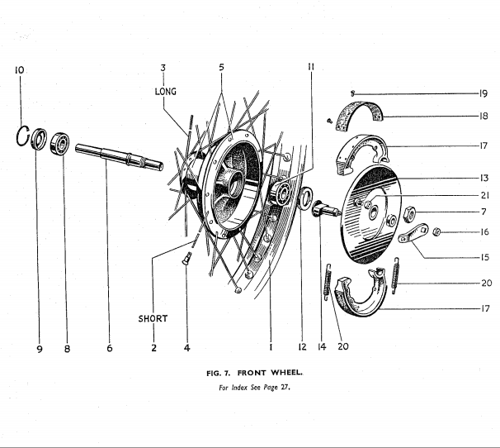
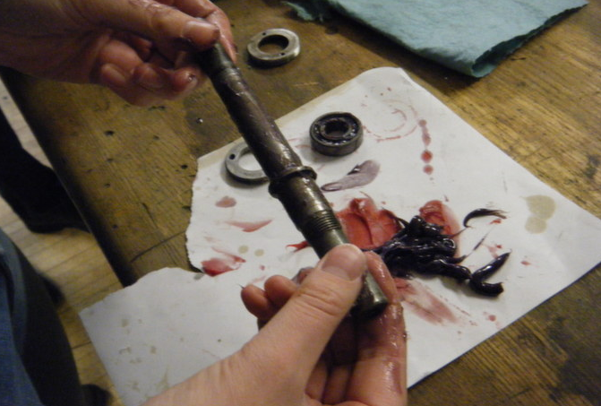
Wheel Assembly
Before we put the spokes on, we had to attach the axles and ball bearings to the front and rear hubs
Notes:
-describe greasing the axle and packing the ball bearings
-we had to make sure the ball bearings were in straight (hammered them out)

Slide 4
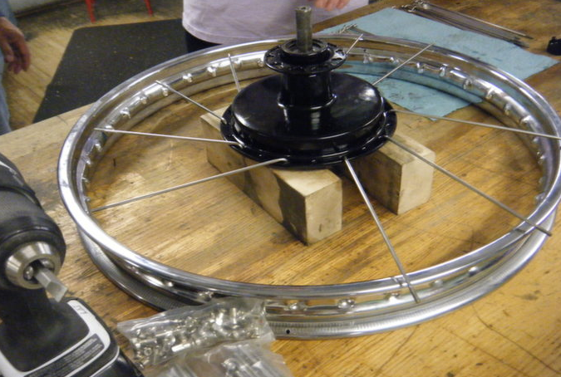
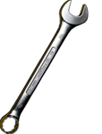
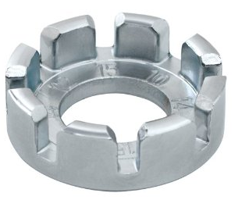
Lacing the Wheels
We had to lace the wheels (more than once)
Two sides of the wheel, two directions per side, two sizes of spokes
Notes:
-first lace up spokes loosely (inside first, then outside, then flip and repeat)
-specific pattern to spoking, every fourth hole goes in the same direction

Slide 5
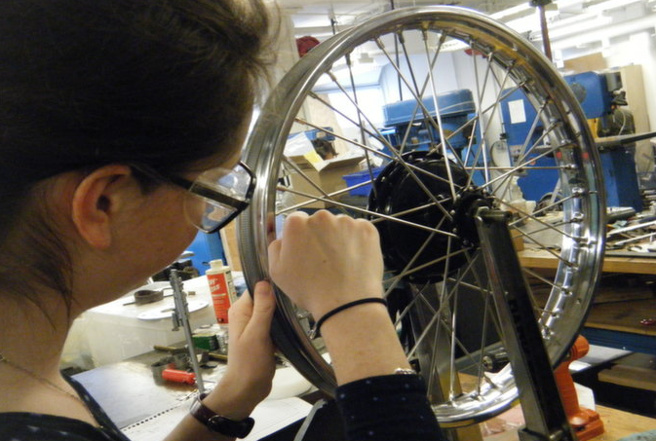
Truing and Tuning the Wheels
Concentricity and side-to-side movement
Tune the different spoke lengths to the same(ish) note — clear sound, no vibration
Loosen this side
Tighten this side
Notes:
-tighten the bottom, the hub moves down and the wheel moves up
-tighten the right side, loosen the left, hub moves left, rim moves right

Slide 6
Wheel Offset Tool
We measured the distance between the sprocket and the rim, so that the chain wouldn’t rub against the rim
We compared our ‘56 Terrier rear wheel to the ‘59 Tiger Cub rear wheel because they are both 19 in. in diameter

Slide 7
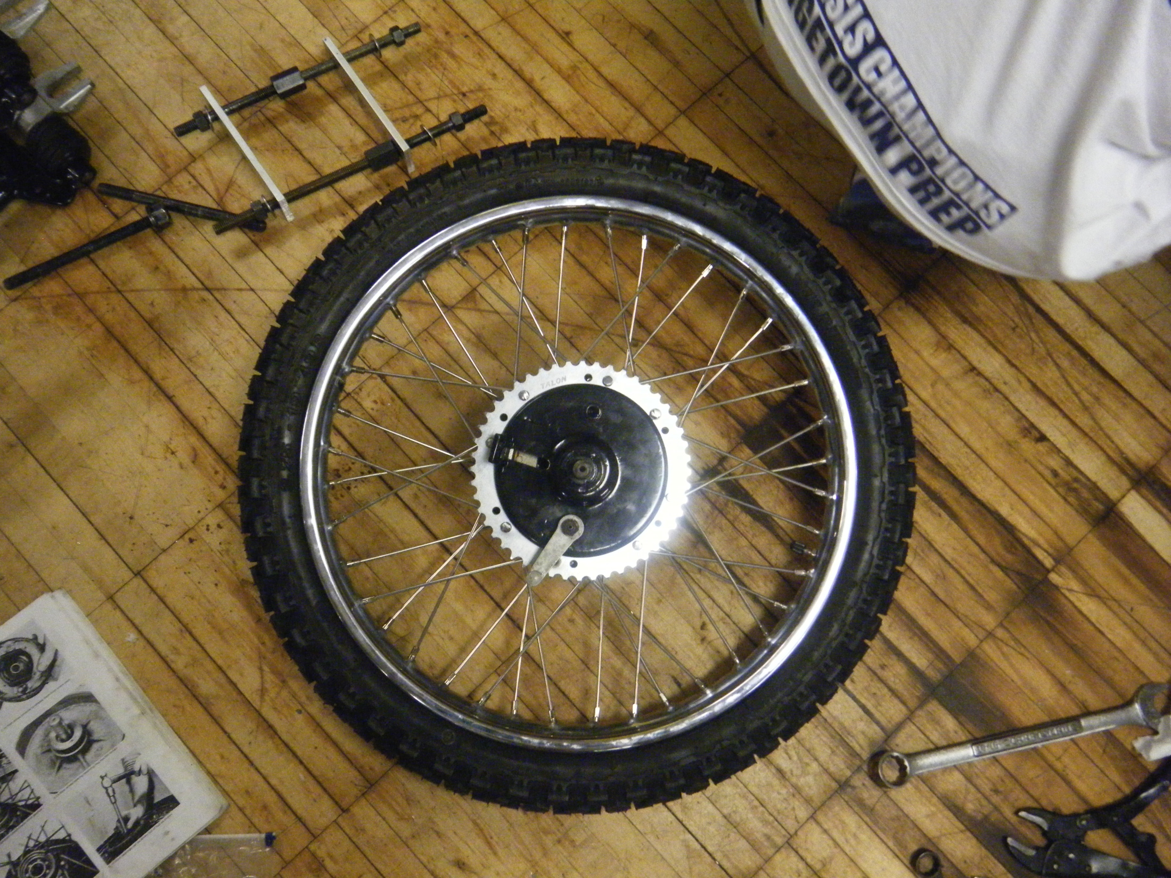
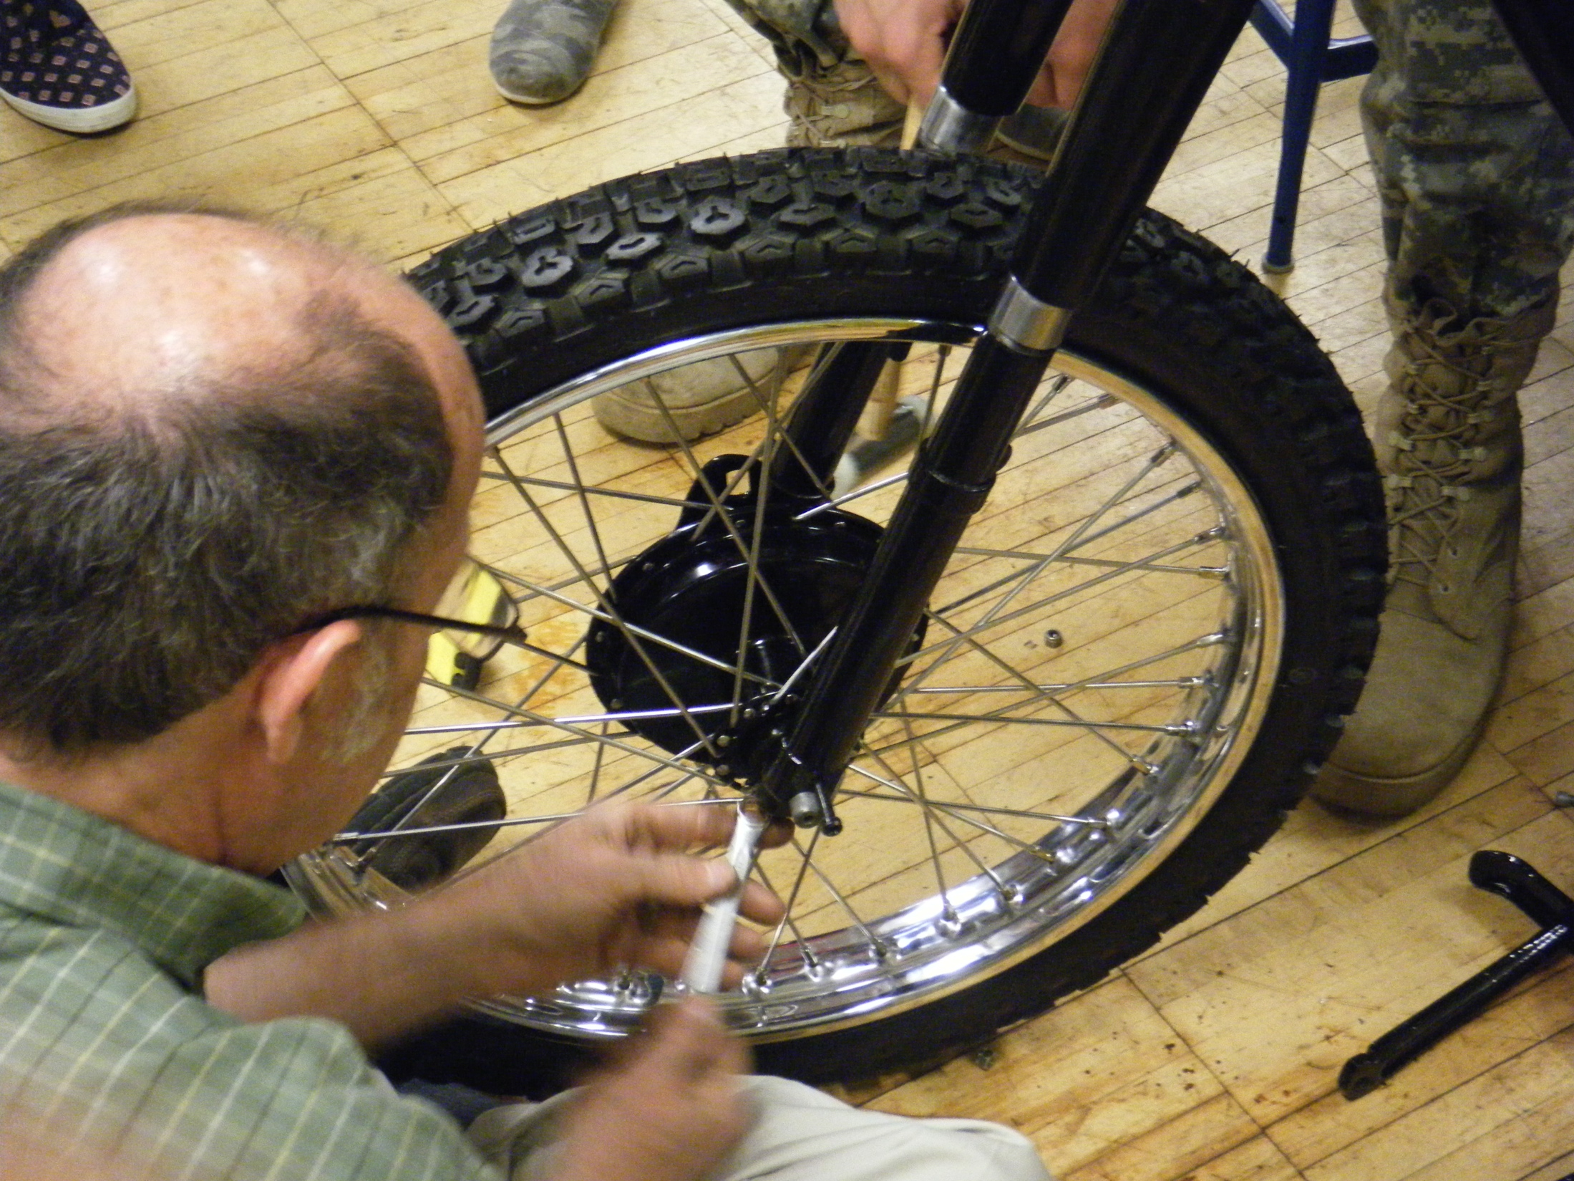
Putting it All Together
We put the liner on first and then wrestled the rubber wheel onto the rim
Then we put the inner tube between the rim and the rubber wheel and inflated it
We waited half an hour to check the inner tube to make sure it wasn’t pinched
Notes:
-one tube got pinched, we had to figure out:
-whether it got pinched in the process of putting it on
-if one of the spokes was too long and had to be ground down

Slide 8
Torque Calculations
Torque is the twisting force produced by the engine which gets split up between the wheels
Multiple sets of plates in a clutch means multiple torques at which the clutch will slip

Slide 9
More Torque Calculations
For example, if the weight on each wheel is 200 foot pounds, you need 28 foot pounds for the flywheel to slip

Slide 10
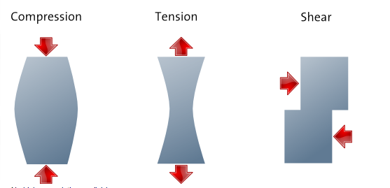
Bill Becker’s Lecture
There are four basic forces that act on a wheel:
Compression — warps spokes on the bottom
Tension — warps spokes on the top
Shearing — can warp the wheel, leads to:
Bending — causes spoke fatigue, continued bending can cause spokes to break
Bending
Notes:
- Continued bending (paperclip example)

Slide 11
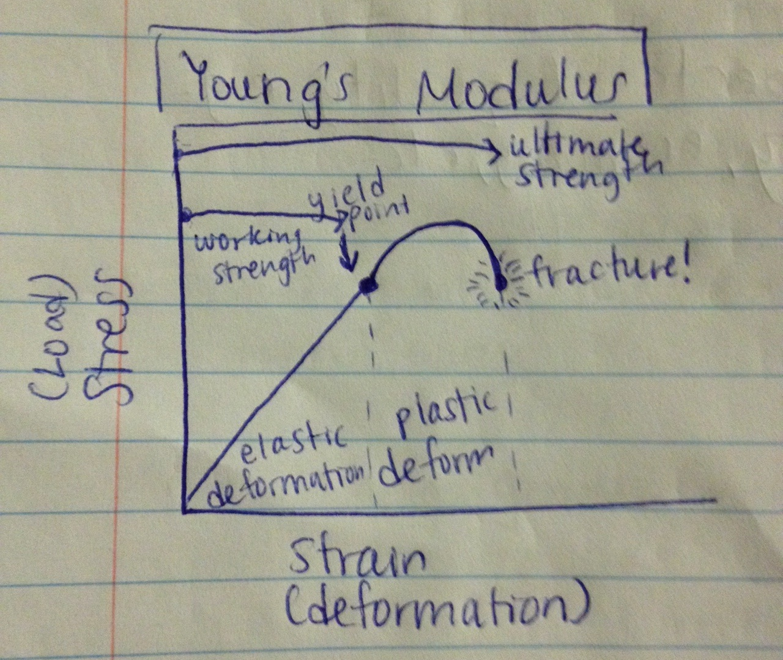
Young’s Modulus
Notes:
You can bend metal/plastic/some material up to a certain point before it becomes permanently bent
After that point, if you keep bending it, it will probably reach the point of fracture
PAPERCLIP

Slide 12
Bill Becker’s Lecture
There are four additional forces acting on the wheel:
Gravity — pulls the hub down, compressing the bottom spokes and straining top spokes
Impact — when motorcycle collides with an outside force, e.g. a speed bump
Acceleration — forces act on the hub in a clockwise direction, forces act on the tire in a counterclockwise direction
Deceleration — the friction occurring from the motorcycle tire coming into contact with the ground

