Slide 1
Clutch and Chain
Sherry Li
Alison Bick

Slide 2
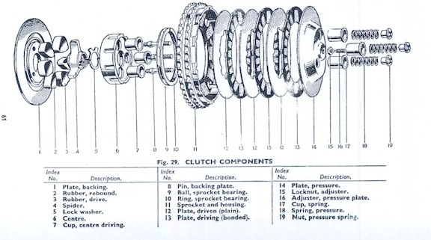
About the Clutch
Function
connects/disconnects engine crankshaft to the transmission
made up of a series of spring-loaded plates

Slide 3
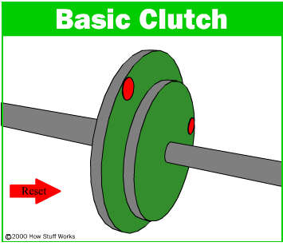
About the Clutch
Clutch operation
Used to switch gears
Wet vs dry clutch
Notes:
Clutch lever, operating rod
Engage disengage
Wet clutch allows “locking in” to occur more efficiently – the driven plates will reach the driving plates’ speed quickly.
Since the surfaces of a wet clutch can be slippery (as with a motorcycle clutch bathed in engine oil), stacking multiple clutch discs can compensate for the lower coefficient of friction and so eliminate slippage under power when fully engaged.

Slide 4
Wet clutch
Fill hole
Drain hole

Slide 5
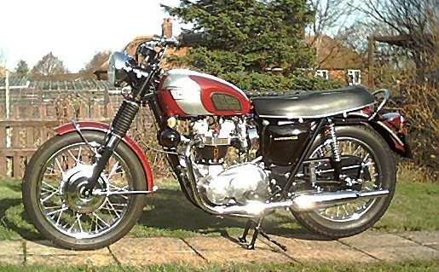
Location
located on the left side of the bike, above and left of the kickstand
It is controlled by the clutch lever which is located on the left handle bar.
Clutch lever
Clutch

Slide 6
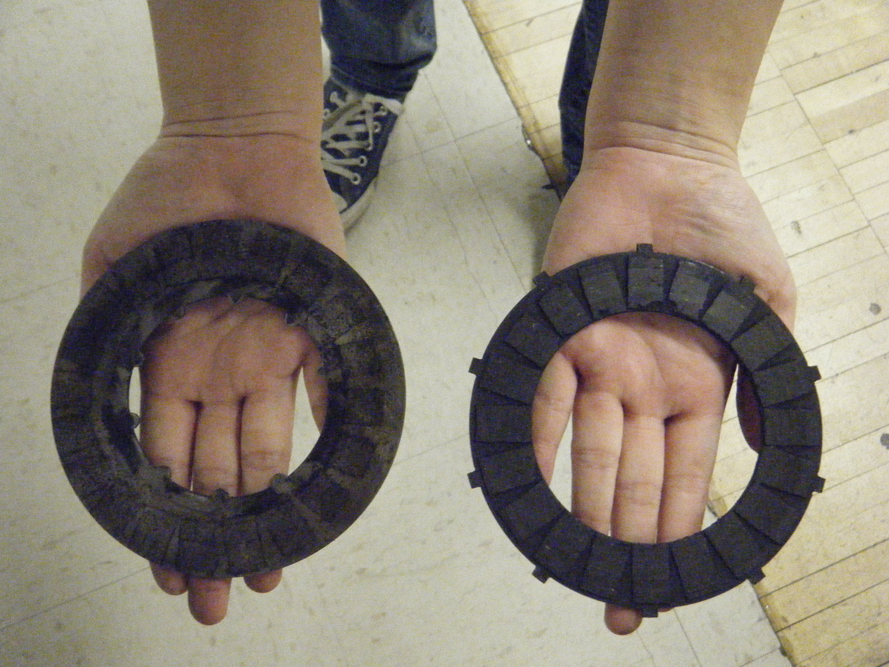
Background for Tiger Cub 64 Clutch
Two types of plates
Plain and friction
Plain and bonded
Driven and driving
Notes:
Two types of plates
The first type of plate had padding and lugs on the outer diameter, which drive the transmission input shaft. We noticed that these plates had equal spacing between the lugs. We noted that we should order new pads and new plates. We will see when we take the real clutch apart.
The second type of plate did not have padding and had lugs on the inner diameter. Of the space between adjacent lugs, one space was not of equal size. These plates are driven by the engine crankshaft.

Slide 7
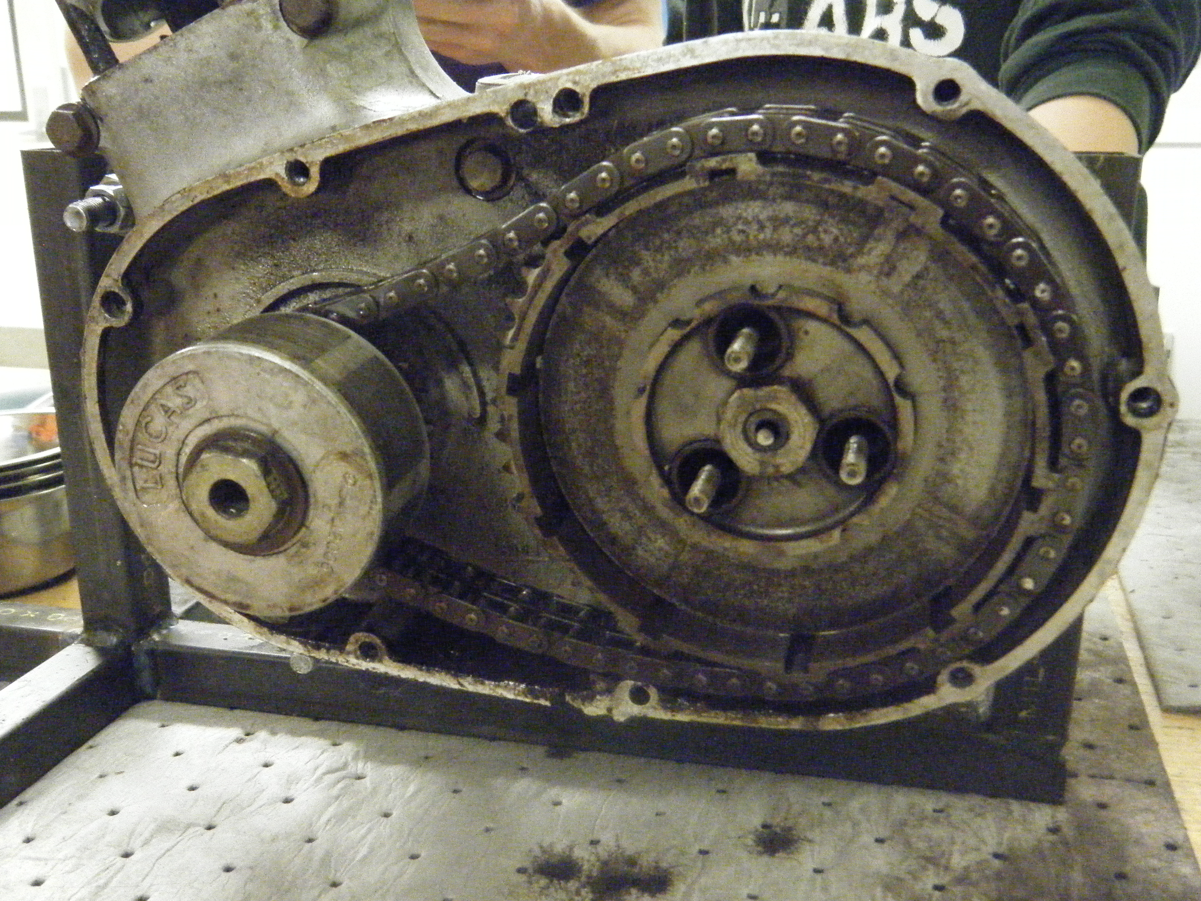
Background for the Tiger Cub 64 Clutch
Chain
62 links, duplex, 3/8 inches by 7/32 inches
primary chain connects the smaller engine sprocket with the larger clutch sprocket
Notes:
Plates are contained within the "basket" of the clutch sprocket.

Slide 8
More about the Chain
The duplex chain provides extra support - a single chain may loosen from wearing down.
It is important not to have too loose of a primary chain (slippage)
The links on the chain should not be worn out.
Notes:
Chain
62 links, duplex, 3/8 inches by 7/32 inches
The primary chain connects the smaller engine sprocket with the larger clutch sprocket. As shown below, it is important not to have too loose of a primary chain. The duplex chain that the

Slide 9
Disassembly
First we removed the three cups, springs, nuts that protrude from the pressure plate.
Notes:
The springs are what actually separate and connect the plates. The clutch operating rod pushes from the opposite end to loosen the plates from each other.
The cups and the springs did not detach.
Glenn is going to make new ones for us.

Slide 10
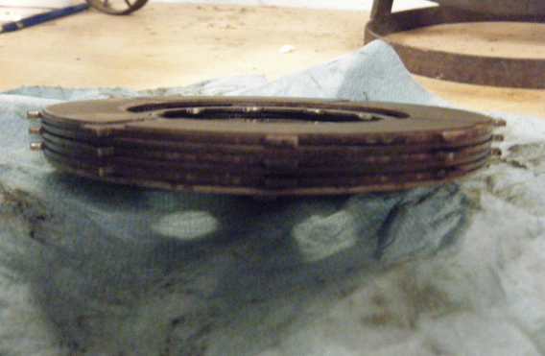
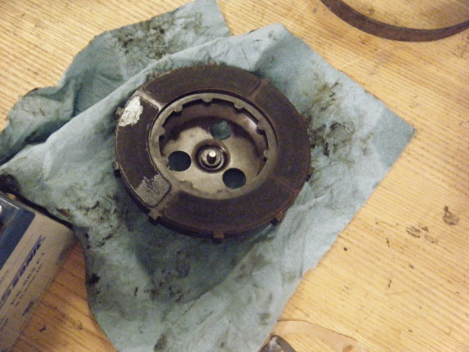
Disassembly
The six plates behind the pressure plate should have been separated, but the first five were stuck together. After some resistance, we decided to leave them be and work on disassembling the rest of the clutch.

Slide 11
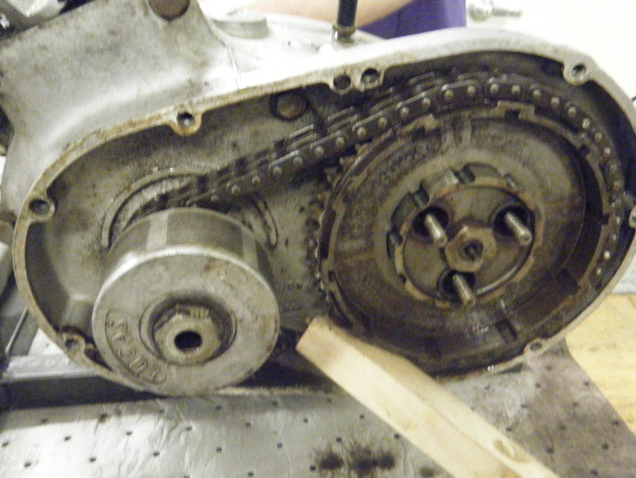
Disassembly
Removal of alternator rotor
Removal of engine sprocket
Troubleshooting
Notes:
In order to remove the chain, we first had to take off the alternator rotor and the engine sprocket.
Using Yield allowed us to unscrew the one sprocket and rotor nut as well as the tab washer.
Because the chain is an infinite chain, we had to jam the chain with a wooden block.

Slide 12
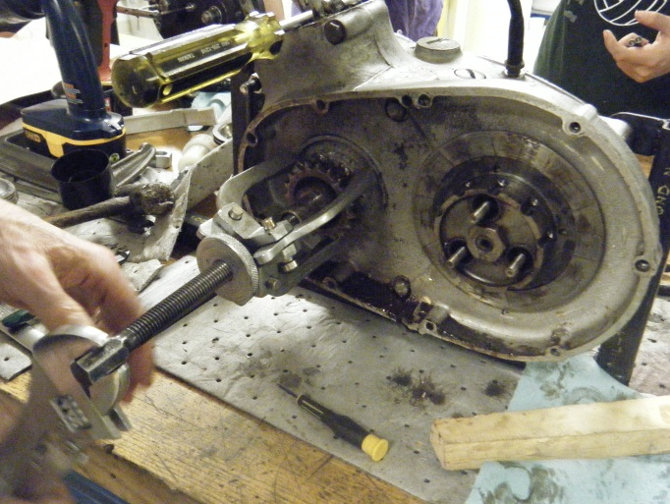
Disassembly - Troubleshooting
Gear puller

Slide 13
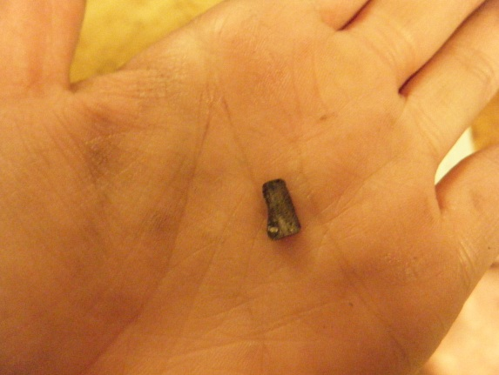
Disassembly
In the center of the engine sprocket was a distance piece. This distance piece had two keyways and a half-moon-shaped key in one of them.
Notes:
In the center of the engine sprocket was a distance piece. This distance piece had two keyways and a half-moon-shaped key in one of them. These steps required a lot of force - so much that the chain kept slipping and we had to hold the crankcase assembly down.
We had to recognize which keyway was the one we needed, and we noted that it was chewed up from use. Just to make sure, though, when the keyway we needed was rotated upwards, the connecting rod in the crankcase assembly was about 30 degrees after top dead center. The connecting rod pumps up and down in an oval-shaped motion in correspondence to the spinning of the chain and sprockets. We also noted that when the keyway we needed was rotated down, the connecting rod was at bottom dead center and hidden in the crankcase assembly.

Slide 14
Disassembly
After the removal of the engine sprocket, we were able to remove the primary chain and the clutch sprocket.

Slide 15
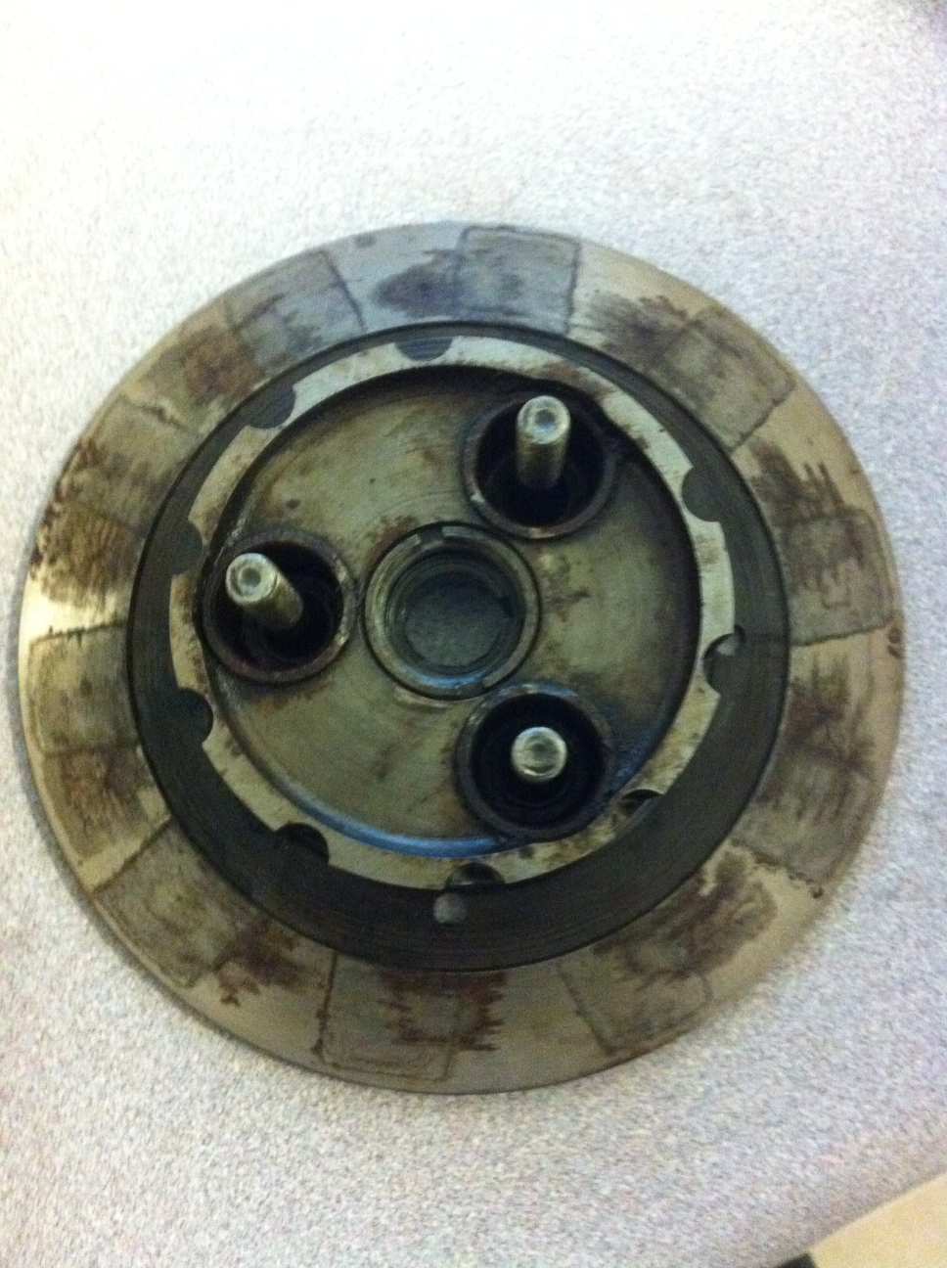
Disassembly
Last step: remove clutch basket
Clutch basket: center piece with three driving cups, rubber pieces, and a backing plate
Clutch basket holds the 6 plates
Notes:
This was easy with the puller and allowed us to remove the clutch basket completely, in one piece. We will not be disassembling the clutch basket further, but it contains a center piece with three driving cups, rubber pieces, and a backing plate. Plates are contained within the "basket" of the clutch sprocket.
Used strap wrench to hold the clutch basket (to prevent it from slipping) and a ratchet wrench to unscrew a nut. Then we used a puller that Glenn made to remove the clutch basket nut behind the clutch sprocket.

Slide 16
Parts Inspection
Part | Instrument of Measurement | Minimum Acceptable Measurement | Our Measurement | Replace?
Pressure Spring 1 | Ruler | 1.656 inches | 1.5 Inches | Yes
Pressure Spring 2 | Ruler | 1.656 inches | 1.5 Inches | Yes
Pressure Spring 3 | Ruler | 1.656 inches | --stuck in spring cup, could not measure | Yes
Bonded plates With lining | Caliper | 0.125 inch | 0.118 inches | Yes
Bonded Plate lining | Caliper | 0.0313 inch | 0.018 inches | Yes
Bonded Plate Without lining | Caliper | 0.0625 inch | 0.109 | Yes
Flat Plates Width | Caliper | -- | .069 inches | Maybe

Slide 17
Parts Inspection
We found that the ends of the teeth of the clutch and engine sprocket were a little rounded.
We examined the plain plates for flatness and stickiness. They were flat, but a little sticky.

Slide 18
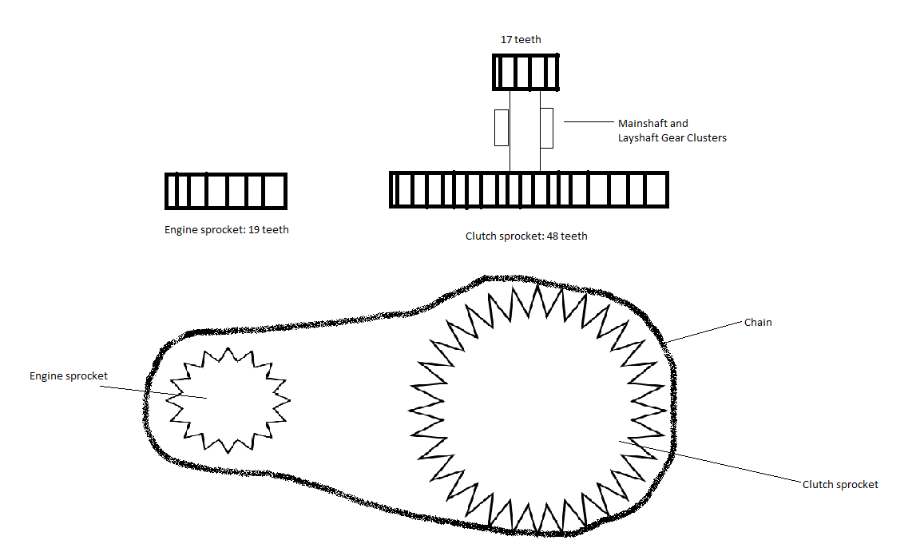
Calculations
How fast can the motorcycle go?
6500 rpm * 19/48 * 17/48 = 911 rpm <---Speed
911 rpm --> 68 mph (top speed)
What is the gear ratio?
Gear Ratio: <--Crankshaft speed to wheel
(19/48 * 17/48 ) ^ -1 = 7.13 <--Top (4th) gear
***This was verified by the table on page 131 in Triumph
Instruction Manual
***Additionally, we found the gear ratio for
Third Gear: 8.60
Second Gear: 13.40
Bottom (1st) Gear: 19.80

Slide 19
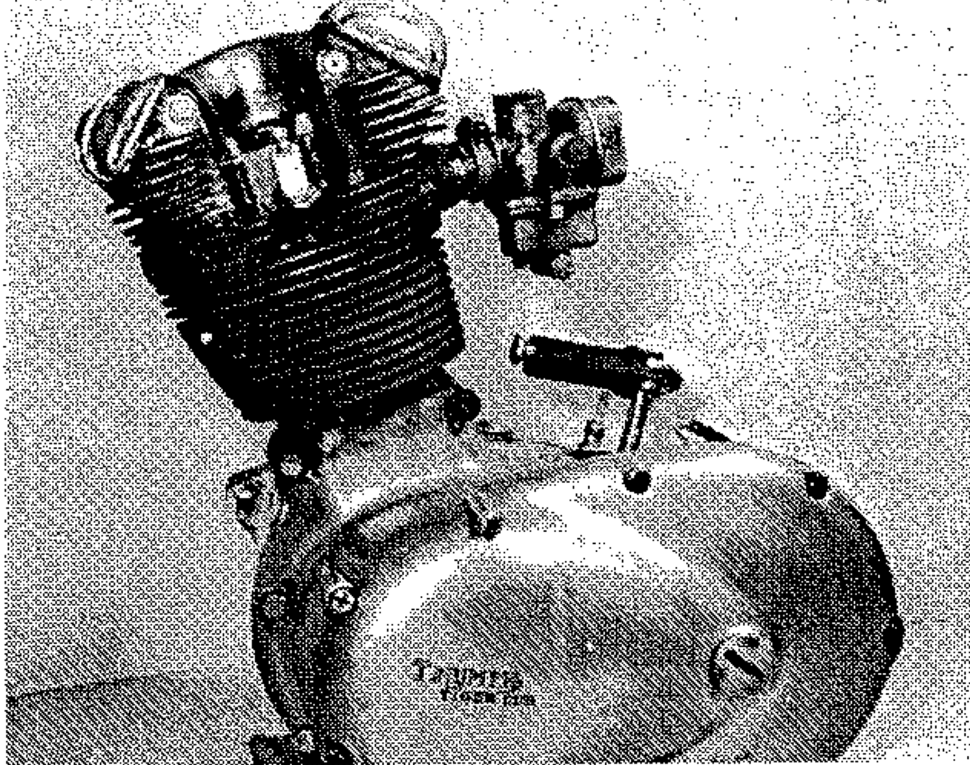
Future work
Torque wrench measurements
Friction calculations of clutch plate surfaces
Engine cover / case sanding
Reassembly with newly ordered parts
Get motorcycle permits

Slide 20
Conclusion
The clutch has an important function within the motorcycle system.
In short, the clutch is awesome.

