Slide 1
Frame
Owen Matthews, Charles An, Simon Rosen

Slide 2
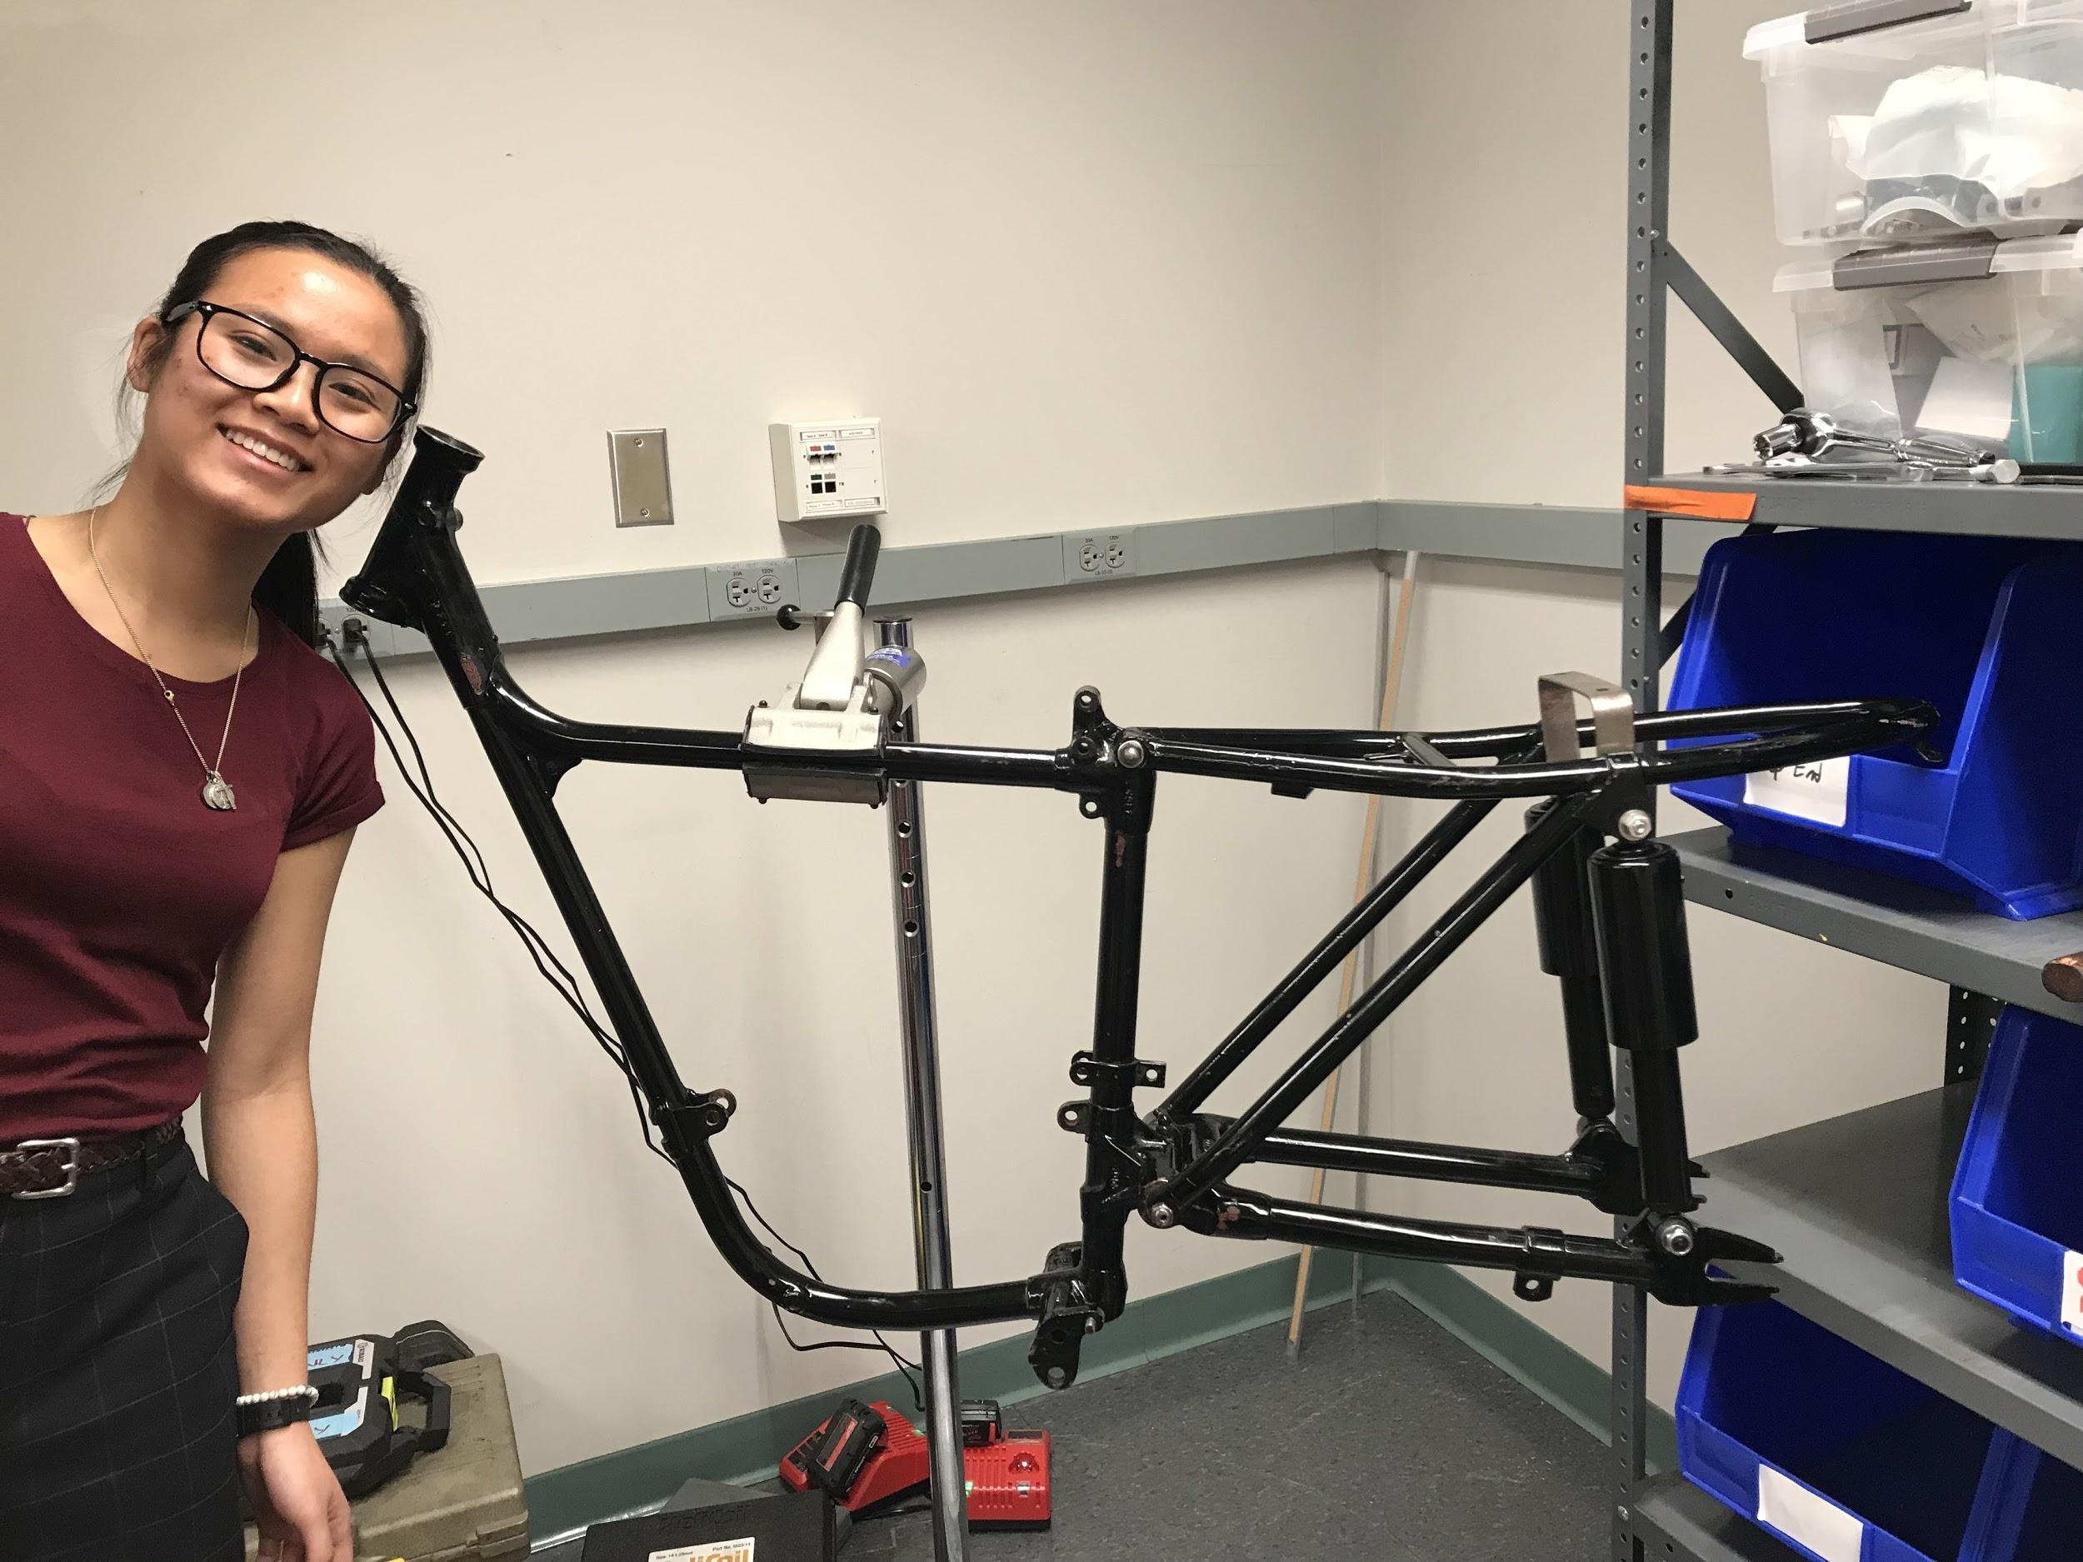
Parts of the Frame
Where Handlebars will go
Agnes
Where the seat will go
Where the forks will go
Shocks
Swingarm (holds rear wheel)

Slide 3
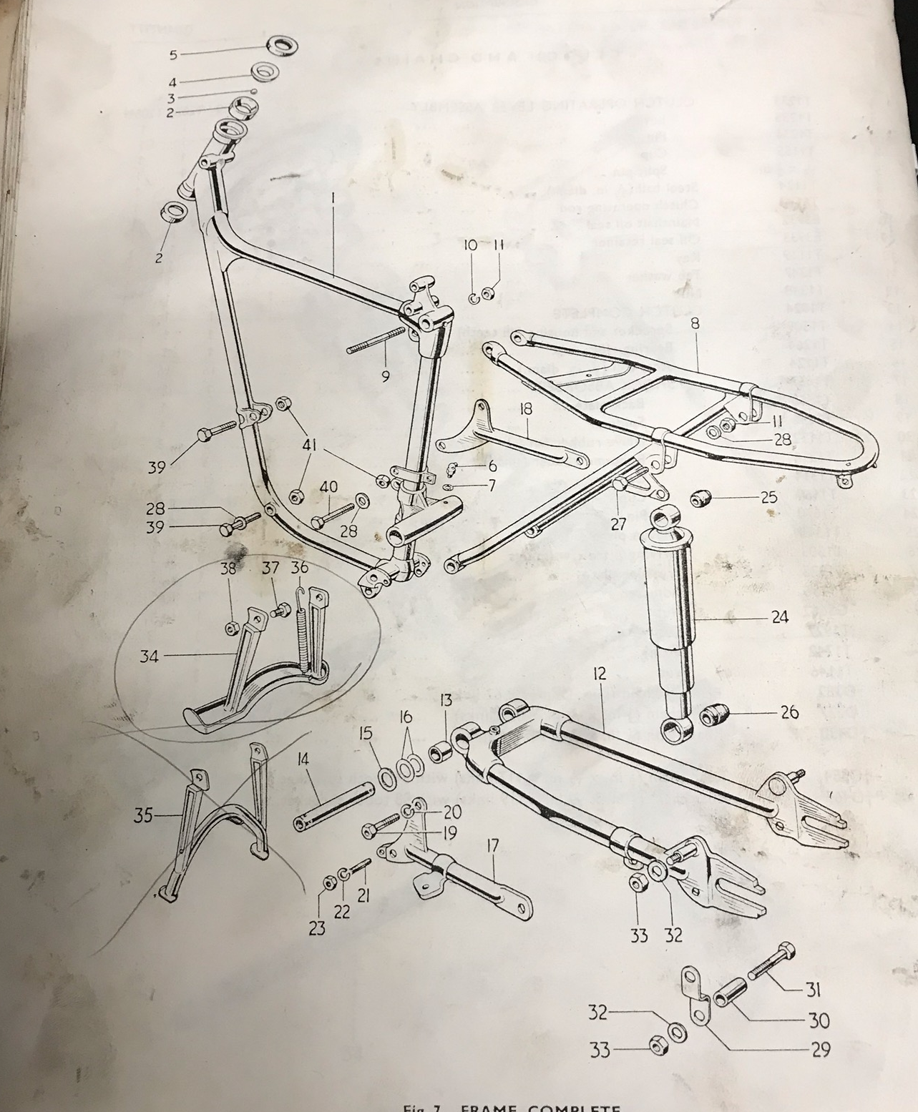

Slide 4
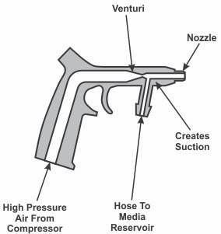
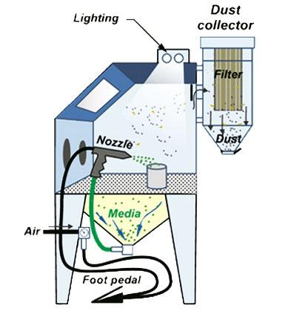
Restoration: Sandblasting
“A siphon sandblaster has three components: a sandblasting gun, an air compressor or normal pressurized tank and a container that functions as a reservoir to hold loose sand. One of the hoses connects to the underside of the barrel, and the other attaches to the bottom of the handle.”
https://www.miraclemaintenance.com/sandblaster-work-sandblasting/

Slide 5
Front Fork

Slide 6
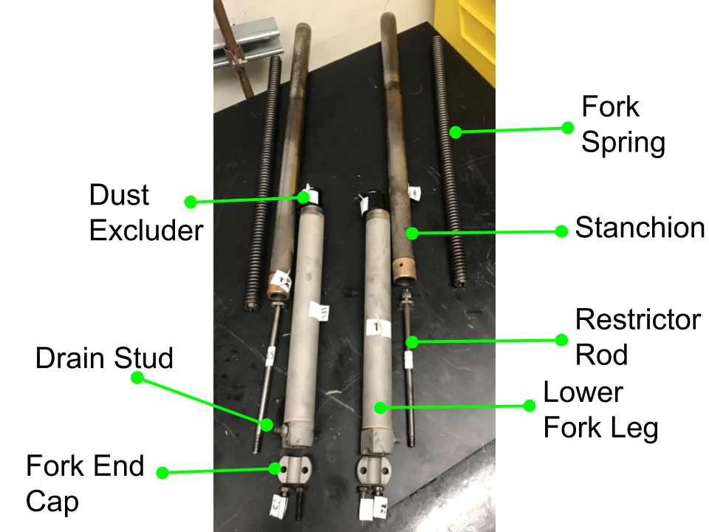

Slide 7
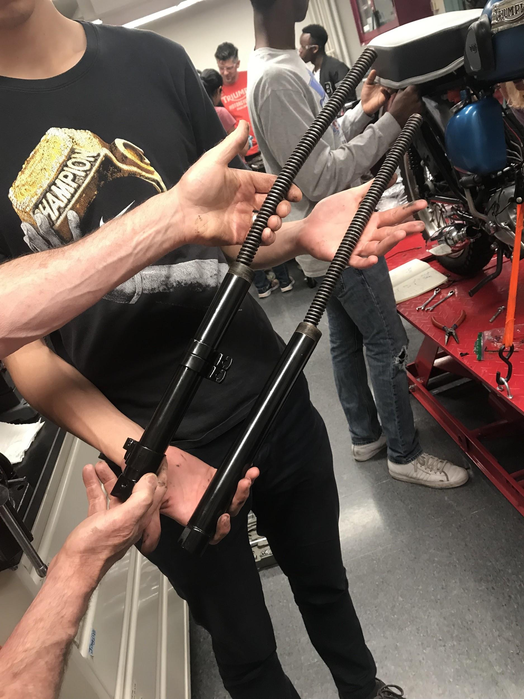
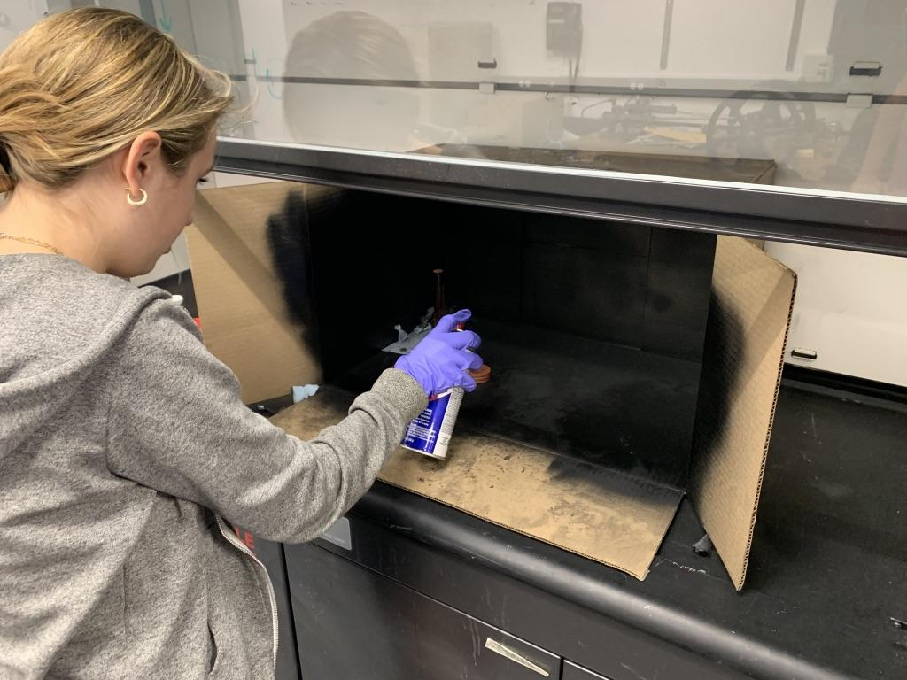
This bike has lightweight forks

Slide 8
So How Does Front Fork Tube Suspension Work?
When the bike goes over a bump, the stanchions slide further into the fork tubes and the springs compress

Slide 10
Springs
-coil spring: spiral of resilient steel rod; stretched or compressed by the vertical movement of the wheels (compress to absorb shock)
The springs absorb the kinetic energy from the motorcycle going over bumps.
The more tightly coiled the spring is, the more force is needed to collapse the spring and while the spring is collapsed it stores potential energy.
At rest or in motion, the bottom surface of your tires is the only part of your vehicle in contact with the road. Any time that a tire's contact with the ground is broken or reduced, your ability to drive, steer and brake is severely compromised.

Slide 11
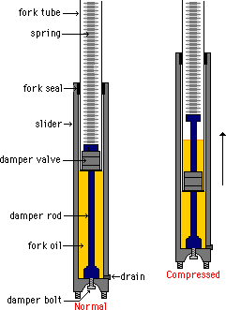
Restrictor Rod
-Viscous friction (oil)
-When the stanchion is pushed down into the fork tube, the oil must flow around a valve. This causes viscous friction and stops the bike from bouncing as much

Slide 12
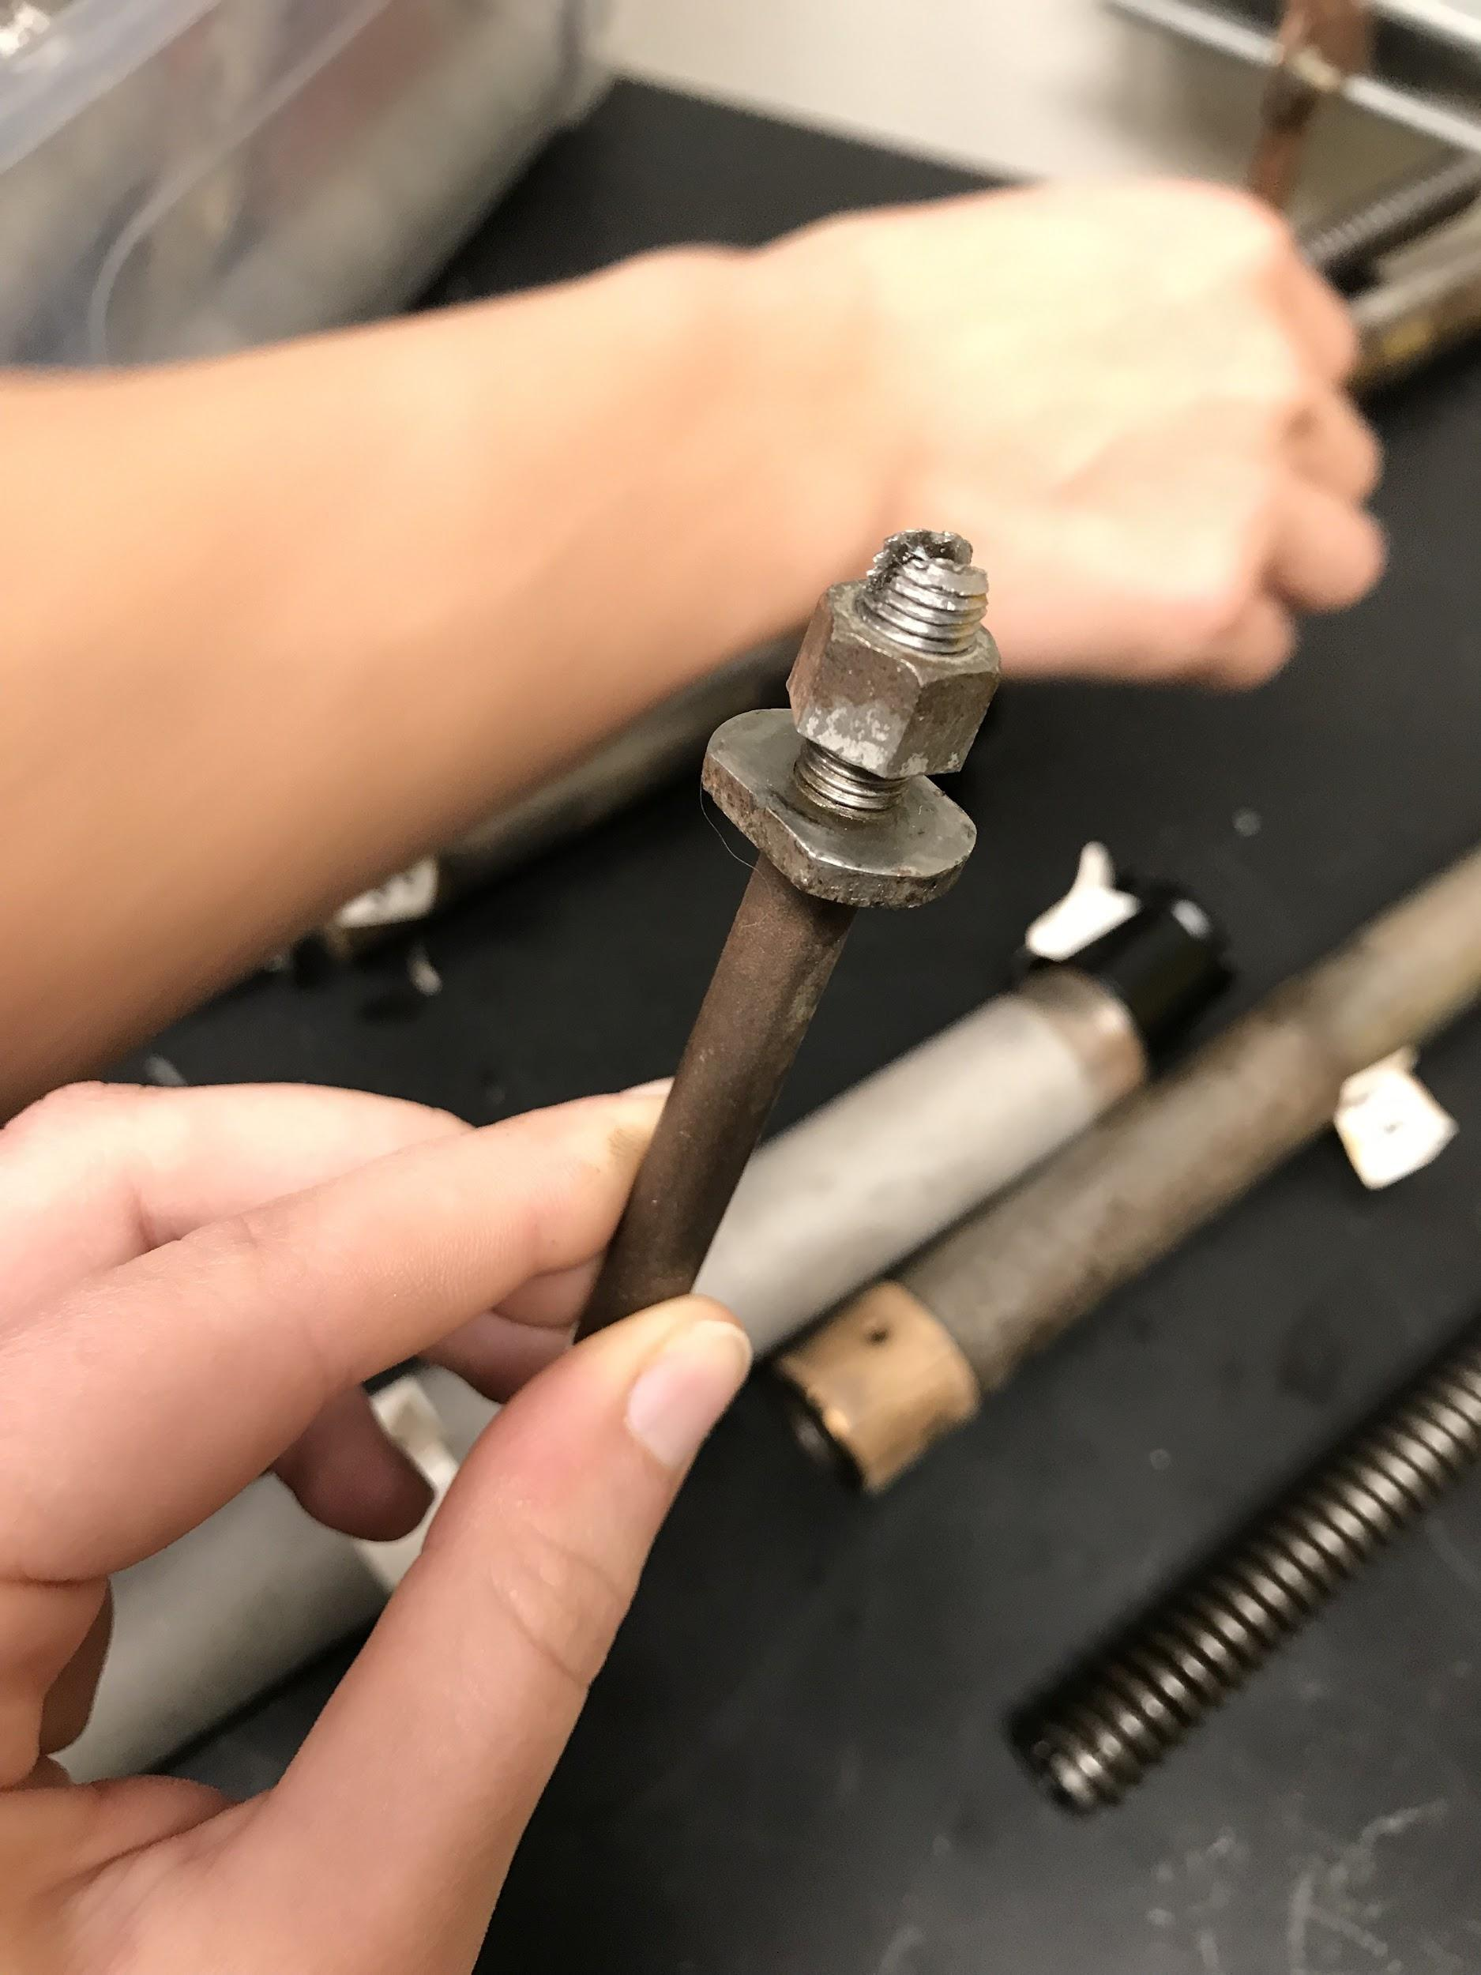
Room for Oil to flow between resistor rod and edges of stanchion (?)
Resistor Rod

Slide 13
Oil Height in Fork Legs (Stanchion Up)
V (cylinder) = h𝞹r²
H𝞹(1.4)²= 75 cm³
H = 12.186 cm
r = 1.4 cm (fork tube)
V = 75 cm³ (according to parts manual)
H = ?
Oil Height in Stanchion when Stanchion Goes All the Way Down into Fork Leg (HUGGEEE BUMP)
V (cylinder) = h𝞹r²
H𝞹(1.015)²= 75 cm³
H = 23.184 cm
r = 1.015 cm (of stanchion)
V = 75 cm³
H = ?

Slide 14
Back Suspension
-comprised of:
-twin shocks (two gigantic springs)
-swing arm (which allows the wheel to pivot without the rest of the bike pivoting)
-this keeps the wheel on the ground (if the wheel comes off the ground, the rider will lose control of the bike)

Slide 15
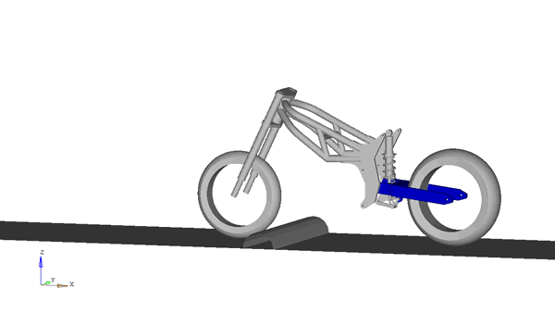
Animation of suspension on rear swing arm

Slide 16
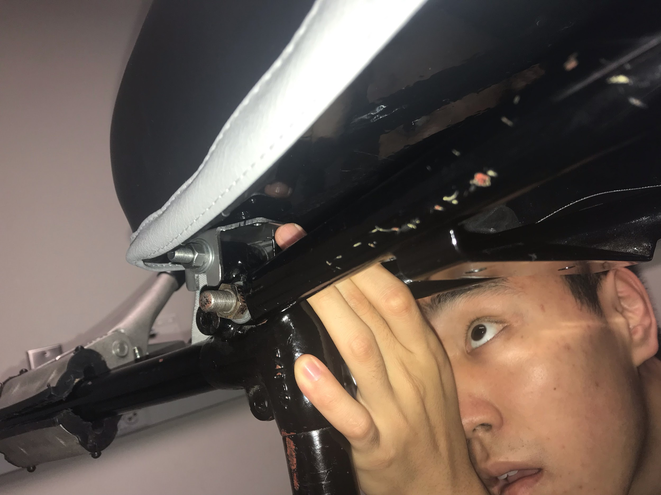
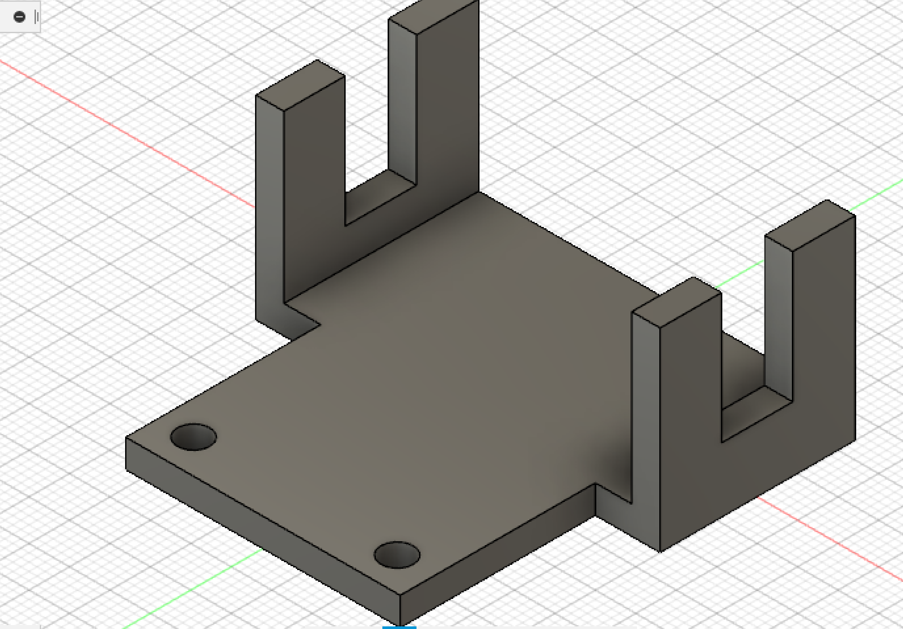
CAD Piece For Seat

Slide 17
