Slide 1
ART AND SCIENCE OF MOTORCYCLE DESIGN: DETAILING
By Brooke, Isabel, and Miles

Slide 2
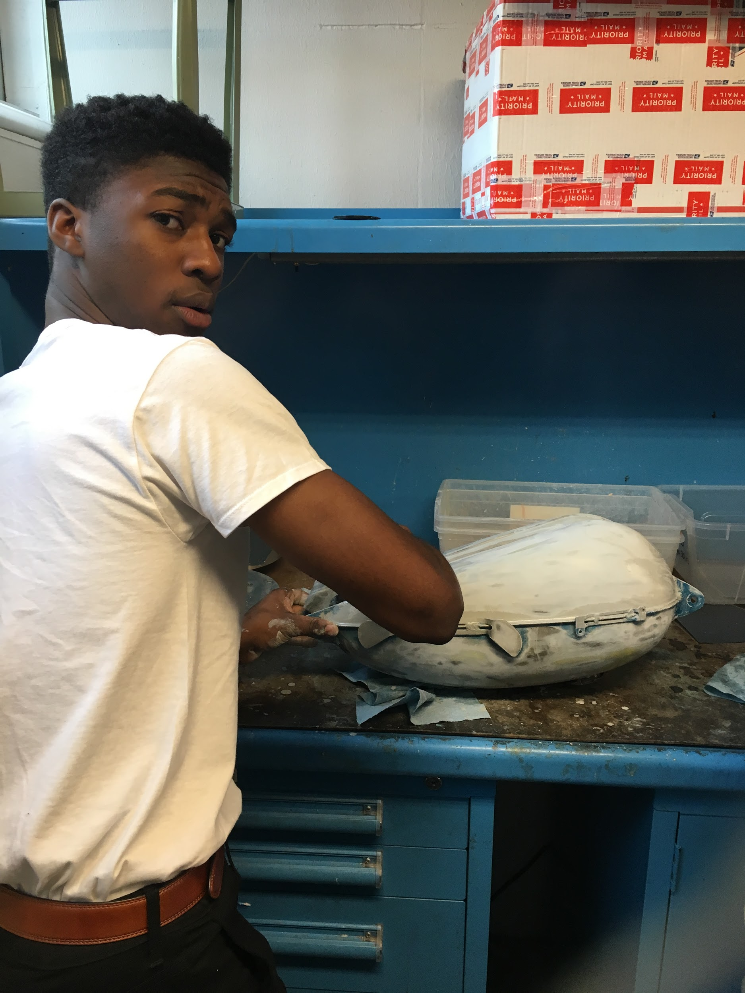
Step 1:
Wet Sanding
Glossy Shine
Carries away debris, prevents it from scratching
One side detergent latches onto particles, the other water
Detergent lowers surface tension (hydrogen bonds) - more thoroughly wet
Grit: size of particles in sandpaper - we started with 800, eventually to 200 (larger)

Slide 3
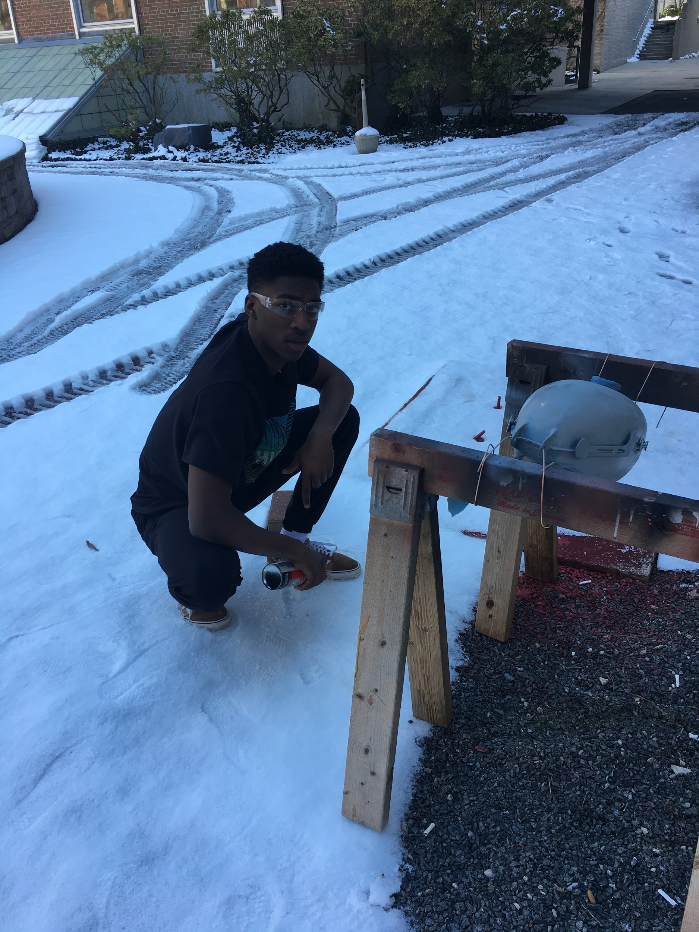
Step 2: Priming
We used automotive primer that helped the paint adhere to the gas and oil tanks. The primer was applied with a spray gun and was left to dry between coats.

Slide 4
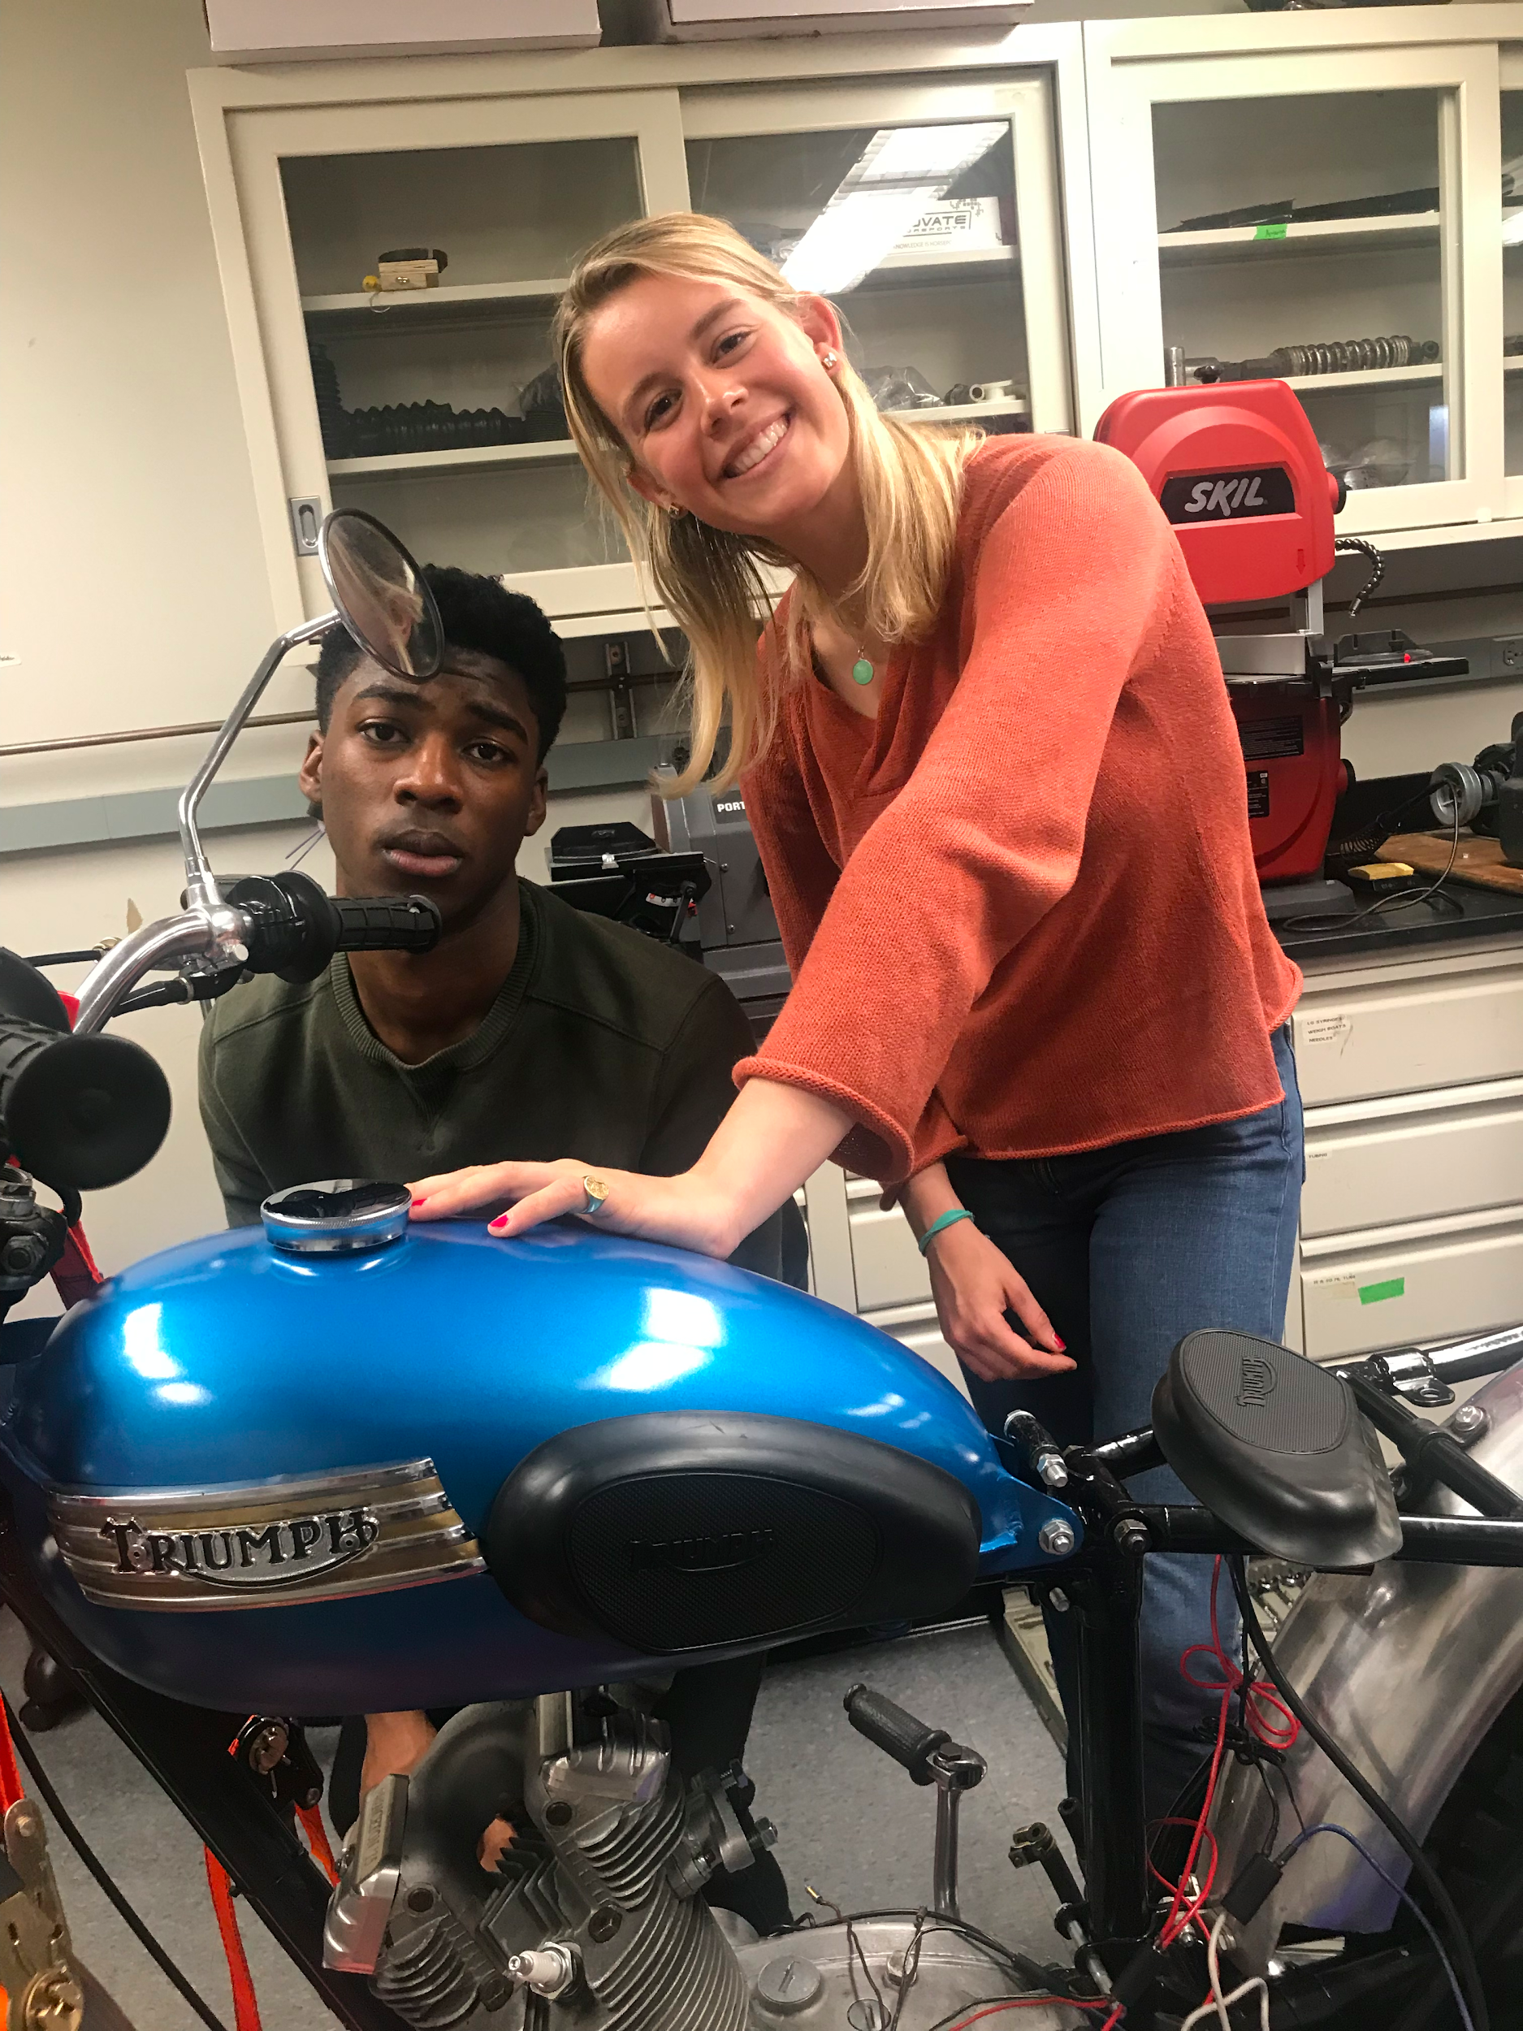
Step 3: Painting
How is automotive paint different from other paints?
How does the painting process work?
Notes:
Automotive paint is mixed with a reducer or thinner so that it becomes the right as well as hardener so that it achieves the right level of gloss and protection
solvent based metallic paints are mixed in different ratios depending on whether they are water based or solvent based

Slide 5
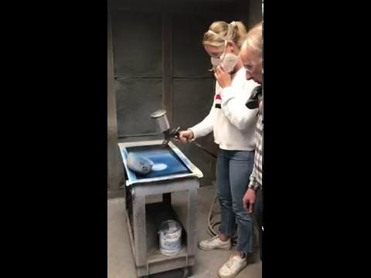

Slide 6
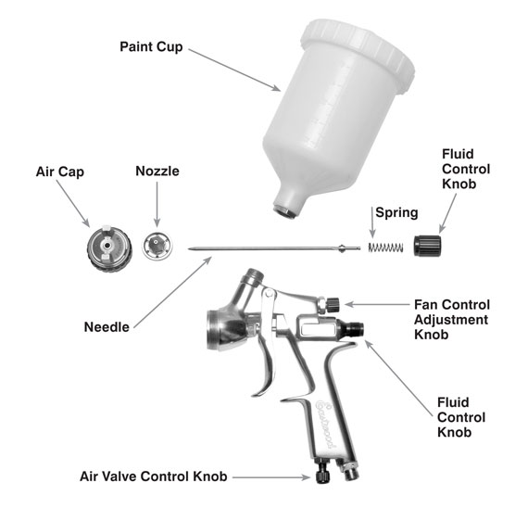

Slide 7
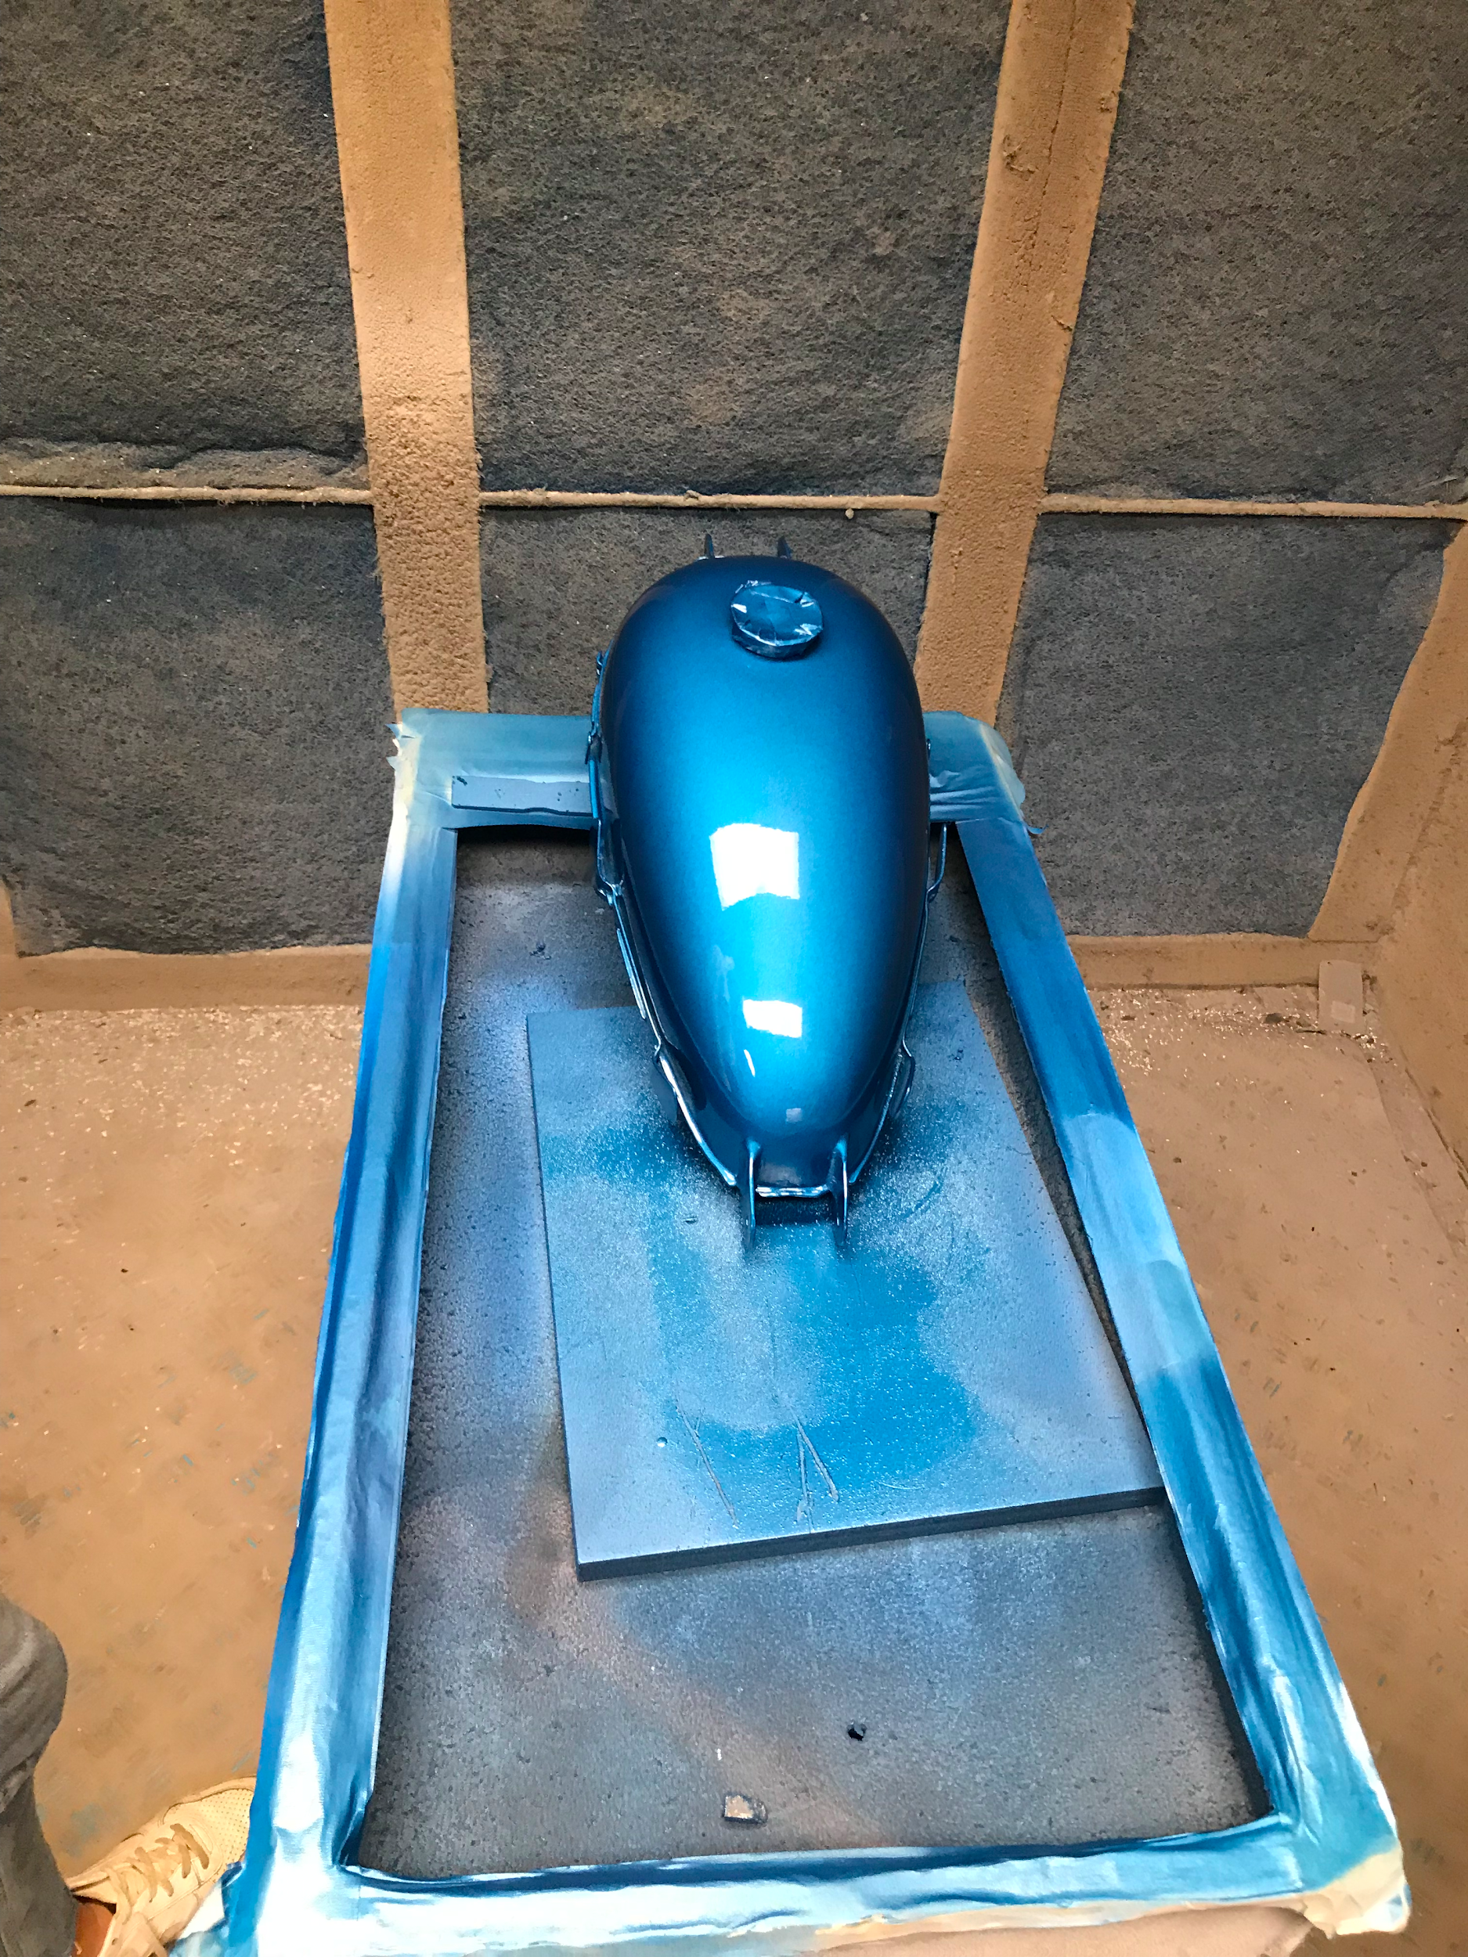
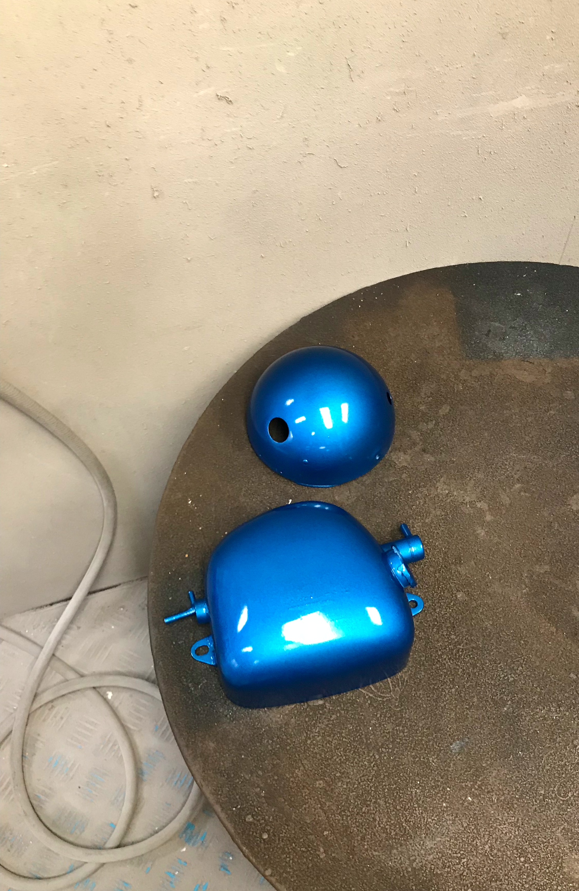
THE FINISHED PRODUCT

Slide 8
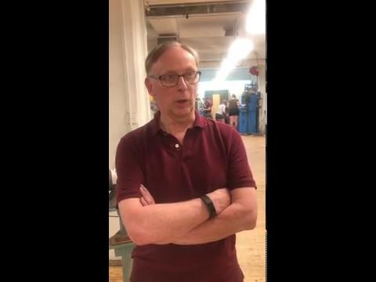
HOW WOULD YOU DESCRIBE THE PAINTING PROCESS?

Slide 9
HOW DO YOU FEEL ABOUT PIRSIG?

Slide 10
THANKS!
Any questions?

