Slide 1
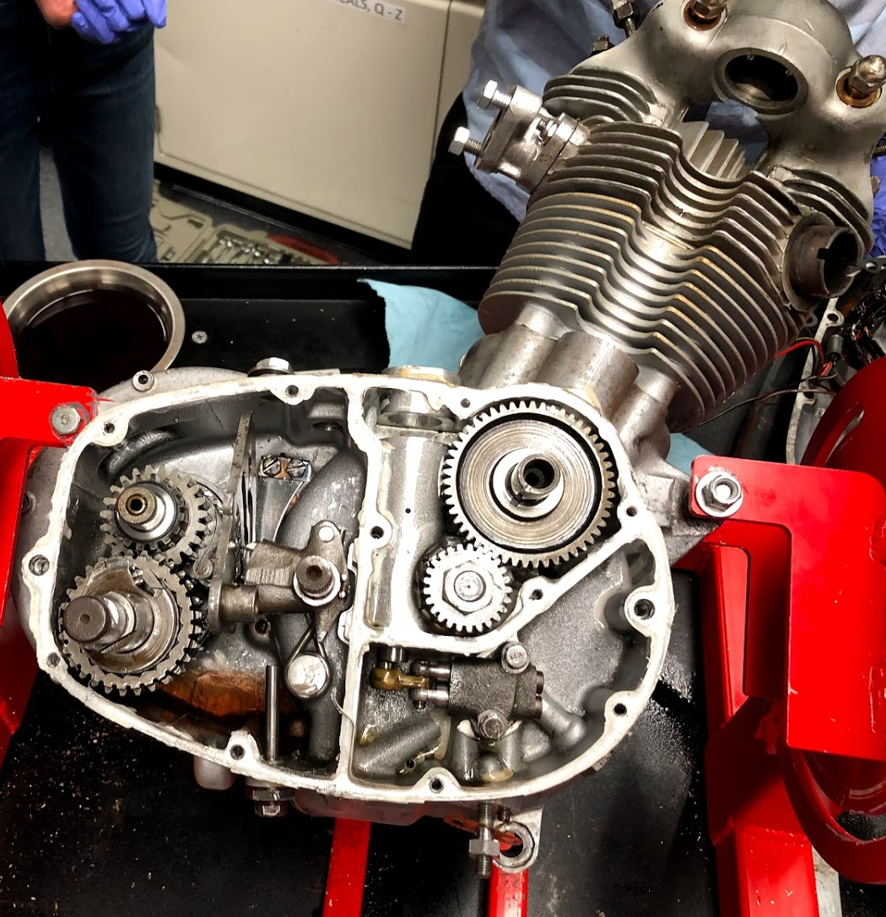
Bottom End
Jack Monaco and Rayyan Sarker

Slide 2
Semester Work Overview
Repaired the engine of the blue bike to address faulty oil system
  Diagnosed issues: grit inside the oil pump, grinding down of the washer on the transmission
  Took apart entire engine, then repaired all issues and checked for missing parts
Gathered together engine pieces for the new (purple) motorcycle, keeping records of pieces that were missing
Cleaned all parts for the new engine, picking pieces that could most closely match our 1967 Mountain Cub engine case
Began the process of putting together the new engine

Slide 3
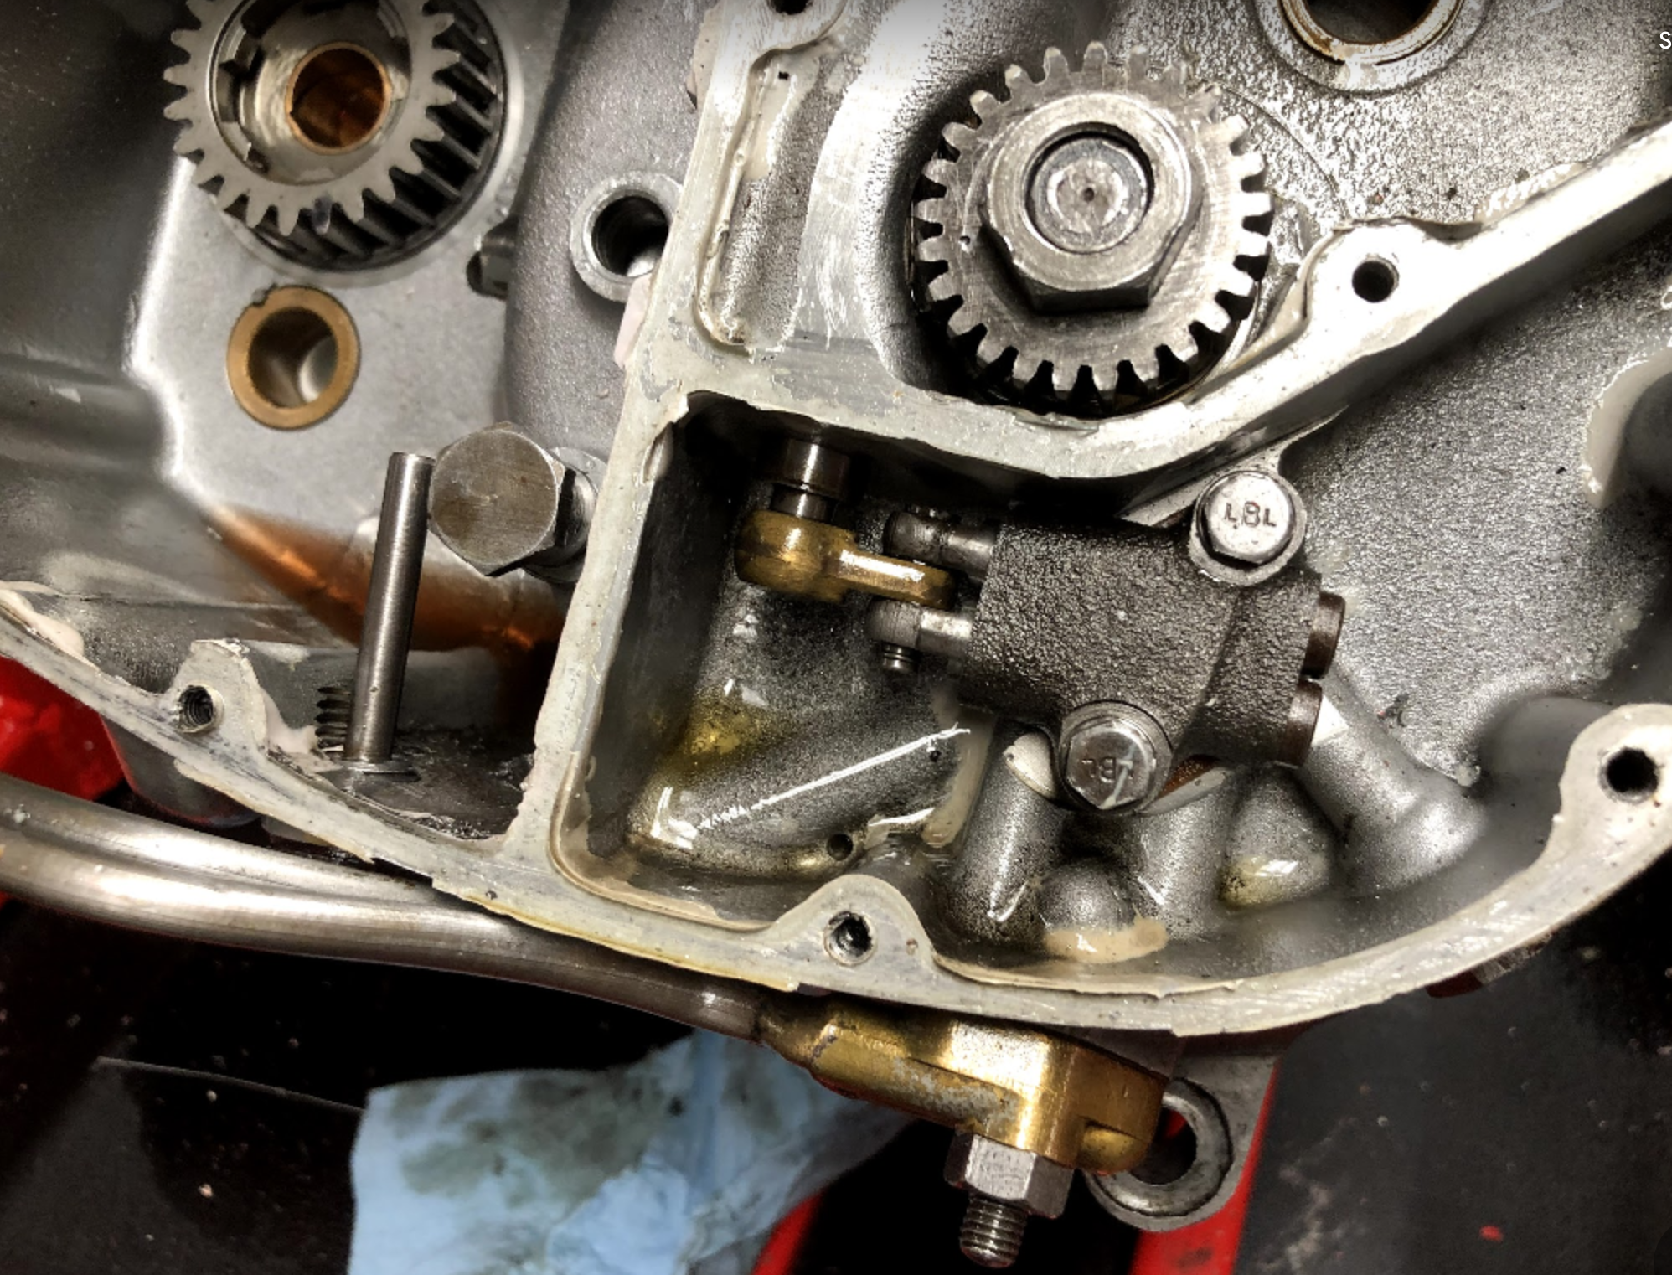
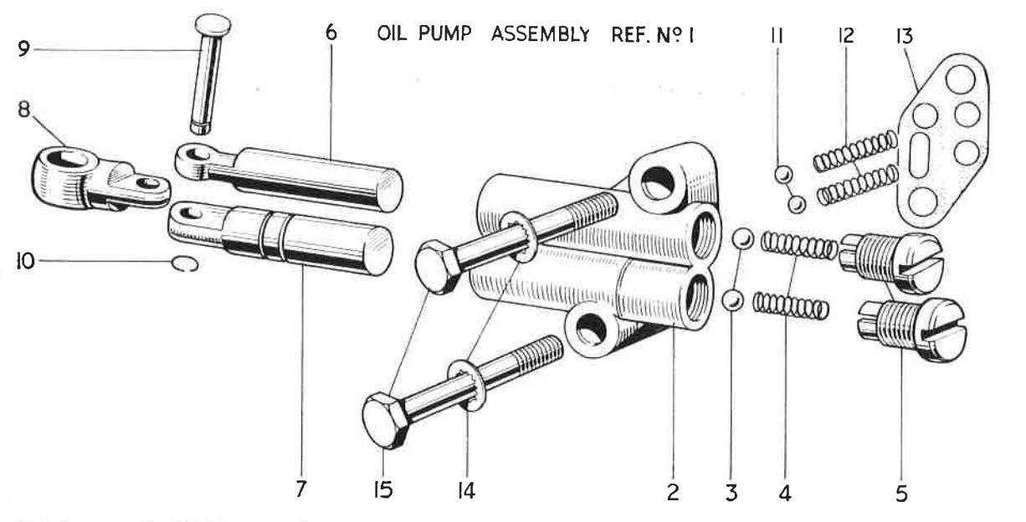
Oil Pump -Explanation
Basically every part of the engine needs oil to prevent wear and overheating
Pump system has two pumps: the feed and the scavenge, both are controlled by a gear on the camshaft
“Dry sump” lubrication system means oil is stored in separate tank

Slide 4
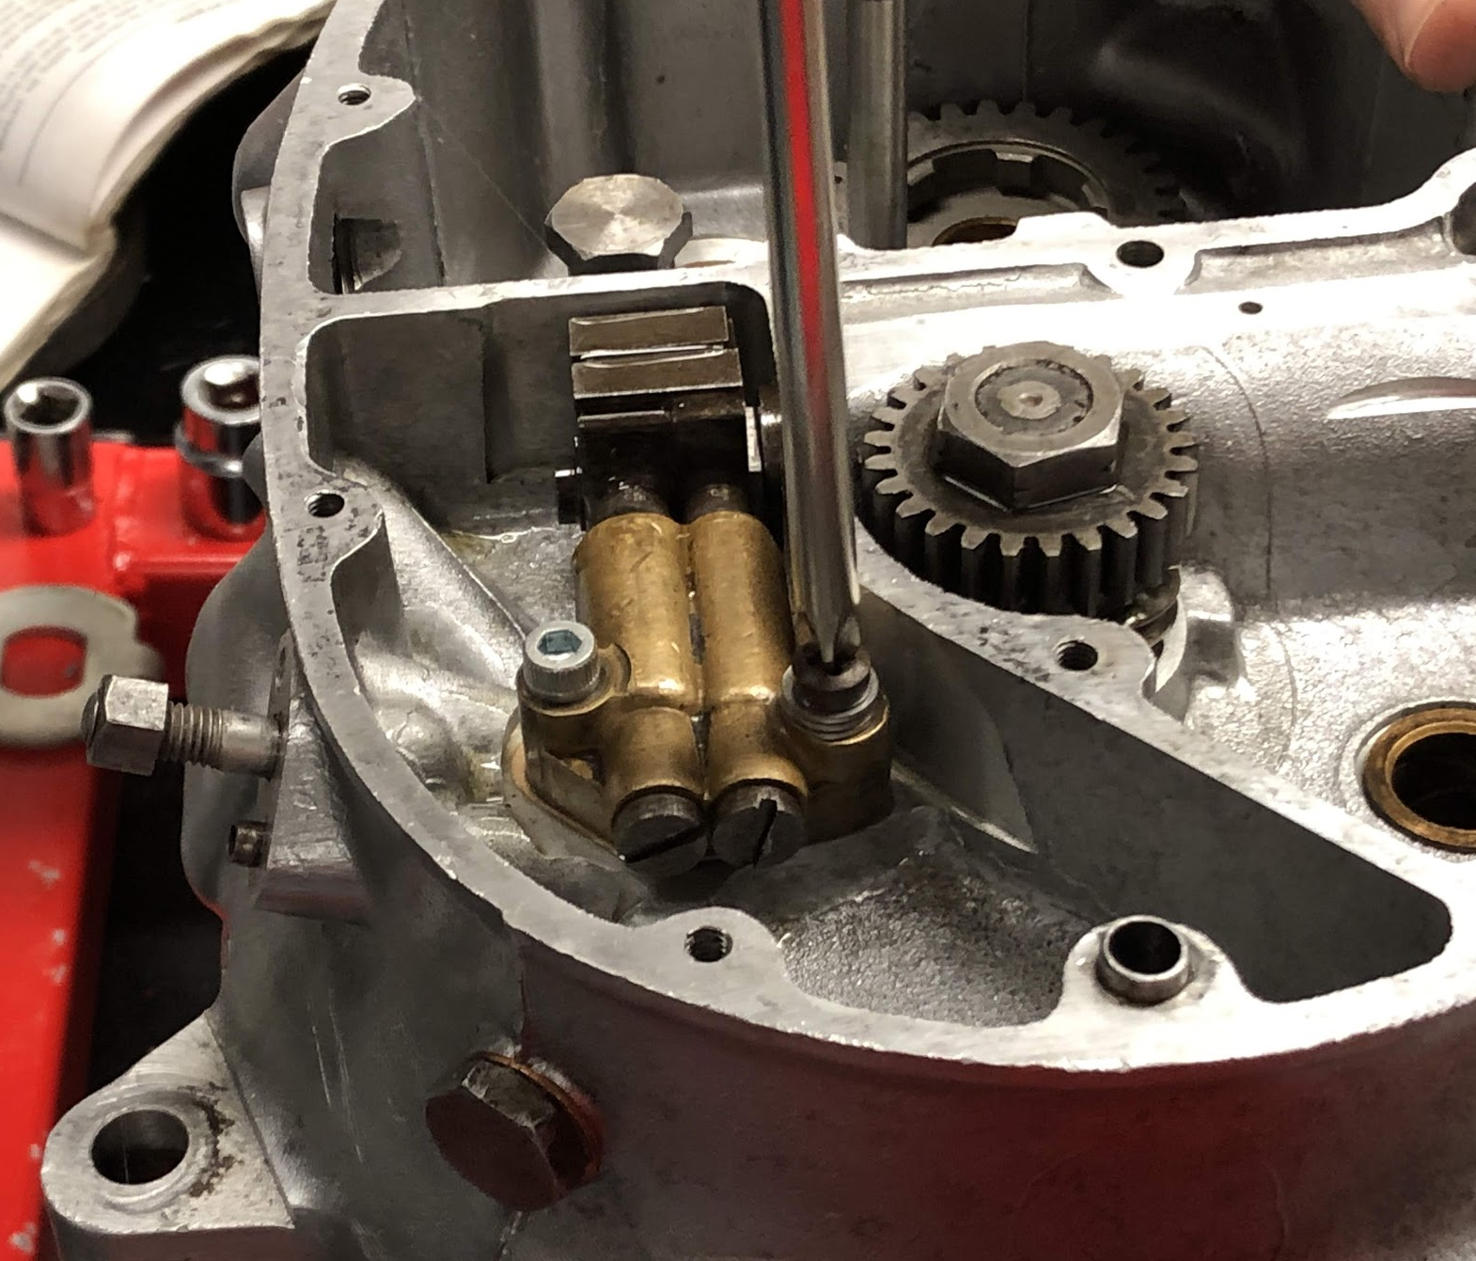
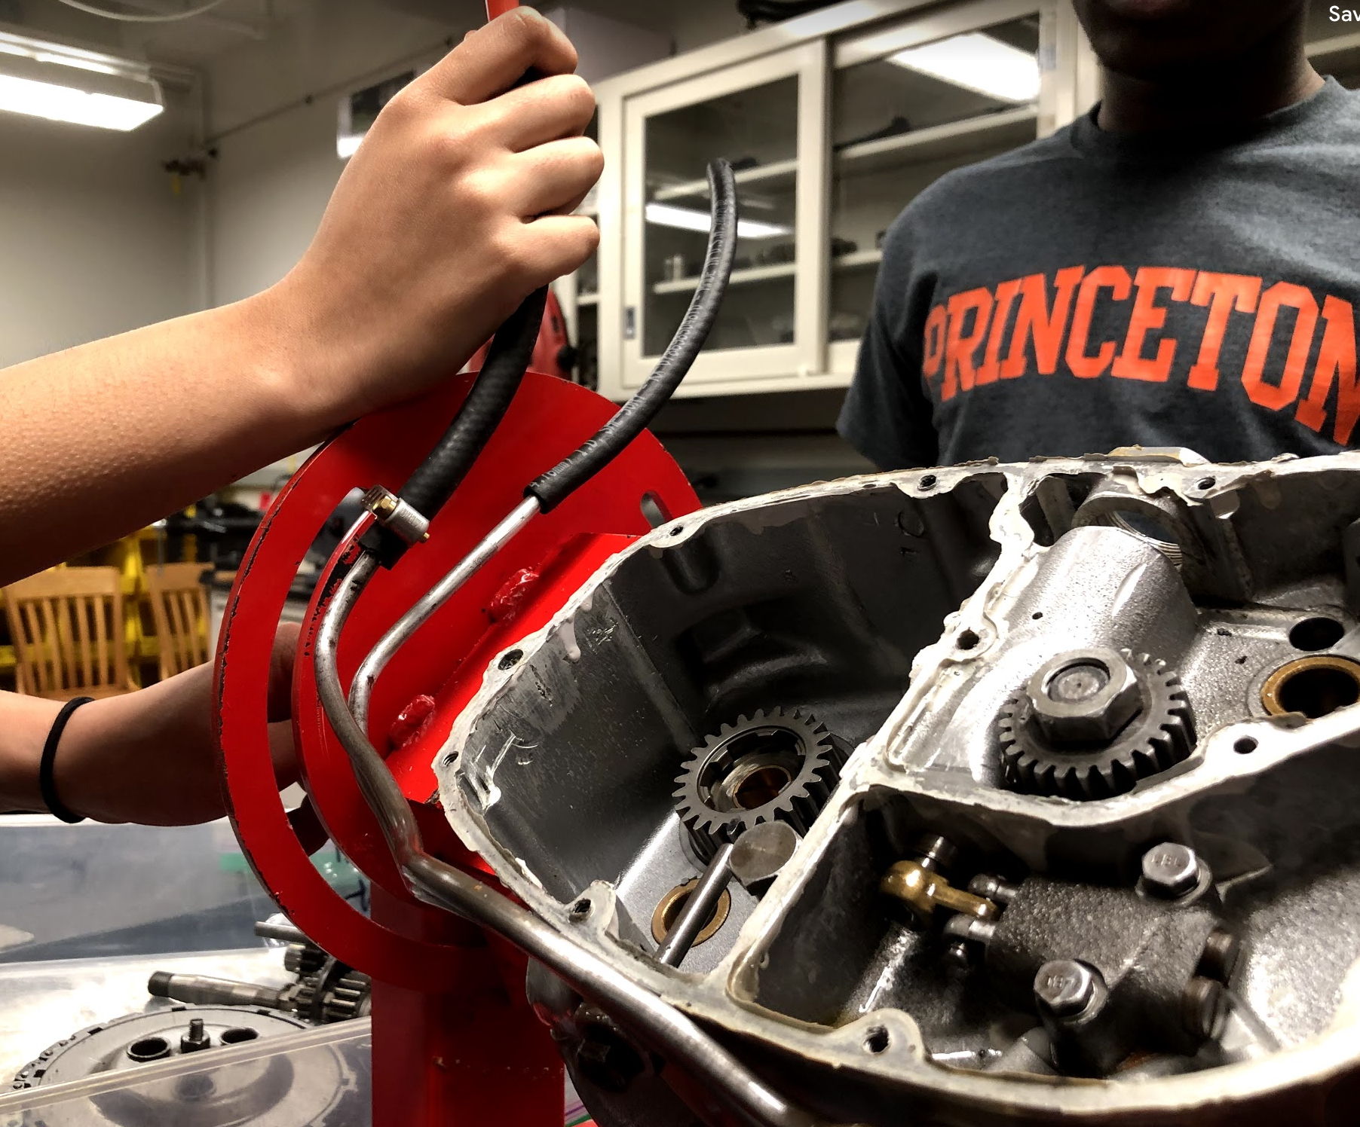
Oil Pump
Oil system of blue bike was not functioning right
“Schmutz” (basically dirt) in the pump was preventing the ball bearings from moving correctly
After cleaning, replacing gasket, and reassembling, pump worked as expected
Also assembled pump for purple bike
https://photos.google.com/share/AF1QipP3rHm-o5zM00D1bTO7hcyMA8g5sw3mmW-XiwJIkkV5ORHR6jH5WRTQwYOcAnQlwQ/photo/AF1QipPQYSyxGRgT_KON1F8Fxb-ohao864EKSgGaKS1U?key=Y0xHVk5yR2hnd0Y3NlA1NEdsQmp0QXVaamNwTXpB

Slide 5
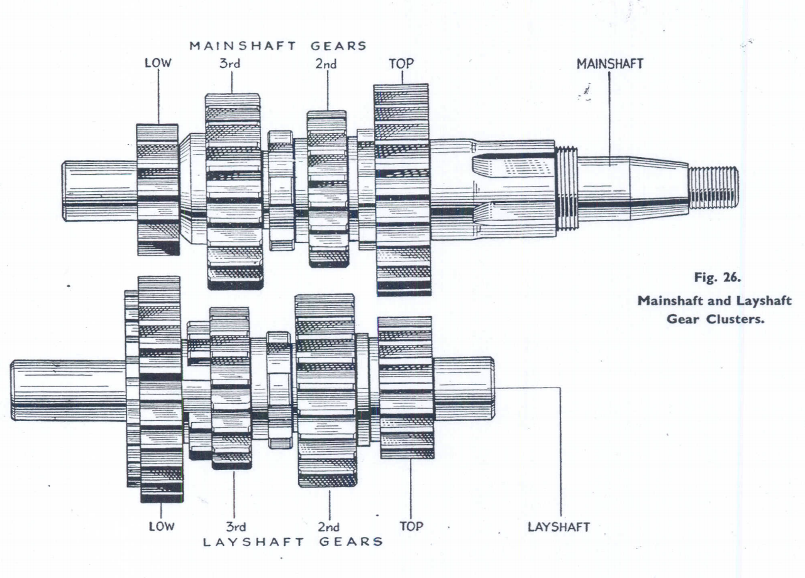
Transmission (engineering woo!)
Gears enable different crankshaft to output sprocket ratios.
Anatomy of the Transmission
Input
Output
Mainshaft
Layshaft

Slide 6
Transmission (engineering woo!)
Gears enable different crankshaft to output sprocket ratios.
Anatomy of the Transmission
Input
Output
Mainshaft
Layshaft
Fixed (rotation)

Slide 7
Transmission (engineering woo!)
Gears enable different crankshaft to output sprocket ratios.
Anatomy of the Transmission
Input
Output
Mainshaft
Layshaft
Shifting Gears

Slide 8
Transmission (engineering woo!)
Gears enable different crankshaft to output sprocket ratios.
Anatomy of the Transmission
Input
Output
Mainshaft
Layshaft
Free Rotation

Slide 9
Overview of Gear Ratios
16 23 20 25
Blue Bike - “extra close” ratio means top 3 gears are all higher
Ultimately means this engine was meant for racing
Neutral = everything is engaged, input and output not connected
29 23 25 20

Slide 10
Overview of Gear Ratios
16 23 20 25
Blue Bike - “extra close” ratio means top 3 gears are all higher
1st Gear = (29/16)(25/20) = 2.265
29 23 25 20

Slide 11
Overview of Gear Ratios
16 23 20 25
Blue Bike - “extra close” ratio means top 3 gears are all higher
1st Gear = 2.265
2nd Gear = (25/20)(25/20) = 1.563
29 23 25 20

Slide 12
Overview of Gear Ratios
16 23 20 25
Blue Bike - “extra close” ratio means top 3 gears are all higher
1st Gear = 2.265
2nd Gear = 1.563
3rd Gear = (23/23)(25/20) = 1.25
29 23 25 20

Slide 13
Overview of Gear Ratios
16 23 20 25
Blue Bike - “extra close” ratio means top 3 gears are all higher
1st Gear = 2.265
2nd Gear = 1.563
3rd Gear = 1.25
4th Gear = 1
29 23 25 20

Slide 14
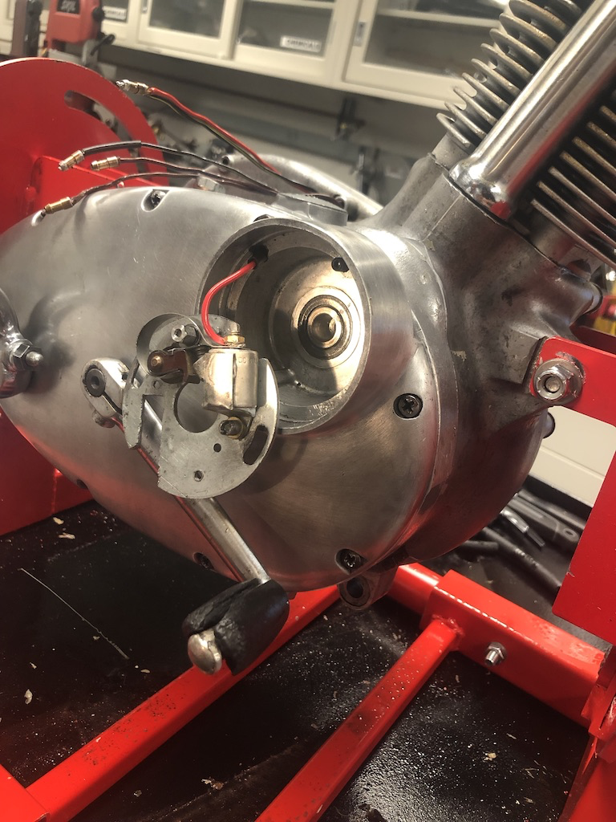
Timing
Our bikes have centripetal advance timing, so as the engine speeds up, the spark advance becomes less retarded
Various models have various ranges of timing positions
The blue bike’s ignition timing piece is from the “French army” model and has the lowest range of motion, meaning that it starts more advanced, and is therefore much more difficult to start

Slide 15
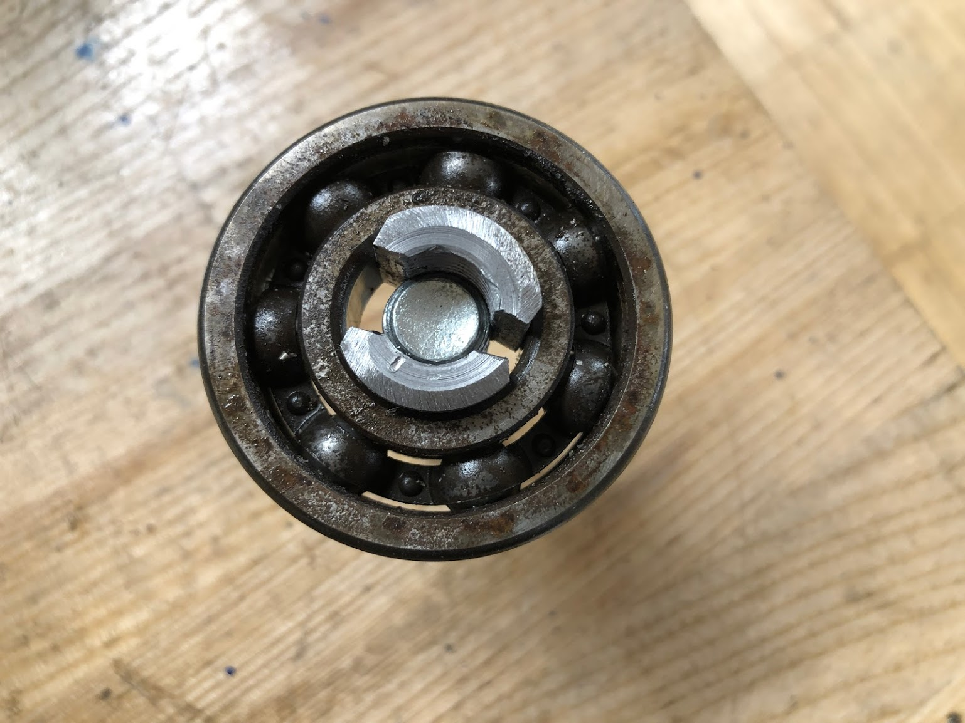
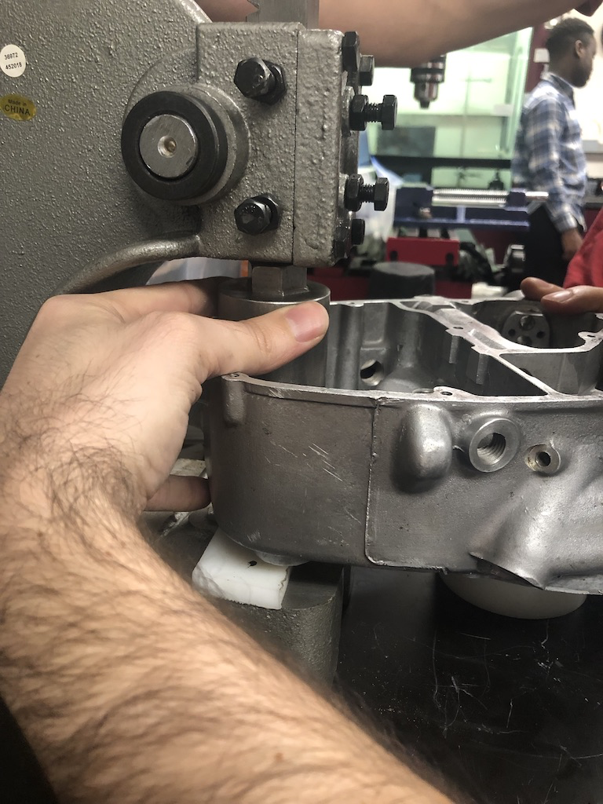
Bearings
Bearings allow for rotational movement within the motor, reducing friction and handling stress of the movement
  Oil seals prevent the lubricating oil from leaking out
To remove bearing from motor case, Glen had to fabricate a blind gear puller and use an arbor press
Failure to press in bearings at the right time resulted in us having to reopen and reseal the crank case of the purple bike twice

Slide 16
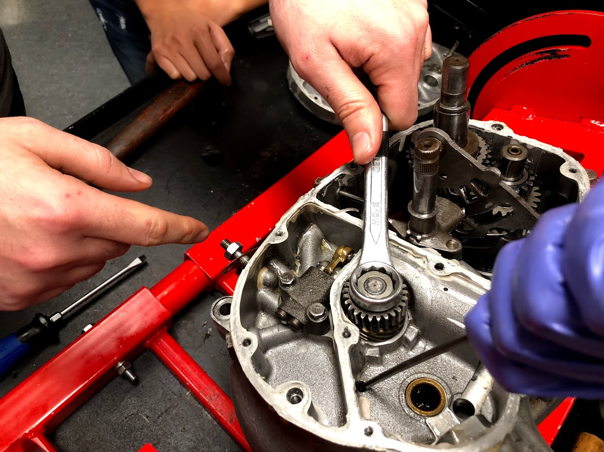
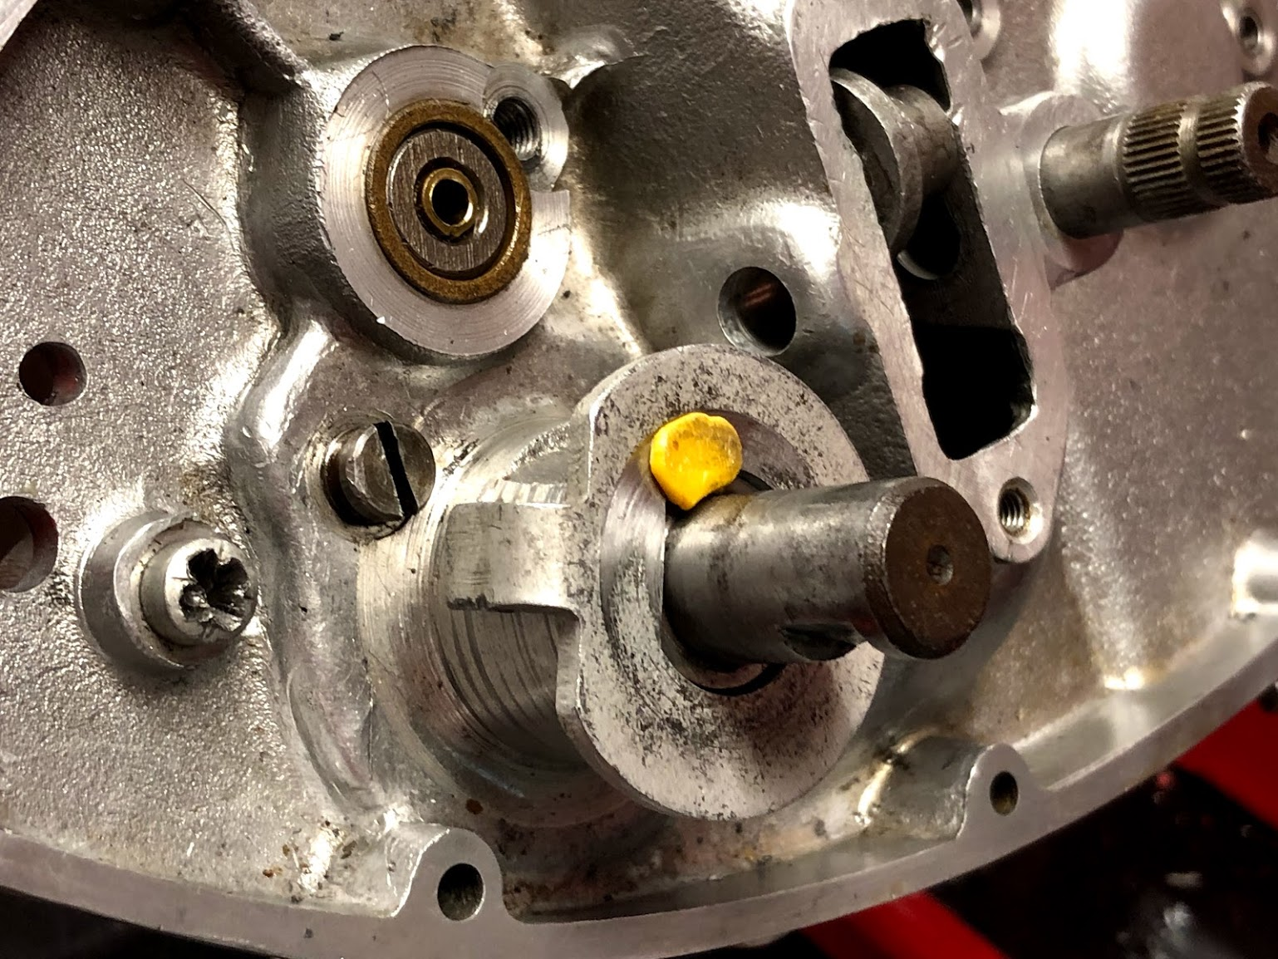
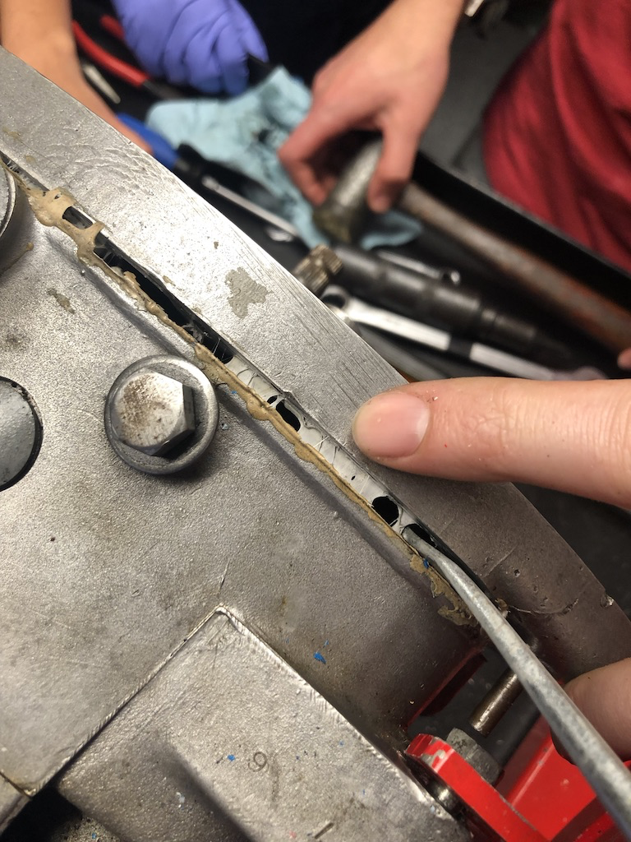
Cool and Unconventional Little Tricks :)
Use an allen key to jam the rotor and crankshaft, allowing you to tighten the nut on the timing pinion.
Use simple old chewing gum as a way to measure the gap between hard to measure areas!
Don’t use steel tools on aluminum surfaces! That scratches the sealing surface, preventing a good seal.

Slide 17
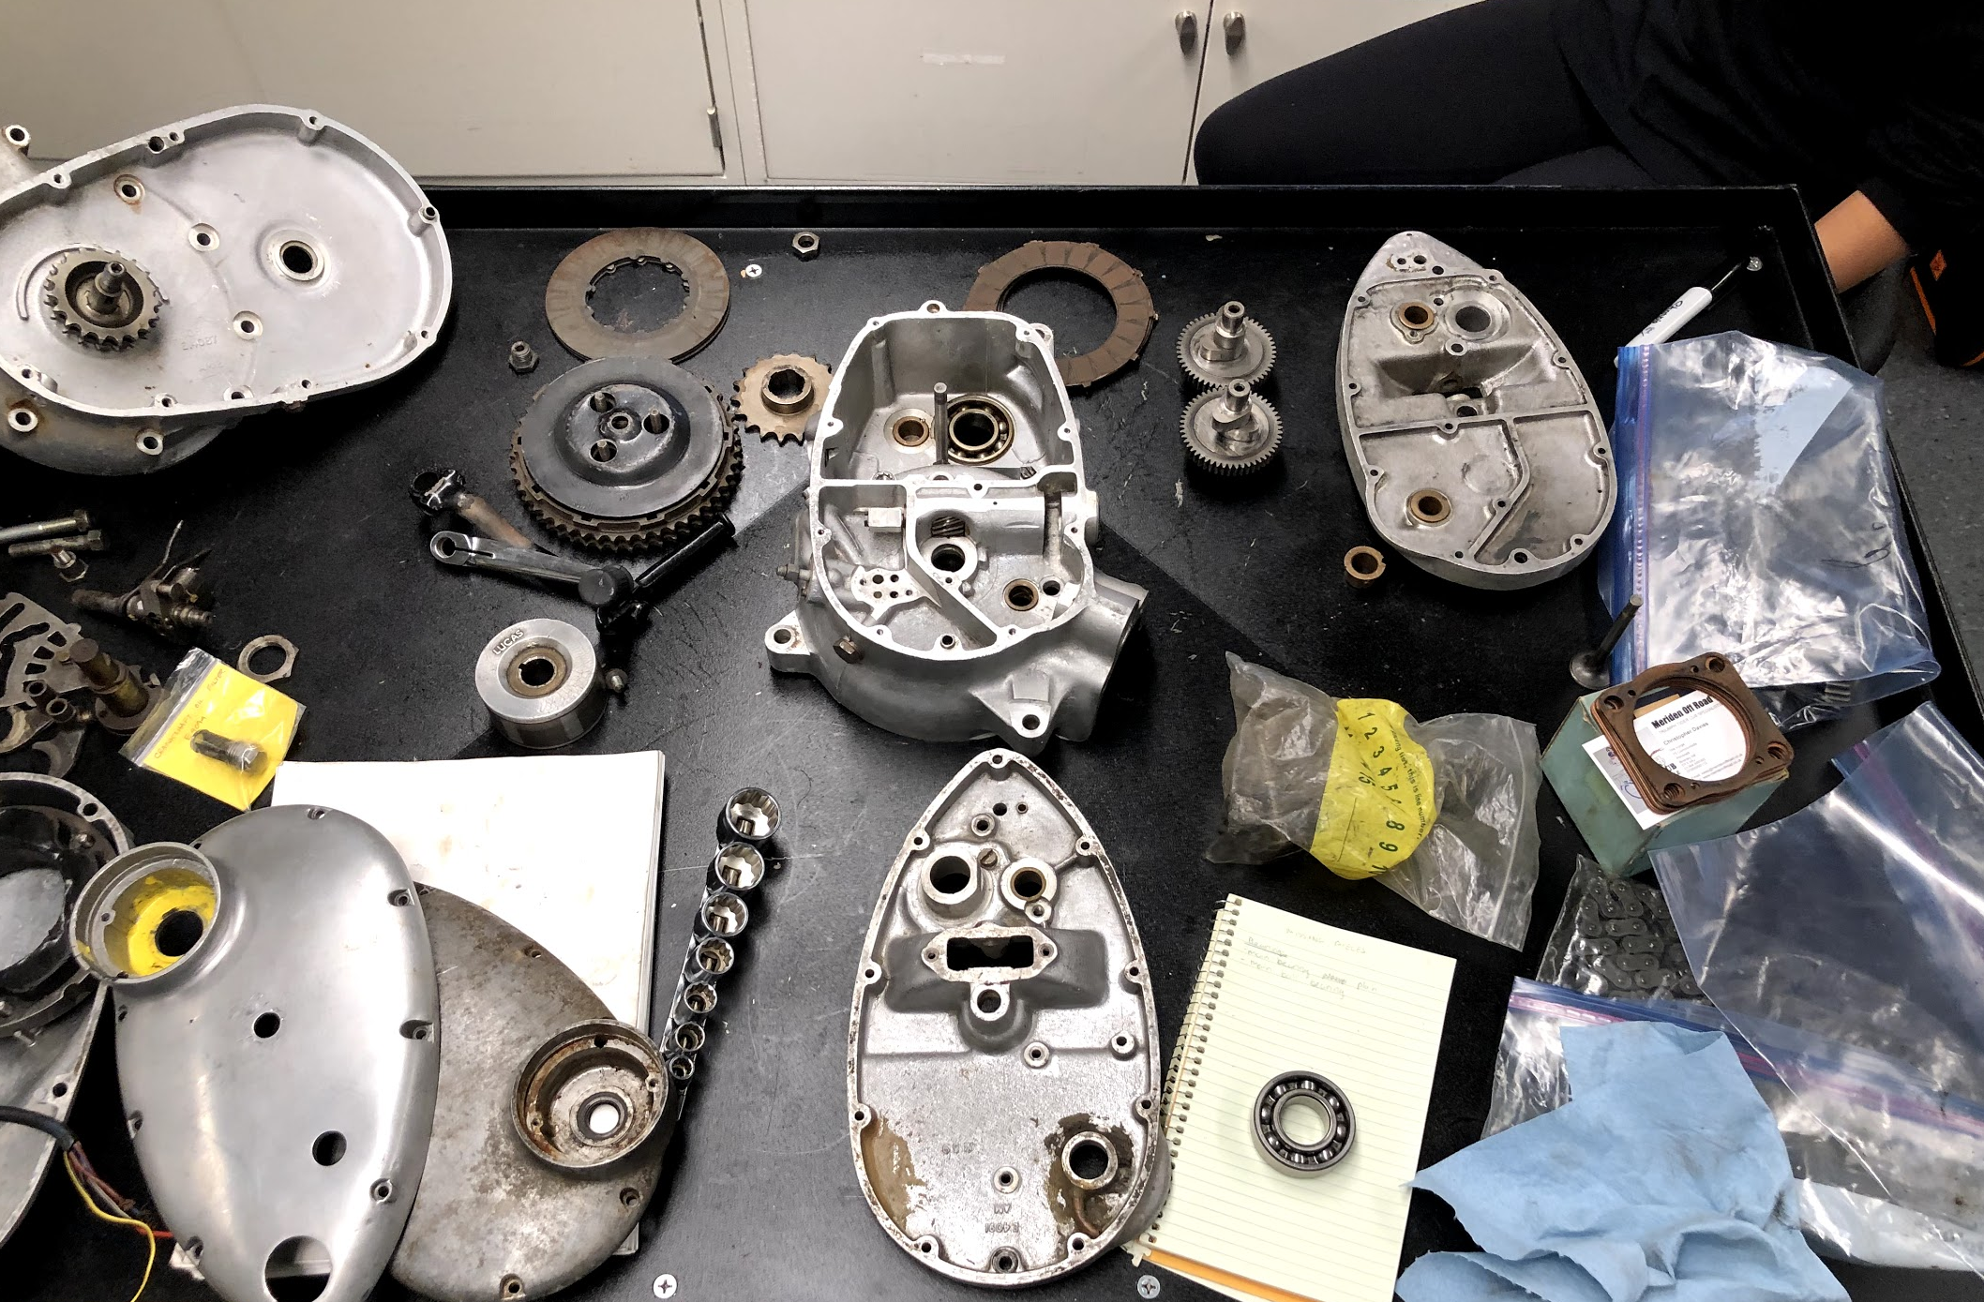
Questions?

